Slide 1
Securing Intellectual Property in Agile
Strategies for Compliance with External and Internal Users

Slide 2
The Problems
Certain documentation in Agile contains sensitive information with high competitive value
Other information in Agile is restricted by US Export law and cannot be disclosed to non-US citizens or permanent residents
Agile is accessible to key suppliers – how much should they be able to see?

Slide 3
Two-Tiered Approach
Permit access to certain subclasses for suppliers
Apply a “matching username” criteria to allow manual activation of access for suppliers for all other subclasses
Control access to file attachments for all users via an “Access Control” field on Page 2 (Multilist)

Slide 4
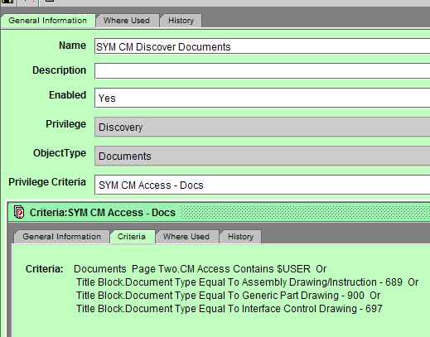
Implementation – Supplier Access
Supplier users in a specific group
Limit Discovery privilege to specific subclasses or to items with a specific field matching the user (Multilist user field on Page 2)

Slide 5
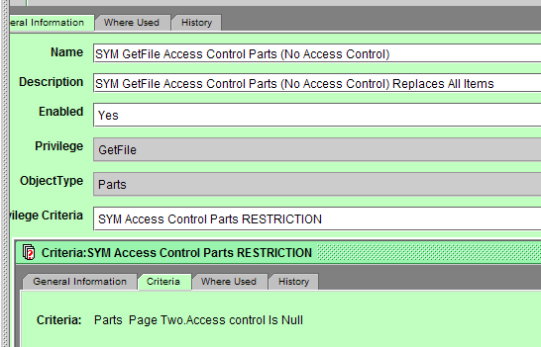
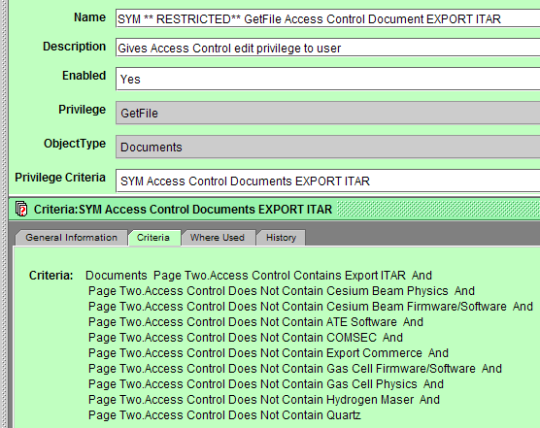
Implementation – Access Control
Replace default file privileges with “No Access Control” privileges
Add special privileges for each Access Control type
Create roles for each Access Control type
Apply roles on a user by user basis

