Slide 1
Best Practices for Oracle Receivables
Cathy Cakebread
Consultant
NorCal OAUG Training Day 2009

Slide 2
Agenda
Introduction
Cash Application
Setup
Processing
Transactions
Setup
Processing
Adjustments
Setup
Processing
Close and Reconciliation
Separation of Duties

Slide 3
Cash Application - Setup
Note: Bank Accounts Are Usually Shared With Accounts Payable
Ideal To Use A Slightly Different GL Account (e.g., Subaccount) for Cash Than AP Uses for Reconciliation Purposes
Watch Accounts You Use!!
Can Cause Serious Issues

Slide 4
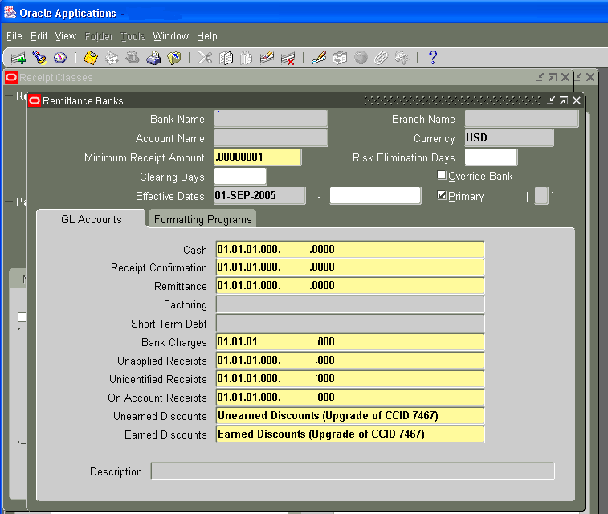
Receipt Classes
Setup → Receipts → Receipt Classes

Slide 5
Receipt Classes – Payment Methods
Cash – Should Be The Only Field That Uses A Real Cash Account
Receipt Confirmation – For Credit Cards And Automatic Receipts – Should Be A Unique Account
Remittance - For Credit Cards And Automatic Receipts – Should Be A Unique Account
Bank Charges – Should be An Expense Account

Slide 6
And…
Unapplied Receipts – Should Be A Unique Account (Not AR Or Cash Account!)
Unidentified Receipts – May By The Same As The Unapplied Account But Better If Different (Not AR Or Cash Account!)
On Account Receipts – Ideally Unique Account = A “Liability” - (Not AR Or Cash Account!)
Unearned Discounts – Unique Expense Account (Receivables Activity)
Earned Discounts – May Be The Same As Unearned But Ideally Unique (Receivables Activity)

Slide 7
Cash Accounting
Apply Receipt Immediately to An Invoice
Debit
Cash (Receipt Class)
Unapplied Cash (Receipt Class)
Note: 4 Sided Entry
Credit
Unapplied Cash (Receipt Class)
AR (Based On The Invoice You
Are Paying)
Apply Receipt Immediately to An Invoice With A Discount
DEBIT
Cash (Receipt Class)
Discount (Receipt Class - Based On Whether Earned Or Unearned)
Unapplied Cash (Receipt Class)
Credit
Unapplied Cash (Receipt Class)
AR (From The Invoice)

Slide 8
And More Cash Accounting
Leave As Unapplied
DEBIT
- Cash (Receipt Class)
CREDIT
- Unapplied Cash (Receipt Class)
Apply Unapplied Amount
DEBIT
- Unapplied Cash
(Receipt Class)
CREDIT
- AR (Based on the Invoice(s)
You Are Paying)
Unapply and Re-Apply
DEBIT
- AR (From the Original Invoice
That You Are Unapplying
- Unapplied Cash (Receipt Class)
CREDIT
- Unapplied Cash (Receipt Class)
- AR (Based on New the Invoice(s))

Slide 9
Lockbox
Ideally:
Include Both Invoice Number AND Amount From Customer Remittance Advise
Can Take Months To Establish With Your Bank
“Auto” Lockbox Is Not “Automatic” Receipts
Considered To Be Manual
Work With Bank To Improve Quality Of Data Received
Provide Examples
Complete Batches Only!
Consistent With Bank Batches
Allow Payment of Unrelated Invoices? Never!

Slide 10
Processing Cash
Closed Batch – Eek!
Meaningless!!!
Only Use On Account If It Truly Is “Cash In Advance” Or Prepayment
Resolve Unapplied And Unidentified ASAP
Prompt Payment Discounts?? May Be An Issue Again With Current Economy
Non-AR Cash (Miscellaneous Cash)
Process All In AR
Predefine As Much As Is Possible
Watch Account Controls
Re-Enter In New Period (e.g., for Reverse and Re-Enter)
Use Special Day E.G., Sunday

Slide 11
And…
Naming Conventions
Batch Names
Deposit Date – Bank
01212009-boa
Lockbox Batch Names
Deposit Date – Bank
01212009-boa
Reverse Receipts:
Debit Memo Vs. Re-open Invoice
Debit Memo Rewards Them For Bouncing A Check
New Due Date
Utilize Controls for Cash Received In House

Slide 12
Credit Card Processing
Always Protect Customer Credit Card Numbers!
Only Show First 4 or Last 4
Auto Schedule Processes – Available In 11.5.10+
Quickly Resolve Items Stuck In Confirm And Remit Status
Use Cash Management To Clear Using Actual Bank Data (If Possible)
Pre-Authorize? Re-Auth Time Frame?
Verify That All Transactions Were Actually Passed from the Service Provider

Slide 13
Credit Card Accounting Impact
(In AR ONLY)
Activity
Debit
Credit
Create Receipt
Confirmation Account (AR Trade Credit Card Clearing?? Use New Unique Account!)
AR (Based on the Invoice)
Remit Receipt
Remittance Account (Use the same account for Remittance and Confirmation?) Ideally – Use a Different Account)
Confirmation Account (Offsets the Confirmation Account)
Clear
Cash
Remittance Account (Offsets the Remittance Account)
Note: The invoice is marked as closed when the receipt is
created, not when the cash is deposited!

Slide 14
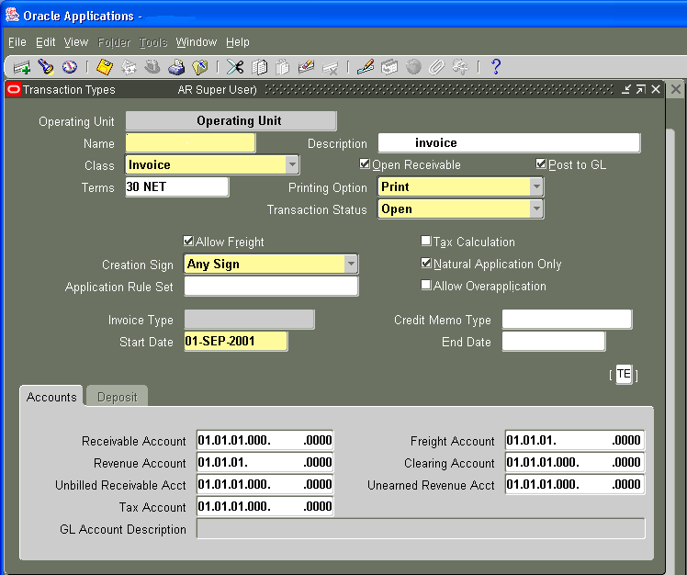
Transactions - Setup
Setup → Transactions → Transaction Types

Slide 15
Transaction Types
Natural Application Only!!
Allow Overapplication – Never!!
Use Meaningful Names
Especially First 4 Characters
E.G., PIGI –
Palo Alto International Government Invoices
Selection Tool For Standard Reports
And – Numbering
Noticeably Different From Sales Order Numbers With Enough Numbers to Extend Into the Future
At Least One Transaction Type Per AR Account
Primary Driver For Accounts Used In AutoAccounting
Utilize Chargebacks? Deposits?

Slide 16
AutoAccounting
Setup → Transactions → AutoAccounting
ACCOUNTING FLEXFIELD SEGMENTS | AUTO INVOICE CLEARING | FREIGHT | RECEIVABLE | REVENUE | TAX | UNBILLED RECEIVABLE | UNEARNED REVENUE
(Possible Default Sources) | -Salesreps* - Standard Lines -Transaction Types | - Salesreps - Standard Lines -Transaction Types | -Salesreps -Transaction Types | -Salesreps -Standard Lines -Transaction Types | - Salesreps* - Standard Lines* - Taxes -Transaction Types | -Salesreps* -Standard Lines -Transaction Types | -Salesreps* -Standard Lines -Transaction Types
Company | Transaction Types | Transaction Types | Transaction Types | Transaction Types | Transaction Types | Transaction Types | Transaction Types
Division | Transaction Types | Transaction Types | Transaction Types | Standard Lines | Taxes | Standard Lines | Standard Lines
Department | Transaction Types | Transaction Types | Transaction Types | Standard Lines | Taxes | Standard Lines | Standard Lines
Account | Transaction Types | Transaction Types | Transaction Types | Standard Lines | Taxes | Standard Lines | Standard Lines
Subaccount | Transaction Types | Transaction Types | Transaction Types | Standard Lines | Taxes | Standard Lines | Standard Lines
Special use | AutoInvoice - where revenue not = qty * price |  |  |  |  | - Bill in Arrears - Guarantees | - Bill in Advance - Guarantees - Deposits

Slide 17
Transaction - Processing
AutoInvoice Frequency?
Clear Exceptions ASAP – Have Process In Place
Deal With Credits For Closed Invoices?
Approvals for Imported Credit Memos?
Manual Items
Debit Memos – Proper Controls?
Credit Memos – Approvals?
Are the Actual Forms Locked up?
Have All Interfaced Items Made It?
How do You Know? Who is Responsible?

Slide 18
Revenue Recognition
Revenue Recognition
SOP-97, 98 - AICPA – Statement of Position
SAB 101 – SEC - Staff Accounting Bulletin
Do You Have Items Where Revenue Can’t Be Recognized Upon Shipment?
Does the Person Entering the Order Know When the Revenue Should Be Recognized?
When Do You Know? How?
What Determines When Revenue May Be Recognized?
Do You Have Standard Payment Terms?
Do You Ever Have Exceptions?
Do You Have a Return Policy? e.g., Full Money Back in 30 Days?

Slide 19
Impacts Revenue Recognition
Do You Use “Arrangements” With Your Customers (Where the Revenue for One Invoice May Not Be Recognized Until the Subsequent Items Ship)?
How Do You Deal With “Revenue” for Invoices Where You Don’t Expect to Receive Payment?
Do You Use Standard Pricing?
How Do You Deal With Variable Pricing and Revenue Recognition?
How Do You Handle Discounts With Bundled Products?
Do You Sell ‘Beta Products’?
Or ‘Future’ Products
How Does Revenue Recognition Impact Your Accounting for Cost of Goods Sold?

Slide 20
Ways to Control Revenue
Define Applicable Accounting Rules
Cover Your Bases
Create As Many as Are Necessary
Tie to Items Where Possible
Utilize Revenue Recognition Wizard and/or
Release 12 “Revenue Recognition Release”

Slide 21
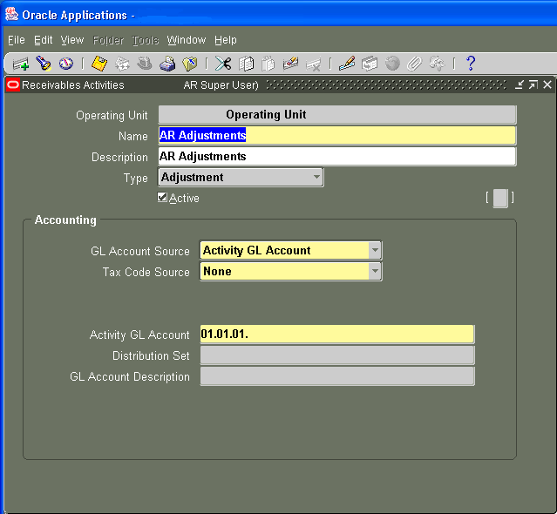
Adjustments - Setups
Setup → Receipts → Receivable Activity

Slide 22
Adjustments – Setup/Process
Define Proper GL Accounts
Should Never Be Your AR Account (It Is Already Offset Automatically)
Adjust
Select Proper Type
Invoice, Line, Tax, Freight, Charges
Un-adjust
Use Same Accounts As Used With Original Adjustment
Use Limits and Approvals!
Check for Lots of Small Adjustments on Single Invoice

Slide 23
Period Close Process
Close Checklist
Close Schedule
Pre-Process As Much As You Can
Reconcile
AR To Aging
AR To GL Activity
Insure AR Only Uses “AR Accounts”
Insure Proper Controls Are in Place
Create Month End Packet
Retain as Needed

Slide 24
Reconciliation – AR to Aging

Slide 25
Tips – Tie to Aging
Journal Entries Report – Summary By Category
Verify That No Illogical Entries (AR Vs. No AR In Category)
Transaction Register (Split By Company And Currency)
Invoices, Debit Memos, Credit Memos, Commitments
Credit Memo Total Should Be Negative
Watch Bottom Total In 11.5.9 – Includes ALL Currencies
Applied Receipts Register –
Add Totals And Multiply By -1
Result May Be Negative Or Positive
Note That Total Does Not Include Discounts In 11.5.9
Note: Cash Received Does Not Equal Amount Applied!
Adjustment Register (May Be Negative Or Positive)
Invoice Exceptions Report (Items Not Aged)

Slide 26
Reconciliation – AR to GL

Slide 27
Reconcile to GL Tips
GL Account Starting Balance
+/- Current Period Manual Journal Entries
+/- To Date Manual Journal Entries
GL Account Ending Balance
Ending Balance Should Equal:
Ending Aged Trial Balance by Account
Potential Issues:
Other Applications Using “Our” Accounts
Manual Journal Entries

Slide 28
Customer Maintenance
Who Can Add, Change, Inactivate?
Who Controls Credit Limits?
Who Can Change Names?
What Are Your Controls for Adding New Customers? Addresses? Inactivating?
Define and Use Order Holds – Leverage!
New Customers
Credit Issues

Slide 29
General Tips
Utilize Processes With Best Audit Trails
Tie To Original Activity – Whenever Possible
Control Customizations
Access
Process Capabilities
Limit Who Can Perform Which Functions by User/Role
Reports Too!

Slide 30
Separation Of Duties
Use External Lockbox
Don’t Allow Collectors to Adjust (Either Without Approvals or Not at All)
Use Credit Memo Approvals
Restrict Ability to Create CM
Use Adjustment Approvals
With Manager as Approver
Check for Multiple Small Adjustments
Different Folks to:
Apply Cash
Create Invoices
Collect

Slide 31
Cathy Cakebread
Consultant
www.cathycakebread.com For More Papers
cathyc@cathycakebread.com
(650) 610-9130
AR List Server
ar-list@yahoogroups.com

