Slide 1

An introduction to Oracle Rapid Planning
Reduce planning cycle time and make faster short-term decisions
John Conlin CPIM
Principal Solutions Consultant: Manufacturing & Value Chain Applications
Notes:
Hello, my name is _________________________, and I’m here today to talk to you about Oracle Rapid Planning and how this product enables you to reduce planning cycle time and make better decisions, faster.

Slide 2
Safe Harbor Statement
The following preceding is intended to outline our general product direction. It is intended for information purposes only, and may not be incorporated into any contract. It is not a commitment to deliver any material, code, or functionality, and should not be relied upon in making purchasing decisions.
The development, release, and timing of any features or functionality described for Oracle’s products remains at the sole discretion of Oracle.
2
Notes:
2
Before we start …

Slide 3


Today’s supply chain executives’ agenda
New world: continuously adapting to changing supply chain business model
Uncertainty
Volatility
Virtualization
Globalization
Credit Crisis
Risk
Consolidation
Compliance
Chaos
Changing Supply Chain Business Model
CEO’s Agenda
Drivers
For Success
Operational Flexibility
Increased
Shareholder
Value
and
Sustainable
Growth
Risk Management and
Compliance
Continuous Innovation
“What is required is a new type of decision support platform, one that integrates analytics and optimization. 15 years after the birth of Supply Chain Planning (SCP), we are now just starting to see analytics and optimization converge on a common platform”
AMR Research Report “How to measure your supply chain today “
Notes:
3
Supply chain executives today face a tough battle of trying to adhere to the CEO’s agenda of sustainable growth and shareholder value while dealing with an ever changing supply chain business model. The drivers for success are operational flexibility, risk management, and continuous innovation and they can really only achieve this by bringing analytics and optimization together into a common platform, as also described by AMR in one of their recent studies.

Slide 4






How to respond to rapidly changing conditions?
Weekly and daily planning cycles are not sufficient to react to exceptions
DEMAND CHANNELS
SUPPLY CHANNELS
Traditional monthly S&OP process
Demand
Review
Supply
Review
Exec
Review
Tier 1
Tier 2
Customers
Forecast &
Sales orders
BATCH
CYCLE
Stores and DCs
Orders
Consensus
Forecast
Tactical
Supply Plan
Demand increase today at key customer
Fix quality issue with component right now (ECO)
Assembly production line down for next two days
Supplier unable to meet this week’s commitment
?
?
?
?
STATIC TACTICAL PLANNING PROCESS
Tactical plan is released – Execution events only factored in during next planning cycle
No ability to quickly react to demand, supply, capacity, and engineering changes
High latency and too many challenges to bring external information into ERP to drive decisions
Broken S&OP process: too much latency to react quickly to latest demand signals
Notes:
Today, you often run a batch process that produces good tactical level plans that are executed too, but when immediate problems occur the batch orientation has just too much latency to react quickly. Often you receive signals that are not even in your ERP systems (the shipment delay was not yet booked, the supplier quality issue not yet logged, the customer big order not yet booked). To react to these signals you need a system that enables you to react more quickly by allowing you to model ERP-type changes on the planning side and use that in fast simulation runs to then analyze potential impacts very pro-actively.

Slide 5



Better approach
Event-driven planning and fast S&OP simulation
DEMAND CHANNELS
SUPPLY CHANNELS
Real-time S&OP simulation process
Simultaneous demand, supply and executive review
Tier 1
Tier 2
Customers
Forecast &
Sales orders
Orders
Stores and DCs
Event-driven
simulations
Demand increase today at key customer
Fix quality issue with component right now (ECO)
Assembly production line down for next two days
Supplier unable to meet this week’s commitment
RESPONSIVE RAPID PLANNING PROCESS
Understand impacts of supply chain events through fast incremental planning
Get visibility to changing conditions directly into planning – no ERP latency
Fast S&OP: Quickly simulate demand shaping actions and constrained supply
Notes:
Deploying an event-driven simulation paradigm really enables you to react quickly to intra tactical planning cycle events: you can enter changing conditions directly into the planning tool, so there’s no latency from ERP. It is also designed for fast S&OP: you can quickly simulate corrective actions and execute them.

Slide 6

How
Delivers
Notes:
So let’s now talk on how Oracle delivers a better solution …

Slide 7
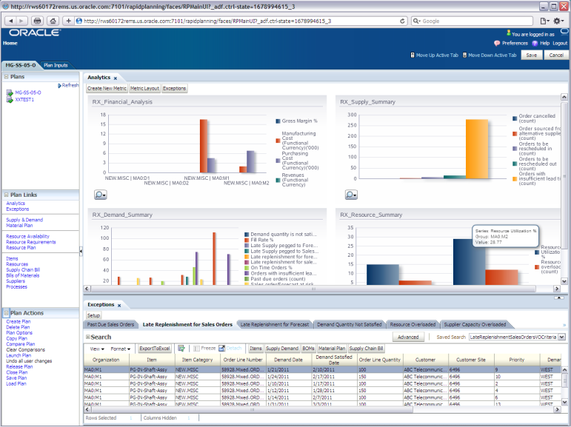
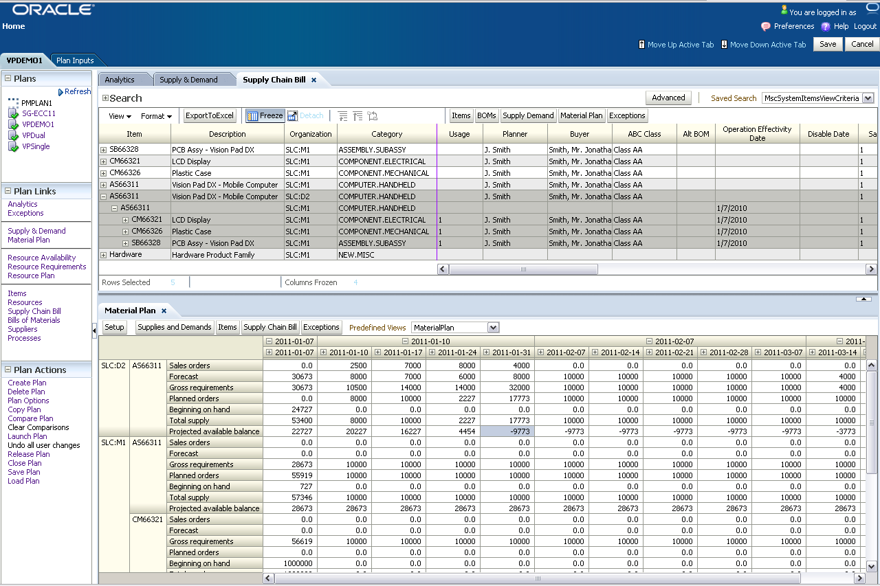
Oracle Rapid Planning
Enabling event driven real-time planning
Empower planners with rapid what-if scenario planning
  React quickly to supply chain events with fast incremental plan runs – make decisions in minutes
  Easily manipulate plans (mass edits)
  Enable fast sales and operations planning simulations
Leverage a strong UI for insightful analytics
  Predictive and actionable insight via embedded analytics and spreadsheet-style UI
  Compare exceptions and key performance indicators
Make faster decisions through collaboration
  Planners collaborate on a single holistic plan
  Multi-enterprise visibility and planning
Translate decisions into actions
  Out-of-the-box integration with ERP
  No latency: release directly to execution
Notes:
Oracle Rapid Planning offers the following key capabilities …

Slide 8
Oracle Rapid Planning – Complements
Strategic Network Optimization
Advanced Supply Chain Planning
Rapid Planning
What are the impacts of choosing
a dual sourcing strategy?
What are the impacts of closing or
opening new distribution centers?
What are the cost and revenue
impacts of entering a new
geographical market?
Which buy, make and transfer
orders do I need to release to
execution?
What orders need to be rescheduled?
What resources are overloaded?
What orders are sourced by
alternate suppliers?
Can I commit to a key customer’s
hot demand in the next minutes?
What would the impact of an ECO
be if I’d implement it in the next hr?
My supplier has a quality problem,
can I make orders on time today by
using alternates or substitutes?
Will running overtime today improve
my schedule?
Recommendations
Recommendations
Recommendations
Sourcing rules
Optimized supply network
Rationalized assets
Reschedule, create, cancel
buy, make, and transfer orders
Simulated exceptions and
performance indicators, and
buy, make and transfer order
recommendations
Monthly
Weekly or Daily
Daily or Intra-Daily
Rapid Planning complements the weekly or daily tactical supply planning cycle as executed with Advanced Supply Chain Planning

Slide 9
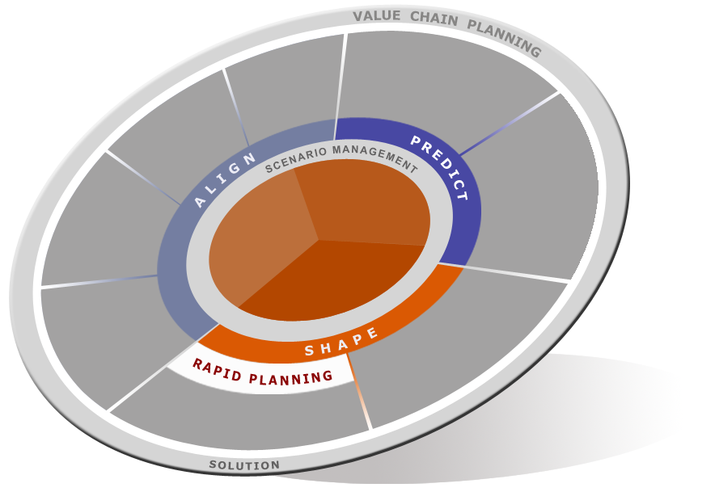
Oracle Value Chain Planning solution
Complete ● Open ● Integrated ● Modular
Service
Parts
Planning
Demand Signal
Management
Order
Promising
Risk
Management
Demand
Management
Plant
Scheduling and Monitoring
Performance
Management
Sales and
Operations
Planning
Collaboration and
Vendor Managed
Inventory
Trade Promotion
Management
Single source of truth
Integrated with ERP
Web services enabled
Supply Chain and Distribution Planning
Notes:
Within the context of the overall collaborative E-Business Suite, Oracle Rapid Planning is part of a broader Value Chain Planning solution that provides a complete, open, integrated and modular planning solution that spans all the way from demand signal management to service parts planning.
It is based on a common planning data model and platform that connects all products to deliver integrated planning functions that in turn enable best business process such as supply chain risk management, demand driven adaptive planning, supply chain excellence, sales and operations planning, and multi-enterprise collaboration.

Slide 10
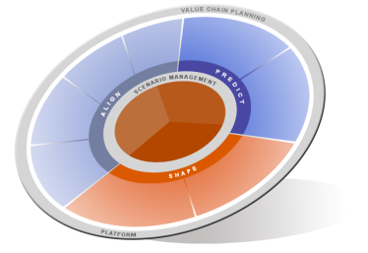
Oracle Value Chain Planning solution
Enables leading edge and transformational business processes
MONITOR and MANAGE with Embedded Analytics
Predict market requirements and manage supply chain risk
  Sense demand closer to the point of consumption with real-time visibility to demand events
  Improve forecast accuracy through advanced analytics and improved consensus forecasting
  Predict impact of risk to your network by simulating planned and unplanned supply chain events
  Account for variability in your inventory positioning and postponement strategy
Shape demand for profitability
  Drive demand via promotions planning
  Manage new product introductions and marketing to shape demand and maximize revenue
  Maximize sales and improve execution by balancing supply and demand in a continuous S&OP process
Align operational plans with corporate goals
  Plan your extended value chain with holistic supply and distribution planning
  Synchronize plans and actions across the extended enterprise
  Improve supply chain visibility and align trading partners via collaboration
  Transform your service operations from cost to profit centers
Notes:
10
Oracle Value Chain Planning enables you to focus on 3 key areas of importance:
PREDICT: (talk through bullets)
SHAPE: (talk through bullets)
ALIGN: (talk through bullets)
Encompassing is the embedded and closed loop analytics to monitor and manage the business

Slide 11


Oracle Rapid Planning
Reduce planning cycle time and make faster short-term decisions
Empower planners with rapid what-if scenario planning
Use a more productive UI for insightful analytics
Make faster decisions through collaboration
Translate decisions into actions
Notes:
So let’s look at all these areas in more detail, starting with rapid what-if planning …

Slide 12
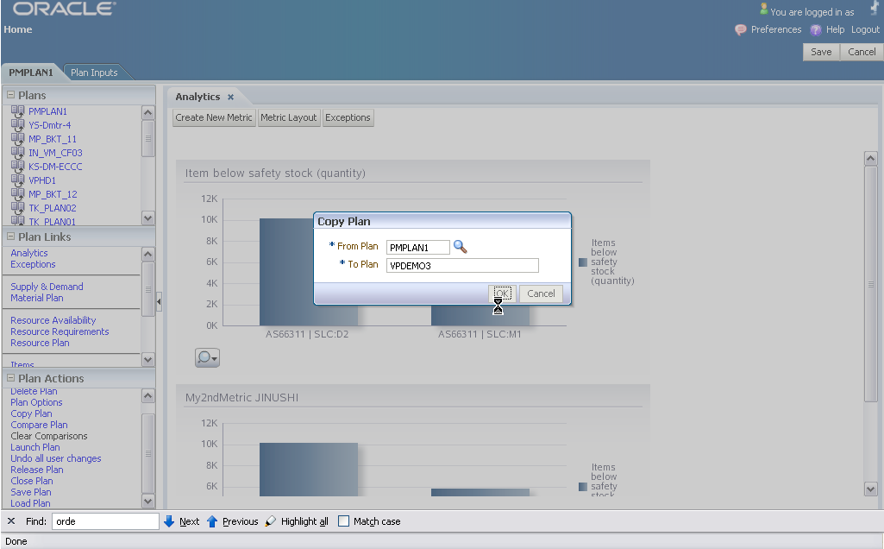
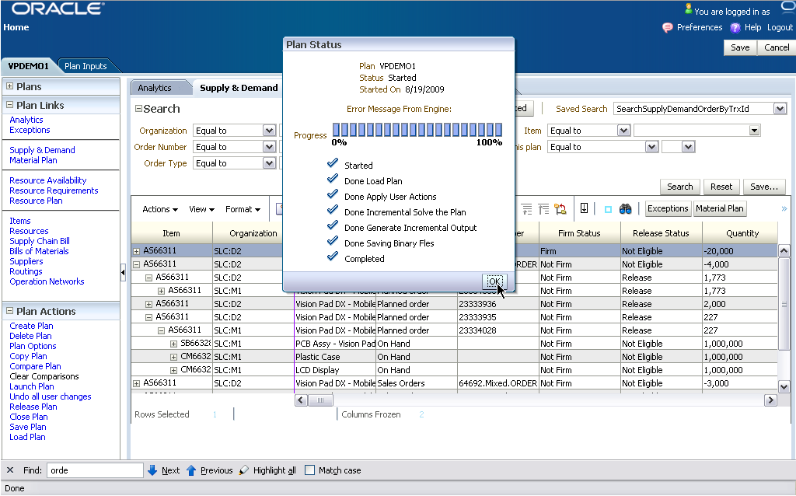
React quickly to supply chain events
Perform fast simulations and compare different planning scenarios
Event-driven, fast, incremental planning
  Respond to demand and supply changes
  Respond to engineering changes
  Respond to demand shaping activities
  Perform fast S&OP simulations
Create what-if scenarios quickly
  Copy plans in seconds
  Compare scenarios to see differences
Easily manipulate plan input
  Mass edit planning data
  Incorporate data not available in ERP
Make better decisions faster
  Automate planning decisions
  Account for key constraints
Notes:
Today’s planning environments need more than a robust tactical plan. Even when running tactical plans daily, there’s always going to be situations that require immediate attention and impact analysis: a ‘hot’ customer order, a supplier not delivering on-time, a product issue that requires a sudden engineering change, and so on. So what you need is an event driven planning tools that supports fast what-if analysis, the ability to quickly manipulate plan input (as you don’t want to wait for ERP to catch up) along with robust automation of planning decisions. This is exactly what Oracle Rapid Planning offers.

Slide 13
Event-driven, fast, incremental planning
Weekly/Daily
Can I accept a new “hot order” from a key customer and let them know right away?
Tactical
Supply Plan
(ASCP)
What is the impact of releasing an ECO to address
an immediate product quality issue?
What end demand is impacted due to
a sudden supplier component shortage?
S&OP
Plan
(Demantra)
What orders should I prioritize to
minimize impacts of machine breakdown?
Fast Simulation Plans
Would it be ok to schedule the new promotion earlier?
Could I fulfill orders earlier to meet my end of quarter numbers?
Demand
Plan
(Demantra)
Intra-day
Notes:
Here are some common examples of events that might happen in between your tactical planning runs. They might originate from supply, demand, as well as S&OP planning and can have a profound impact on your planning performance if not looked at quickly.

Slide 14

Enable rapid S&OP simulation
Provide supply constraints for Sales and Operations Planning
Seamless S&OP Workflow
Integrated with Demantra Real-Time Sales and Operations Planning to evaluate supply constraints
  Quickly and interactively simulate impact of demand changes on the supply picture
  Seeded templates for supply review, allocation decisions, and capacity review
Real-time S&OP supply simulations
  Seamless S&OP workflow to plan demand and supply simultaneously and interactively
Demantra
Demand
Management
Rapid
Planning
Forecast
Promotions
NPIs
Constrained
supply
Demantra Real-Time
Sales and Operations
Planning
Fast supply constraint simulations
Notes:
Oracle Rapid Planning seamlessly works with Demantra Demand Management and Demantra Sales and Operations Planning, enabling you to run a better S&OP process with real-time supply simulation.

Slide 15
Easily manipulate plans – Mass edits
Quickly assess impact of engineering, demand, and supply changes
Mass edit item attributes
  Mass edit key item attributes such as lead times and order modifiers
Change supply chain bill
  Sourcing rules
  Ship methods
  Supplier lead times, capacity, calendar
Simulate the impact of engineering changes by editing:
  Bills of materials
  Routings
Simulate resource and capacity changes
  Change resource availability
  Change resource calendar
Simulate demand changes
  Change existing demand
  Enter new (high priority) demand
Simulate supply changes
  Change existing supply
  Enter new supply
  Change manufacturing order resource requirements
  Change manufacturing order operation networks
Notes:
When it comes to making plan input changes, you do not always want to do this in your ERP system or wait for your ERP system to process the transactions and feed them into Planning.
There are many occasions where planners simply want to model a change that they are anticipating and see what the affect is on their plan performance.
Rapid Planning supports this by enabling planners to quickly mass edit key plan input data for simulation purposes.

Slide 16
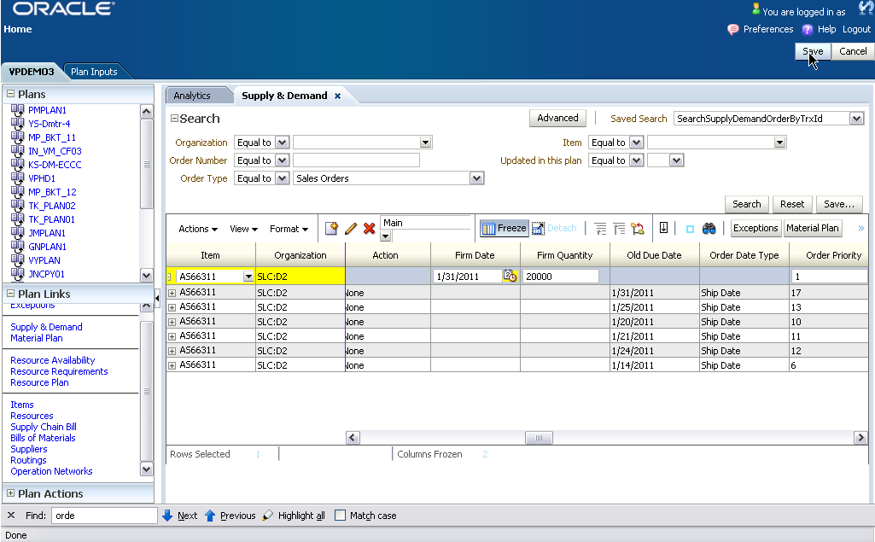
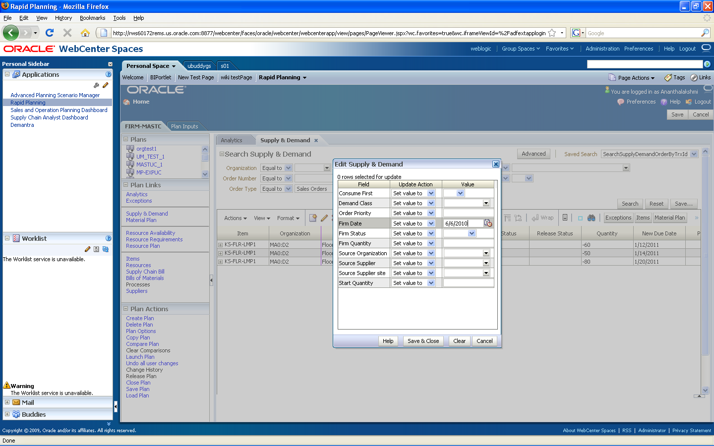
Simulate changes to demand and supply
Simulate urgent
“hot demand”
Mass edit
supplies
Notes:
An example …

Slide 17
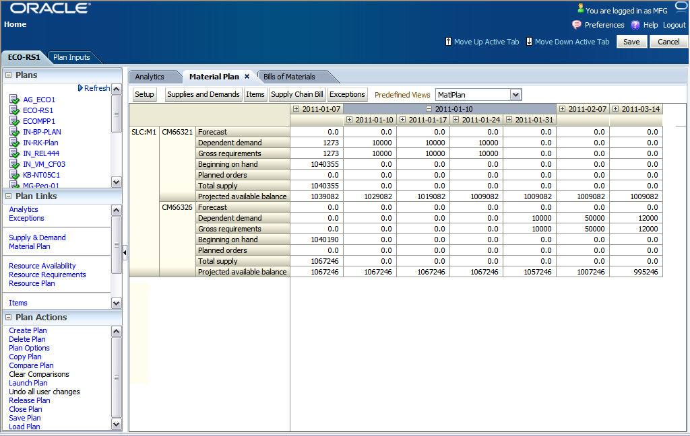
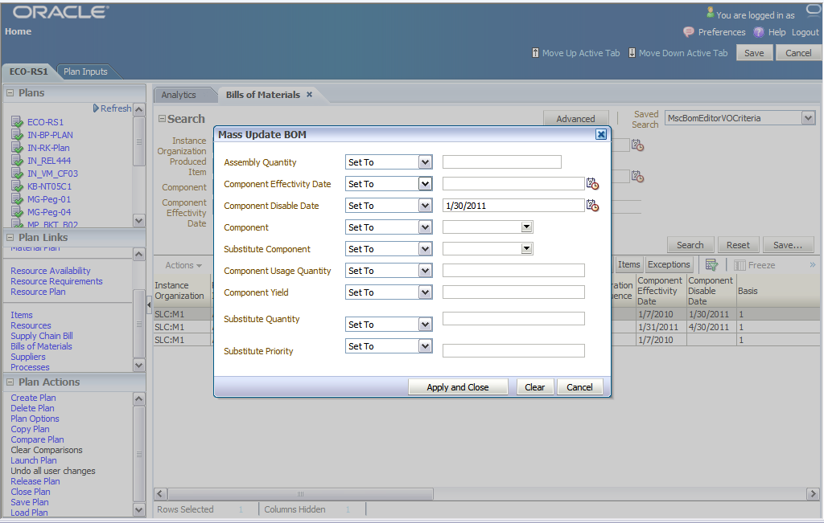
Simulate ECO cut-in
Analyze ECO cut-in
on Material Plan
Mass edit
BOM
Notes:
An example …

Slide 18

Make better decisions faster
Automate planning decisions and model the constraints of your supply chain
Decisions
Constraints
Fulfill demand with substitutes
  End items
  Components
Offload to alternates
  Source (mfg sites, distribution centers, suppliers)
  Routing
  Bills of material
  Resource
  Ship method
Account for effectivity
  BOM effectivity
  Engineering change orders
  Sourcing effectivity
Consider user-defined ranks and priorities
Order modifiers
  Item, supplier
Lead times
  Item, supplier, manufacturing
Planning time fence and calendars
  Shipping, receiving, supplier, resource work days
Co- and by-products
Firm orders
Forecast spreading and consumption
Routings
  Operation yield
  Max assigned units
  Resource efficiency
Notes:
It is not only important to have a fast planning tool – you also want to make sure that real life constraints can be taken into consideration and where possible decisions are automated.
Examples … (talk through bullets selectively)

Slide 19
Oracle Rapid Planning
Reduce planning cycle time and make faster short-term decisions
Empower planners with rapid what-if scenario planning
Use a more productive UI for insightful analytics
Make faster decisions through collaboration
Translate decisions into actions
Notes:
Rapid what-if scenario planning by itself is not sufficient – you also need a productivity enhancing user experience that improves planner’s productivity and provides quick and insightful analysis. Let’s talk about that next.

Slide 20
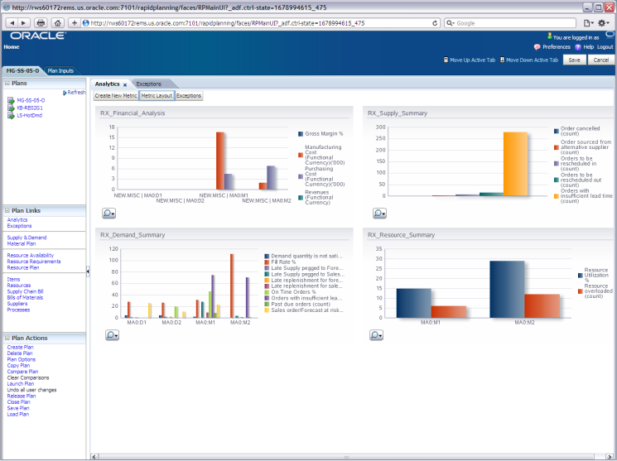
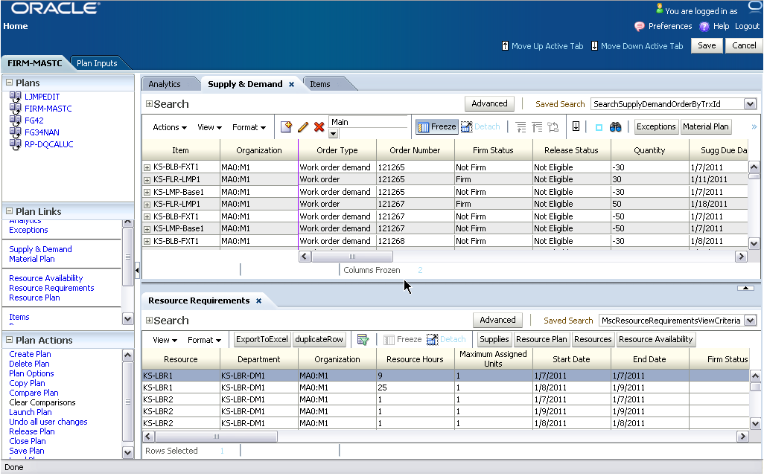

Strong UI for improved planner productivity
Highly configurable spreadsheet-style planner workspaces
Spreadsheet style UI
Personalization
Interactive analytics
Interactive what-if simulation
Fast plan copy
Compare multiple plans
Ad-hoc queries and filters
Sort on all columns
Mass edit
Find in work sheet
Planner collaboration
Export to MS Excel
Notes:
Oracle Rapid Planning was designed with the wishes of our 1000+ customers in mind. It provides all key elements to provide planners with a configurable productivity enhancing user experience that provides many features.

Slide 21

Strong UI for improved planner productivity
Highly configurable spreadsheet-style planner workspaces
Notes:
This is how it looks like …
{speaker note: production screen subject to change}

Slide 22
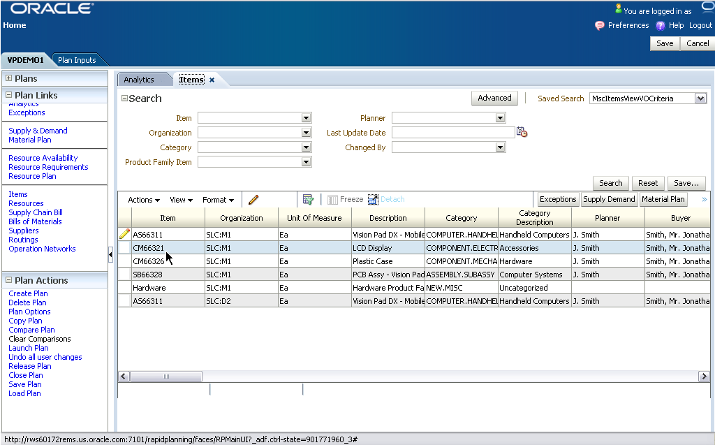
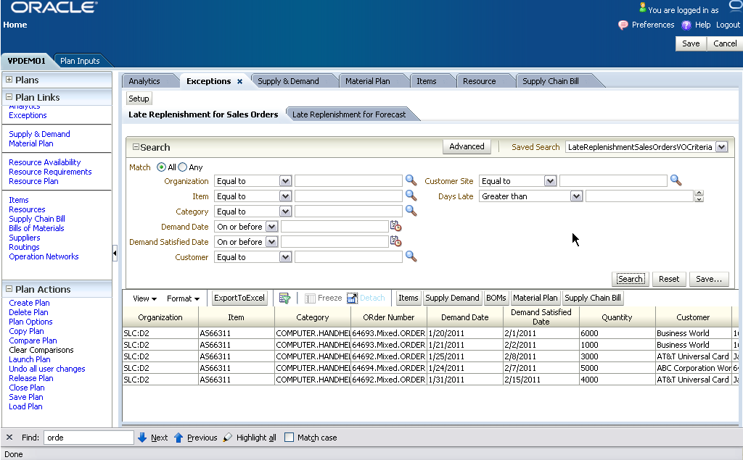
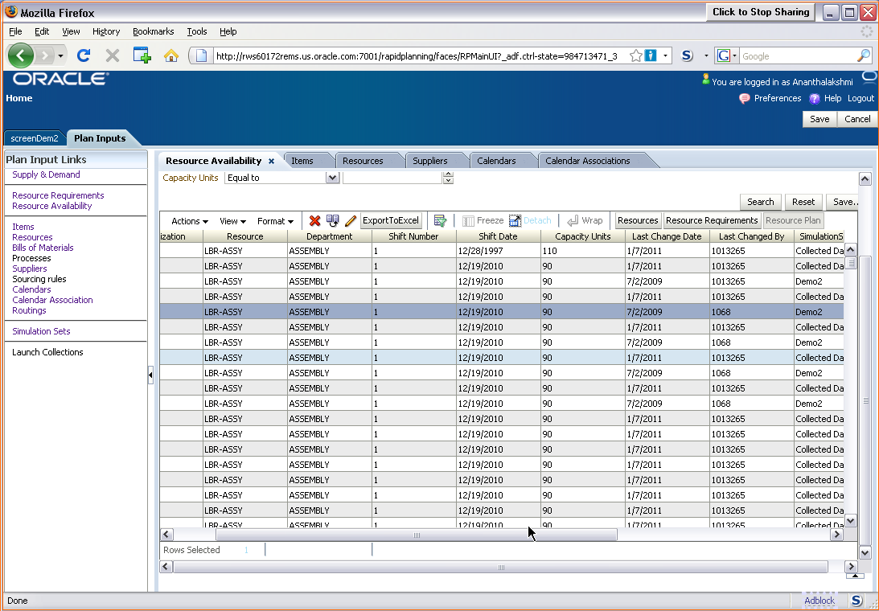
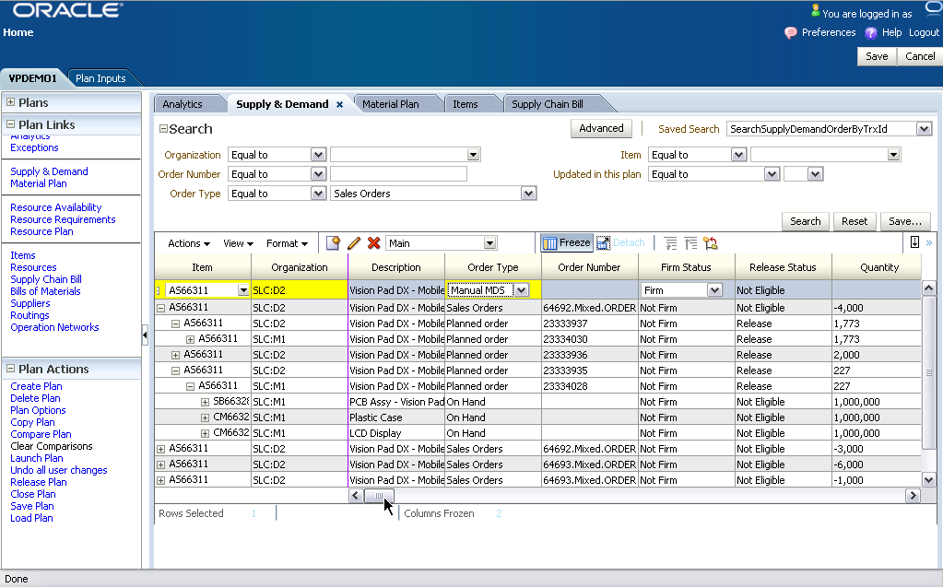
Strong UI for improved planner productivity
Saved searches, mass edits, and quick order simulations
Mass edit items
Saved searches
Mass edit resources
Edit demand
and supply and enter new orders for simulation
Notes:
We placed great emphasis on the personalization aspect of the user interface as different planners need to organize their workflow to their needs
{speaker note: production screen subject to change}

Slide 23
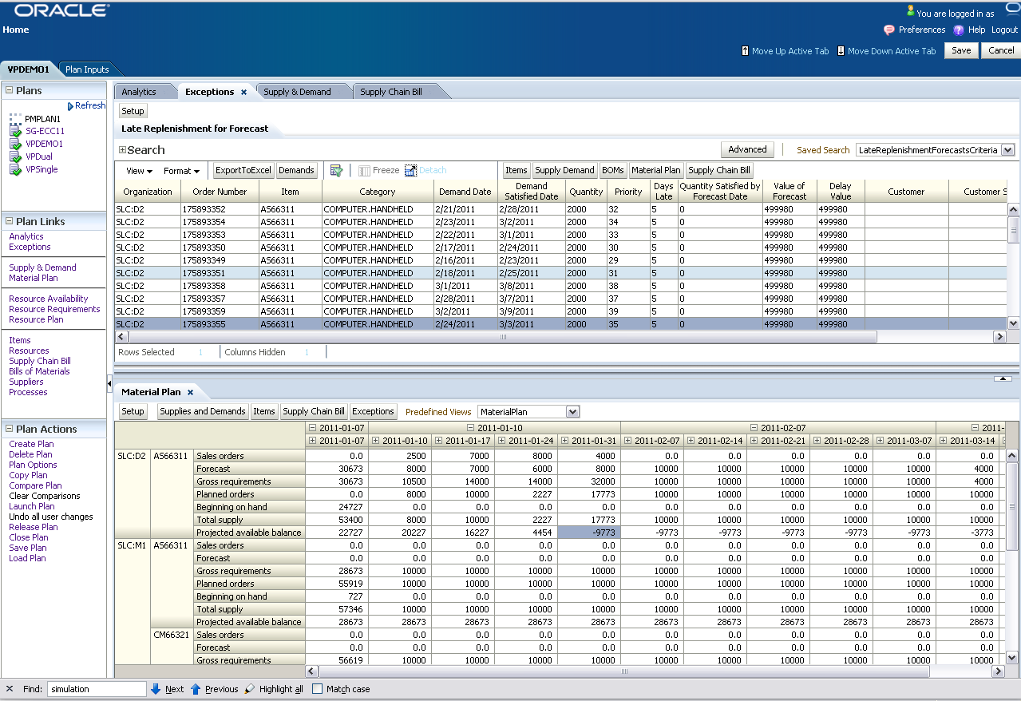

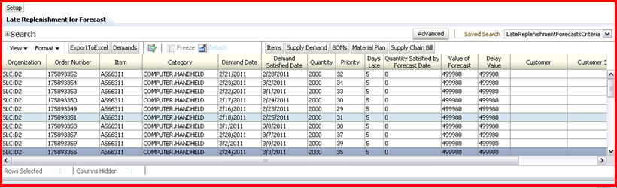
Flexibly arrange workspace

Slide 24
Simultaneously view Supply Chain Bill
and Material Plan

Slide 25
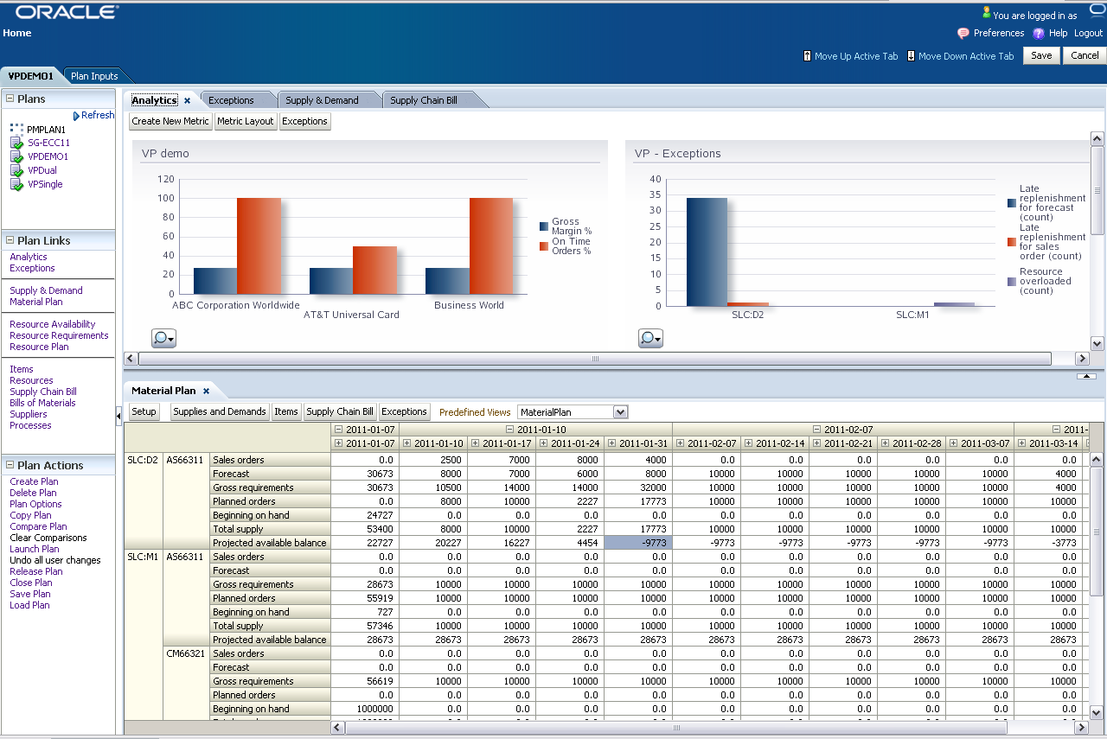
View KPIs and Material Plan

Slide 26
View Exceptions and Material Plan

Slide 27
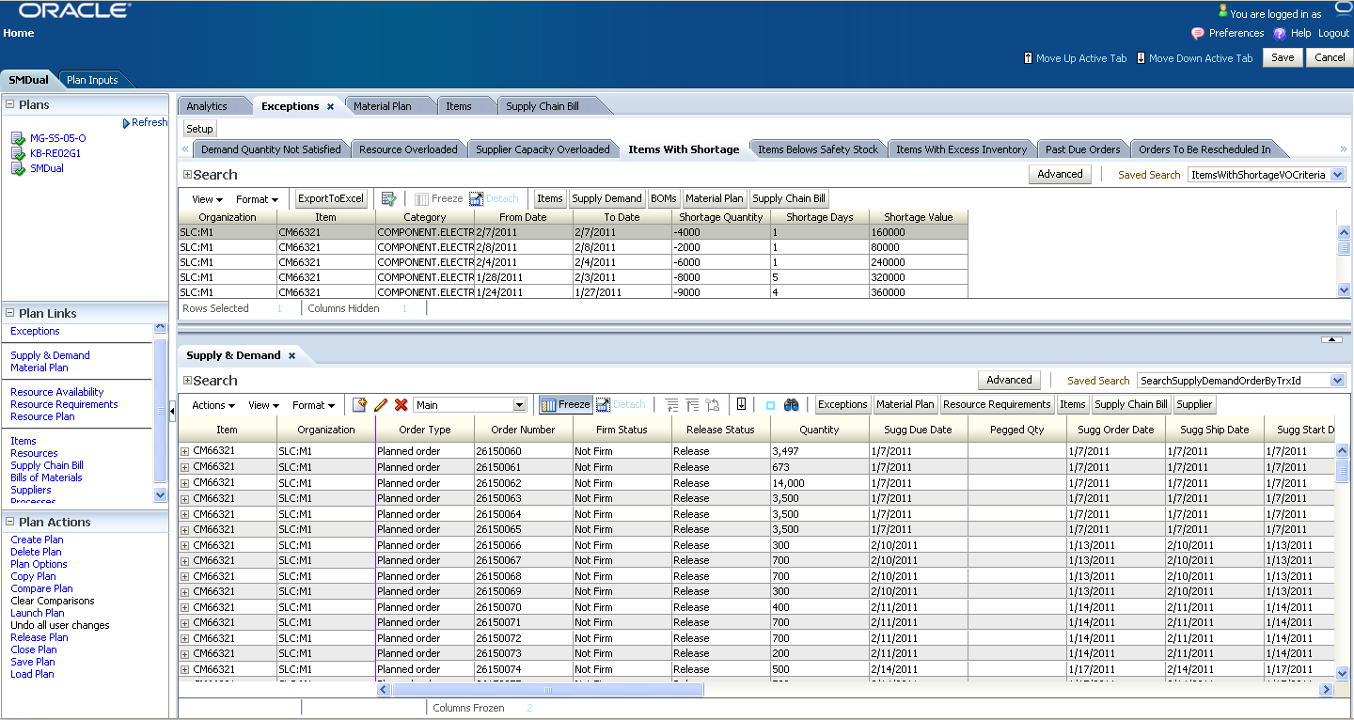
View Exceptions and Orders

Slide 28
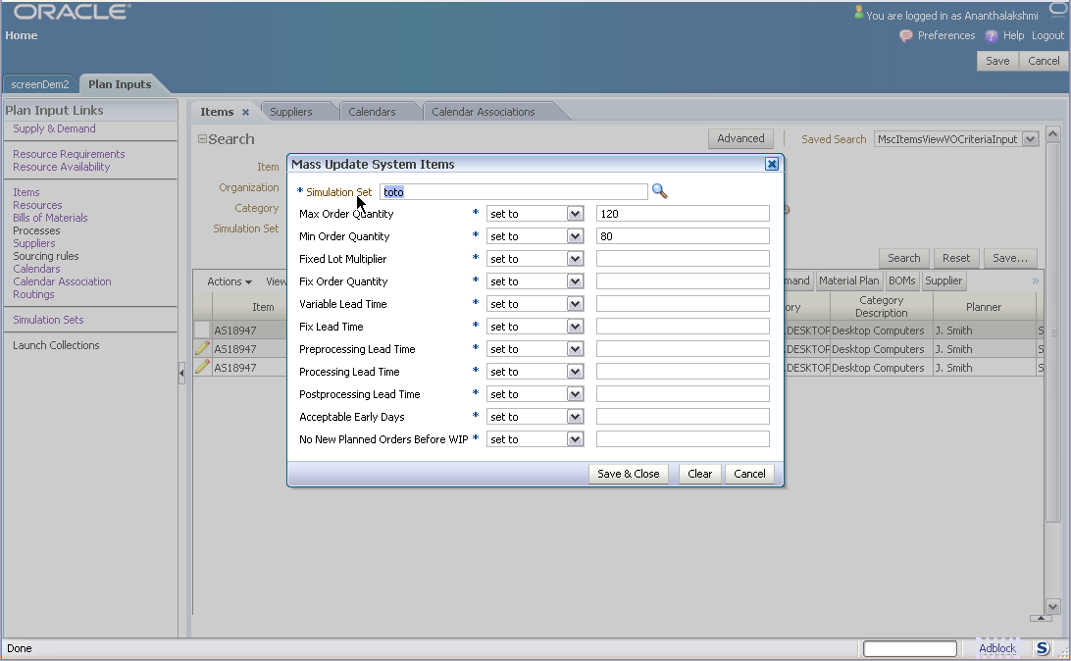
Example: mass edit item changes

Slide 29
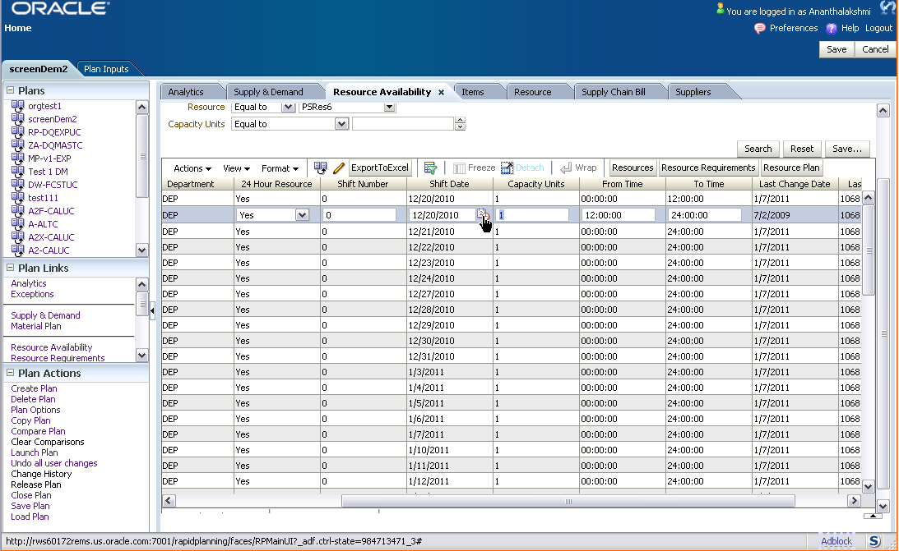
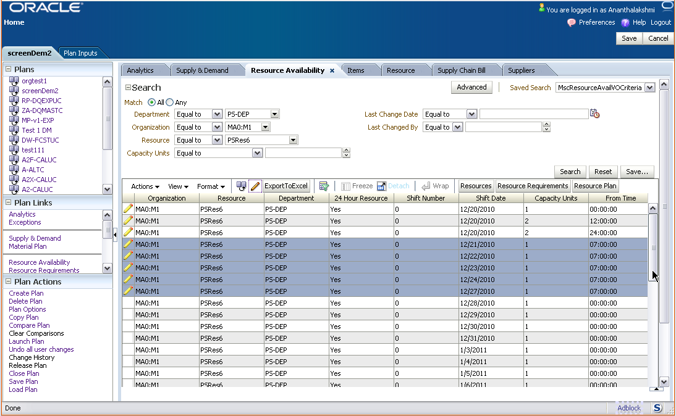
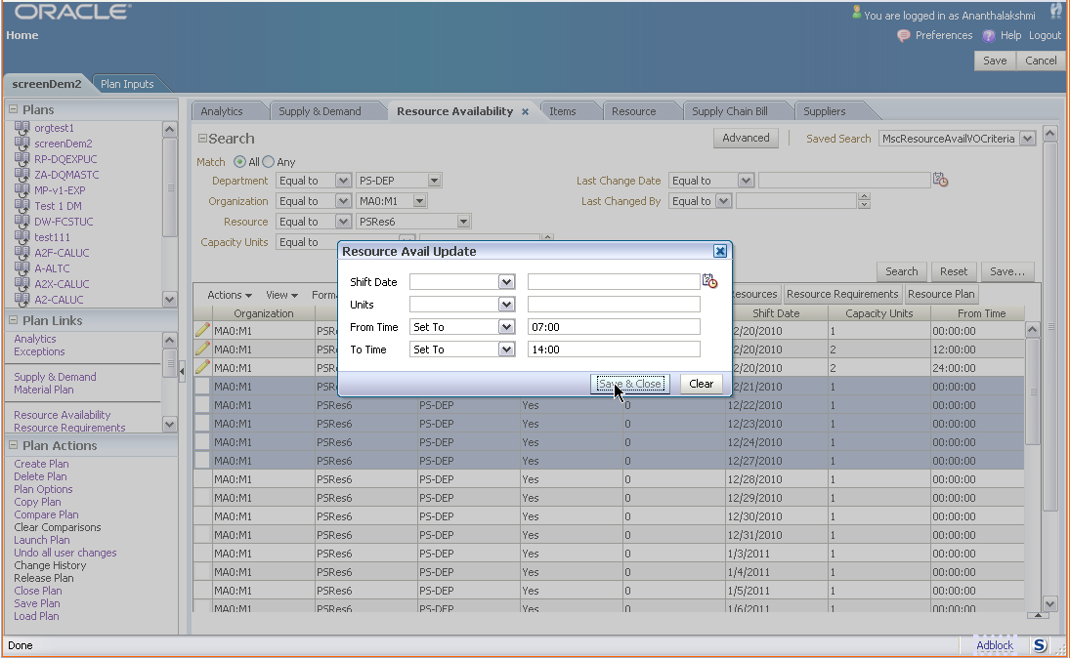
Example: mass edit resource changes

Slide 30
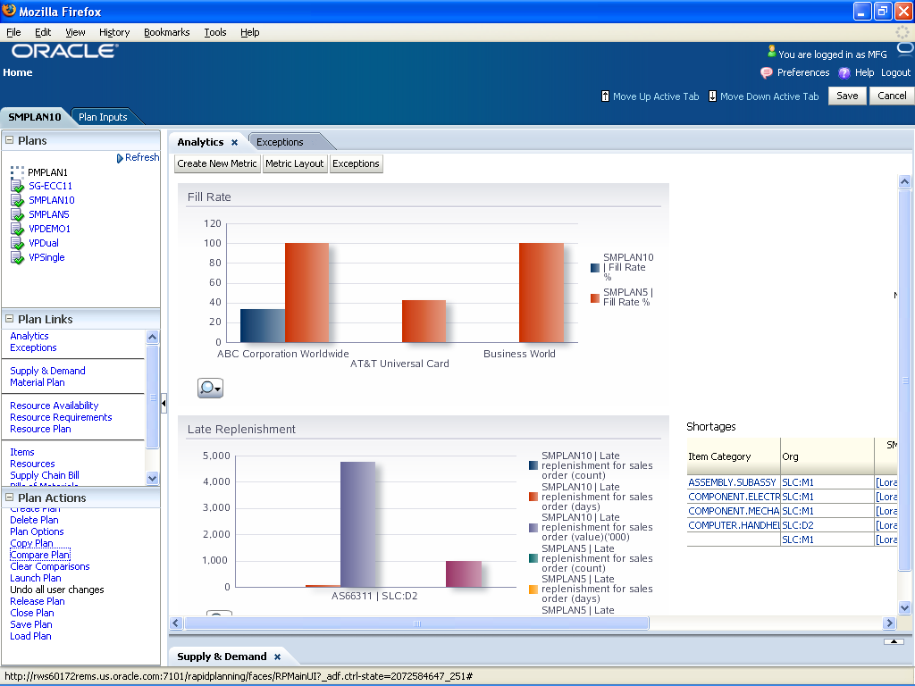
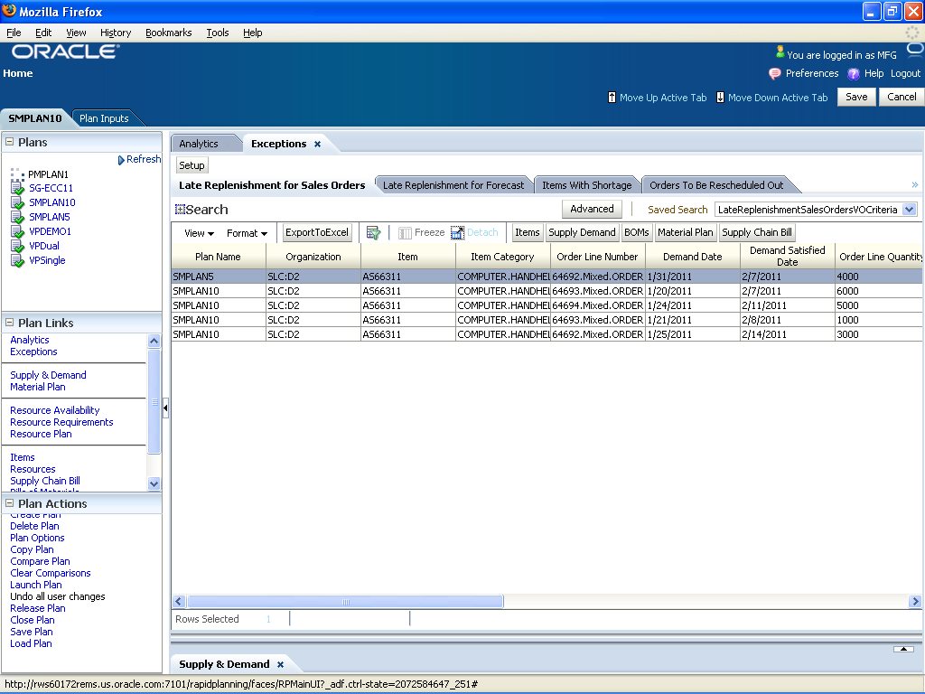
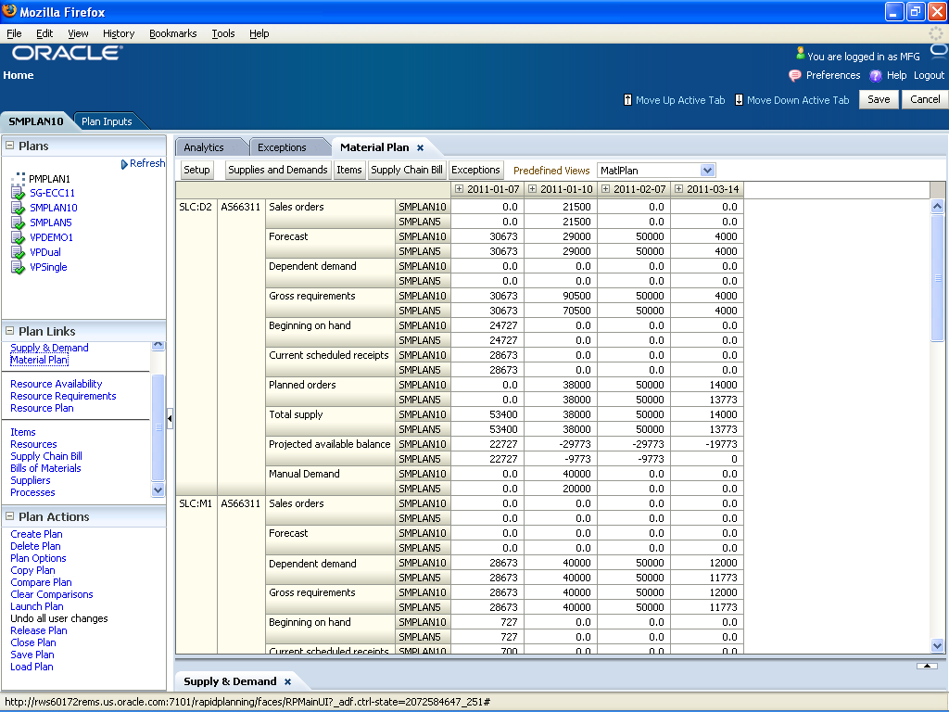
Monitor plan performance
Review key performance indicators and exceptions
Compare plans
  Compare performance indicators
  Compare exceptions
  Compare supply and demands
  Compare material and resource requirements
Analyze plan exceptions and KPIs
  Demand, supply, resource, and alternate usage exceptions
  Large set of pre-built performance indicators
  Drill down from KPIs to related exceptions
Flexible configuration
  Exclude exceptions
  View multiple exception types simultaneously
  User-defined KPI sets and filters
Notes:
We also ensured that you can view your decision in context of key performance metrics and exceptions. For example, you can compare different plan runs and analyze whether or not the changes that you are proposing will really improve the plan quality; you can selectively view key exceptions and performance indicators and compare them across multiple plans.
{speaker note: production screen subject to change}
Analyze plan performance with following KPIs:
Stock out days
Fill rate
Inventory turns
Safety Stock violation days
Revenue
Gross Margin %
Manufacturing cost
Purchasing cost
Late orders ratio count
Resource utilization %
Supplier capacity utilization %
Exception count, days, and ratio KPIs

Slide 31
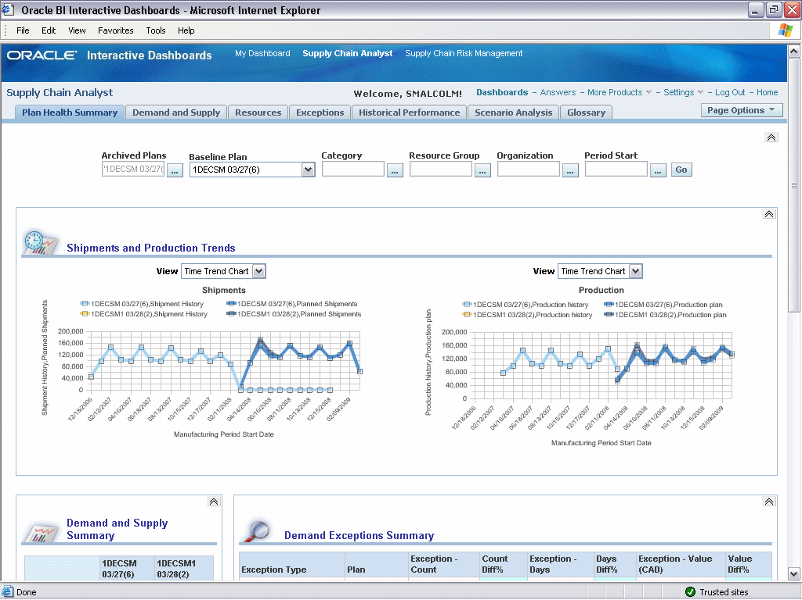
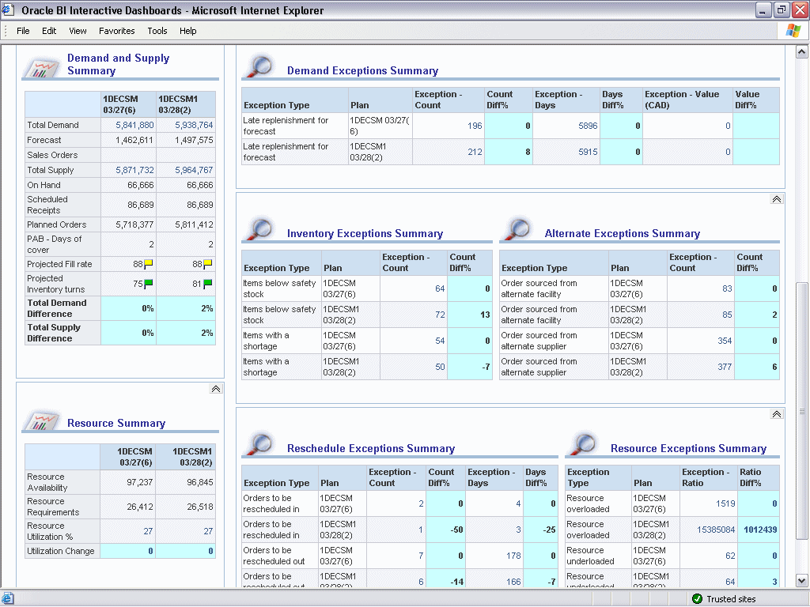
Compare planning scenarios
Enable key decision makers to evaluate planning output in corporate metrics
Analyze specific product categories, organizations and resource groups
Check your shipment and production trends
Compare previous run to current run exceptions and metrics
Integrated with Oracle Advanced Planning Command Center !
Notes:
You can also compare different planning scenarios and even leverage the Advanced Planning Command Center integration to expose plan output to other key decision makers that do not (on a regular basis) work with Oracle Rapid Planning and maybe need a more casual user interface to perform their analysis.

Slide 32
Oracle Rapid Planning
Reduce planning cycle time and make faster short-term decisions
Empower planners with rapid what-if scenarios planning
Use a more productive UI for insightful analytics
Make faster decisions through collaboration
Translate decisions into actions
Notes:
In most companies you will have more than one planner making decisions and a key point here is that even though you want to give the individual planners the capability to play with their own decisions, you need to align their decisions at the end.

Slide 33




Multiple planners collaborate on a single plan
Personal Simulations
Work with a single holistic plan
  Model all manufacturing and distribution facilities, include customers and suppliers
  No alignment required between different supply plans
Planners run “sand-box” copies of “master” plan
  Make fast copies
  Group simulation changes and mass edits into simulation sets
Copy
‘Master’ plan
Simulation Sets
Copy
Plan copy
Plan
edits
Simulated
plans
Notes:
Oracle Rapid Planning enables multiple planners to work on a single holistic plan, yet they can also simulate alternatives in their own “sand-box” and implement only the changes they like into the master plan.
Working with a holistic plan ensures that all decisions are measured against each other and that no decisions are made in a vacuum to conflict later on.

Slide 34
Oracle Rapid Planning
Reduce planning cycle time and make faster short-term decisions
Empower planners with rapid what-if scenario planning
Use a more productive UI for insightful analytics
Make faster decisions through collaboration
Translate decisions into actions
Notes:
Planning is only as good as your execution. It is therefore important that you can quickly and seamlessly translate planning decisions into actions, from day 1

Slide 35
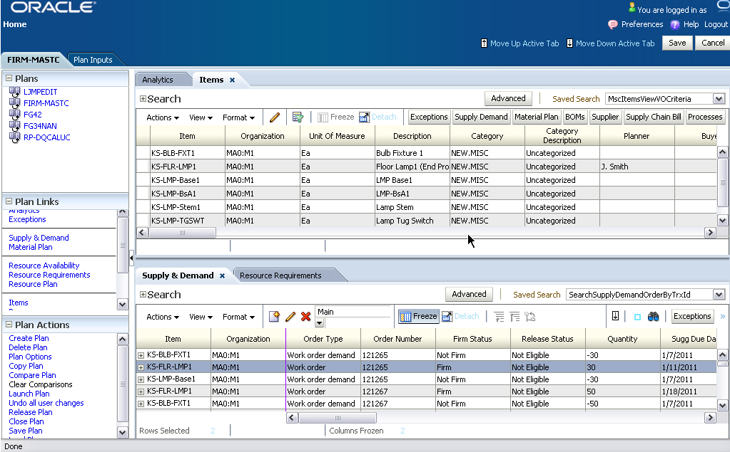
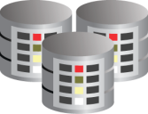
Translate decisions to actions
Rapid Planning
Release planning recommendations via out-of-the-box integration to Oracle ERP
Quickly release order recommendations to Execution
  Purchase orders (new, change, cancel)
  Work orders (new, change, cancel)
  Sales order recommendations
Release to multiple source systems
Out-of-the-box integration with Oracle ERP
  Oracle E-Business Suite
  JD Edwards EnterpriseOne*
Orders
Orders
Orders
ERP
* Requires JDE E1 integration PIP
Notes:
Oracle Rapid Planning is integration with Oracle ERP so there’s no need for additional investment. Changes to purchase orders, on-hand, work orders, and sales orders are recognized instantly and planning recommendations can be released en mass or individually when planning. The pre-built integration alleviates you having to worry about different versions from different vendors having to work together when being released on different schedules, supported by different Support organizations.

Slide 36
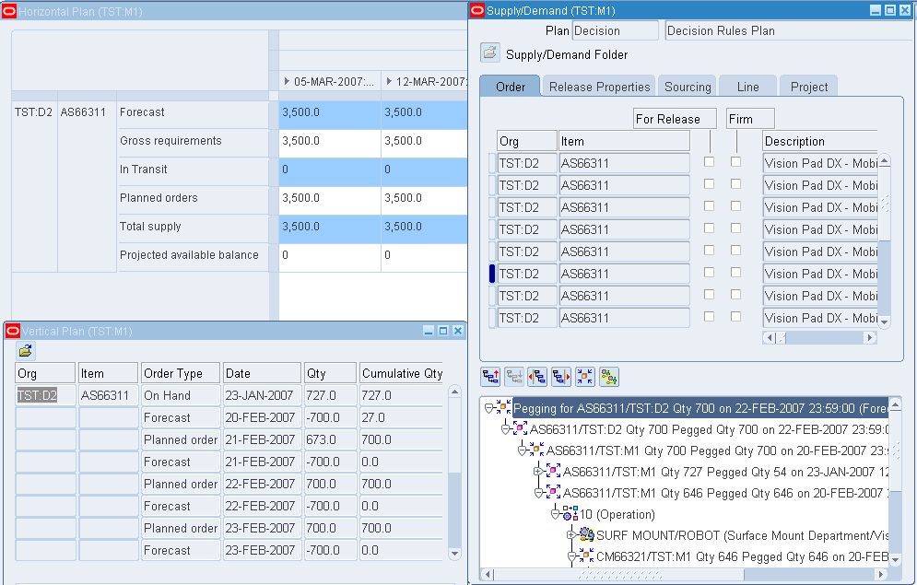
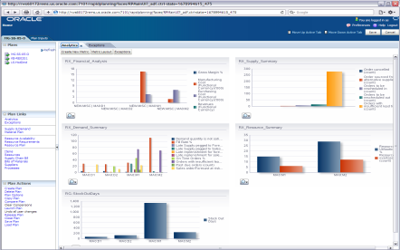
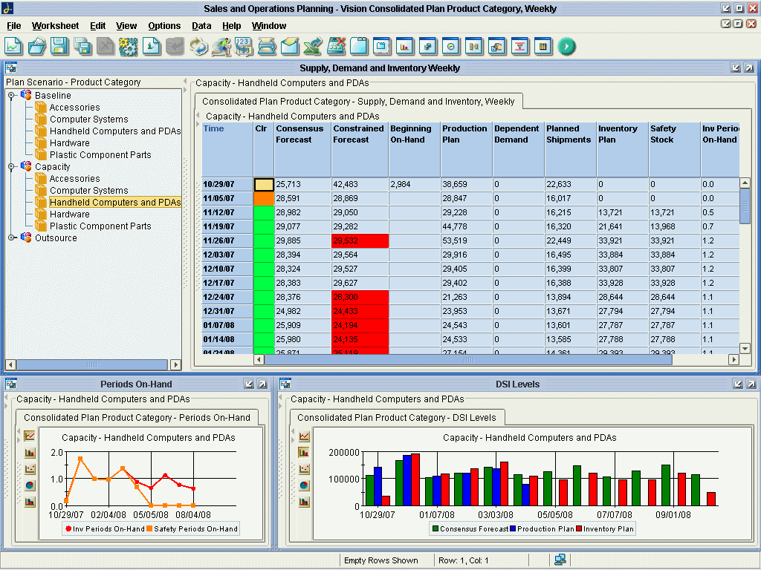
Complements Value Chain Planning capabilities
Common foundation: quick ROI when deploying incremental components
Production Scheduling
Firm production
schedules
Supply plan
Firm production schedules
Supply plan
RAPID PLANNING
Supply scenarios
Simulation results
Advanced Supply
Chain Planning
Supply plan
Advanced Planning
Command Center
Sourcing rules
Strategic Network Opt
Supply scenarios
ATP plan
Global Order Promising
Reservations
Order forecast
Collaborative Planning
Supply commits
Demand
scenarios
Inventory scenarios
Inventory Optimization
Sales and Operations
Planning
Demand scenarios
Demand Management
Demand scenarios
Collections
Release
Work orders
Purchase orders
Sales orders
Master data
Changes to work orders
purchase orders
sales orders
ERP/ Legacy
Available with Rapid Planning 1.0
Targeted for Rapid Planning 1.1
Targeted for Rapid Planning beyond 1.1
Notes:
Here’s a diagram that shows how Rapid Planning interacts with the other Value Chain Planning products.
{Speaker note: When deploying Rapid Planning with ASCP, you would run GOP and PS against ASCP, but in standalone configuration they would run directly against RP)

Slide 37

<Insert Picture Here>
Comparison with ASCP
37
Notes:
37
To summarize …

Slide 38
Comparison with ASCP
Solution methodology
Rapid Planning
ASCP
Single pass
  Constructive heuristic
  No mathematical programming
Pegging is post-process
  FIFO only
  No cross-pegging
Incremental solve
  Output created demand by demand
  Freeze existing output, add changes (e.g., “hot demands”) on top
Safety lead time
No detailed scheduling
  Resource capacity at day level
Day boundaries for resource loading
3 phases
  Supply Chain Optimization (linear program), Memory-Based Planner, High Level Scheduler
Embedded pegging
  In middle (MBP) solution phase
  FIFO or priority-based Quantity-based safety
  stock targets
Bulk solve
  SCO must first solve to completion, then provides output in its entirety
Quantity-based safety stock targets
Detailed scheduling
  Minute-level resource capacity
Notes:
It is not only important to have a fast planning tool – you also want to make sure that real life constraints can be taken into consideration and where possible decisions are automated.
Examples … (talk through bullets selectively)

Slide 39
Comparison with ASCP
Functional comparison
Rapid Planning
ASCP
Designed for rapid simulation
  Fast one-pass heuristic
  Simulation results in memory
  Quickly edit planning inputs (demands/supplies, BOMs, routings, etc.) for simulation
  UI: mass edits, plan compare
Multi-plan collaboration
  Merge changes from multiple plans into single master plan
Planning modes
  Unconstrained, Enforce Capacity Constraints
  Enforce Demand Due Dates after initial release
  Decision rules only, no cost optimization
Limited process, project mfg support
Batch planning oriented
  Multi-phase, math programming
  Simulation results flushed to database
  Make changes on transaction source instance, re-collect
  No mass edits; plan compare requires Advanced Planning Command Center
Single-plan collaboration
  Multiple planners must work on same plan
Planning modes
  Unconstrained, Enforce Capacity Constraints, Enforce Demand Due Dates
  Optional cost-based optimization
Process manufacturing support
Project manufacturing support

Slide 40
Customer Profile
Rapid Planning
Rapid Planning is a good fit in industries that have:
  Volatile demand
  Variability in execution
  Frequent engineering change orders
  Short product life cycles (numerous NPI)
Supply Chain Attributes:
  Discrete manufacturing
  Internal or outsourced manufacturing
  Minimal DRP requirements
Target Industries
Mfg of Electronics
Mfg of Medical Equipment
Semiconductor (outsourced mfg)
Communications
Mfg of Machinery
Note:
No support for detailed scheduling constraints (Process manufacturing)
No support for project netting (A&D)
Not suited for distribution oriented industries (CPG)
No shelf-life planning (Life Science, Med-Device)

Slide 41
High Value Questions & Issues
Questions to ask VP of Supply Chain or Operations
Have your customers expressed dissatisfaction with your ability to respond to their changing requirements?
How often do you run supply chain planning? The longer the interval, the better the opportunity for RP to provide benefits between planning cycles
How long does it typically take to respond to a customer inquiry for a large potential order?
Are you able to determine the impact of such a change in demand beforehand?
How quickly can you determine impact of a shortfall from a vendor or subcontractor?
Has variability in execution impacted your on-time deliveries?
Are you able to perform full stream supply and capacity evaluations during your S&OP process?

Slide 42

Rapid Planning Deployment Environments
Customers Who:
Using ASCP
  Knowledgeable & sophisticated users
  Challenging planning environment, looking for simulation capabilities
Purchased ASCP but never implemented
  ASCP purchase was driven by IT not business
  Difficulty gaining user acceptance
Still running MRP/Spreadsheets
  Users typically lack advanced planning skills
  Organization struggles with change

Slide 43
Rapid Planning with ASCP installed
Rapid Planning Deployment Environment
  Key Points
  ASCP CAB members have been asking for a quick simulation tool to complement ASCP
    Need for speed and flexibility
    Mass edit data for simulation what-if
    Enables quick response to changes without sending shock waves through the entire supply chain
  Very short learning curve for users with ASCP knowledge
  Out of box integration makes implementation time significantly shorter than competition for fast ROI
    Uses same data collection as ASCP
  Use of RP will help planners see the value of embracing all of ASCP capabilities (many companies only run unconstrained)
Notes:
Overwhelming feedback from VCP CAB was the need for a fast simulation planning tool to complement ASCP’s tactical planning capabilities
Simple excel-like UI and fast interactive simulation results
Showcase latest Fusion Middleware and Oracle Db technology

Slide 44
Rapid Planning, own ASCP but not installed
Rapid Planning Deployment Environment
  Key Points
  User acceptance is often a major obstacle to successful planning tool implementations
  Intuitive UI provides simple navigation
  What-if capability provides short cycle of learning for planner
    User can experiment with inputs and quickly see results which speeds their understanding and acceptance of RP
    Can gain a year’s worth of experience in two days
    Simplified engine is easier for planners to grasp
  Using RP will help planners see the value of using ASCP and RP in tandem
    Knowledge of RP will help them understand strengths of ASCP
    Using full features of ASCP will not seem as daunting
  Creates opportunity to use additional VCP products

Slide 45
Running MRP/Spreadsheets
Rapid Planning Deployment Environment
  Key Points
  RP is a perfect stepping stone to move from unconstrained single org to multi-org constrained planning for customers that are now not moving beyond the traditional MRP paradigm.
  Short cycle of learning and great UI will motivate risk adverse users to migrate from MRP
    User can experiment with inputs and quickly see results which speeds their understanding and acceptance of RP
    Simplified engine is easier for planners to grasp
    Built-in analytics and integration with APCC aids change management
  RP then can also be the stepping stone to an even richer planning tool like ASCP once their organization is ready for it.
  Getting RP positioned opens the door for the use of Demand Management, Sales and Operations Planning, Advanced Planning Command Center, and of course ASCP and CBO

Slide 46

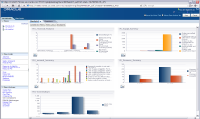
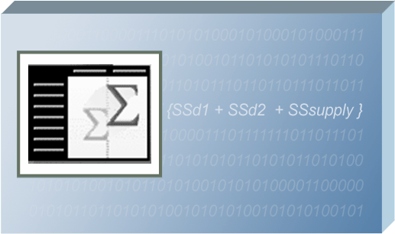

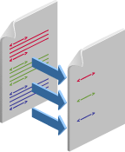



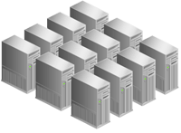
Flexible deployment, modern architecture
UI (ADF)
Planning
Engine and
Cache Manager
ERP
COLLECTIONS
CANONICAL
DATA MODEL
SIMULATION
PLANS
Legacy
WEB SERVICES
Customers can deploy Rapid Planning:
Integrated with Oracle EBS and APS 11i10, 12.0, and 12.1
Integrated with Oracle JD Edwards E1 9.0 (via VCP-JDE E1 Integration PIP)
Standalone against legacy systems
Notes:
Rapid Planning can be deployed against different versions of APS and EBS, as well as be deployed against E1 ERP 9.0.
So existing Oracle EBS customers that are on older versions such as 11i10 or 12.0, can leverage Rapid Planning to make better decisions, without having to upgrade to the latest version right away.
In addition, it leverages the proven legacy collections infra-structure that we had for many years to run against other systems.

Slide 47

Built with proven Oracle technology
J2EE Application Server
Service-Oriented Architecture
Business Process Mgmt
Business Intelligence
Content Management
Identity Management
Collaboration Suite
Enterprise Portal
Business Integration
Data Hubs
Developer Tools
Web Services Management
Real Application Clusters
Advanced Security
Embeddable
Secure Enterprise Search
Data Warehousing
Server Virtualization
Enterprise Management
Partitioning
OLAP
Data Mining
Spatial Data
Secure Backup
Notes:
Oracle Rapid Planning is built with Oracle’s proven technology

Slide 48
Pre-built integrations to ERP
ERP
Bill of material headers, bom components,
component substitutes, engineering change orders
Value Chain Planning
Constrained order forecast (DEM RTS&OP)
Calendars, calendar exceptions, work day patterns
Categories, category sets; UOMs, UOM class conversions
Global and local demand schedules (DEM DM)
Demand classes, forecast demands, demand schedules
Time phased safety stocks (IO)
Work order headers, components, operations
Routings, operations, resources, resource instances, lines
Firm planned work orders (PS)
Forecast designators, demand schedule designators,
plan order designators, sales channels
Sourcing rule assignment sets (SNO)
ORACLE
RAPID
PLANNING
Planners, unit of measures, UOM class conversions
Items, item substitutes, co- and by-products
Order reservations (GOP)
Organizations, shipping networks, subinventories,
location associations, shipping methods
Order forecasts and supply commits (CP)
Sourcing
Plan archives and scenario assignments (APCC)
Items, item substitutes, co- and by-products
OSFM material requirements, operations resources,
operations, operation networks
Purchase order supplies, requisition supplies, supplier
capacities, supplier flex fences, item suppliers
Resource availability, resource requirements, resource
groups, resource shifts, shift exceptions, shift times
Safety stocks, sales order demands, reservations, on-hand,
intransit supplies, work order supplies
Some integrations planned for future release
Notes:
This slide illustrated some of the pre-built integration touch points you receive “out-of-the-box”

Slide 49
<Insert Picture Here>
Summary
Notes:
To summarize …

Slide 50
Oracle Rapid Planning
Enabling event driven real-time planning
Empower planners with rapid what-if scenario planning
  React quickly to supply chain events with fast incremental plan runs – make decisions in minutes
  Easily manipulate plan (mass edits)
  Enable fast sales and operations planning simulations
Leverage a strong UI for insightful analytics
  Predictive and actionable insight via embedded analytics and spreadsheet-style UI
  Compare exceptions and key performance indicators
Make faster decisions through collaboration
  Planners collaborate on a single holistic plan
  Multi-enterprise visibility and planning
Translate decisions into actions
  Out-of-the-box integration with ERP
  No latency: release directly to execution
Notes:
Rapid Planning offers the following key capabilities …

Slide 51
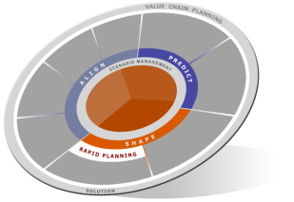
Key takeaways
Provides superior UI experience for highest planner productivity
Enables significant value by enabling real-time planning
  Reduces planning cycle time by providing a fast what-if environment
  Enables you to react quickly to supply chain disruptions
Complements your existing planning solution
  Augments your tactical planning solution, no need to replace
  Leverages your existing Oracle and Value Chain Planning infrastructure
Provides lower cost of ownership and deploy quickly
  Pre-built integration with Oracle EBS and JDE EnterpriseOne
Notes:
I’d like to wrap up with the following key takeaways …

Slide 52

Questions
Thank you!
Notes:
Any questions?

Slide 53



