Slide 1
Automating Oracle AP With Kofax
January 18, 2010
Scott Tompkins, Sales Account Executive

Slide 2
What‘s Top of Mind in Finance?
Top Pressures
Need to reduce invoice processing costs
68%
Need to improve visibility into invoices
47%
Need to decrease invoice cycle time
46%
Need for better cash management
39%
Top Strategic Actions
Automate invoice receipt/workflow processes
55%
Standardize invoice receipt/workflow processes
54%
Conduct internal assessment of A/P capabilities
46%
Integrate e-payables solutions w/other systems
37%
Centralize A/P processes
36%
Source: AberdeenGroup, 2009
Slide 2
Notes:
Finance managers feel the pressure to address critical aspects of the AP process, and evaluate strategic actions to respond. This information is taken from a May 2009 survey by the Aberdeen Group.
In particular, Finance managers feel the pains of high processing costs, the lack of visibility, slow processes, and poor cash management in AP. They view process standardization and automation as the best ways to address theses pains.

Slide 3
World Class Results
Finance cost as a percent of revenue
1.90%
1.50%
1.40%
1.08%
1.24%
1.00%
.74%
.61%
Source: Hackett Finance Executive Advisory Program

Slide 4
Stages of AP Automation
Performance Optimization
Supplier Interaction
ERP System
Shared Service Center/ Centralized Operations
AP Automation
(Capture, Entry, Workflow)
In-depth views of ERP and workflow enable real-time actions to impact business processes and manage working capital
Automates supplier interaction to increase AP productivity and improve cash management.
Foundation Intermediate Advanced
Drives financial controls, business process and timely payment.
Addresses process and control issues. First step toward being a strategic operation.
“System of record” for the organization and single source of all financial truth.
Slide 4

Slide 5

Invoice Lifecycle
Capture & Transform
Entry
Review & Resolve
Coding & Approvals
Payment
Audit
Notes:
5
Accounts Payable Automation
January 2009
5

Slide 6
The Kofax Solution

Slide 7
Capture Invoices – Anywhere, Any Format
Capture & Transform
Entry
Review & Resolve
Coding & Approvals
Payment
Audit
Scan Paper
Email
Fax
MFD
Supplier Networks
Electronic Invoices
    Benefits
Faster invoice processing
No lost invoices
Access by multiple users/locations
Reduced costs
Compliance
Notes:
7
Accounts Payable Automation
January 2009
7

Slide 8
Transformation into Process-Ready Information
Capture & Transform
Entry
Review & Resolve
Coding & Approvals
Payment
Audit
Extract information
Paper, fax, email
Classification
Validation
Feed ERP
Receipt confirmations
Exception notifications
    Benefits
    Reduce AP labor and costs
    Increase data accuracy
    Faster processing
    through automatic routing
    Unified processing
Notes:
8
Accounts Payable Automation
January 2009
8

Slide 9
Workflow with Real-time ERP integration
Capture
and Transform
Entry
Review & Resolve
Coding & Approvals
Payment
Audit
ERP Environment
Leveraging your investment
in ERP, data and resources
with no duplication
Corporate Data
Organizations
Sets of Books
Hierarchies
Vendor Supplier Lists
Chart of Account Information
Business Rules
Materiality Limits
Etc.

Slide 10
Workflow with Real-time ERP integration
Capture
and Transform
Entry
Review & Resolve
Coding & Approvals
Payment
Audit
ERP Environment
Leveraging Kofax’s extensive library of best practices workflows, developed and refined over 20 years and 100’s of implementations
Kofax MarkView
Context Sensitive Workflows
PO Based
Non-PO Based
Pre-Approved
Self Service
Supplier Maintenance

Slide 11
Workflow with Real-time ERP integration
Capture
and Transform
Entry
Review & Resolve
Coding & Approvals
Payment
Audit
ERP Environment
Allow suppliers real time access to invoice and payments as well as the ability to submit
Give insight into invoice processing, cash management and compliance
Kofax MarkView
Context Sensitive Workflows
PO Based
Non-PO Based
Pre-Approved
Self Service
Supplier Maintenance
Supplier Express
Advisor

Slide 12
End-to-End Solution from a Single, Trusted Partner
Market leading intelligent capture combined with best practice workflow for complete financial process automation
Fully integrated in real time with ERP systems of record
Scalable enterprise platform
Supplier integration
Intelligent management workspace

Slide 13
Benefits for All Users
Accounts Payable
Faster, lower cost entry, fewer errors
  Eliminate paper handling, filing, copying
  Reduce keying
Improved exception handling
  Eliminate calls back and forth with field,
  faxing documents
Reduced interactions with suppliers
  Self service automated response
Finance Management
Improved process visibility
  Bottlenecks, performance, invoice status, discount capture
Improved management of high profile invoices
  High Value, Discounts, Supply Chain impact
Reduced risk
  Fraud protection, SoD violations, Duplicates, Errors
Line of Business
Fast, intuitive invoice interaction
  Electronically Code, Approve, Confirm Receipt, Comment
Self Service check request, Inquiry
IT
Pure product – easy to implement
and maintain
Real-time Oracle/SAP integration
  No duplication of data or logic
Oracle tech stack/No impact on SAP
system performance
Suppliers
Self Service query on invoice status
Invoice submission

Slide 14
Case Study: Juniper Networks
2009 revenue: $3.5B
Global workforce: 7,000
Finance in four key locations:
  Sunnyvale, Dublin, Hong Kong, Bangalore
Invoice Processing “before”: time-consuming and expensive
Too slow — cycle time 8-9 days
Lack of global scalability
  Receive paper invoice
  Look up authorizer on purchase order
  Email invoice details to authorizer
  to approve invoice via email
  File invoice waiting for approval
  in file drawer
  Wait for approval via email
  Follow up for approval if no response
  Receive approval
  Pull invoice from file drawer
  Key invoice in ERP system
  File invoice in AP file storage
  Execute payment
  Pull invoice from file when inquiries received
Slide 14
Notes:
14

Slide 15
Case Study: Juniper Networks
Benefits
Worldwide Metrics | Historical 2003 | Current 2009 Annualized
Invoices Processed | 62,000 | 1,280,370
No. of AP Employees | 5 | 12
Annual Transactions per FTE | 12,400 | 67,387
Minutes Per Invoice | 9.2 | 2.7
Backlog | 9 Days | < 3 Days
Cost Per Invoice | $4.72 | $1.61
% of Process Automated | 48% | 94%
Notes:
15

Slide 16
World’s Leading Companies Automate AP with Kofax
Communications
Healthcare
Energy
Travel / Entertainment
Aerospace / Defense
BT (British Telecom)
O2
Orange Business Services
Verizon Wireless
Vodafone
Cigna
PacifiCare
Select Medical
University Hospitals
Atmos Energy
British Energy
Chevron
Enbridge
Exterran
Magellan
Mirant
MI SWACO
NOV
Plains All American
Shell
Smith International
Tronox
Williams
Carlson
Gaylord
Holland America
Maritz
Princess Cruise Line
Sabre Holdings
Travelport
TUI
General Dynamics
Sandia National Labs
Info / Technology
Food / Beverage
Canon
Juniper Networks
NCR
Qualcomm
Red Hat
Sapient
SAS
Seagate
Teradata
ThomsonReuters
TIBCO
Yahoo
Engineering / Construction
ConAgra
Hormel
Schreiber Foods
J.M. Smucker
Granite
Macerich
Michael Baker Corp.
M.A. Mortenson
Network Rail
Suffolk Construction
Tetra Tech
Retail
Nordstrom
Sportsman’s Warehouse
Starbucks
Government /
Public Sector
Cheshire County Council (UK)
Defra (UK)
NIH
NYC Housing
Scottish Legal Aid Board
Social Security Administration
TSA
US DOT
US FAA
US CDC
US Coast Guard
World Wildlife Fund
Manufacturing/Supply
Arrow Electronics
Donaldson
Eaton
Essilor
GE
Safelite
Toyota
Financial Services
Education
Allianz
Bank of Montreal
Broadridge Financial Services
Citi
D&B
Genworth Financial
JP Morgan Chase
Marsh
TD Bank
Wells Fargo
Consumer Goods
Harvard Business School Publishing
Ryerson U.
San Diego State U.
Stanford U.
U. Pennsylvania
Electronic Arts
Mattel
Sony
Pharmaceuticals / Biotechnology
Services
Biogen Idec
King Pharma
Exel
Marine Resource Group
Slide 16
Notes:
16
16

Slide 17
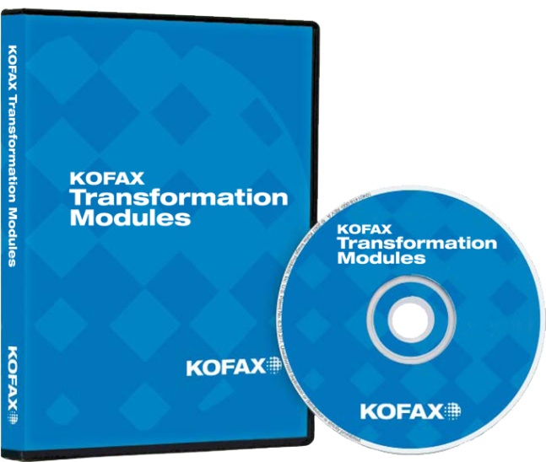
What is Kofax Transformation Modules?
An add-on to Kofax Capture that automates:
  Document classification
  Document separation
  Data extraction
Key business benefits
  Streamlined business processes
  Reduced cost
  Improved data quality and consistency
Key applications
  Invoice capture
  Sales order processing
  Forms processing
  Mailroom automation

Slide 18


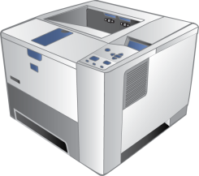






Kofax e-Transactions for Invoices: Print Capture
Seller
Invoicing System
Accounts Payables
ERP System
KeT
Sender
KeT
Receiver
KC + KTM
Instant electronic delivery (2-3 sec)
Postal Service
(2-3 days)
Open, sort, distribute mail
(1-2 days)
Envelope
Stamping
Mail
Notes:
18

Slide 19
Kofax e-Transactions for Invoices: EDI Capture
Seller
Buyer
Invoicing System
Accounts Payable System
ERP System
EDI via
VAN/FTP
EDI
Receiver
EDI
Validation
ERP System
Kofax
e-Transactions
KC + KTM
Postal Service
(2-3 days)
Open, sort, distribute mail
(1-2 days)
Envelope
Stamping
Mail
Notes:
19

Slide 20



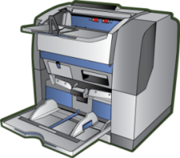




Hybrid Invoice Processing – Kofax Single Pipe
Supplier A
Buyer
EDI via
VAN/FTP
ERP
System
VAN
Connector
VAN/FTP
Conector
Supplier B
e-Transactions
Sender
ERP
System
Print spool or
EDI /XML stream
Extract/
Business Rules
Validate
e-Transactions
Sender
e-Transactions
Receiver
Release to Oracle then to MarkView
Instant electronic delivery (2-3 sec)
Supplier C
ERP
System
Print
Post
Scan, email, fax, MFD
Open and prep
Postal service
(2-3 days)
Notes:
1/15/2010

Slide 21
Kofax
Successful for more than 20 years
  Optimize/automate mission critical, document driven business processes.
  Information capture market leader
Global presence
  1200 employees in 33 countries
  Global professional services and support
  Product development/management in US, Europe, Asia
Global partner ecosystem
  Value Added Resellers, System Integrators, BPOs
Proven track record
  Across industries, around the globe
  ROI/payback typically within less than 12 months

Slide 22
Thank you
Scott Tompkins
Sales Account Executive

