Slide 1
Upgrading To Siebel 8.x
NorCal OAUG Training Day
Robert Ponder
Ponder Pro Serve, Inc.

Slide 2
Agenda
Lessons Learned On Eight Recent Upgrades.
How The Upgrade Works.
Upgrade Best Practices.
Undocumented Siebel Application Upgrade Tips And Techniques.
New Siebel Application Features And Justifications For Your Upgrade.
Open Discussion, With Questions And Answers.

Slide 3
Robert and Ponder Pro Serve
Small System Integrator Focused On Siebel Upgrades, Siebel Performance And Fixing The Most Challenging Siebel Issues.
Dedicated Oracle Partner, Two Star OAUG Partner and IOUG Member Interested In Making Siebel Customers Successful.

Slide 4
Who Is Upgrading To Siebel 8?

Slide 5
Eight Siebel 8.0 Upgrades
# | Industry | Duration | Customization | Highlights | Version
1 | Pharma | 4 months + 3 months | Nearly OOTB | Upgrade Rescue | 7.5 -> 8.0 SIA
2 | Retail | 14 months | Extreme Customization | The Most Challenging 6 To 8 Upgrade Ever! | 6.2 -> 8.0 SEA
3 | High Tech | 6 months | Medium w/ eScriipt | Normal Upgrade That Hit Major Issue | 7.5 -> 8.0 SEA
4 | Finance | 7 months | Medium w/ eScript | Normal Upgrade | 7.5 -> 8.0 SEA
5 | Finance | 12+ months | Medium w/ eScript | Large User Base With Remote | 7.5 -> 8.0 SIA
6 | Pharma | 9 months | Medium w/ eScript | Normal Upgrade With Specific Challenges | 7.8 -> 8.0 SIA
7 | Finance | 5 months | Medium w/ eScript | Normal Upgrade With Specific Challenges | 7.5 -> 8.0 SIA
8 | Insurance | 7 months | Medium w/ eScript | On Demand Brought In House And Upgraded | 7.8 -> 8.0 SIA

Slide 6
And One 8.1.1 Upgrade!!!
PPS Upgrade Assessment Earlier This Year.
ICL Return To Standard Bug.
Huge Database / Zero Downtime.
Began Upgrade Tuning Very Early.
Part Time PPS Model.
A Few 8.1.1 Bugs.
10G Now And 11G Later.
ST Changes Made Before Upgrade.

Slide 7
Siebel Upgrade Delima
You Want This
New Features
Better Performance
Newer Platform
Continued Platform Supportability
Reduced Maintenance Costs
But You Have To Survive This
Siebel Upgrade Process
Fixing Things That Break
Possibly Facing Product Defects
Surprises
Full Regression Test

Slide 8
Siebel Upgrade Process
Dev
Test & Prod
Pre Upgrade Steps
Pre Upgrade Steps
Upgrep
Prepare For Upgrade
Merge
Upgphys
Upgrep & Upgphys
Post Upgrade Steps
Post Upgrade Steps

Slide 9
Upgrade Guide Provides Our Roadmap
Upgrade Database Schema UPGREP
Upgrade Third Party Software
Perform Repository Merge
Extract Local DBMS
Pre-Upgrade Application Data
Upgrade RDBMS
Review Siebel UI
Search Metalink 3
Upgrade the Servers
Pre-Upgrade Tasks For RDBMS
Upgrade Custom Database Schema
UPGPHYS
Prepare Developers
Post Merge Development Tasks
Prepare For Repository Merge
Pre-Upgrade Oracle

Slide 10
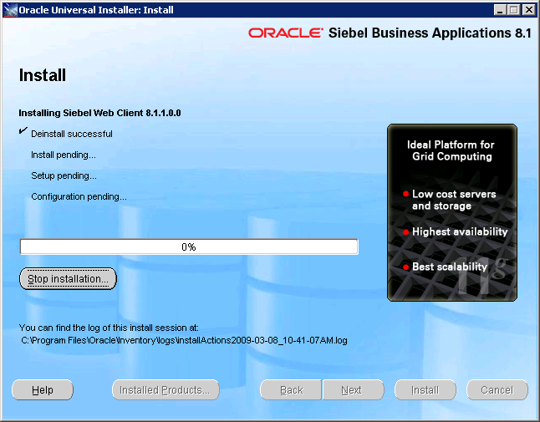
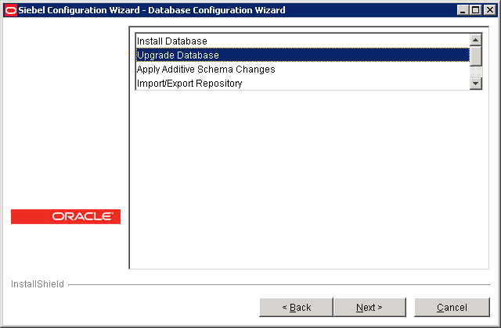
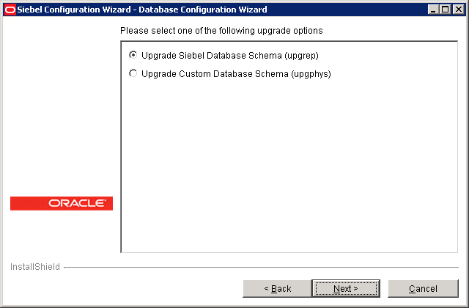
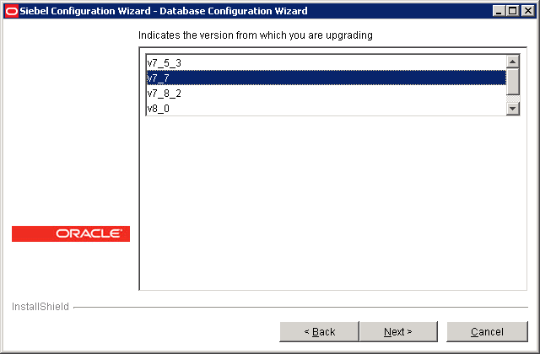
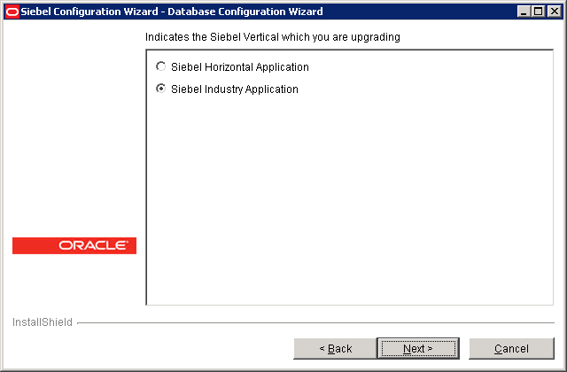
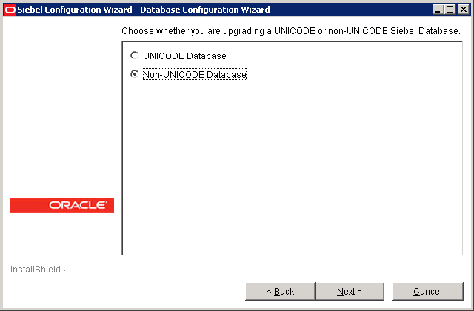
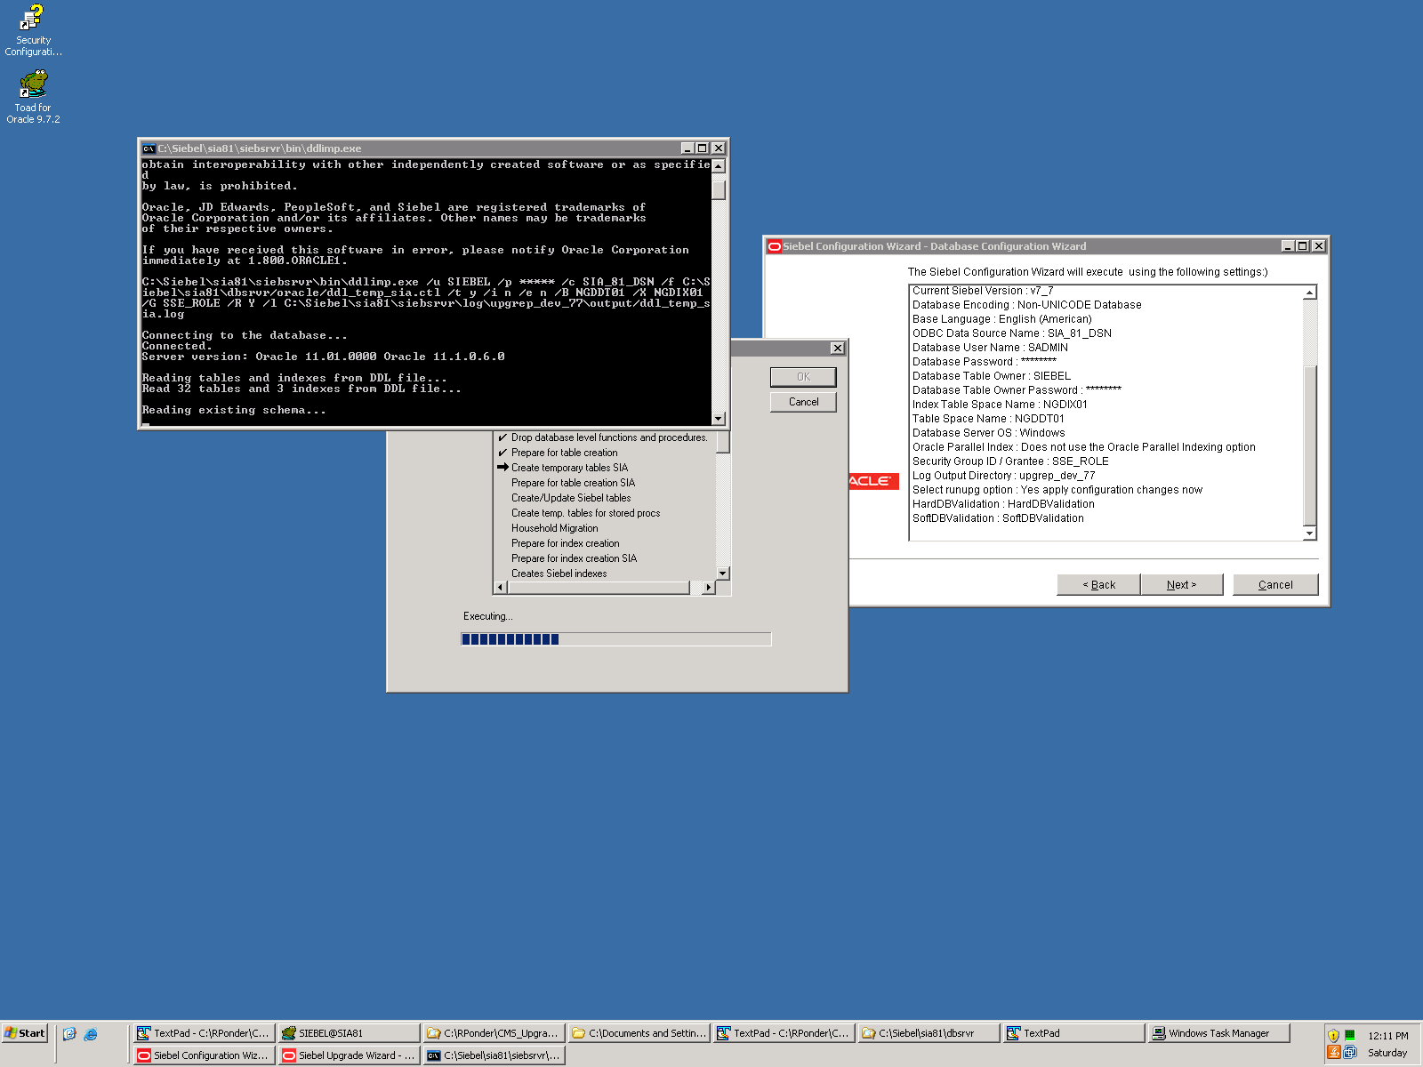
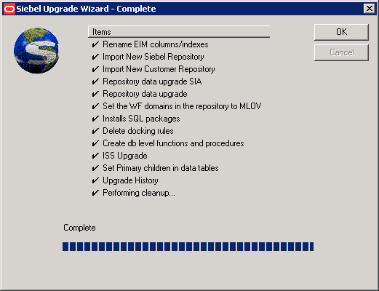
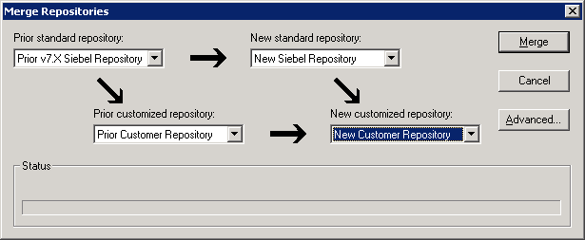
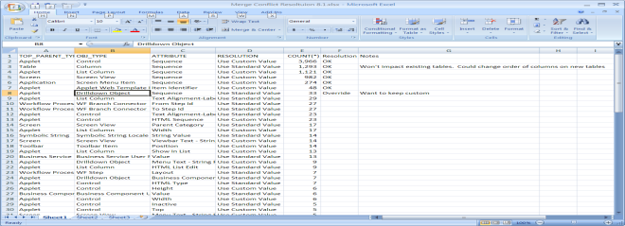
What A Siebel 8.1.1 Upgrade Looks Like

Slide 11
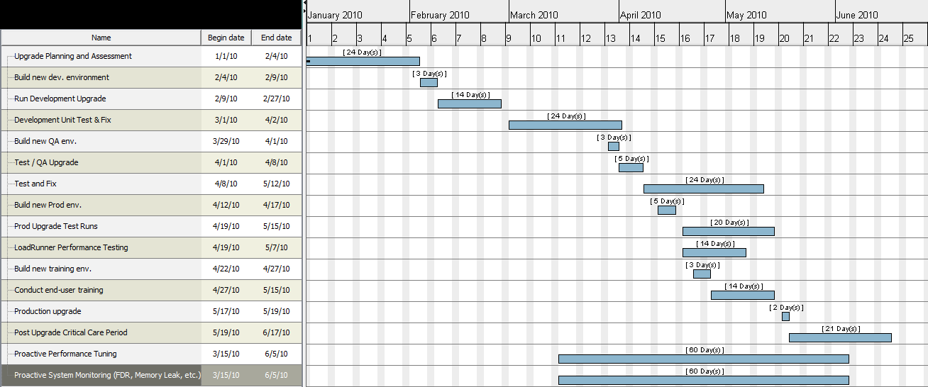
Typical Upgrade Project Slide

Slide 12
New Siebel Features
If On 7.5 Then We Need To Know 7.7, 7.8, 8.0, 8.1.
All Relevant Features And Not Just The Headlines.
Oracle TAM XLS Does A Great Job But Is Not 100% Complete.
Proper Upgrade Assessment Covers Features Applicable And Also Demonstrates Features.

Slide 13
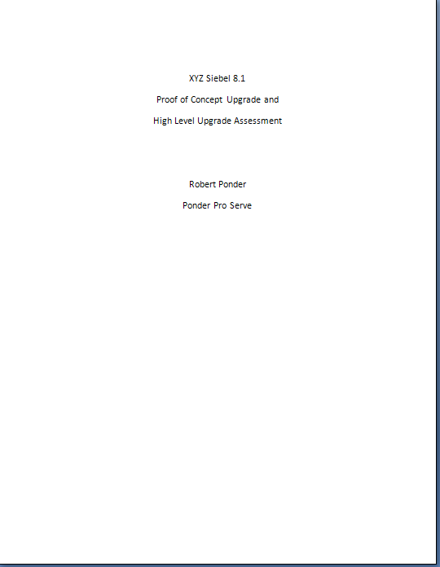
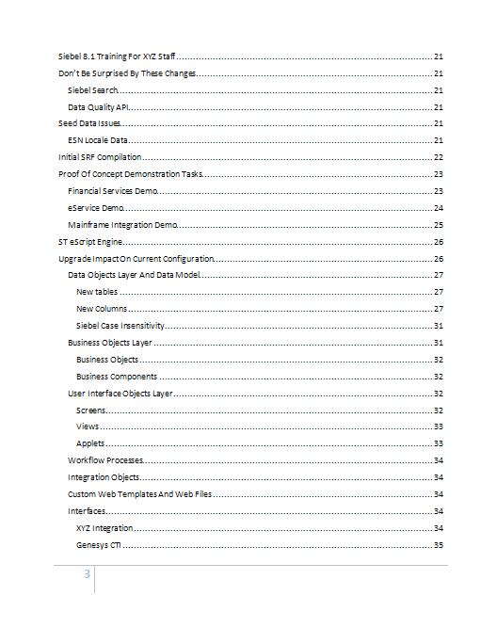
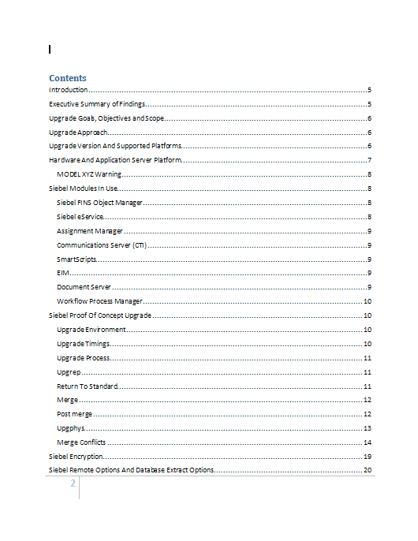
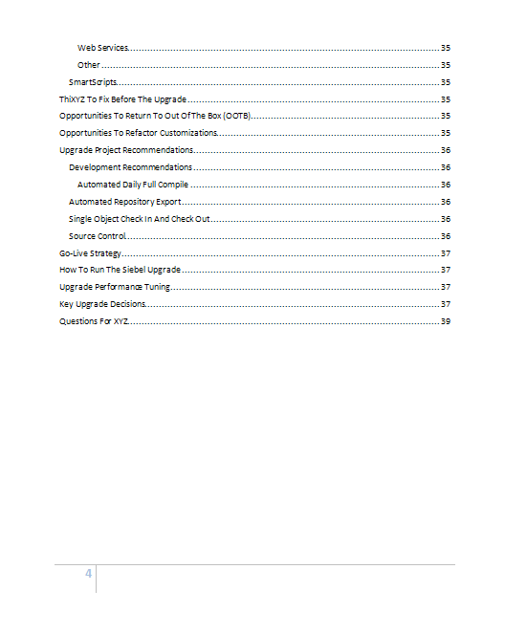
What Does A Proper Upgrade Assessment Look Like?
Items To Address Before Upgrade
Important Siebel Changes
Summary, Goals, Upgrade Approach
Opportunities To Return To OOTB
ST eScript Engine
Supported Platforms
Go-Live Strategy
Siebel Modules In Use
What Upgrade Will Do To Current Configuration From Every Aspect
Proof Of Concept Upgrade Findings

Slide 14
Assessment Table of Content
Need To Agree What Items Should Be Included As Part Of This Assessment.
Normally We Include:
Upgrade Approach
Upgrade Changes At Database, BO, And UI Levels
Scripting
Workflow Processes
Interfaces (Batch, Real-time And Desktop)
CTI
Specific Models Such As Loyalty
Opportunities To Return To OOTB Or Redo Customizations
Reporting And BI Publisher
New Siebel Features
Proposed Server Architecture
Training Recommendations
Go-live Strategy
Supported Platforms And Other Upgrades Requires (OS, DBMS)
Oracle Database Upgrade
POC Upgrade Results
High Level Project Plan
Global Deployment Issues
Performance Tuning Strategy
Upgrade Tuning Assessment

Slide 15
Siebel Application Performance
If Coming To 8.1 From 7.5/7.0 Then Expect Much Better Performance.
Plan To Spend A Significant Amount Of Time Tuning If You Want Stellar Performance.
Oracle 10g/11g CBO Performance Tuning.
Comprehensive Siebel Performance Starts Early And Runs The Duration Of The Upgrade.

Slide 16
eScript ST Engine
New Improved Engine We Recommend You Use And So Does Oracle.
Better Performance And Features.
If You Have Significant Code There Will Be Effort To Switch.
Start Fixing Code Now If On 7.7 Or Above.
var MyInt 100; // What is this?

Slide 17
eScript Overhaul
eScript Remove / Replacement.
Uniform Indentation.
Objects Not Destroyed / Objects Destroyed In The Wrong Order.
Add Missing Try / Catch / Finally.
Refractor Existing Code – 16K Limit.

Slide 18
Best Practices
Small Team Size.
Upgrade A Copy Of Production – Leave Old Prod Up And Running As Your Fallback Plan.
Practice Makes Perfect.
QA Practice Runs Too.
Never Do Anything The First Time On Go Live Weekend.
Automate Everything Possible.
Upgrade Assessment And POC Upgrade.
Get Experienced Siebel Upgrade Help.

Slide 19
Best Practices - Continued
Find Memory Leaks Early.
Find Crashes Early.
Know Which Siebel Bugs Will Effect You.
Take Great Care Applying QF/FP. Full Regression Test Required.
Don’t Underestimate ST eScript Level Of Effort.
Avoid Surprises – Know What Is Going To Happen.
Buy The Right Hardware.

Slide 20
Best Practices – Continued II
Follow Upgrade Guide Very Carefully.
Create Detailed Upgrade Instructions.
Include QA Details For Each Upgrade Step.

Slide 21
Don’t Make These Mistakes
Installing The Wrong Version.
Buying The Wrong Hardware.
Hiring Inexperienced Help.
Hiring Way Too Many Consultants To Help You.
Estimating Too Little Or Too Much Time.
Waiting Too Late To Load Test.
Doing The Actual Upgrade Different In Any Way From Your Practice Runs.

Slide 22
Going Live
Bring Your “A” Team.
Know How To Debug Crashes Or Have Someone That Does Onsite.
Know How To Fix Performance Issues ASAP Or Have Someone That Does Onsite.
Establish Hyper Care Team For Several Weeks.

Slide 23
Upgrade Tuning
Database Parameters And Settings.
Network Issues.
Oracle Parallel Index Creation.
Siebel Upgrade Tuner.
Tuning The Siebel Upgrade Scripts.
Only 10% Of Customers Need To Worry.

Slide 24
Undocumented Tips
Pre And Post Upgrade SQL File.
Automate Everything Starting In Dev.
Two-Step Upgrade.
New Database Extract Parameters.
Merge Conflicts.
Automated Daily Compile.

Slide 25
Dealing With Product Issues
On Upgrades We May Encounter Product Defects.
How Long Does It Really Take To Get A QF?
Finding Workarounds For Defects.
Even If Not A Defect, Opening And Working A SR Takes Time.
Have To Test Every QF/FP With Full Regression Test.

Slide 26
Did You Know
7.0 To 8.1 Requires Two Steps.
DeDup Changes In 8.x – Not eScript Based.
DDLIMP Bug/Feature With IndexSpace.
Actuate Reports Replaced By BIP.
SIA Only Version After 8.2.
Consultant Doing Your Upgrade May Have Never Done One Before!
Most Siebel Upgrades Run Into Issues They Should Have Known About.

Slide 27
Questions & Answers
rponder@ponderproserve.com
770.490.2767
www.ponderproserve.com

Slide 28
Contact Info
Robert Ponder
Ponder Pro Serve, Inc.
rponder @ ponderproserve.com
770.490.2767

Slide 29
Notes:
Bring up on stage two customers to tell the audience about their experiences.
Manpower Associates is a $14.9B global company with 27,000 employees in the temporary staffing business. Manpower runs a combined PeopleSoft Enterprise and JD Edwards EnterpriseOne shop. These experts in human resources use Enterprise HCM for their own staffing and EnterpriseOne Payroll and Service Billing for handling the large volumes of US-based temporary staff. Manpower is very happy with Oracle’s support since purchasing PeopleSoft and is looking forward to a long relationship with Oracle.
Spokesperson will be Jay Schaudies, Vice President, Global eCommerce.
Welch Foods is the food processing and marketing arm of National Grape Cooperative Association. Organized in 1945, National Grape is a grower-owned agricultural cooperative with 1,461 members. The company, headquartered in Concord, Massachusetts, operates six plants located in Michigan, New York, Pennsylvania and Washington. The company was running a mix of legacy, home grown, and manual systems that failed to provide senior management with accurate and timely cost and production information. Welch’s required a centralized manufacturing and financial information system to improve management decision making. The solution had to be hot-pluggable with existing technologies, for example, Welch’s Plumtree portal.
Welch Foods chose Oracle over SAP for this business-critical application. The key to the customer’s business problem was their ability to manage costs. The company’s costs are driven by fruit solid content in each of their products, and they use a specialized technique called BRIX for measuring and calculating the cost of materials. Welch’s compared SAP and Oracle SAP’s software was too rigid and, therefore, unable to include the BRIX calculation in their manufacturing solution. Only Oracle’s OPM could bind this custom cost method into the Quality Management Process.
Technology customer yet to be determined. Current possibilities include eBay and FTD Florists.

Slide 31
Siebel Upgrade Process
 | Development | Test | Production
Upgrade Steps | Upgrep Merge Post Merge Utilities Generate EIM Processing Columns Upgphys | Prepare for Production Upgrep & Upgphys | Upgrep & Upgphys
What You Do | Upgrade, fix issues, unit test | Upgrade, QA and Acceptance test Optionally tune upgrade | Practice upgrade, upgrade and go live
Upgrade Infrastructure
Pre-Upgrade Tasks
Upgrade Data and Schema
Repository Merge
Post Upgrade Tasks

Slide 32
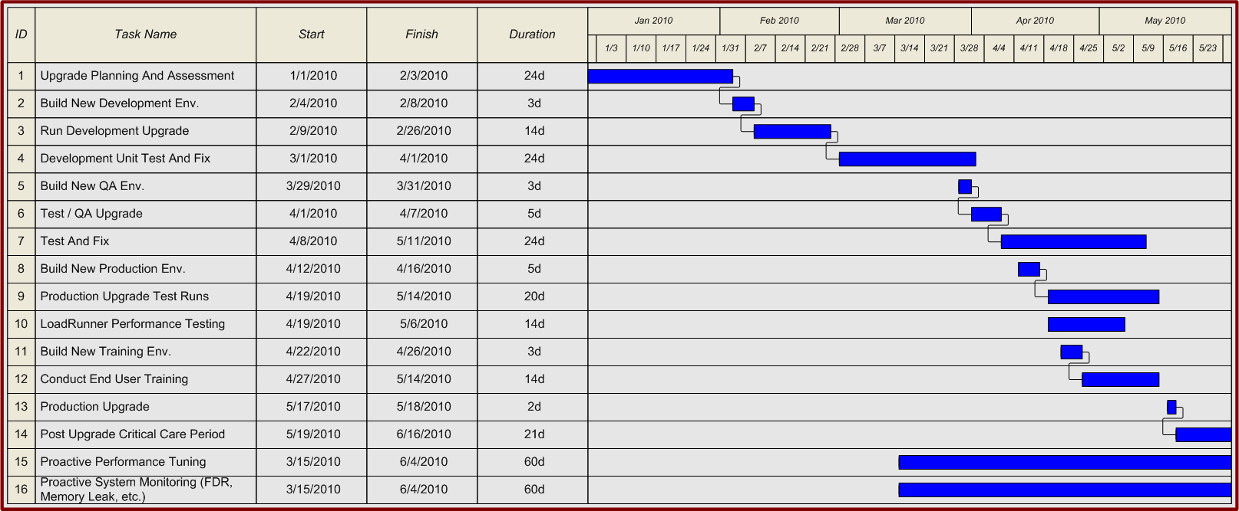
Typical Upgrade Project

Slide 33
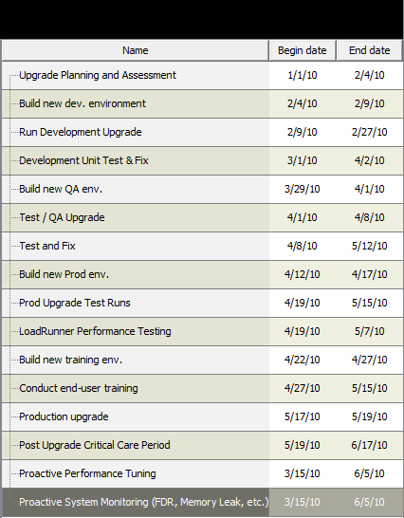
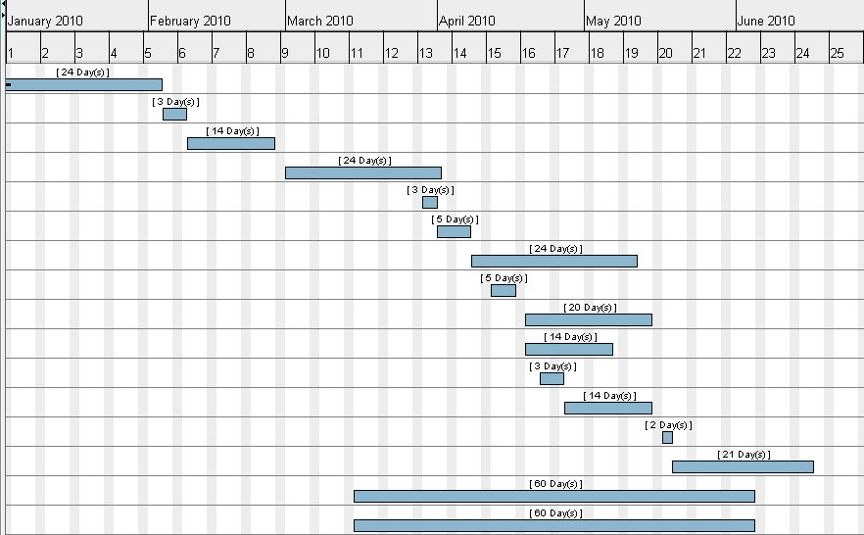
Typical Upgrade Project v2

