Slide 1


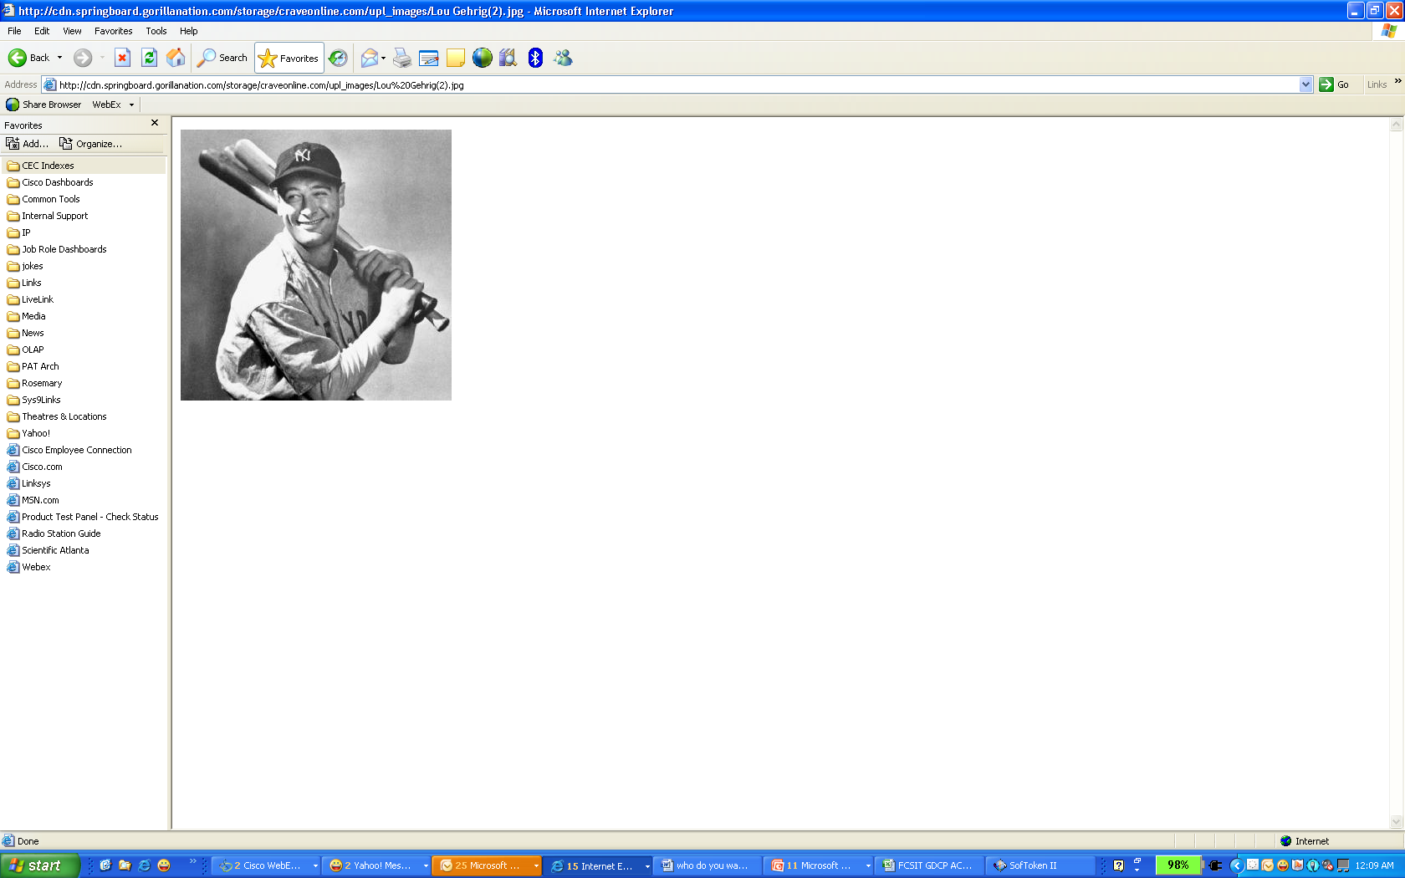
Who’s on First, a RACI on Talent and Team necessary to bring in an EPM Homerun
Micaela Hoskins
Jan 19, 2010

Slide 2
Disclaimer
The ideas identified in this document were accumulated from discussions with more than a dozen individuals working in the Hyperion space. Between these individuals there are over 200 years of experience and over 300 projects at 100 companies. Basically
No two implementations are the same.
The presentation reflects my ideas, but I’d like to open dialog with the group here today.

Slide 3



Agenda
Cisco History and experience with Hyperion
Who do you want on the team?
Hyperion Center of Excellence
Collaboration and Teamwork
Notes:
This presentation consists of four chapters:
The first two chapters gives a overview about the business climate in the Nordics and the challenges that the Nordics Companies are facing in this global economy.
The Third Chapter will describe how the networked collaboration technologies can help create a borderless organization thus, provide superior customer experience and boost productivity
The forth Chapter will descibe why it is important for the Nordics organization to continue to innovate and to invest in the new emerging technologies.

Slide 4
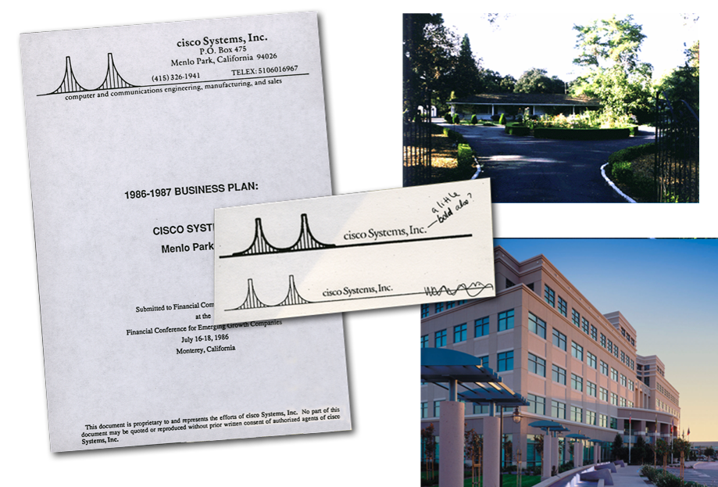


1984
Computer scientists,
Len Bosack and Sandy Lerner found Cisco Systems
Bosack and Lerner run network cables between two different buildings on the
Stanford University campus
A technology has to be invented to deal with disparate local area protocols;
the multi-protocol router is born
Notes:
At Cisco, customers come first. An integral part of our DNA is creating long-lasting partnerships with our customers, working with them to identify their needs and provide solutions that support success.
The concept of creating solutions to address needs has been with Cisco since it’s inception. Husband and wife, Len Bosack and Sandy Lerner, both working for Stanford University, wanted to email each other from their offices, located in different buildings.
A technology had to be invented to deal with disparate local area protocols; and as a result of solving their challenge of not being able to email each other - the multi-protocol router was born.

Slide 5

FY
1985
1986
1984
1985
1986
1984
1985
1986
1987
1987
1988
1987
1988
1989
1990
1991
1992
1993
1993
1994
1995
1996
1997
1998
1999
2000
2001
2002
2003
2004
2005
2006
2007
Revenue
$27M
2
Headcount
2
2
4
4
9
4
9
29
111
First system ships—
Massbus-Ethernet
Interface Subsystem
AGS
multi-protocol
router
Innovation
Innovation
Facts
Facts
Hires
first employee
Notes:
Since then, Cisco has shaped the future of the Internet by creating unprecedented value and opportunity for our customers, employees, investors and ecosystem partners…
In just over 2 decades Cisco has grown from 2 employees to over 63,000

Slide 6



FY
1991
1992
1990
1991
1992
1984
1985
1986
1987
1988
1989
1990
1993
1993
1994
1995
1996
1997
1998
1999
2000
2001
2002
2003
2004
2005
2006
2005
2006
2007
$183M
Revenue
$69M
$183M
$381M
$381M
$714M
503
Headcount
251
503
875
875
1459
Cisco 3000
low-end router platform
CiscoWorks
Router-Management Software
Communication Server Family
First patent
4000 Series
Innovation
Innovation
$
$
Facts
$1B
Facts
$
First international office: UK
First stock split
Market capitalization
of $1 billion
Canada and Japan
offices open
Notes:
Our internal innovation has earned thousands of patents…

Slide 7





FY
1993
1992
1992
1991
1994
1984
1985
1986
1987
1988
1989
1990
1991
1992
1993
1993
1993
1994
1993
1994
1995
1996
1997
1998
1999
2000
2001
2002
2003
2004
2005
2006
2005
2006
2007
$381M
Revenue
$183M
$381M
$714M
$714M
$1.33B
1,459
Headcount
503
875
875
1459
2269
Cisco 3000
low-end router platform
CiscoWorks
Router-Management Software
7000 Router Platform
Shipping Milestone:
100,000 routers
First patent
4000 Series
100K
Innovation
Innovation
Acquisitions
Facts
Canada and Japan
offices open
Facts
Belgium, Mexico, Hong Kong
offices open
Certified Internetwork Expert (CCIE) program

Slide 8


FY
1993
1994
1992
1993
1994
1984
1985
1986
1987
1988
1989
1990
1991
1992
1993
1995
1993
1994
1993
1994
1995
1996
1997
1998
1999
2000
2001
2002
2003
2004
2005
2006
2005
2006
2007
$1.33B
Revenue
$381M
$714M
$714M
$1.33B
$2.23B
1,459
Headcount
875
1459
2,269
2269
3827
First ATM Router Interface / ATM Switch ships
7000 Router Platform
Shipping Milestone:
100,000 routers
Patent
Catalyst Switch
100K
Innovation
Innovation
Acquisitions
Facts
Facts
Belgium, Mexico, Hong Kong
offices open
Certified Internetwork Expert (CCIE) program
San Jose, CA
corporate headquarters
Brasil office opens
Notes:
And our acquisition strategy has enabled us to enter new markets and accelerate customer success.

Slide 9




FY
2003
2004
2002
2003
2004
1984
1985
1986
1987
1988
1989
1990
1991
1992
1993
1994
1995
1996
1997
1998
1999
2000
2001
2002
2003
2004
2003
2005
2004
2005
2006
2007
2008
2009
2010
2011
2012
2013
2014
2015
$18.9B
Revenue
$18.9B
$18.9B
$22B
$22B
$24.8B
34,466
Headcount
35670
34466
34,371
34371
38413
Wireless IP Phone 7920
Shipping Milestone:
2M IP phones
Carrier Routing System (CRS-1)—
Significant routing innovation
Cisco Enters
Commercial Market
Shipping Milestone:
4M IP phones
Innovation
Innovation
Acquisitions
Acquisitions
Facts
Presidential Award for Corporate Leadership
20 years of innovation—
employees volunteer
‘20 years’ of community service
Reorganize to better serve emerging market countries
Notes:
Our commitment to customer success and world-class service and support offerings are acknowledged throughout the world…

Slide 10
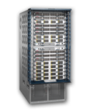
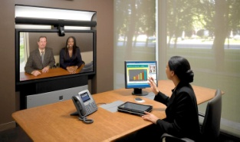
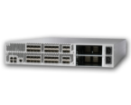


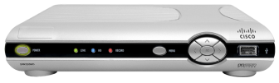






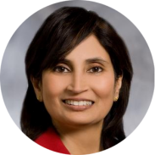

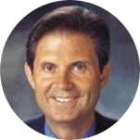
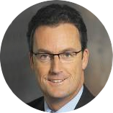

2009
FY
2008
2009
2007
2008
2009
1984
1985
1986
1987
1988
1989
1990
1991
1992
1993
1994
1995
1996
1997
1998
1999
2000
2001
2002
2003
2004
2005
2006
2007
2006
2007
2008
2010
2009
2010
2011
2012
2013
2014
2015
$36.1B
Revenue
$34.9B
$39.5B
$39.5B
$36.1B
67,647
Headcount
63050
67647
65,545
65545
Nexus
Platform
Comprehensive Collaboration:
UC, Video, Web 2.0
Enterprise-class 802.11n
Wireless LAN System
EOS: Cisco enters
media & entertainment
market
Unified
Computing
System
Telepresence
Public Suites
Shipping Milestone:
49M Digital Set-tops
UNIFIED
COMMUNICATIONS
VIDEO
Innovation
Innovation
WEB 2.0
Acquisitions
Acquisitions
Facts
$
Facts
Technology
leadership team
of 7 formed
Padmasree Warrior
named CTO
Cisco to invest up
to $16B in China
over 5 years
CSCO
Virtual Strategic
Leadership Offsite
Long-standing EVP Rick Justice Retires.
Rob Lloyd named successor
Notes:
10

Slide 11




























































































Acquisition Summary
1993
1997
1999(cont)
2005(cont)
2007
2009
1999
1994
2000(cont)
2001
2004
1998
1995
2002
2006
1996
2000
2003
2008
2005
1999

Slide 12
Market Share for Product Groups
Security
Security
Digital Video: IPTV
Switching: Modular/Fixed
100%
100%
100%
100%
Cisco/SA
80%
Cisco/SA
65%
80%
80%
80%
70%
60%
35%
60%
Cisco
60%
60%
40%
40%
40%
40%
20%
20%
20%
20%
0%
0%
0%
0%
Voice
Wireless: LAN
Storage: Area Networks
100%
100%
100%
80%
80%
Cisco
54%
80%
60%
28%
60%
60%
40%
Cisco
40%
40%
24%
Cisco
20%
20%
20%
0%
0%
0%
Routing: Edge/Core/Access
Networked Home
Web Conferencing
100%
100%
100%
80%
Cisco
80%
Linksys
80%
50%
57%
45%
60%
60%
60%
40%
40%
40%
Cisco/WebEx
20%
20%
20%
0%
0%
0%
Notes:
Market share and increasing market share is one of the most important objectives used in business as it represents customer demand from a company for a particular product. (Based on the total market size/opportunity).
Cisco is uniquely positioned in varous market share product segments – and quickly becomes a leader in product areas – including new markets and existing markets that Cisco enters.
This ability is a testiment to our strategy and mindful approach to growing our business and our proven track record of stellar execution and teamwork in accomplishing goals.
Market Share data is based on Calendar Quarters as provided by market anlaysts. Data above reflects Q2CY09 ( 2009)
Starting Timelines for each graph vary
Security Q4CY04
Digital Video Q3CY05
Switching Q1CY06
Voice Q1CY04
Wireless Lan Q2CY03
Storage Q4CY02
Routing Q2CY03
NW Home Q1CY05
Web Conf 2003

Slide 13
Geographical Balance
55%
4%
10%
11%
20%
(10%) Y/Y
2%Y/Y
(30%) Y/Y
(6%) Y/Y
(15%) Y/Y
U.S. and
Canada
Japan
Emerging
Markets
Asia
Pacific
Europe
Q1 FY10 Fiscal
Revenue by Geography
Notes:
Cisco also has a strong reputation for financial stability as demonstrated by our earnings results. A firm financial foundation is extremely important to remain a long-term industry leader and ensure long-term customer partnerships.
Cisco's solid financial foundation and balanced product portfolio and geographical breadth – means we can continue to invest in the future and weather industry downturns that may occur.
NOTE –
For additional information on Cisco Finance and/or quarterly earnings go to:
http://wwwin.cisco.com/FinAdm/

Slide 14
Hyperion & Oracle Applications
19
2
2
36
1
In Development In Production
0
2
3
10
3
Essbase
HSF
Planning
OBIEE
HFM
Most dimensions 19
Most users 2500
Notes:
Cisco has been an essbase shop for a long time. OBIEE is used in marketing and finance. Numbers in production and in development reflect numbers for Cisco and its subsidiaries.
GL’s mostly Oracle E business suite

Slide 15



Who do you want on your team?
The right people with the right amount of time and commitment
Notes:
Key message: Businesses, globally and in the Nordics countries, are faced with tremendous opportunities and challenges:

Slide 16
Team Members and Time Commitment
Executive Sponsor
Project Manager
Hyperion Experts
Finance Subject Matter Experts
IT & Business Analysts
Database Administrator
100
90
80
70
60
I% of Time
50
40
30
200
10
0
SME”s
Hyperion Experts
Analysts
Executive Sponsor
Project Manager
Presentation_ID
© 2009 Cisco Systems, Inc. All rights reserved.
Cisco Confidential
16
Notes:
Key message: Consumers in the Nordic Region have made ICT a way of life through the integration of technology into their daily lives.

Slide 17
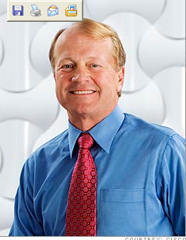
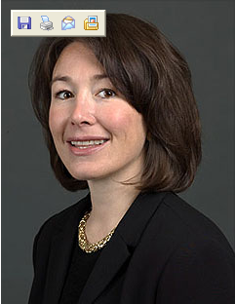
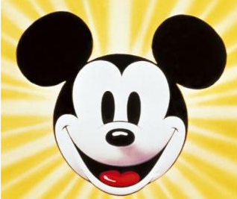
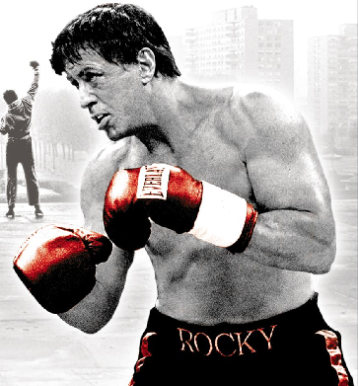
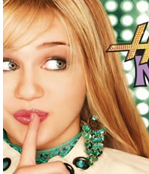
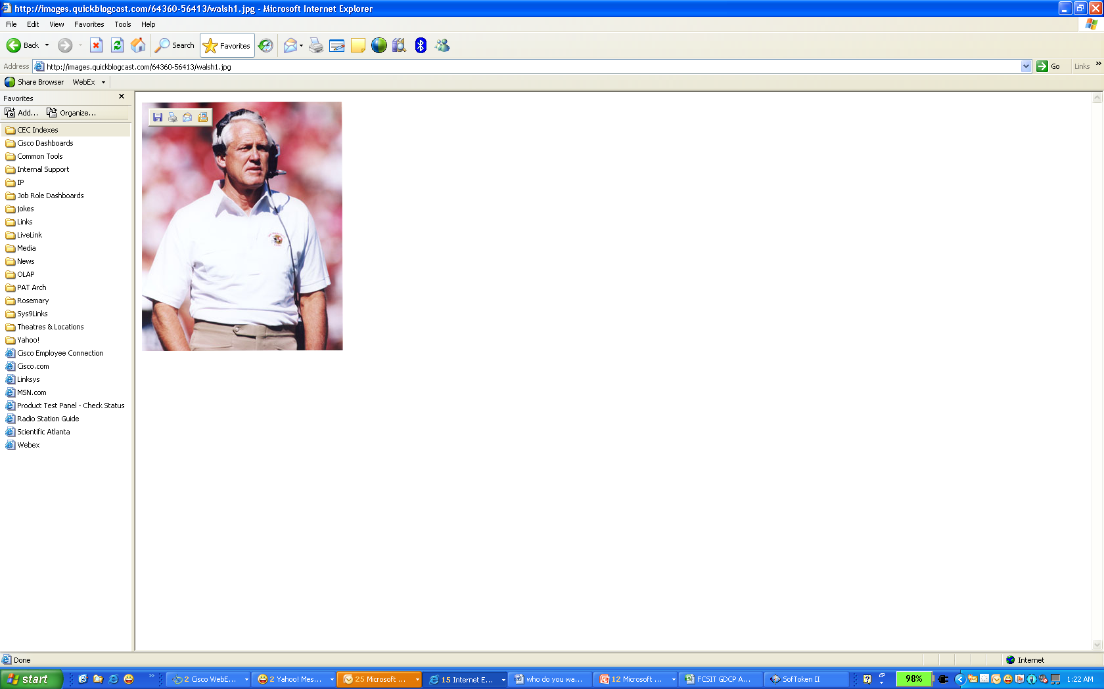
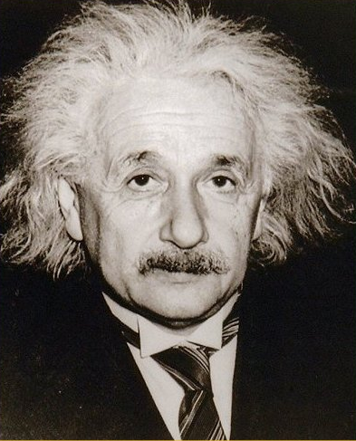
Executive Sponsor

Slide 18
Executive Sponsor
As high as you possibly can go, but still have someone who is committed, available and visionary.
CFO or someone on his/her staff ideal for corporate wide finance applications.
If you have more than 1 sponsor, get clear responsibilities
Get meeting schedule committed upfront.
Could use as little as 5% of executives time.

Slide 19
Project Manager

Slide 20
Project Manager
Previous Project Management Experience (must).
Previous Experience with Hyperion (really good).
PLC, DMAIC, Six Sigma (must).
Team Player, Listen, Bright, Creative, politically savy, solicit participation, fight when necessary and most important willing to have fun
Fully Committed to project

Slide 21
Hyperion Expert

Slide 22
Hyperion Expert
Heavy Hitter, great batting average in the Hyperion Space. A number of successful implementations under the belt.
Previous experience with organizations of a similar size and Industry.
Certification with recent versions of Hyperion Products.
Bright, Persistent, Straight Forward, Good Communicator, Natural Mentor, Good Multitasking and most important willing to have Fun
Fully committed to project

Slide 23
Core Team

Slide 24
Core Team
Typically dedicated or highly committed to project.
Both IT and Business should be represented.
Small as possible. Clear responsibility.
Present throughout the project
Local or able to attend design sessions, web conferences
Prefer team members who have played with the product
Team members must know the business requirements
Project Manager(s), Analyst(s), Developer(s)
Fully committed to project

Slide 25
Extended Team

Slide 26
Extended Team
Primarily part time resources. Know the availability.
Both IT and Business.
Typically subject matter experts and targeted early adopters.
Representative group from various countries, teams, subsidiaries.
Key role in requirements, testing, rollout and adoption
Consider Executives, Accountants, Controllers, Finance Managers & Directors, GL system and Warehouse Administrators, Internal Auditors
5 to 25% commitment is common, plan for highest involvement during testing

Slide 27
Responsibility Matrix RACI
Responsible Those who do the work to achieve the task. There is typically one role with a participation type of Responsible, although others can be delegated to assist in the work required.
Accountable (also Approver or final Approving authority) Those who are ultimately accountable for the correct and thorough completion of the deliverable or task, and the one to whom Responsible is accountable. In other words, an Accountable must sign off (Approve) on work that Responsible provides. There must be only one Accountable specified for each task or deliverable.
Consulted Those whose opinions are sought; and with whom there is two-way communication.
Informed Those who are kept up-to-date on progress, often only on completion of the task or deliverable; and with whom there is just one-way communication.
List All Tasks, for large teams make sure you include the consulted and informed so individuals can plan their time

Slide 28
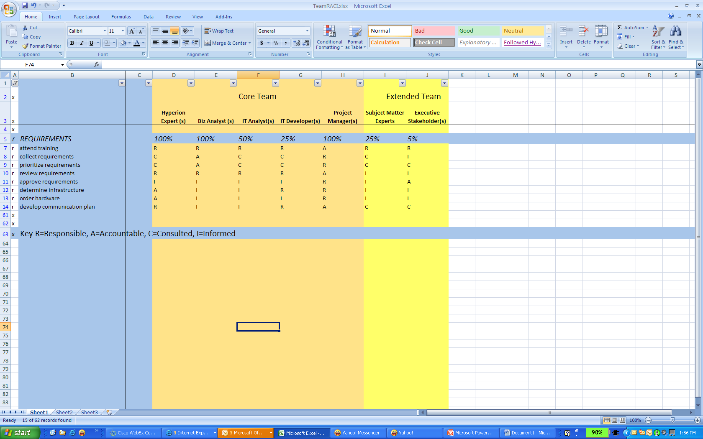
Sample RACI – Requirements Phase

Slide 29
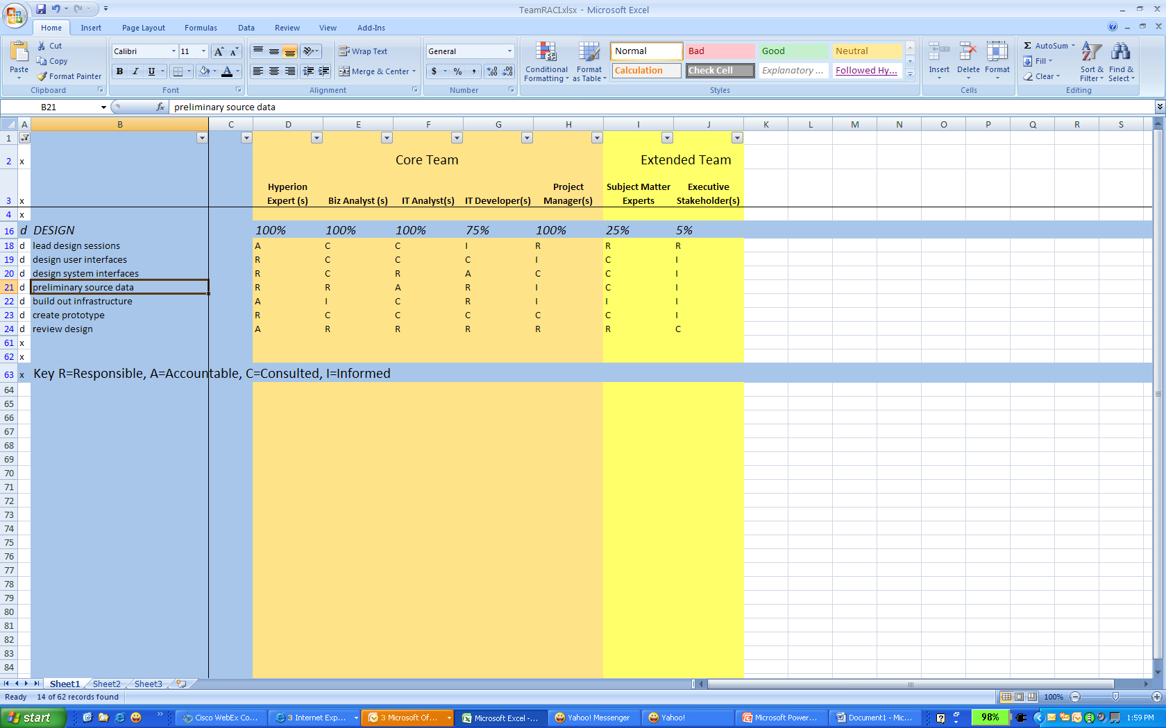
Sample RACI – Design Phase

Slide 30
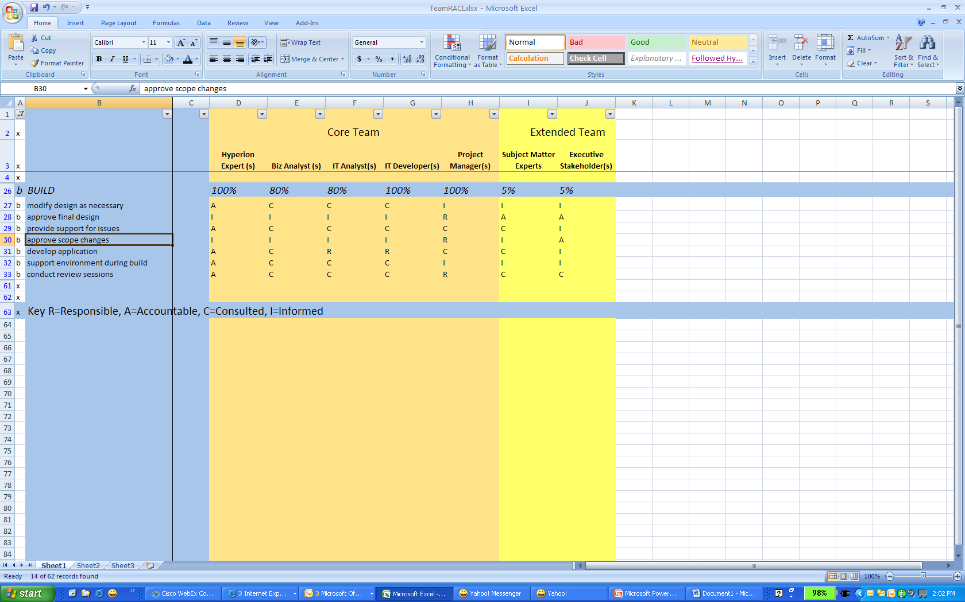
Sample RACI – Build Phase

Slide 31
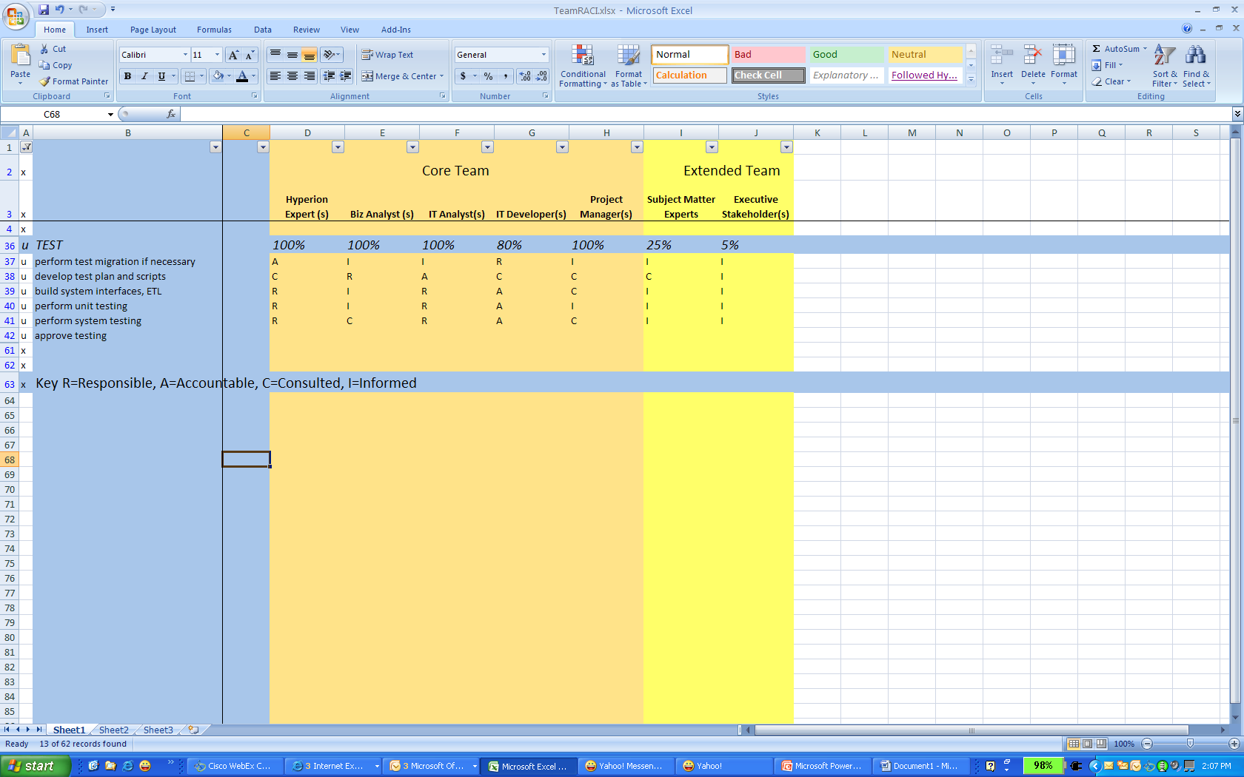
Sample RACI – Test Phase

Slide 32
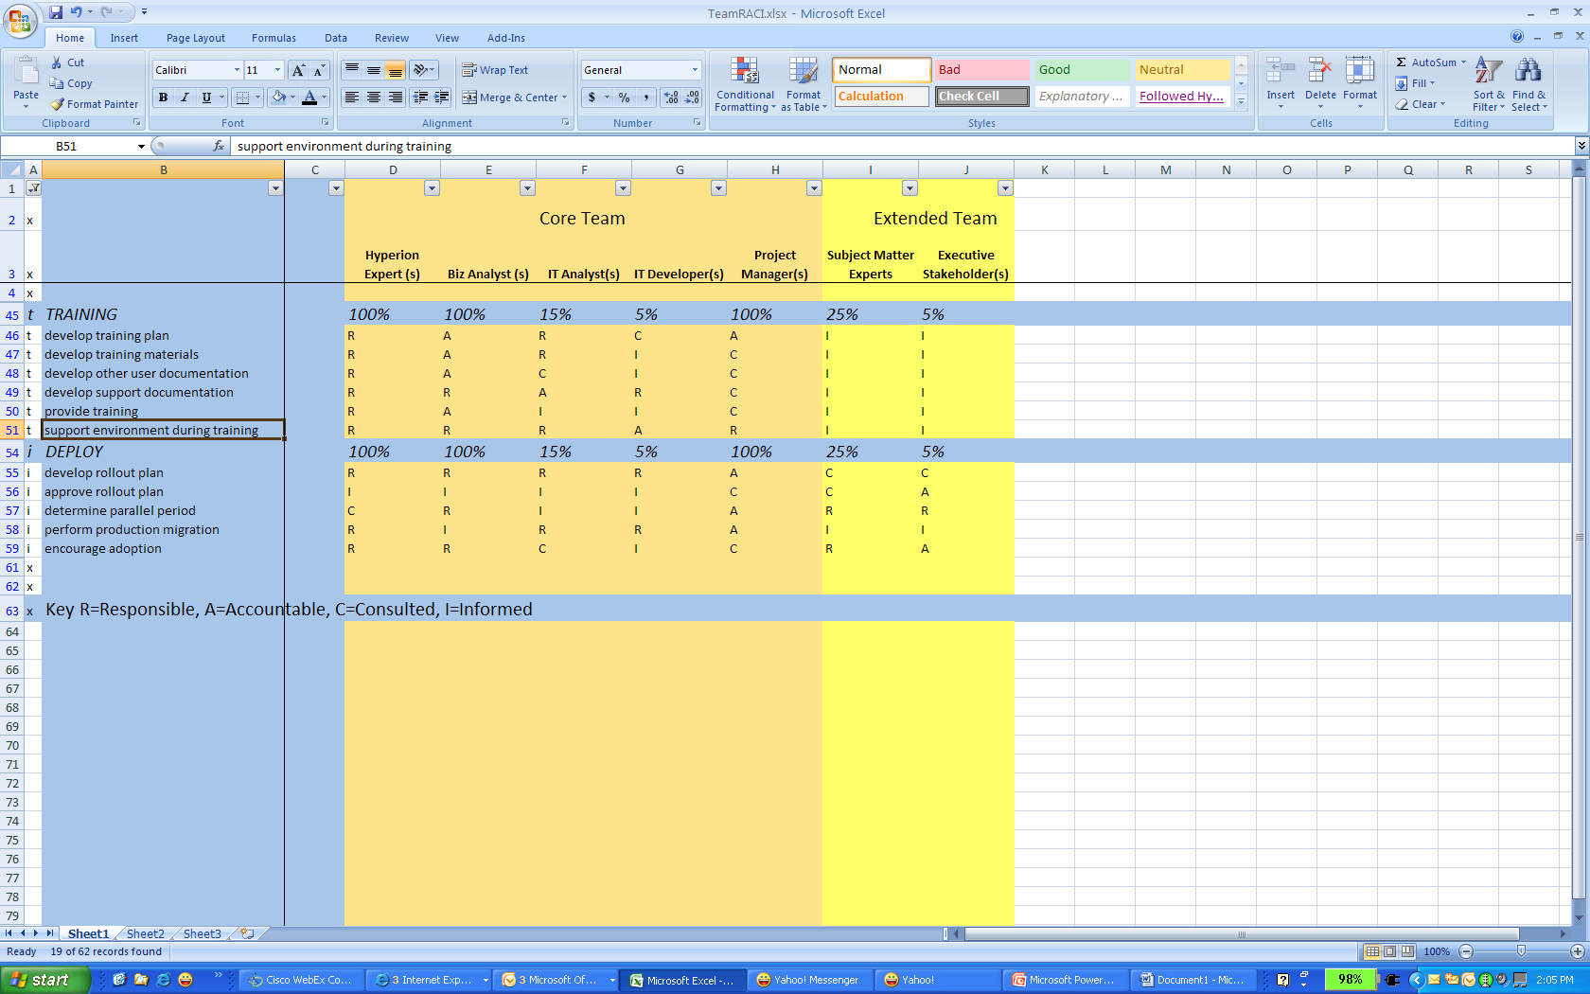
Sample RACI – Train Users & Deploy

Slide 33

Hyperion Center of Excellence
Notes:
In this challenging economy, tomorrow’s winners are those who invest in today’s technologies to create short term savings while laying the foundation for long term business capabilities

Slide 34
Hyperion COE
What does it do?
Centralize and leverage expertise
Develop talent
Standardize methodologies
Govern hierarchies
Adopt best practices
Improve documentation

Slide 35
Hyperion COE
How to get it started
From the very first project
Think leverage, recycle, reduce, reuse
Document lessons learned
Adopt best practices
Continuous Process Improvement

Slide 36
Hyperion COE
Results
Happier Developers
Happier Users
Faster Ramp up for Projects
Lower Project Costs
Easier organization adoption
Happier Executive Sponsors

Slide 37

Collaboration & Teamwork

Slide 38








Essential Elements of Collaboration
Not So Long Ago…
Today…
Primarily single source Largely asynchronous |  | Multiple sources, multiple devices, multiple applications Non real-time and real time, interactive
Inside my organization |  | Dispersed teams, outside my organization
Static and pre-defined networks |  | Dynamic teams
You find information, people |  | Right time, right people, right resource
Inside the firewall, walled off |  | Inclusive, selective, fluid
Communities
Notes:
38
38
In Cisco’s view, these are the five fundamental elements of collaboration that must be considered for collaboration strategies going forward.
Let’s start with information. Not too long ago information was largely from a single source, either email or voicemail, and largely asynchronous. Now, information comes from many applications and through multiple tools. Look today at the number of information sources – blogs, wikis, RSS feeds, texting, social networks, team spaces, and increasingly video – as well as the number of devices, now including smart and mobile phones, as well as laptops and the desk phone – that we must manage. And due to some of these new sources like social networks, IM and texting, the expectation is that our response is much more real time and interactive.
Next is the people we work with. Before, our teams were largely inside the four wall of the enterprise. Increasingly with global value chains, we work with contractors, partners and suppliers outside the company. People networks are more self-forming and are extending beyond the firewall. As an example, take professional organizations that use Linked In or other social networking sites to create networks of colleagues that can support each other.
The next element is communities. Where once the teams that helped us with our job and processes were largely based on networks inside our company and were largely pre-defined. Now, we may find that the person with the expertise to help us is someone we have not met before within our organization, or even out side the company. At Cisco we have a great example of this within our sales organization. Our sales force is largely composed of generalist account managers. A much smaller number of technical specialists are available to help them answer more detailed customer questions. These specialists are not assigned 1 to 1, but rather are part of a community that can be called upon by any sales person. An internal application – Specialist Optimization – allows the AMs to search for the expertise they need and see contact information for the individuals. Presence and UC capabilities are integrated such they can instantly see who is available, how to reach them contact and begin collaborating with the specialist. In this way if an account manager on the east coast is up late and needs help on a question, he might see that a technical specialist is available in Australia that he can connect with immediately. This is a great example of how dynamic teams are formed within Cisco around our sales processes.
Next is context. Today, we are flooded with information – almost all of us can relate to how we are overwhelmed by our inboxes daily – and it is up to us to sort out what information is critical as well as who we need to work with. As an example within Cisco, if I need to work with the field marketing person [Note to Presenter: use a personal example drawn from your own experience within Cisco that you or the audience can relate to] responsible for collaboration in Asia, it might take me several days and many emails or phone calls to ascertain who the correct individual is. This is a common complaint we have heard from many customers – even Lew Platt, former CEO of HP said “If only HP knew, what it knew.” Moving forward, collaboration systems will be able to help us sort through this overload of information – delivering to us the information that we need at the right time, and assisting with finding the right people to work with.
Last, but not least, is security. The change required here has much to do with the global value chains that are a standard part of how so many of us do business. Traditionally, the security model has been to keep people outside the enterprise out. In our new world with partners, suppliers and even customers critical to key business processes, we need to have a much more selective and inclusive security and policy management. This is a real challenge – one that we are continuing to work on. It’s key for Cisco in many functional areas, but none more than our own Supply Chain organization. This organization has 6000 Cisco employees, but over 30,000 partners and suppliers who are considered essential members of the team. For many critical supply chain processes, they must collaborate daily with Cisco employees and information.
Transition: With these changes in the way we work, it’s clear that standalone text and document-centric systems alone are not enough to meet the business requirements and user expectations. Let’s talk about Cisco’s strategic direction for collaboration.

Slide 39

Collaborative Tools
Meetings
Working Sessions
Email
Documentation
Wiki’s, Blogs, Home pages, & Workspaces

Slide 40
Meetings
Depends on length of project
Primarily for status updates and assure people know where things can be found and what is going on
Not working sessions
Typically 30 to 60 minutes maximum
Core Team – weekly
Extended Team – monthly 30 to 60 min
Executive Sponsor – monthly (6 week or tied to milestones) –

Slide 41
Working Sessions
Only the appropriate people invited, but let the extended team and executive sponsors know about them
Good Candidates for Working Sessions
  Design sessions
  Training
  Issue Resolution
  Presentation Preparation
  Collaborative Development
Summarize and store minutes, accomplishments, decisions, action items

Slide 42
Email
Include appropriate team members
Selective about copies
Use links to documents stored in wiki’s, blogs, etc
Keep them short and on topic
Highlight actionable items or conclusions

Slide 43

Wiki’s, Blogs, & Workspaces
Great way to keep people informed
Place to document
  Minutes from meetings
  Resources
  Project Plan Status and Milestones
  Team members and contact information
  Issues and resolutions
  Presentations
Great way to keep people involved

Slide 44
Right People
Right Commitment
Right Communication
Right Timing
Successful Project
Good Luck

Slide 45


