Slide 1
2010 NorCal OAUG Training Day
One Touch EBS Close to HFM Consolidation
Integration of E-Business Suite and HFM Data and Metadata using EPMA Architecture
Dhananjay Pandit
Coherent, Inc.

Slide 2
Coherent Environment Overview
E-Business Suite Worldwide, Single-Instance, v11.5.10
12 Sites, 40 Entities, 7 Operating units, 30+ Inventory Orgs
9.3.1 HFM and 3 Planning Applications live with EPMA since October 2008
Upgraded to version 11.1.1.3 and live since November 2009
HFM and Planning Metadata integrated through EPMA (Accounts, Product, Employee, Entities ..)
Data Loads through EPMA interface table based data synchronization
1/14/2010
Notes:
2

Slide 3

  Coherent Hyperion Financial Reporting Environment

Slide 4
Hyperion EPM Architecture
Oracle EBS
Single Global Instance
v 11.5.10 CU2
7 SOB, 40 Entities
QV UI
BBB Reporting Datamarts
Mapping
Tables
EPMA
OM
BBB
Interface Tables
GL
Financials
Data Feed
DB Links
FA
Depreciation
Dimensional Model Meta Data
HR
Headcount
Task & Job Scheduler
Concurrent Process

Slide 5
Hyperion EPM Architecture
Data Feed
BBB/SPC
P/L
Clear & Reload Data
Data Synch
Calc
Planning Essbase
Forecast
Budget
B/S
Capex
Concurrent Process
WF
Data Synch
Calc
Consolidation
HFM
Consolidation
Review results
Submit
Eliminations
Top Side JE
Reporting

Slide 6

Month End Close Process

Slide 7
Period Close Process
Pre-Close (Friday)
  Metadata Sync Process (mostly new accounts)
  Enter Currency Rates, Open Period, Start Phase in HFM
  Update EBS GL Daily & Month-end rates (EBS process reads Rates entered in HFM)
Automated Close (Sunday)
  E-Business Suite Sub-ledger Close Automation Process
  Data Collection process to extend GL Data to include Product
  HFM Data Feed for All Entities
  Consolidated Data Available in HFM
Close Activities (Monday…)
  HFM Data Feed Runs Post Close Day 1,2,3,4 (Scheduled)
  Month-End data Available in HFM for Review
  GL Journal Entries and HFM Data Feed done by Site Controllers
  Report, review, and submit data in HFM
  Top Side Journals in HFM

Slide 8
HFM Data Flow Process (EBS Concurrent Process)
Check Phase
  Check Process Phase in HFM for Each Entity
Collect Data
  Collect P&L, B/S, HR, BBB Data
  Apply Entity, ICP, Account Mappings as applicable
Validate
  Validate Dimension members are present in EPMA
Insert
  Insert Data into EPMA Interface Tables via DB Link
Data Sync
  Run Data Sync Using EPMA Batch Client
HFM Calc
  Run HFM Calculation
  Run Consolidate Impacted

Slide 9
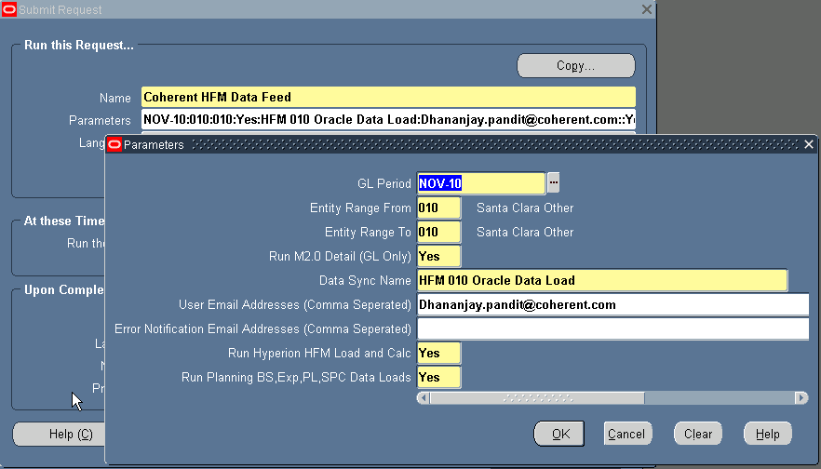
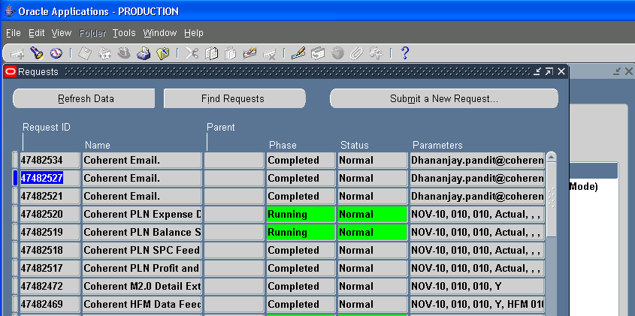
HFM Data Feed Concurrent Process submission Parameters (IT and Business)
Data Sync Name drop down (from EPMA via DB Link) is made available to run applicable data sync process.
HFM data feed also submits planning data feeds to keep data consistence across HFM and planning applications
1/14/2010
Notes:
9

Slide 10
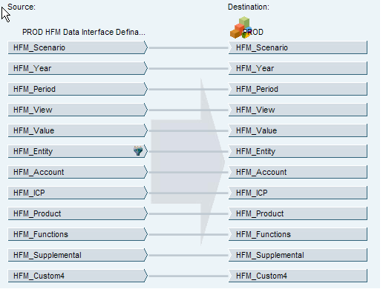
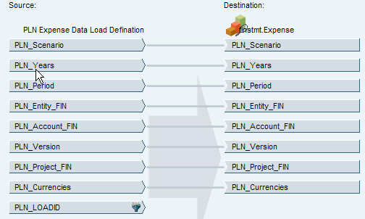
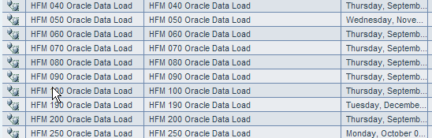
Data Synchronizations (Create one per Source and then copy)
1/14/2010
Notes:
10

Slide 11
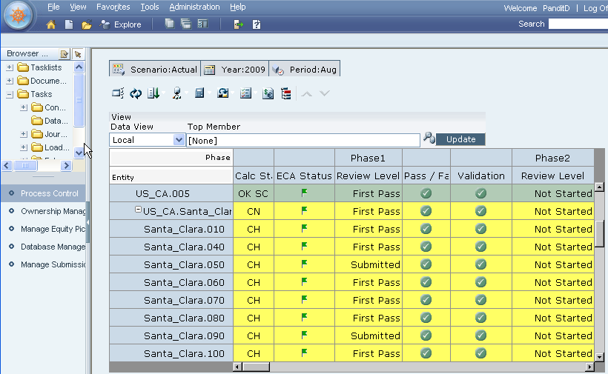
HFM Entity Phases
1/14/2010
Notes:
11

Slide 12
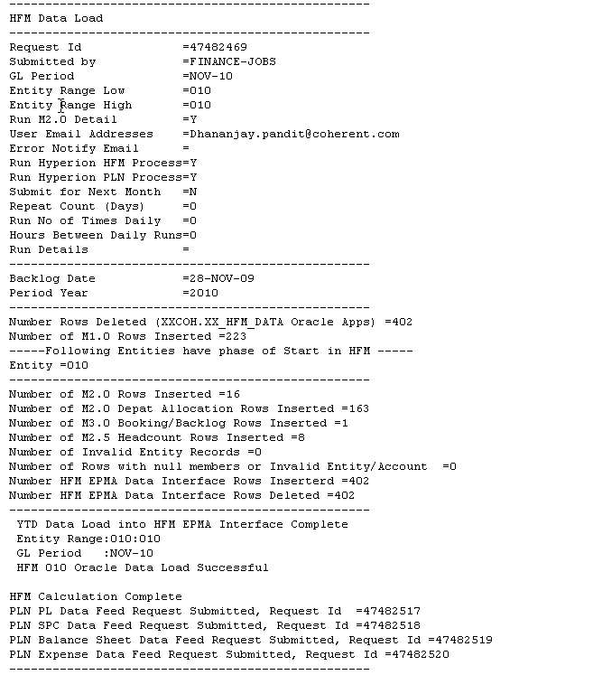
Review HFM Data Feed Concurrent output
1/14/2010
Notes:
12

Slide 13
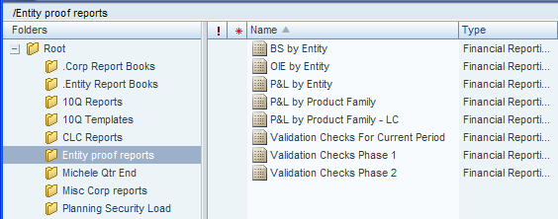
Entity Reports ( By Site/Entity Controllers)
1/14/2010
Notes:
13

Slide 14
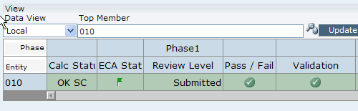

Submission of Entity (By Site/Entity Controllers)
1/14/2010
Notes:
14

Slide 15
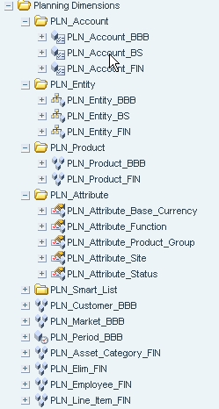
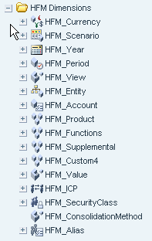

EPMA Metadata Dimension Model
HFM and Planning Dimensions
1/14/2010
Notes:
15

Slide 16
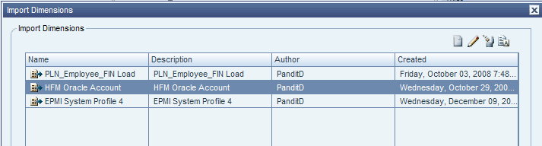
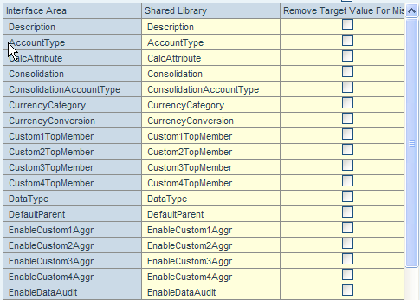
EPMA Import Profile
Import Profile based on Interface area defined
Interface Table column to Dimension property mapping
1/14/2010
Notes:
16

Slide 17
EPMA Meta Data Sync Process (EBS Concurrent Process)
Look for New Members
  Look for newly created dimension members
  Metadata properties from common mappings
Check Presence in EPMA
  Check if members are present in EPMA via DB Link
  Get next level parents for new members
Insert into EPAM interface
  Insert new members in EPMA dimension member interface table
  Insert hierarchy into EPMA dimension hierarchy interface table
Run Dimension Import
  Run dimension import manually or EPMA batch client import command submitted by EBS process
Deploy Application
  Review dimension changes in EPMA or Dimension change history report
  Deploy Application manually or batch client deploy command submitted by EBS process
1/14/2010
Notes:
17

Slide 18
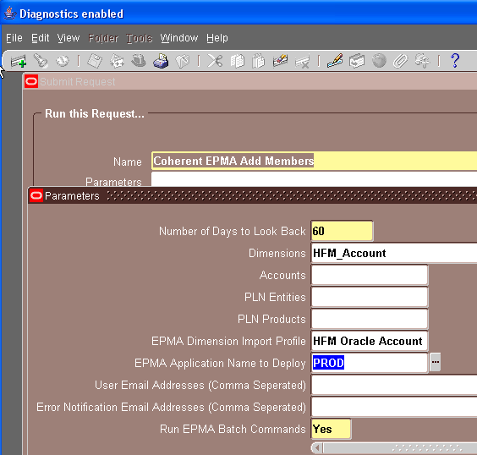
Meta Data Sync Concurrent Process submission Parameters
EPMA Dimension import profile drop down (from EPMA via DB Link), process will run this import profile using EPMA Batch Client
EPMA Application Name drop down (from EPMA via DB Links), process will re-deploy this application using EPMA Batch Client
1/14/2010
Notes:
18

Slide 19
Meta Data Sync Concurrent Process output
These three accounts are not present in EPMA are inserted as children of FG_Inv,
Add Dimension Members to EPMA Interface
Request Id =46462733
Submitted by =PANDITD
No of Days =60
Dimensions =HFM_Account
Email Addresses =
-----Inserting HFM Accounts into EPMA Interface--------
----------- ------------------
HFM Account HFM Parent Account
----------- ------------------
05482 Gross_Inv>FG_Inv
05483 Gross_Inv>FG_Inv
05484 Gross_Inv>FG_Inv
-----HFM Accounts insert into EPMA Interface Complete --------
Dimension Data into EPMA Interface Complete
“HFM Oracle Account” import Successful
EPMA Application “PROD” Deployment Complete
1/14/2010
Notes:
19

Slide 20
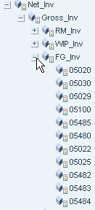
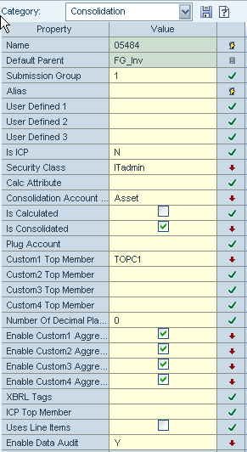
HFM Account dimension after sync from Oracle EBS
Some Metadata Properties are inherited and some are specifically set based on Common Metadata Mappings
Three accounts added to FG_inv based on new accounts in EBS and Common Metadata Mapping
1/14/2010
Notes:
20

Slide 21
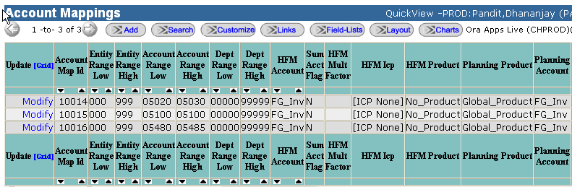
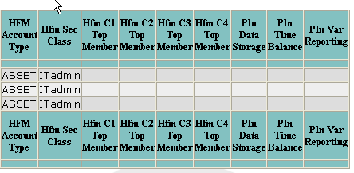
HFM Data/Metadata Mapping Example
Some Member Properties derived using mapping tables
Most other properties derived using inheritance/defaults
1/14/2010
Notes:
21

Slide 22
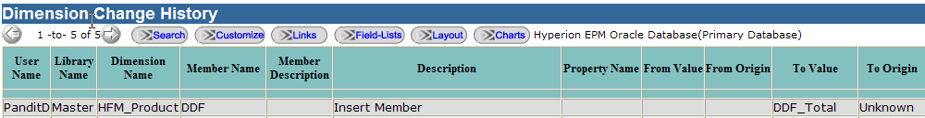

Dimension Change History
EPMA has limited reporting capability for reviewing changes
Wrote Query to review dimension changes for Audit Reporting
If changes have wider scope then review changes prior to Deploy
1/14/2010
Notes:
22

Slide 23
Drill down from HFM :11.1.3 Drill Down Capability
HFM Provides drill capability to ERPI/FDM if used for Data feed, which is limited to elements of data available in either elements.
HFM/Planning Drill capability can be extended to web based reporting tool by populating ERPI/Essbase drill information and placing simple JSP page to handle parameters, redirection to reporting tool pages.
Drill down is based on type of account and view (YTD/QTD),
Balance Sheet → GL Balance Summary
Profit & Loss → Profit and Loss Detail Trans
Head Count → HR Employee List
Backlog/Booking → Backlog Booking Detail Trans
1/14/2010
Notes:
23

Slide 24
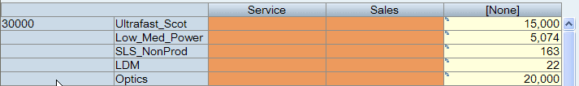
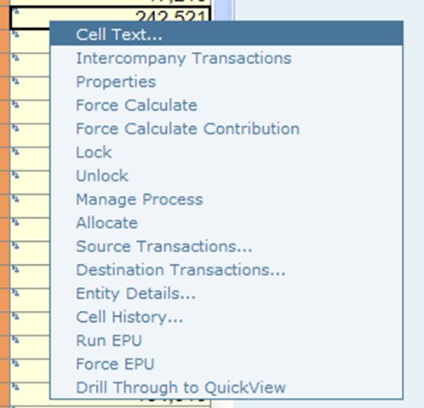
Drill Down Examples (Right Click on cells with blue icon: Base Level)
1/14/2010
Notes:
24

Slide 25
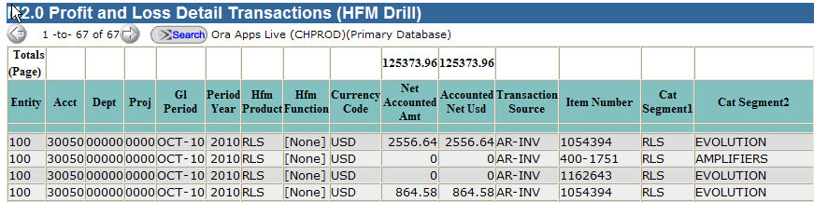
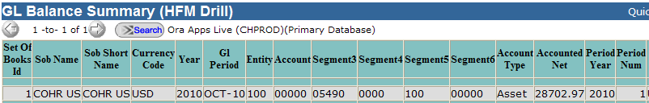

Drill Down Examples (Right Click on cells with blue icon: Base Level)
1/14/2010
Notes:
25

Slide 26
HFM Integration Tips/Tricks (Lessons Learned)
Use of MDM/DRM should be considered carefully
(if metadata is being fed to multiple systems besides Hyperion and objective
is to address issues relating to metadata consistency – fairly complex app and integrations)
Minimize Integration Layers for Data/Metadata, Extract to Flat files,
DRM, ODI, FDM, etc.
Use of EPMA Data Synchronization processes to move data between applications
(no scripts needed, UI based simple mappings)
Use Oracle DB Links and native interfaces instead of flat files where possible to move
data/metadata
Use of EPMA for consistency and ease of integration and metadata management
Use EBS Concurrent Manager Scheduling capability instead of task flows
  task flow does not provide flexibility to run process based on events
  or scheduling based on fiscal calendar dates
Drill to detail using QuickView/WebBased Reporting (if FDM/ERPI is not part of your architecture)
Run HFM in parallel with current consolidation system for 2 cycles
1/14/2010
Notes:
26

Slide 27
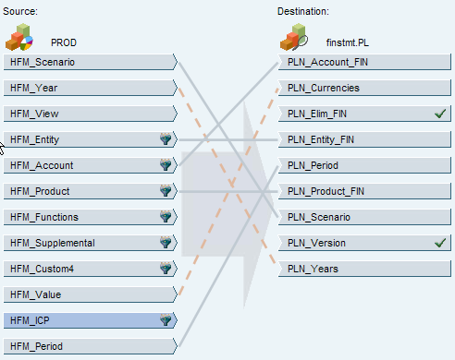
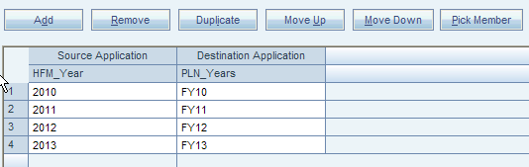
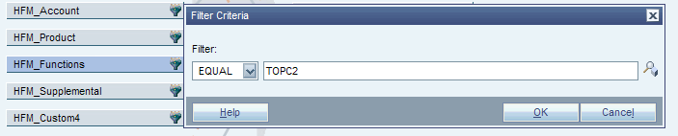
Use of Data Sync to Move data from HFM to Planning/Essbase
Source to Target Dimension Mappings/Default Memeber
Source to Target Member Mappings
Source Data Selection Filter
1/14/2010
Notes:
27

Slide 28
Benefits and Plans

Slide 29
Benefits of Implementing new Hyperion EPM
Automated, tightly integrated Financial Close
Improved metadata, dimensional management
Improved timing and data consistency
Reduced Financial Close cycle-time
Improved Management Reporting
Improved Sox 404 Compliance using phased submission for sign offs, EBS concurrent processes to load data. Only supplemental data loads are done through SmartView
1/14/2010
Notes:
29

Slide 30
Future Plans
Rollout and Expand Drill from HFM/Planning Applications
Utilize Lifecycle Manager for test-DR environments
Develop Executive Financial Metrics
Consider other critical reporting cubes in Essbase leveraging EPMA existing dimensions and adding new ones as needed
Review Oracle Hyperion products HSF and IOP
1/14/2010
Notes:
30

Slide 31

dhananjay.pandit@coherent.com

