Slide 1
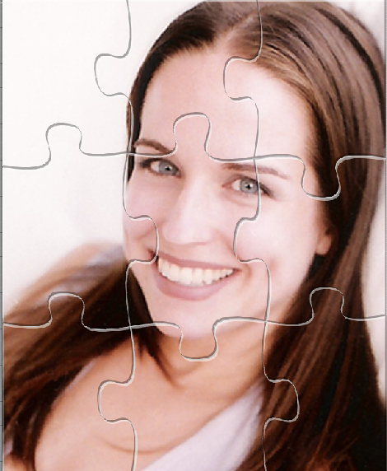
Master Data Management for Oracle Applications
Rick Beck
Principal Sales Consultant

Slide 2
The following is intended to outline our general product direction. It is intended for information purposes only, and may not be incorporated into any contract. It is not a commitment to deliver any material, code, or functionality, and should not be relied upon in making purchasing decisions.
The development, release, and timing of any features or functionality described for Oracle’s products remains at the sole discretion of Oracle.

Slide 3
“Lack of quality customer data is one of the top causes of CRM failure. ”
Source: Gartner; Customer Information and Insight Are the Lifeblood of CRM; John Radcliffe, Gareth Herschel; June 16, 2009

Slide 4

Agenda
MDM: Definitions & Architecture fit
MDM ROI Impact
Implementation challenges
Oracle solutions & investments

Slide 5









Fragmented data in typical enterprise topology
Ever proliferating islands of information
…in disparate applications covering multiple channels, divisions & functions
…duplicated, incomplete, inaccurate,
SFA
Call
Center
Web
site
Fusion
App
Partner
Operational inefficiencies
Questionable Analytics
Error prone integration
Slow enterprise agility and innovation
ERP 1
ERP2
Call
SCM
Fusion
App
Legacy

Slide 6






MDM: The source of clean data for the enterprise
Nurture one of your most valuable asset
Consolidate/Federate shared information into one place
Cleanse data centrally
Share data as a single point of truth as a service
ETL
SFA
Call
Center
Web
site
Fusion
App
Partner
BI/
DW
Middleware
Application Integration Architecture
MDM
Consistency in siloed environment
(Integrated Best of Breed)
ERP 1
ERP2
Call
SCM
Fusion
App
Legacy
ETL

Slide 7
MDM: The source of clean data for the enterprise
Push Mode
Event in operational apps
(e.g. new address)
Consolidate/Federate shared information into one place
Cleanse data centrally
Share data as a single point of truth as a service
ETL
SFA
Call
Center
Web
site
Fusion
App
Partner
BI/
DW
Middleware
Application Integration Architecture
MDM
Match
Cleanse & Enrich
Consolidate (Dedup & build golden record)
X-reference
ERP 1
ERP2
Call
SCM
Fusion
App
Legacy
ETL

Slide 8
MDM: The source of clean data for the enterprise
Push Mode
Distribution of clean, consolidated, complete master object to all subscribing applications
Consolidate/Federate shared information into one place
Cleanse data centrally
Share data as a single point of truth as a service
ETL
SFA
Call
Center
Web
site
Fusion
App
Partner
BI/
DW
Middleware
Application Integration Architecture
MDM
ERP 1
ERP2
Call
SCM
Fusion
App
Legacy
Update BI Dashboard maps and DW cross reference
ETL

Slide 9
MDM: The source of clean data for the enterprise
Pull Mode
Need clean & up to date info to support specific business process
Consolidate/Federate shared information into one place
Cleanse data centrally
Share data as a single point of truth as a service
ETL
SFA
Call
Center
Web
site
Fusion
App
Partner
BI/
DW
Middleware
Application Integration Architecture
MDM
MDM provides real time web services to access master data (match / request entire profile / request selected info)
Consistency siloed environments
(Integrated Best of Breed)
Lower data management costs
Better reporting
Enterprise foundation for agility
& innovation
ERP 1
ERP2
Call
SCM
Fusion
App
Legacy
ETL

Slide 10
Categories of MDM Benefits we have benchmarked from our customers implementations
GROWTH
Improve CRM performance to increase revenue and market share
EFFICIENCY
Operational efficiency across multi-functions of an enterprise
IT AGILITY
Increase IT resiliency in a changing business landscape
COMPLIANCE
Reduce operational risk and improve regulatory compliance
CUSTOMERS ON AVERAGE GENERATED 2%-5% INCREASED REVENUE FROM SALES WITH MDM
EFFICIENCY OF OPERATIONS INCREASE WITH IMPROVED PROCESSES AND DATA GOVERNANCE
EFFICIENCY OF IT OPERATIONS RESULTING IN GREATER AGILITY OF BUSINESS MODELS
EFFICIENCY OF IT OPERATIONS RESULTING IN GREATER AGILITY OF BUSINESS MODELS
Notes:
10

Slide 11
Growth
A large global insurance company
A large US retail grocery chain
Single view of customers across 100+ life and non-life insurance policies, pension funds and employee pension schemes
Enable loyalty program, drive up-sell and empower self service
Why:
Customer Hub with about 1.5 million customer golden records
Customer hub along with Siebel CRM
What:
2 % increase in amount of insurance premium collected
12 % reduction in marketing reach costs
5% increase in cross-sell/up-sell
Improved marketing response resulting in increased gift card order sales by 5%
Increased sales from loyalty cards customers by 1%
So what:
* Expected benefits
Notes:
11
11
11

Slide 12
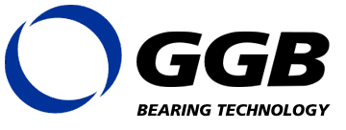
Efficiency
A major big box retailer
Streamline GGB Global supply chain and provide an acquisition platform
Streamline complex marketing & account management processes
Provide single view of its customers to every store
Why:
Oracle Customer Hub feeding to marketing applications, SAP ERP & CRM
What:
Live on Oracle Customer and Product Hub integrated with ERP systems with no disruption
Improved marketing campaign response rate by 15%
Reduced sales order errors by 20%
So what:
Improved inventory levels by 5%
Reduced order lead times by 2%
Increased order returns by 15%
12
Notes:
12
12
12

Slide 13

IT Agility
A large telecom manufacturer
Support KPN’s business transformation from product to customer centric enterprise
Support total customer satisfaction goals with single view of customer data for company’s mobile devices division
Why:
Live on Oracle MDM with Informatica Power Center & Data Quality
Foundation to CRM & BRM
Centralized B2B customer master in a single instance
What:
$1.8 million savings in IT project costs
So what:
Retired 6 legacy applications, saving on maintenance costs
Reduced integration costs by 20%
13
Notes:
13

Slide 14
Compliance
A large bank in Asia-Pacific region
A leader in electricity transportation & distribution
CIS legacy inflexible and too expensive to maintain & evolve
Improve relationships and service to its customers in an ever changing organizational environment
Why:
What:
Live on Customer Hub with 14,000 users and 400k tx /day peak operations
Customer Hub as a foundation to CRM , Supply Chain Mgmt
2% reduction in credit risk costs
75% reduction in annual compliance costs
So what:
Anti money laundering compliance
14
Notes:
14

Slide 15
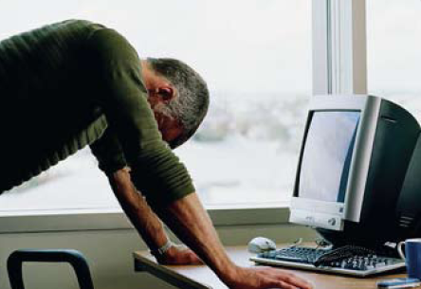
MDM Implementation challenges
What we hear loud and clear
Achieve material & sustainable data quality improvements
  Effort grows exponentially with source
  systems / domains covered
  Clean the data (Initial load) vs. keep it clean (on-going operations)
  Raising / evolving data quality criteria
Effort involved in integration
  Intrusive to consuming applications
  Legacy applications
  Hub web services too granular
Implement true enterprise data governance
  Agree on an enterprise model & data rules
  Communicate & enforce enterprise data policies
  Easily operate and monitor the hub

Slide 16


Oracle MDM Investment & differentiation strategy
Pushing the limits of MDM to achieve faster time to value
End-to-End Data Governance
Source
Systems
MDM
Aware Apps
Siebel
Siebel
EBS
End-to-End
Data Quality
End-to-End
Integration
EBS
Trusted Master Data
SAP
SAP
JDE
JDE
Custom
Custom
Unclean to clean data
(Initial & Delta load)
Operational exchanges
Hub / Apps
© 2009 Oracle Corporation

Slide 17
Oracle MDM Investment & differentiation strategy
The Product Offering
New
Data Governance Manager
Source
Systems
MDM
Aware Apps
Siebel
Siebel
EBS
Oracle
Data
Quality
Application
Integration
Architecture
EBS
Trusted Master Data
SAP
SAP
JDE
JDE
Custom
Custom
© 2009 Oracle Corporation

Slide 18




Oracle MDM Investment & differentiation strategy
The Product Offering – End to End Data Quality
Source
Systems
Siebel
EBS
Trusted Master Data
Profile
Standardize
De-Dup
SAP
Validate Address
JDE
Custom
© 2009 Oracle Corporation

Slide 19










End to End Data Quality Framework
The Data Quality “Machine”
Oracle
Data
Quality
Rules Manager - Design, Develop & Validation (IDQ)
Rules Execution Engine
(Workbench)
Relational and Flat Files
Loans
Analyze / Profile
Standardize & Cleanse
Match &
De-duplicate
Enrich
Credit
Card
Legacy
ERP
Scorecards & Reporting
(Report Viewer)
CRM / MDM
Other
Objective:
Zero rejects
Corrective
Actions
Error Report
Correction Files
Manual Rêviez
Candidates
Singles
Merged
Exception Management Process (Data Quality Assistant)
ETL
© 2009 Oracle Corporation
Notes:
19
Rules box
ETL
19

Slide 20


Oracle MDM Investment & differentiation strategy
The Product Offering – End to End Pre-build Integration
MDM
Aware Apps
Match
Siebel
Fetch
EBS
Trusted Master Data
Sync
SAP
Merge
JDE
Custom
© 2009 Oracle Corporation

Slide 21



Push Mode – MDM for Customer Data
AIA
Asynchronous or Batch
Non intrusive
Fast Implementation (<3-4 months)
Does not assume the hub is the data master (Authoring is decentralized)
Out of the box integration with Siebel CRM and Oracle EBS
Siebel
Siebel
EBS
EBS
Consolidate
Cleanse & Enrich
Deut & build golden record
Publish to participating applications
PFST
PFST
JDE
AIA
Customer
Party EBO
JDE
Portal
Portal
iFlex
iFlex
Customer
Hub
Retek
Retek
© 2009 Oracle Corporation
Notes:
21

Slide 22

Pull Mode – MDM for Customer Data
AIA
Real time interaction with the hub
The right data at the time of entry
Out of the box integration with Siebel CRM and Oracle EBS
PFST
JDE
Legacy
EBS
ilex
SAP
Retek
Siebel
ODS
AIA
Customer
Party EBO
Customer
Hub
3
Sync Process: Data is entered in the application and synchronized back to the customer hub
2
Fetch Process: Once candidate selected, returns the entire profile of the customer / prospect
1
Match Process: returns the list of candidates to a list of selection criteria
© 2009 Oracle Corporation
Notes:
22

Slide 23



Push Mode: MDM for Product Data
AIA
Siebel
Import & Synchronization
Product Data Quality Management
Catalog Administration & Security
Syndication & Publication
Access & Search
Item BO / EBS
Bombed / EBS
Product
Hub
EBS
Agile
(PLM)
© 2009 Oracle Corporation
Notes:
23

Slide 24
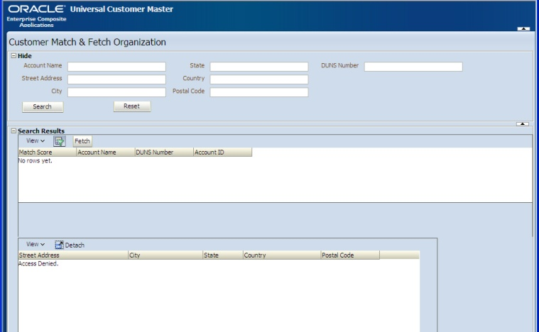

What about legacy applications?
AIA
Legacy
Easily “embeddable” in legacy / web applications
Enables Match / Fetch / Sync processes for org and person
Makes legacy applications “MDM aware”
Customer still needs to build Enterprise Business Object to Legacy application
url pointer
Composite Application User Interface
AIA
Customer
Party
EBO
MDM
Hub

Slide 25
Oracle MDM Investment & differentiation strategy
The Product Offering – End to End Data Governance
Define
Operate
Monitor
Fix
Trusted Master Data

Slide 26

End to End Data Governance
Data Governance Tools Functions
Define
(and Communicate & Enforce)
Easily Operate hub
Define enterprise Master Data (Metadata mgt)
Define enterprise data policies
  Data accountability, Escalation process,…
Administer hub
Execute day to day hub operations
(Consolidate, Cleanse, Share, Master functions)
Manage Escalations
Perform data steward tasks (e.g. Merge/Unmerge)
Monitor hub operations
Fix data issues
Analyze Hub DQ metrics
Track sources of bad data
Monitor hub transaction load
Fix import error and manage re-submission
Proactively conduct data watch & repair tasks
Tune Data Quality rules

Slide 27
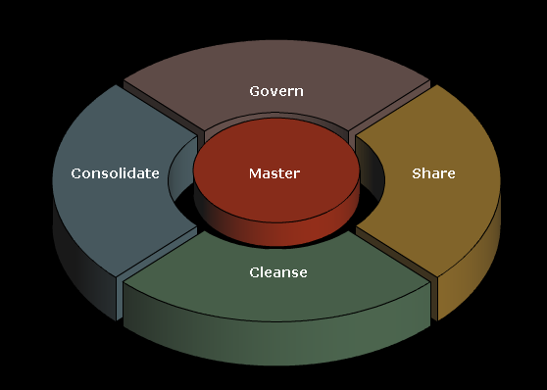
Oracle New Data Governance Manager
1- Operate and Monitor hub Consolidate, Master, Cleanse and Share functions
2 – Define enterprise master data policies and fix data issues: Govern

Slide 28
Oracle MDM: Committed to Industry specialization
© 2006 Oracle Corporation

Slide 29




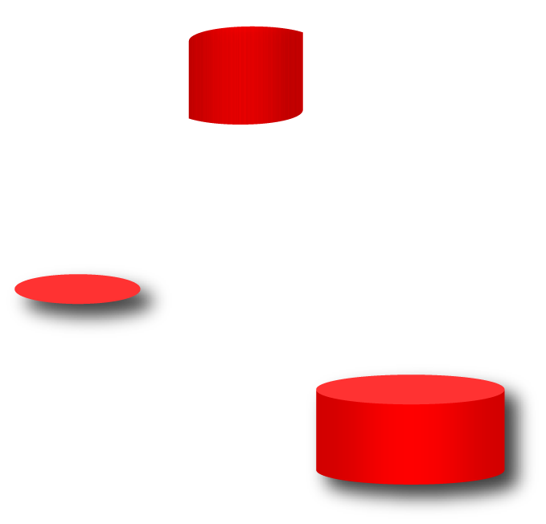







Oracle Enterprise Master Data Management
The most complete MDM offering in the market today
Data Governance Manager
Operational
Systems
Analytical
Systems
Operational MDM Apps
Analytical MDM
Siebel
Dashboards
EBS
DW
SAP
Customer
Supplier
Product
Site
Financial
Analytical
BI &Datamarts
PeopleSoft
Planning
JDE
Oracle
Customer
Hub
Oracle
Supplier
Hub
Oracle
Product
Hub
Oracle
Site
Hub
Oracle / Hyperion Data Relationship Management
Financial Consolidation
Custom Apps
Application Integration Architecture
Budgeting
External
Apps
Oracle Fusion Middleware
Notes:
Here we see that Oracle has a broad and deep set of MDM products including the ability to master customers, suppliers, employees, citizens, students, clients, patients, members, products, assets, locations, accounts, and other financial data such as chart of Accounts.
In addition, the suite includes data quality capabilities with Oracle Data Quality and Data Stewards applications, data governance tools such as Data Watch & Repair, along with OOTB integration with applications via AIA and OBI EE integration via ETL maps in ODI and Informatica. B
All connected operational and analytical systems are kept in sync with the clean accurate authoritative master data via AIA and FMW with its powerful data integration tools such as ODI and OWB.

Slide 30













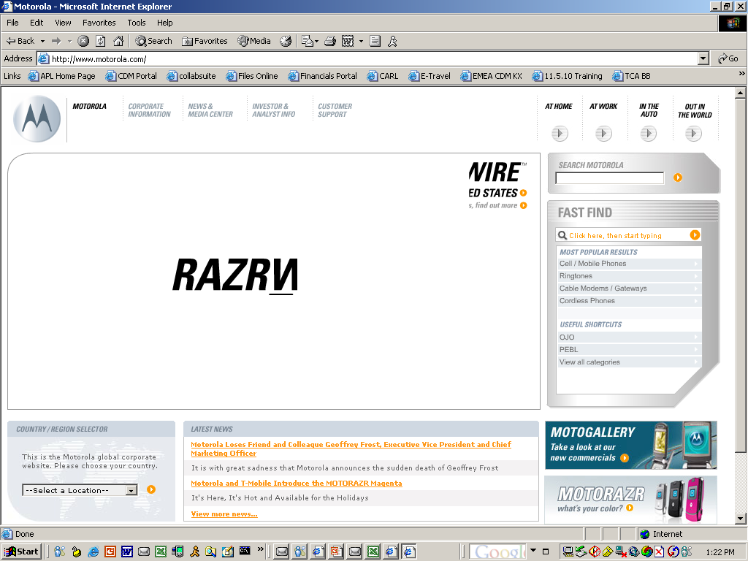



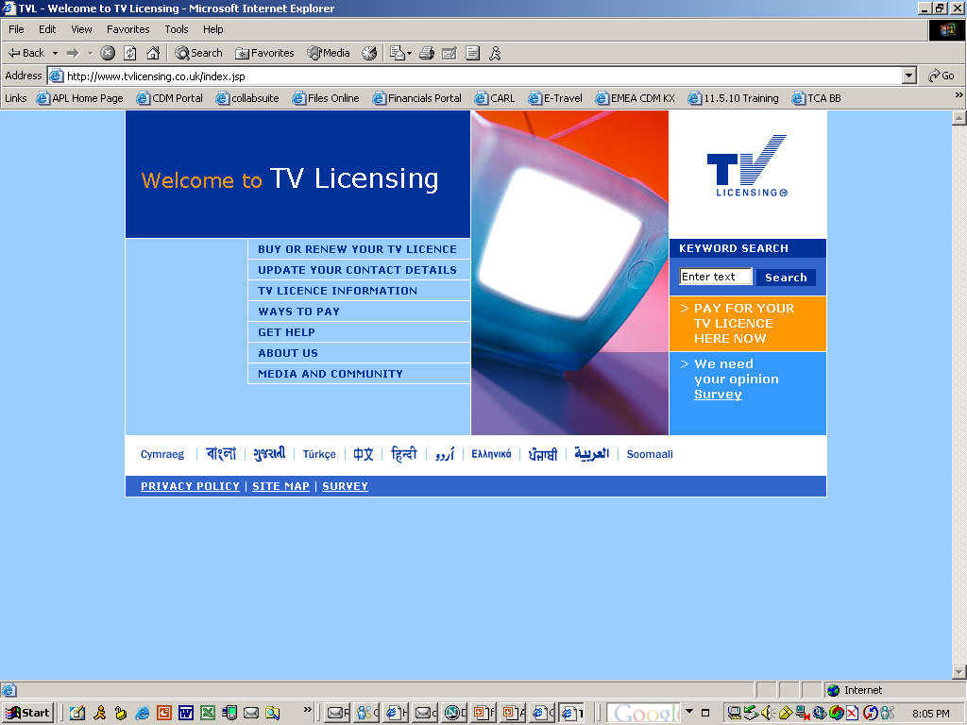




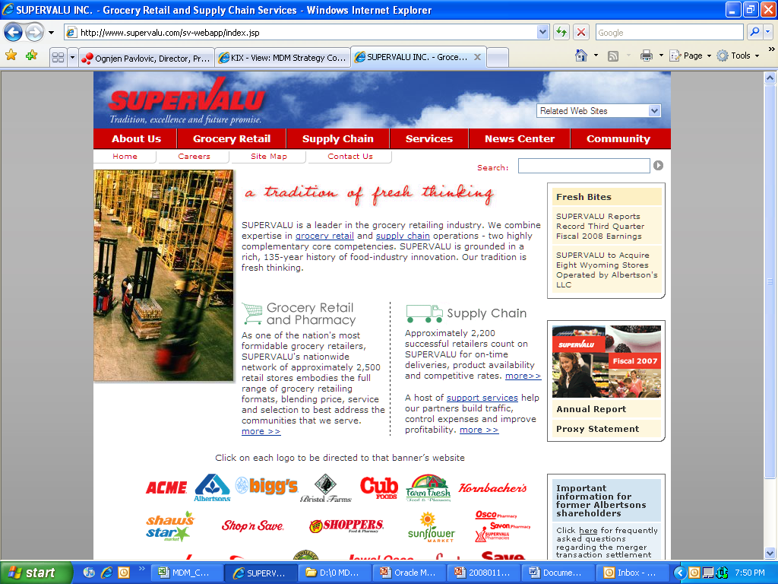





































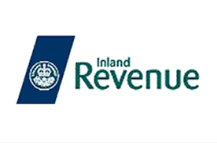


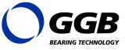






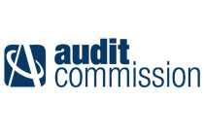


Learning from our customers
900+ customers have chosen Oracle MDM
Communications,
Media & Utilities
Financial Services
Public Sector
Manufacturing &
Distribution
High Technology
Retail & CPG
Belgium Post
Notes:
500+ MDM Customers; 3 Billion+ records mastered

Slide 31
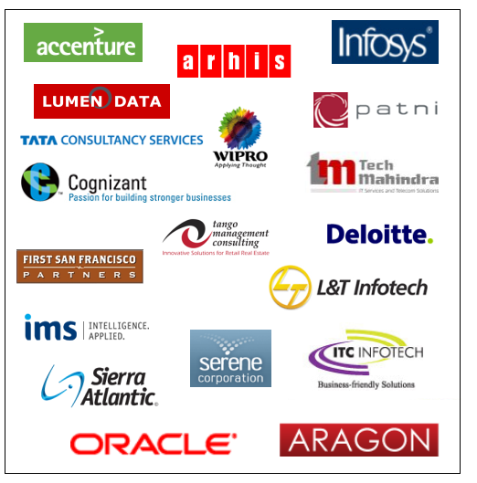
MDM Partner Program – Strategic Priority #1
Critical to your success
Skilled and experienced in priming Oracle MDM projects
Co-Development partnerships deliver deep expertise
Augmentation from Oracle Consulting
Global & Regional specialists

Slide 32
For More Information
search.oracle.com
Master Data Management
or go to
www.oracle.com/master-data-management

Slide 33
The preceding is intended to outline our general product direction. It is intended for information purposes only, and may not be incorporated into any contract. It is not a commitment to deliver any material, code, or functionality, and should not be relied upon in making purchasing decisions.
The development, release, and timing of any features or functionality described for Oracle’s products remains at the sole discretion of Oracle.

Slide 34


