Slide 1


How to enrich OBIEE UI using Custom Java Scripting
Sunil S. Ranka
OBIEE Solution Architect

Slide 2





Trianz Overview
When Execution Matters
Execution is the art & science of
turning strategy and plans into tangible results
Established Consulting, IT Services, and BPO firm with a strong focus operational improvements
Known for enabling superior execution and long-term client partnerships
Global reach with offices in Santa Clara, Washington DC Metro, Bangalore, Hyderabad, Chennai and Tokyo
Serving Fortune 500 and fast-growing companies on a global basis
Experienced professionals with business consulting, industry and technology backgrounds
Consulting
IT Services
BPO Services

Slide 3
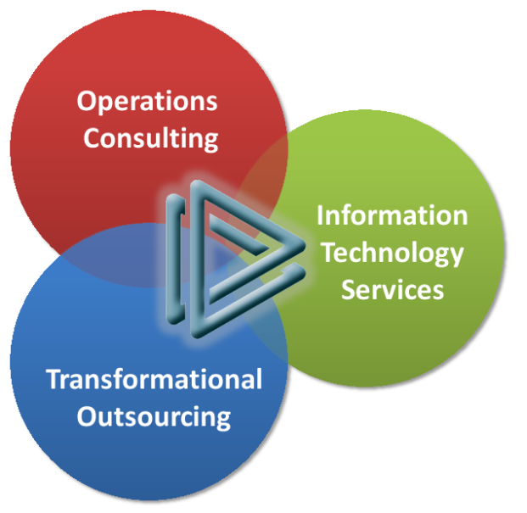
Services
We partner closely with clients to address their holistic needs through comprehensive business, technology and operations related service offerings
Consulting
Execution Strategy
Execution Decision Enablement
Business Process Design
Program & Project Management
Organizational Analysis & Design
Change Management
Information Technology Services
IT Strategy & Planning
Portfolio Management & Governance
Custom Applications Development
Packaged Systems Implementation
Software Product Development
Analytics & Reporting
Apps Management & Support
IT Service Management
Testing & QA Services
BPO Services
BPO Strategy
Sales Operations
Finance Operations

Slide 4

About Me
OBI EE Architect, currently working for Trianz Inc (www.trianz.com).
Currently an Architect/Tech Lead in analytics space at Cisco Systems
Extensively worked with fortune 500 leaders.
Held positions of Head Of Product Development, Architect, etc.
Blog : http://sranka.wordpress.com, Twitter : sunil_ranka
Speaking engagements at following conferences :
  OAUG COLLABORATE 09,
  BIWA SIG TechCast Series (10th Feb , 2010),
  NorCal OAUG-2010 at Santa Clara Convention Center, CA
  OAUG’s COLLABORATE 10 at Las Vegas, Nevada.
  My Tag Line :: “Superior BI is the antidote to Business Failure”

Slide 5
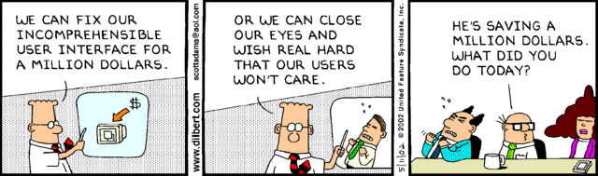
Dilbert on User Interface
Ice Breaker or Question
Why BI Project Fails ?

Slide 6
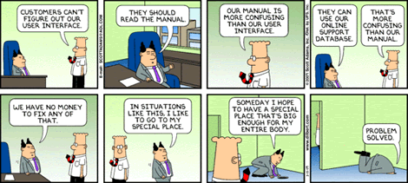
Dilbert on User Interface

Slide 7

Reason for BI Projects Nonperformance
While there are many reasons UI fail, the most likely include:
No Clear Road Map for BI Implementation
Using Analytical tool as reporting tool.
Ignoring the True end users
No Data Quality Processes
No Audit Controls
Manual, Error-Prone Processes
No Single Source Of Truth for Data
Lack of trust in data delivered.
Lack of User Adoption due to poor user interface
Some of the easiest ones to avoid are related to the UI

Slide 8
Quotes Speaks One’s Mind
“The location of visual elements in the UI has a huge impact on how the user interprets information.”
—Rick Oppedisan, 2002

Slide 9
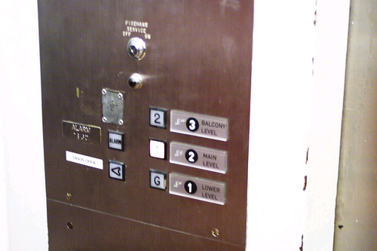
Examples of Poor User Interface
UI does not work the way users work
Too many clicks to reach the results
Lack of customization flexibility due to pre existing framework
Missing visual presentation

Slide 10

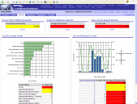
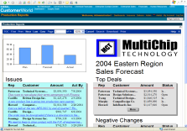
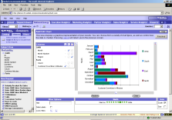

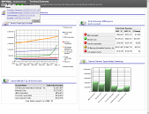




Oracle BI Suite Enterprise Edition
Unified Business Intelligence Infrastructure
Interactive
Dashboards
Reporting &
Publishing
Ad-hoc
Analysis
Proactive
Detection
and Alerts
Disconnected
Analytics
MS Office
Plug-in
Web
Services
Common Enterprise Information Model
Intelligent Caching Services
Oracle
BI Server
Multidimensional Calculation and Integration Engine
Intelligent Request Generation and Optimized Data Access Services
OLTP & ODS
Systems
Data Warehouse
Data Mart
SAP, Oracle
PeopleSoft, Siebel,
Custom Apps
Files
Excel
XML
Business
Process

Slide 11


About JavaScript
JavaScript
An object-oriented scripting language embedded in HTML documents
When the page gets to the browser, the JavaScript is executed.
It is primarily used in the form of client-side validation, and UI rendering
It is implemented as an integrated component of the web browser
Allows the development of enhanced user interfaces and dynamic websites.

Slide 12

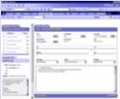

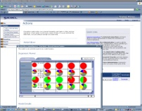
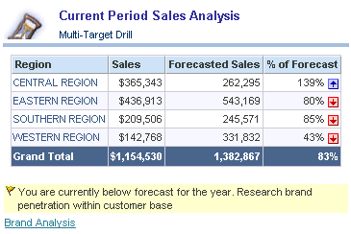

Report Composition in OBIEE
HTML/XML/JAVAScript
Web Server
Web Server
Presentation Server
ODBC
Oracle BI Server
Enterprise Biz Model
Web Server
Multidimensional Calc Engine
Aggreg and Integration Svcs
EAI
Req Gen and Opt Data Access
SQL
OLTP
EDW
App
DW
XMLA
DW

Slide 13

How to Include custom Javascript in OBIEE
Add your script to Common.JS ( {OracleBI}\web\app\res\b_mozilla )
If using OC4J sync the file with in {OracleBI}\oc4j_bi\j2ee\home\applications\analytics\analytics\res\b_mozilla
Restart the SAW server and SAS Server

Slide 14

OBIEE UI enhancement using Javascript
What If Analysis
Customized Help Page
Passing parameters to external application/webservices
Downloading data based on selected prompts
Integrating Reports from two different subject areas
Disabling hyperlink for value interaction column
Removing Images at the Grand Total Level
Replacing multiple Go button by single Go Button
Downloading dataset directly to Excel/PDF/HTML
Multi-Select Prompt Bug
Breadcrumbs implementation

Slide 15
DEMO

Slide 16
Q & A

Slide 17


Slide 18
BACKUP SLIDES

Slide 19





Oracle BI EE Architecture
Web Server
(IIS, Tomcat, Websphere, iPlanet)
Web Browser
SAW Bridge (J2EE/ISAPI)
TCP/IP (SSL)
XML, HTML,
XLS, PDF, TXT over HTTP/HTTPS
Java script
for Usability & Interactivity
Oracle BI Publisher
Oracle BI Presentation Services
Delivery Server
SOAP Web Services, XML and URL Interface
Web Catalog Service
Layout Interfaces
Oracle Interactive Dashboards
Oracle Answers
HTML, SOAP over HTTP/HTTPS
XSL
Data Logic
User Profiling, Security and Session Mngmt
XML Framework
Cache Services (Web) & Connection Mngmt
External Applications
and Portals
Oracle Delivers Server
ODBC over TCP/IP (SSL)
TCP/IP
(SSL)
Oracle BI Server
Scheduling/Event Services
Logical SQL ODBC/JDBC (Logical Business Model)
Agent Execution Logic
Load Balancer
Device Adaptive Content
Session Management
Metadata Interchange
Intelligent Request Generation
Oracle BI Administration
Oracle BI
Cluster Controller
Cache Services
Logical Request Generation
Metadata Management Services
Navigator
Multi-User Development Services
Security Services
Multi-Pass /
Sub-Request Logic
Query Govern
Metadata Documentation Services
Externalized Authentication
Fragmentation Optimization
LDAP
Aggregate Navigator
Server Management Services
DB Authentication
System / Perf Monitoring
Custom Authenticator
Optimized Query Rewrites
Execution Engine
Data Source Adapters
ODBC, CLI, OCI, XML, MDX
Analytical and Operational Data Sources

Slide 20
Oracle BI EE And Javascript
Web Server
(IIS, Tomcat, Websphere, iPlanet)
Web Browser
SAW Bridge (J2EE/ISAPI)
Javascript
for Usability & Interactivity
XML, HTML,
XLS, PDF, TXT over HTTP/HTTPS
Oracle BI Publisher
Oracle BI Presentation Services
TCP/IP (SSL)
Delivery Server
SOAP Web Services, XML and URL Interface
Web Catalog Service
Layout Interfaces
Oracle Interactive Dashboards
Oracle Answers
XSL
Data Logic
User Profiling, Security and Session Mngmt
XML Framework
HTML, SOAP over HTTP/HTTPS
Cache Services (Web) & Connection Mngmt
External Applications and Portals
Oracle Delivers Server
ODBC over TCP/IP (SSL)
TCP/IP
(SSL)
Oracle BI Server
Scheduling/Event Services
Logical SQL ODBC/JDBC (Logical Business Model)
Agent Execution Logic
Security Services
Query Govern.
Load Balancer
Metadata Interchange
Device Adaptive Content
Session Management
Intelligent Request Generation
Oracle BI Administration
Oracle BI Cluster Controller
Cache Services
Logical Request Generation
Navigator
Oracle BI Web encompasses the user interaction, visualization and proactive components of Oracle BI Enterprise Edition
Metadata Management Services
Multi-Pass /
Sub-Request Logic
System / Perf Monitoring
Multi-User Development Services
Externalized
Authentication
Fragmentation Optimization
Metadata Documentation Services
LDAP
Aggregate Navigator
Server Management Services
DB Authentication
Optimized Query Rewrites
Custom Authenticator
Execution Engine
Data Source Adapters
ODBC, CLI, OCI, XML, MDX
Analytical and Operational Data Sources

