Slide 1


Slide 2

Monetizing the Cloud: Turning XaaS Related Services into a Profitable Business
Paul Hughes
Director, Product Marketing

Slide 3
The following is intended to outline our general product direction. It is intended for information purposes only, and may not be incorporated into any contract. It is not a commitment to deliver any material, code, or functionality, and should not be relied upon in making purchasing decisions.
The development, release, and timing of any features or functionality described for Oracle’s products remains at the sole discretion of Oracle.

Slide 4


Agenda
<Insert Picture Here>
Cloud Computing Hype
XaaS/Cloud Computing Definition
Business and Technical Challenges
Oracle BRM for Cloud Monetization
Key Business Enablers and Customer Examples Proposition
Summary: BRM’s Unique Value Proposition

Slide 5
Cloud Computing Hype

Slide 6
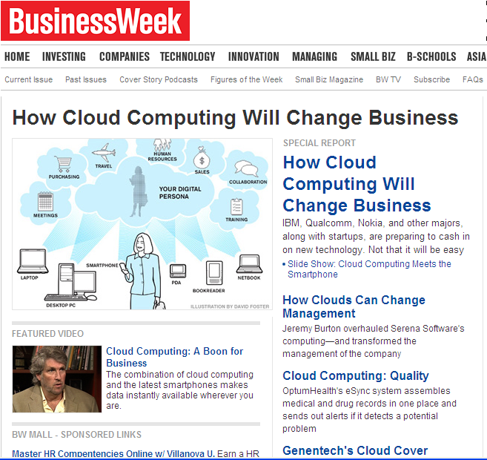
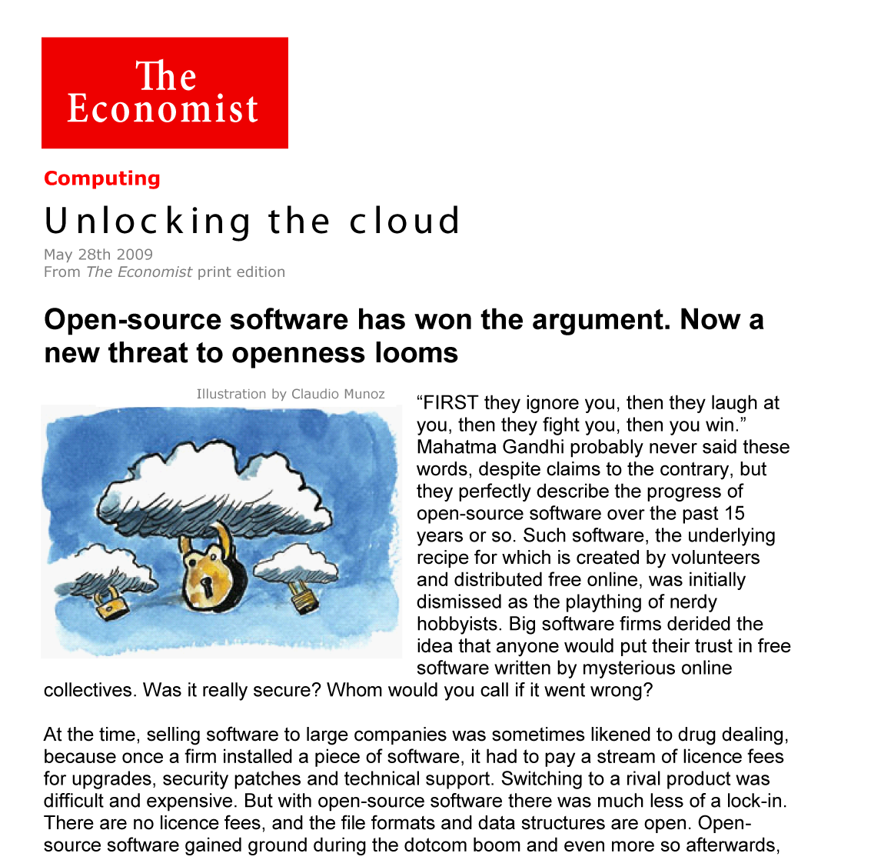
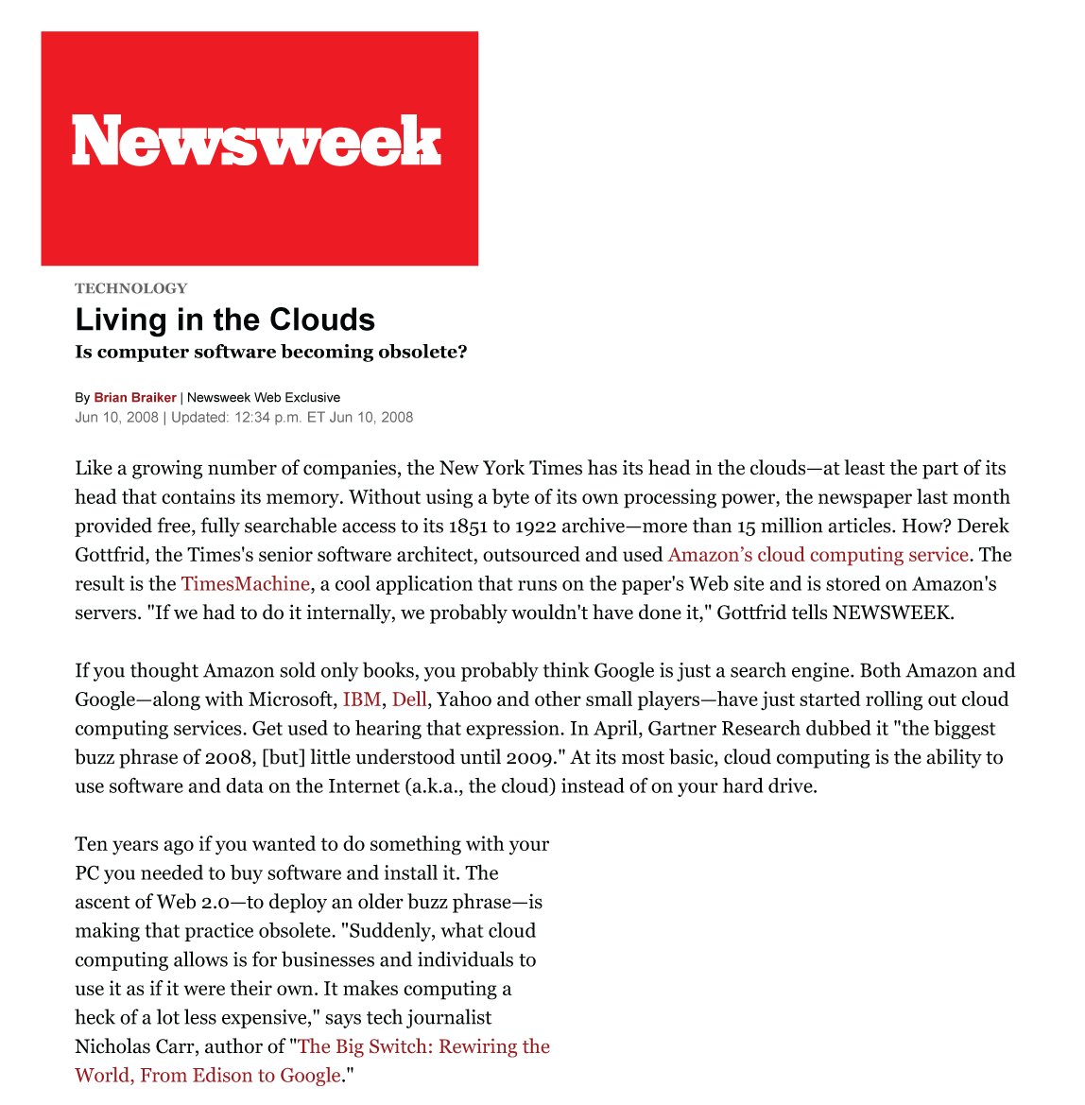
Cloud in the News
Notes:
6

Slide 7
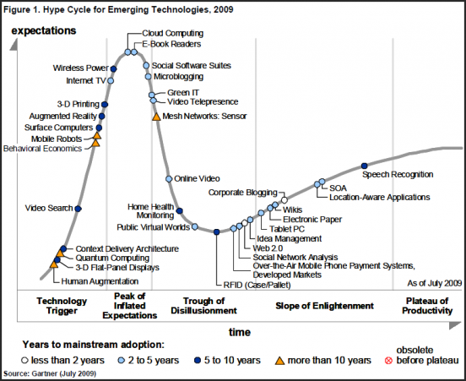
Cloud is at the Peak of the Hype Curve
Notes:
7

Slide 8
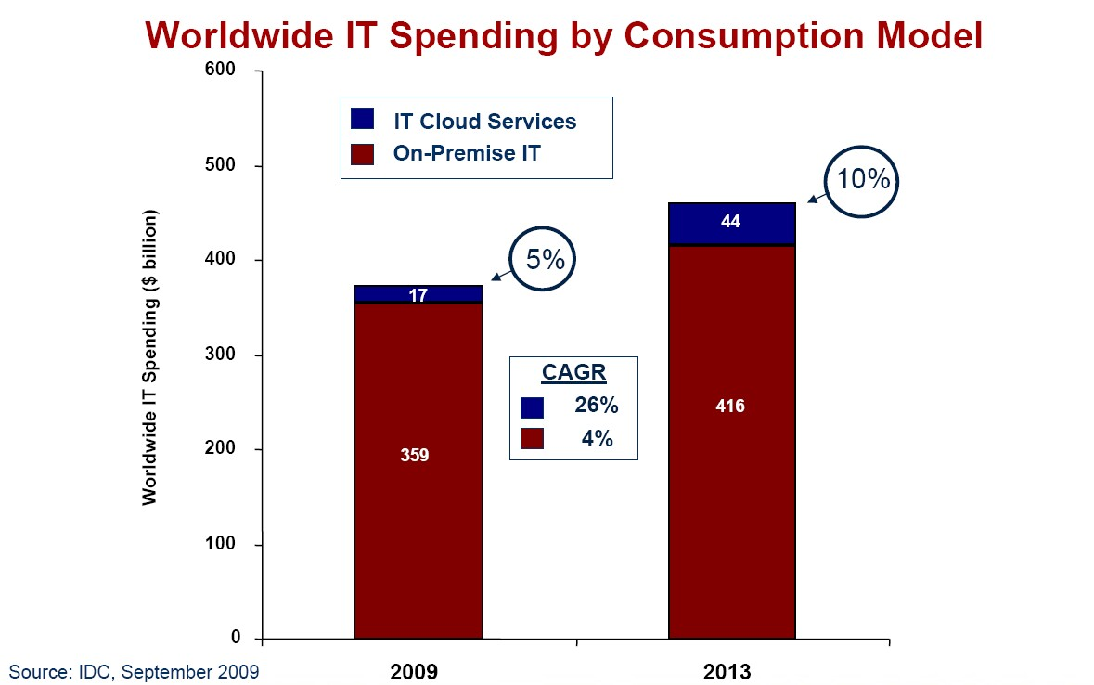
Public Cloud Will Grow To 10% Of Enterprise IT Spend By 2013
Public Cloud
vs.
On-Premise

Slide 9
44% of Large Enterprises Are Interested In Building A Private Cloud

Slide 10
Cloud Computing/XaaS Definition

Slide 11

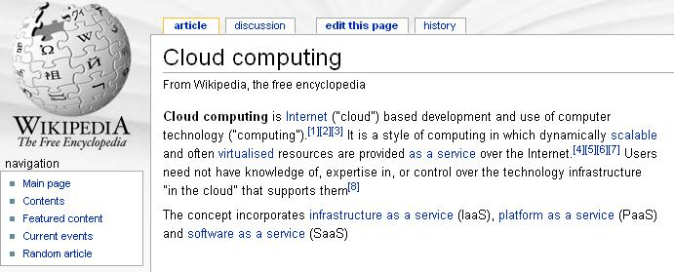
What is Cloud Computing?
*
Often characterized by:
Virtualized computing resources
Seemingly limitless capacity/scalability
Dynamic provisioning
Multi-tenancy
Self-service
Pay-for-use pricing
* Source: Wikipedia.org

Slide 12

Defining the “X” in XaaS
Digital goods/services that are owned, managed and delivered by a service provider
  Pay-per-use or subscription model based on user metrics
  A single common offering delivered to many users
  Consumed in a common service model
  Upgradable on demand
  When the subscription period expires, the offering is no longer valid

Slide 13


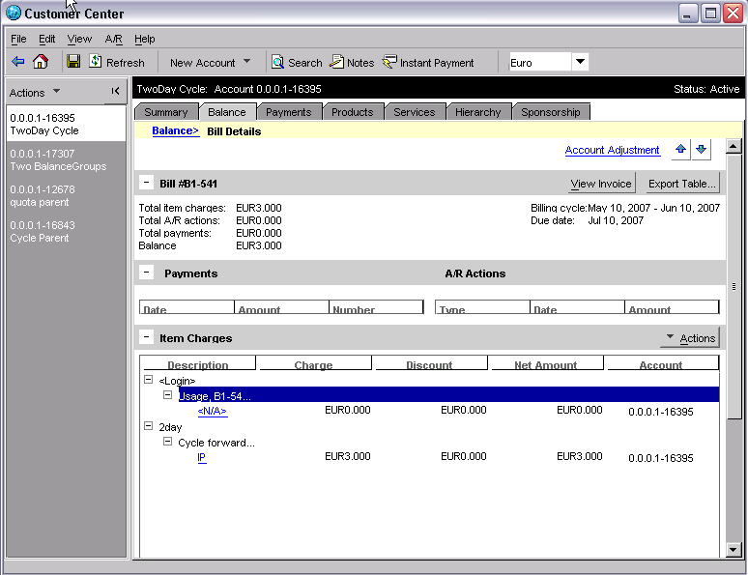


XaaS Creates Three Monetizable Layers
Service Offering Example Billing Metrics
Applications
SaaS
Platform
PaaS
Infrastructure IaaS
Games, music
Web-conferencing
Online or downloadable apps
Per Application User
Per Transaction
# Calls, # Minutes
Google Apps, Amazon
APIs for CRM, Retail
Tools to develop new apps
Per Hour
Per GB Transfer In/Out
Per Message
Infrastructure for apps
Storage, Collocation
General purpose computing
Per Named Host
Per GB
Per Server, Per CPU

Slide 14
Business and Technical Challenges

Slide 15






Top Business and Technical Challenges
What XaaS Providers Must Address Today
Business Challenges
Industry Evolution
Technical Challenges
Value Chain Management
Flexibility
Scale
Account Management
Integration
Customer Acquisition
Notes:
Business Challenges:

Slide 16
Key Questions Every XaaS Provider Must Answer
Flexibility and Account Management
Flexibility
Account Management
Can you offer a wide range of pricing options?
Can you implement discounts in real-time?
Can you launch new services in a matter of minutes?
Can you support prepaid and post- paid hybrid accounts?
Do you have a single view of your customers?
Can you access all account information from a single system?

Slide 17

Key Questions Every XaaS Provider Must Answer Integration and Scale
Integration
Scale
Can your billing system support millions of transactions per hr?
Do you have integrated billing/CRM?
Can you seamlessly upgrade existing systems?
Is your back office “plug-’n’-play” with open APIs?
Do you know the limits of your existing architecture?
Can you adequately handle sudden spikes in usage/traffic?

Slide 18
Oracle BRM for Cloud Monetization

Slide 19
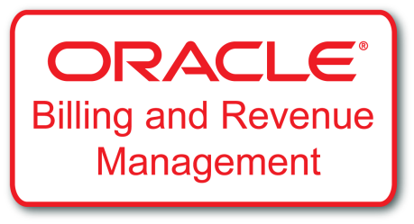
Oracle Billing and Revenue Management
Supporting High Transaction Businesses
Highest Rating in 2009 Gartner Scorecard
300 + Live Implementations
Single Platform for ALL XaaS implementations
Short Time to Market
Market leading ROI
Pre-integrated to CRM and ERP

Slide 20
Oracle Billing and Revenue Management (BRM)
Turns transactions into revenue
Maximizes the value of each transaction
Ensures accuracy of billing, collections and settlement
Handles all service and customer types
Monetizes ANY Service
Supports usage based, subscription and prepaid based services
Helps Deliver an Exceptional Customer Experience

Slide 21

BRM Monetizes Every XaaS Layer
Application Layer (SaaS)
Example Billing Metrics
Games, music
Web-conferencing
Online or downloadable apps
Per Application User
Per Transaction
# Calls, # Minutes
Platform Layer (PaaS)
Google Apps, Amazon
APIs for CRM, Retail
Tools to develop new apps
Per Hour
Per GB Transfer In/Out
Per Message
Infrastructure Layer (IaaS)
Infrastructure for apps
Storage, Collocation
General purpose computing
Per Named Host
Per GB
Per Server, Per CPU

Slide 22

Oracle Billing and Revenue Management
Core Value Proposition
Quick Time to Market
Market Leading ROI
Exceptional Customer Experience
BRM
Comprehensive out of the box functionality
Flexible SOA based architecture
Over 1000 functions exposed via APIs
Integrated with best in class applications
Enables
Enables
Enables

Slide 23






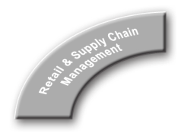

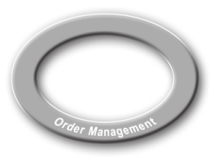

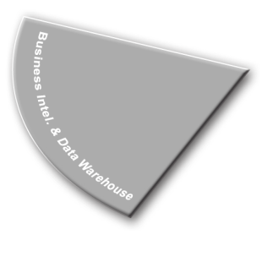
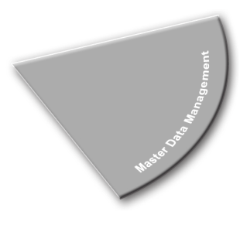
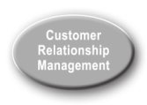

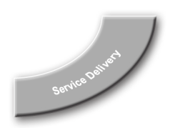
BRM - Open, Flexible, Standards-based Architecture
Pre-integrated
Open
Scalable
Convergent
Globally Deployed
Industry’s only solution pre-integrated with best-in-class applications: Siebel CRM, Oracle Communications OSM, Oracle E-Business Suite, Oracle Enterprise Manager, Oracle BI, HPOV etc.
Open data model, open API, standards-based, and SOA-enabled
Multi-database and multi-schema architecture
On-line/off-line charging on a single platform with built-in high availability architecture
Out-of-the-box languages (including double-byte) and currencies allow seamless deployments across different countries

Slide 24

Enabling End-to-End XaaS Concept to Cash to Care
Critical Applications Integrations
Service Fulfillment
Service Delivery
Usage / Charging
All Oracle applications
Extensible to third-party and legacy applications
Built on open, standards- based middleware
Upgradeable
Common Object Model
Process Integration Packs (PIPs)
Customer Order
Management
Billing / Collections
Offer
Management
Revenue
Management
Concept to Cash To Care
Campaign Execution
Analysis
Service Creation
Reporting
Service Design

Slide 25
Key Business Enablers and Value Proposition

Slide 26
Oracle BRM XaaS Business Enablers
Key Business Enablers
Pricing
Flexibility
Powerful Subscriber Management
Comprehensive Billing Operations
Business Intelligence
Value Chain Management

Slide 27
Oracle BRM XaaS Business Enablers
Industry Leading Pricing Flexibility
Pricing Flexibility
Any Charging Model/Metric
Promotion Support
Bundling
Payment Options
One time, real-time, recurring, usage based
Trial periods, free months, loyalty, volume discounts
Per usage, service type, user, CPU, storage
Multiple products, promotions
Prepaid or postpaid
Automated payments
Pricing
Flexibility

Slide 28
Oracle BRM XaaS Business Enablers
Power Subscriber Management Capabilities
Powerful Subscriber Management
Any Subscription Type
Account Relationship
Account Terms
Subscriber Lifecycle
Fixed Period
Consumer or Business
Continuous
Price and Discount Overrides
Upsell, cancel, suspend
Modify services
Hybrid and/or Group
Tailor Made Plans
Real-time Balance Management
Prepaid and Postpaid support
Usage thresholds
Powerful Subscriber Management

Slide 29
Oracle BRM XaaS Business Enablers
Comprehensive Billing Operations
Powerful Subscriber Management
Easy to
Configure
Collections Management
Revenue Recognition
Invoicing
Flexbile billing cycles
Improve Cash Flow
Bill on demand and in advance
Business Rules
Summary and detailed invoices
S-Ox Compliance
G/L and
Reporting
Custom reports
Comprehensive
Billing
Operations
Comprehensive Billing Operations

Slide 30
Oracle BRM XaaS Business Enablers
Value Chain and Business Intelligence
Value Chain Management
Automated remittance
Multi-partner enabled
Revenue share terms
Revenue exposure protection
When customer is billed
Simple or complex settlement terms
When customer pays
Business Intelligence
Improved Visibility
Business Processes
Revenue streams
Configurable templates
Over 60+ available
Value Chain Management
Business Intelligence

Slide 31

Intuit
Packaged Software & SaaS
COMPANY OVERVIEW
Intuit is a leading provider of business and financial management solutions for small and mid-sized businesses; financial institutions, including banks and credit unions; consumers and accounting professionals
Industry: Software
Segment: Accounting
Employees: over 8000
Revenue: over USD 3.1B
CHALLENGES/OPPORTUNITIES
Consolidation of multiple IT and billing systems
Cross-product and cross-business line offers
Product/Offer Standardization
Real-time balance management
Regulatory compliance
Time to market for new offers
SOLUTIONS
Project delivery by Oracle Consulting
Oracle BRM integrated with Siebel CRM, Oracle E-Business Suite, and GEMS Order Management
ANTICIPATED RESULTS
Single global process supported by a single global instance
Subscription and billing tightly integrated with accounting (compliance & operational efficiency)
Reduction/simplification of application infrastructure
E2E solution that offers an integrated Shop, Buy, Use experience

Slide 32

Cisco WebEx
Software as a Service
COMPANY OVERVIEW
WebEx is a leading provider of online meeting applications with 7M users per month and 35,000 customers
Industry: SaaS-based conferencing
Employees: over 3500
Revenue: US $.5B
CHALLENGES/OPPORTUNITIES
Consolidate of multiple IT and billing systems
Ensure flexible support for B2B pricing & charging models
Support high-volume transaction processing
Enable intuitive offer configuration
Support settlements with channel partners
SOLUTIONS
Oracle BRM to manage customers, accounts, pricing, rating, billing, invoicing, A/R, collections, payments, and financials
Project delivery by Oracle Consulting
ANTICIPATED RESULTS
Oracle Communications BRM processes millions of transactions per day
Provides real-time balance management
Processes partner settlements
Handles complex corporate account hierarchies
Supports custom pricing for corporate customers
Supports multiple lines of business in multiple countries

Slide 33



Summary: BRM’s Unique Value Proposition
Technology Foundation
Innovative Pricing Models
Real-time Visibility into Revenues
Complex Pricing models – any price, any metric
Pre-pay, Post-pay, Now-pay
Price Optimization
Ease of Integration
Performance and Scalability Advantage
Real-time Balance Tracking and Usage Rating
Flexible and Automatic Billing
Secure Payments and Collections Processes
Partner Management

Slide 34
For More Information
Additional Contacts
Product Marketing
  Brian Pawlus
  +1 408 642 2985
  brian.pawlus@oracle.com
  Paul Hughes
  +1 323 203 8275
  paul.hughes@oracle.com
Product Management
  Derek Peterson
  +1 805 907 5717
  derek.peterson@oracle.com
Or email us at Oraclecomms_ww@oracle.com

