Slide 1
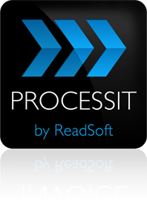
Automated invoice processing in Oracle E-Business Suite
January 13, 2011

Slide 2
Agenda
AUTOMATING ACCOUNTS PAYABLE
The challenges of efficiently processing invoices
Integrating document & data capture with structured workflows
Implementing process automation while upgrading to Oracle E-Business Suite R12
World Class Invoice Processing—rate your performance
Cliff Autin
Manager, Oracle Consulting Services
Readsoft North America
Notes:
Thank you Emily and welcome folks to the webinar. I appreciate you taking the time today. My name is Steve Bennion and I’m the Sales Director for ReadSoft. It’s been my pleasure to help many companies over the years automate their processes and especially those within the Oracle eBusiness suite.
Today I’d like to sort of highlight some of the challenges I’ve encountered as companies process invoices. Let’s see if you recognize them in your company. I’m going to share how automation can solve these problems.
Then I’m going to share a real life and really typical company example so we can learn from their experiences.
And I know many of your are thinking about R12 upgrades as you contemplate an AP automation initiative. So we’ll talk some about this.
And finally we’ll give you some follow ups to consider after the presentation.

Slide 3
Purchase to Pay and Order to Cash
AUTOMATING ACCOUNTS PAYABLE
Purchase to Pay:
Invoice processing
Buyer areas
Various departments
Demand, need or requirement
Create a requisition
Supplier areas
SALES
PURCHASING
Process incoming PO
Purchase order
Create purchase order
Create a sales order
Order confirmation
Process incoming confirmation
Logistics executioN
Logistics executioN
Deliver goods or services
Delivery note
Process incoming delivery notes
ACCOUNTS RECEIVABLES
ACCOUNTS PAYABLE
Create outgoing invoice (bill)
Invoice
Process incoming invoices
Process RA and find open items
Remittance advice
Create remittance advice
Clear open items
Payment
Pay invoice
Notes:
As you can see from this diagram, there are alot of processes that inter-relate to each other. For example, it is hard to separate the purchase order creation from the invoice. They really work together and matching them is a significant part of the process. Although our focus today is on AP let me just say, automating one process only makes the other process better. So why not extend those automation concepts to other processes as well such as for more accurate purchase order creation and delivery notes, etc.

Slide 4
Automating accounts payable will liberate valuable resources for more rewarding work. Complete, correct, approved, and cost allocated purchase orders will further simplify and speed up your invoice processing.
Notes:
Think about the number of issues that are purchase order related that wind up having to be resolved in accounts payable. Eliminating these with more accurate purchase orders only speeds up invoice processing in AP.

Slide 5
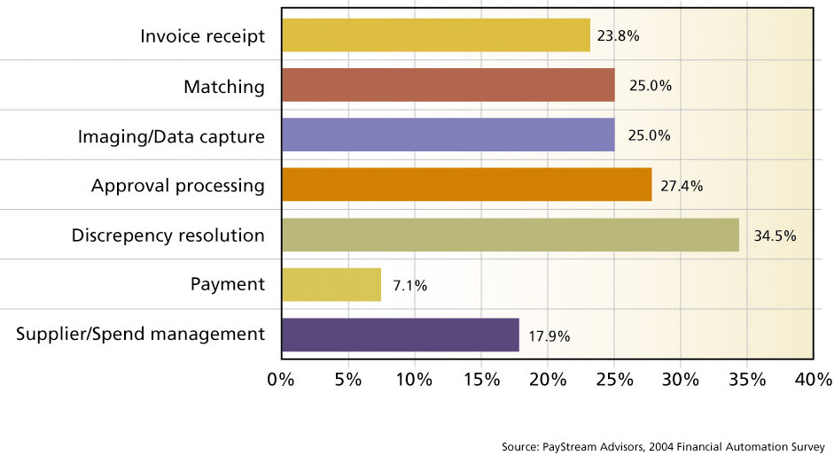
Top pain points for AP processes
AUTOMATING ACCOUNTS PAYABLE
Source: PayStream Advisors Financial Automation Survey http://www.paystreamadvisors.com/
Notes:
An interesting Paystream advisors Financial Automation Survey asked the question, “What are the top pain points in the AP process. Of those many companies who responded, these are the results:
Notice the two largest ones are Discrepancy Resolution and Approval processing. These are followed by Invoice Matching and Imaging Data capture.
So these are principal targets if we want to capture the Low Hanging fruit in automating the accounts payable environment.
Double Payments
Late payment penalties
Early payment discounts
Incorrect payments
Telephone queries
Storage Costs
Lost Invoices
Reporting
Compliance Issues
Photocopying time and costs

Slide 6
What are the Business Issues we see? Accounts Payable Management
AUTOMATING ACCOUNTS PAYABLE
Repetitive manual data entry
Line item matching
Low quality of data caused by human error
Cost control / high A/P operational costs
Inefficient invoice storage and retrieval
Invoices get lost, fraudulent invoices, duplicates
Penalty for late payments
Poor supplier service levels
Challenges with financial reporting
Cash management
Corporate compliance / Sarbanes-Oxley
Notes:
So what are the challenges that we encounter as we talk with companies?
Well, obviously a lot of unnecessary and manual activity
Line Item matching
Keying, copying faxing, phone calls
Because of the manual activity
data quality may suffer due to human error during keying for example.
Cycle times are way too long which leads to
Discounts being missed
You may incure penalties for late payments
Suppliers may not be happy – many times it may even impact your credit rating.
Because it is paper and not in the viewable system until later in the process visibility is very low
Cash management is difficult
Challenges with financial reporting
Invoices get lost

Slide 7
There is a lot you can do
AUTOMATING ACCOUNTS PAYABLE
Manual keying: Eliminate
Verification and validation: Reduce costs dramatically
Registration and allocation: Reduce costs
Personal copies: Eliminate
Archiving : Reduce costs dramatically
Late payment penalties : Eliminate
Write-offs : Reduce
Early pay discounts: Get them
Notes:
The good news is – There’s alt you can do to eliminate these challenges.
Paper is the culprit. As long as it is physical, it spawns a lot of manual activity. If we can capture the data into an electronic form we have solved most of the challenges.

Slide 8
Invoice Automation…it’s a good thing
AUTOMATING ACCOUNTS PAYABLE
Aberdeen Group
The use of electronic integration, messaging, reconciliation and reporting solutions in accounts payable reduced transaction cost between 63% and 67%.
Most companies have moved to a shared services model to improve policy and process compliance. Yet, only 3% of accounts payable processes reported having a high-level of automation.
79% of AP managers see "automation" as the key enabler to future success.
The invoice reconciliation and payment solution framework addresses invoice receipt, approvals, reconciliation and payment considerations for solution selection.
(From the Electronic Invoicing Solution Selection Report)
Notes:
Aberdeen Group says the automation can reduce transaction costs by as much as 67%
Interestingly, although companies have largely moved toward the SSC model, only a fraction have highly automated their processes.
But most AP managers recognize that this is something they should do. As you can see this is on the radar of 79% of them.
Obviously the Aberdeen Group thinks there is a lot of untapped potential in invoice automation, and we certainly have seen this as well.

Slide 9
Better control and security
AUTOMATING ACCOUNTS PAYABLE
Fast and simple electronic distribution
Full control of your document flow
Electronic account coding and payment authorization
Easily accessible information
High security
SOX compliance support
40-60% cost savings
Notes:
If invoices are digital, we can
Make them available to anyone in the organization that needs to see them.
We can build business rules that route them around to get approvals or resolve discrepancies
Because the data is electronic we have visibility of
total liabilities
and also of where an specific invoice is in the process.
And what would take weeks can be done in a fraction of the time.

Slide 10
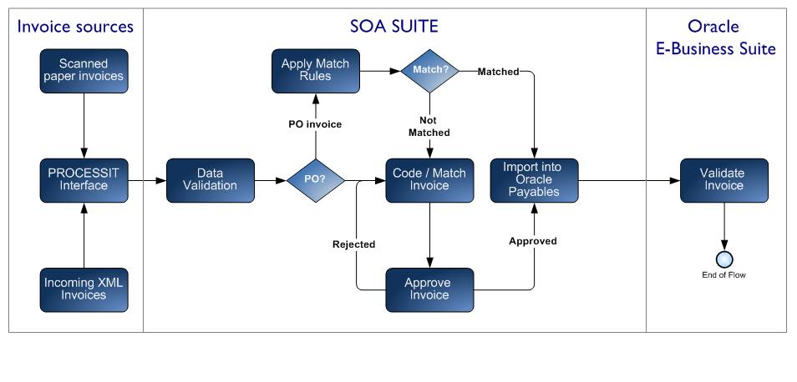
ReadSoft PROCESSIT Architecture High level workflow description
AUTOMATING ACCOUNTS PAYABLE
Notes:
This slide shows how an automated solution fulfills this vision of an automated solution. The invoice comes to your company either in paper or electronic format (an electronic format may be invoices that are attached to emails for example).
The INVOICES solution captures the image of the invoice.
The image is passed to an archive and the header and line item details are passed to the invoice Process within Oracle.
If it is a general expense invoice it is electronically routed for proper coding and approval and posted.
If it is a PO based invoice – it is automatically matched with the PO and goods receipt and automatically posted. If there are discrepancies, it is routed for correction and then posted.

Slide 11
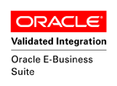
Upgrading to EBS R12.1
AUTOMATING ACCOUNTS PAYABLE
Many organizations took a “wait and see” approach to R12
Need to consider customizations in R11.x
EBS R12 is the bridge to Fusion Applications
If you are considering or in process of R12.1 upgrade, be sure any vendor applications are validated through Oracle.
Notes:
Now let’s talk about the current Oracle market and the R12 release from Oracle.
From the Gartner advisory - they report that
- as of this fall, ess than 5% of customer base moved to R12.1.
- Many of the Fusion Applications s are still a ways away and will be somewhat complex.
- Many organizations taking a wait and see approach
Your company may be considering when to upgrade to R12, or perhaps you are in the process now.
The key point is, be sure that your add-on applications are recognized and validated by Oracle.
The ReadSoft Accounts Payable solution is available in both R11 & R12 releases and are Validated by Oracle

Slide 12
AUTOMATING ACCOUNTS PAYABLE
ReadSoft AP automation solution - Validation by Oracle
Thoroughly tested and approved
Operates in your familiar Oracle environment
Security and Support is guaranteed by Oracle
Supports Oracle version upgrades
Notes:
Why is Oracle Validation so important?
To become validated and approved a solution must go through extensive analysis and testing
It is insurance to you that
Oracle Security and Support guarantees will not be in jeopardy
and that future Oracle releases will be supported

Slide 13
Oracle integration
AUTOMATING ACCOUNTS PAYABLE
Business Needs
ReadSoft Solution
Oracle Integration
Oracle validation for PO, supplier, site, duplicate invoice, contact person etc.
Use of E-Business Suite components such as legal entity, GL code combinations, users, employees, responsibilities, hierarchies, AP/PO options, Oracle standard workflow engine, profile options etc.
More accurate information, using existing Oracle set-up:
Automatically assigns organization code
Automatically assigns supplier/site
Prevents duplicate invoices
Checks for valid PO
Uses existing COA, code combination, Hierarchies etc.
Uses Oracle standard workflow engine
Uses standard Oracle validation rules & hold codes
Notes:
The ReadSoft solution is built to leverage the exiting Oracle tools and capabilities such as
The workflow engine and standard routines. So it basically eliminates any redundancies of functionality. So it’s a better use of your investment dollars.
Incorporates the standard Oracle workflow engine. These items listed here are some illustrations of that.

Slide 14
Single source vendor
AUTOMATING ACCOUNTS PAYABLE
Business Needs
ReadSoft Solution
One Stop Shop
The OCR to Oracle solution for automated AP processing on the market developed and supported by the solution provider
We can provide customers with support for all areas of the solution – no grey areas
Because document recognition and Oracle workflow components are from the same company:
You only need to call ReadSoft
Same solution across the world, software, implementation & support
Upgrades guaranteed to work
No risk with multiple vendors
Product roadmap known
Notes:
Nothing more frustrating than hearing it’s an Oracle problem, call their support, or it’s a sub vendor issue. ReadSoft basically provides both the front end image and OCR as well as the Invoice Management. This gives you one vendor accountability. Which is a big plus.

Slide 15
Low risk
AUTOMATING ACCOUNTS PAYABLE
Business Needs
ReadSoft Solution
Proven Solution
Industry leaders in AP Invoice automation
More installations than any other solution provider
Low risk for our customers:
Market leader
Experts in OCR
Experts in AP
Experts in Oracle
Notes:
We think this all adds up to a low risk way to approach accounts payable automation.

Slide 16
Invoice Automation in practice: Graco
AUTOMATING ACCOUNTS PAYABLE
Graco, Inc.
World leader in fluid handling systems and components
Pain Points:
Too much time wasted keying invoices
Too many lost discounts
Couldn’t locate invoices
Low visibility
Invoice Automation Results:
Initial goals set for two years were met within the
first six months
Staff cut in half within the first four months
Average invoice processing time dropped from 24
days to 9
70% of invoices are not touched by staff
Notes:
But enough about ReadSoft. Let me introduce you to the Graco company. Graco is located in the upper midwest and specializes in fluid handling systems.
This is from a recent presentation given by them. They had the same typical issues we have been discussing.

Slide 17
What you can learn from Graco’s experience
AUTOMATING ACCOUNTS PAYABLE
AP process automation can pay big benefits with…
Thoughtful preparation
Identifying needs and goals
Assigning & empowering staff resources
Consider implementation phases & schedules
Be prepared to adapt and adjust, but…
Always keep the scope of each phase as a touchpoint
Notes:
I hope you can relate to their experiences and how they overcame challenges in the process.
As a recap, I’d like to point out some of the key concepts from Graco that you should keep in mind as you think about automation.
Automation can produce dramatic cost savings and efficiencies but it doesn’t happen overnight.
Like Graco you need to really assess where you are today.
Document your current AP status and what you would like to change about it.
Set a benchmark for your goals.
In other words, what do you want the system to look like when you are complete?
How will you judge the success of the project?
Trust your staff and give them the support to make changes.
After all, they are the ones who are living with it day to day.
Since implementation is a very dynamic process, changes will occur along the way.
So be sure your partners are flexible. Can they adapt to changes?
Having said that, I’d advise you really work to contain the scope of the project at each phase or milestone.
If you do not really control change requests during implementation, the project will exceed your budget.
Graco did a great job at balancing change with project focus.

Slide 18
Additional Customer Successes
AUTOMATING ACCOUNTS PAYABLE
Vodafone
Processed 50% more invoices in 2nd month after implementing ReadSoft
Kellogg’s
50% of PO-based invoices go from Scan to Post untouched
Green Mountain Power
Enabled to take early payment discounts, greatly reduced vendor calls, and majority of top vendors are now enabled to send PDFs instead of paper
Alcan
Significant reduction in manual processing, data entry, filing and retrieval; majority of PO-based invoices automated
Sheridan
3-month installation, including testing and go-live; able to negotiate significant discounts; able to process more invoices with fewer people; able to report in real-time on vendor spend
Notes:
After the webinar you’ll be sent a link where you can view video interviews from Graco and several other companies who have been through this process. If you are contemplating a project it should be very helpful.

Slide 19
When Considering AP Automation…
AUTOMATING ACCOUNTS PAYABLE
Know the difference between “it can” and “it does”
Questions and dialogue with potential vendors
Was it designed to work in your environment?
Know yourself
Are you hands-on ready or do you expect turn key?
How involved in detail planning & process implementation can you/do you want to be?
Start with an assessment
Don’t underestimate the culture fit
Know where you are today and where you want to go
Notes:
So what do you do next?
First - Develop functional requirements
Next align your requirements with potential solution capabilities.
As you evaluate vendors, it’s important to go beyond vendor claims. Drill into the capabilities to be sure they are a match to your requirements.
At the end of the day you are the one responsible for making sure capabilities are real.
And remember, no feature will matter if the solution isn’t designed to work within Oracle EBS.
I would also point out that you should evaluate the cultural fit between you and your potential vendor.
Is this vendor compatible with how your company does business?
Graco and ReadSoft forged a great partnership that I can truly say benefited both companies.

Slide 20
Benchmark Your Performance
AUTOMATING ACCOUNTS PAYABLE
The Hackett Group has developed a tool with ReadSoft to help you benchmark your AP process performance
Comparison to world class organizations, peer groups and median performance
A ReadSoft consultant will walk you through the assessment tool and provide an actionable report
Notes:
What can you do today? I’d recommend starting with a benchmark of your current practices. We have worked with the Hackett Group to develop a good benchmarking tool.
Here’s how it works. Our consultants would be happy to walk through a short interview process. This will help to score your current practices. This is a good start to assess where you are today.
If this makes sense for you, there is no cost or obligation to participate in the benchmark assessment.

Slide 21
Q&A
Cliff.Autin@ReadSoft.com
Notes:
Thank you again for your participation today. We’ll now open the webinar to questions.

Slide 22
THANK YOU
Cliff.Autin@ReadSoft.com

