Slide 1

Oracle Advanced Supply Chain Planning(ASCP)
Alternate Decisions
John M. Conlin CPIM
Principal Solutions Consultant, Value Chain & Manufacturing Applications

Slide 2
The following is intended to outline our general product direction. It is intended for information purposes only, and may not be incorporated into any contract. It is not a commitment to deliver any material, code, or functionality, and should not be relied upon in making purchasing decisions.
The development, release, and timing of any features or functionality described for Oracle’s products remains at the sole discretion of Oracle.

Slide 3
Agenda
Working Backwards - A theme that guides our thinking
    We know what we want to do, now how we do it ?
Oracle Solution
    ASCP Capabilities and Features
    EBS foundation set up and review
Why are we doing this ?
What tells us whether we are on track ?
Wrap Up/ Q&A

Slide 4
Agenda
Working Backwards - A theme that guides our thinking
    We know what we want to do, now how we do it ?
Oracle Solution
    ASCP Capabilities and Features
    EBS foundation set up and review
Why are we doing this ?
What tells us whether we are on track ?
Wrap Up/ Q&A

Slide 5
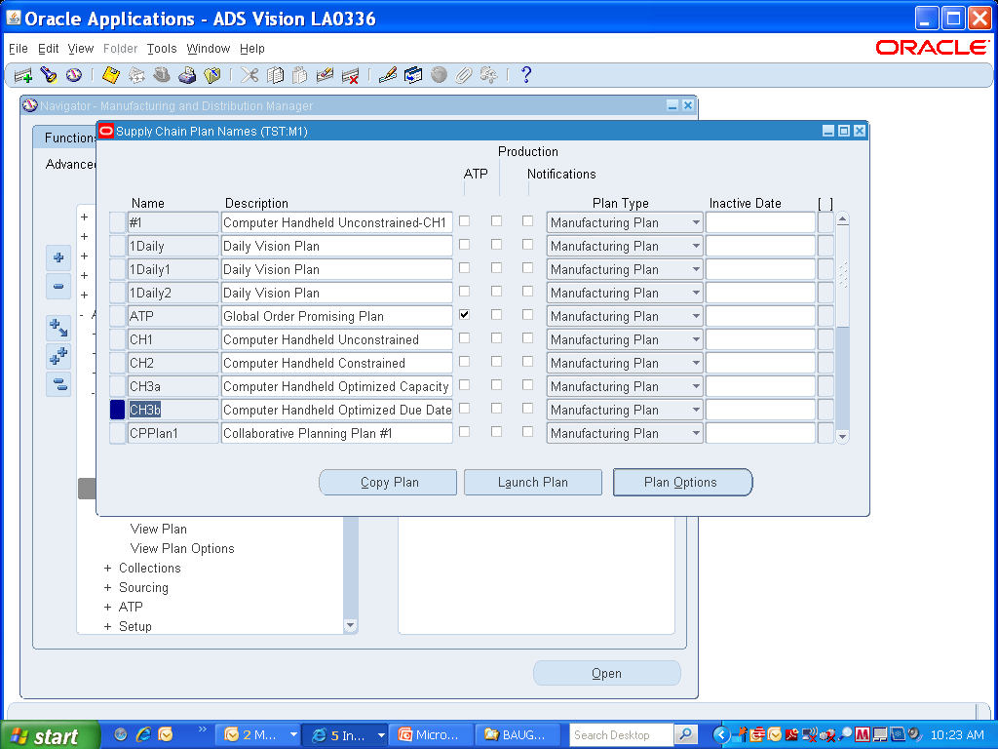

Slide 6
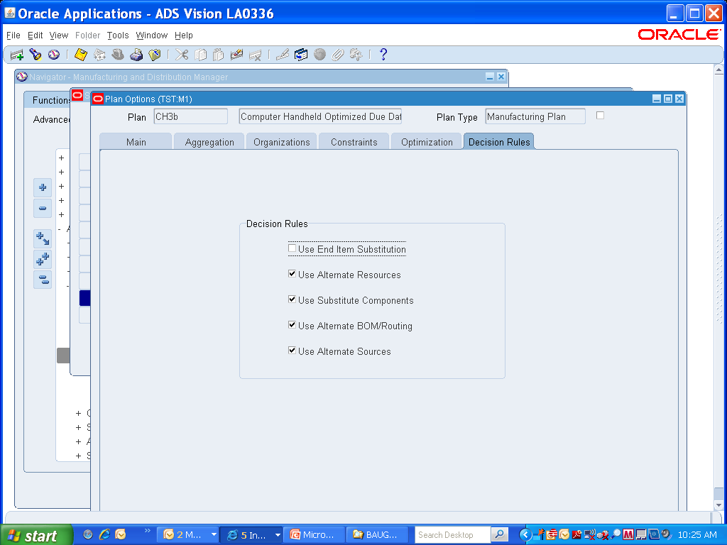

Slide 7
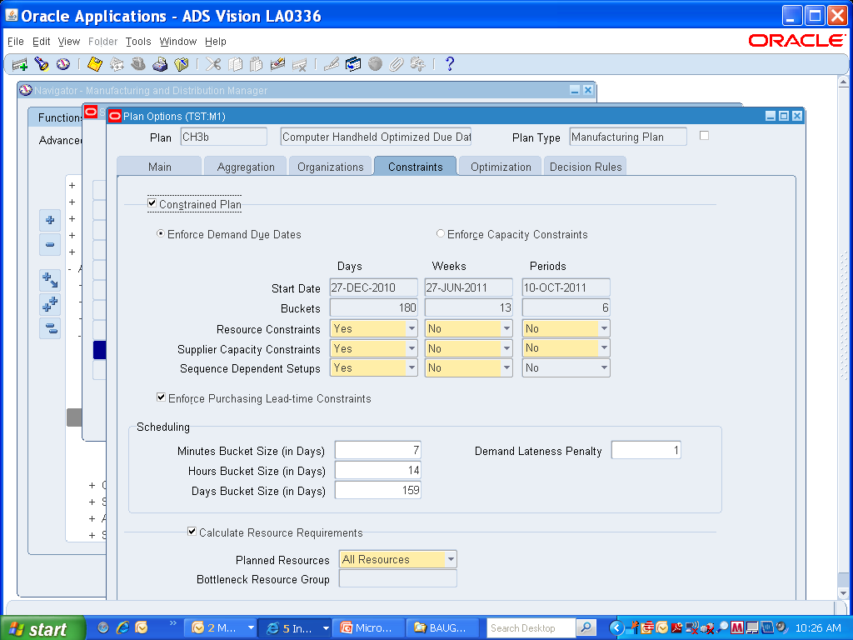

Slide 8
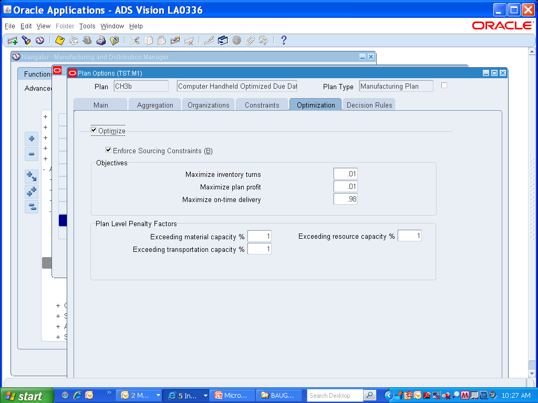

Slide 9
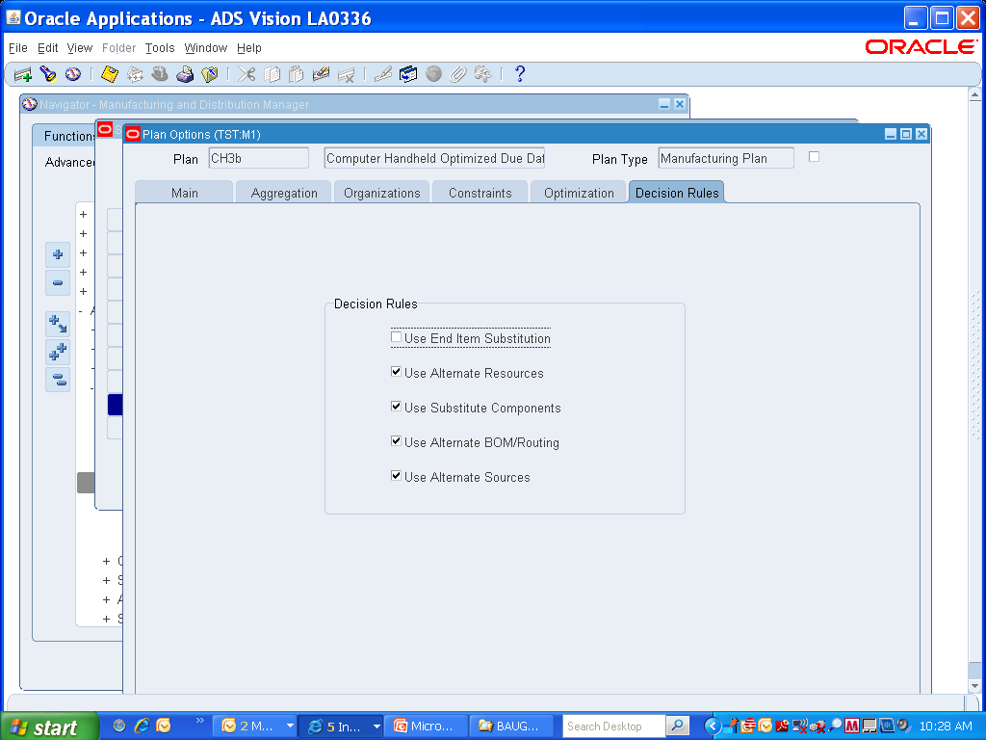

Slide 10
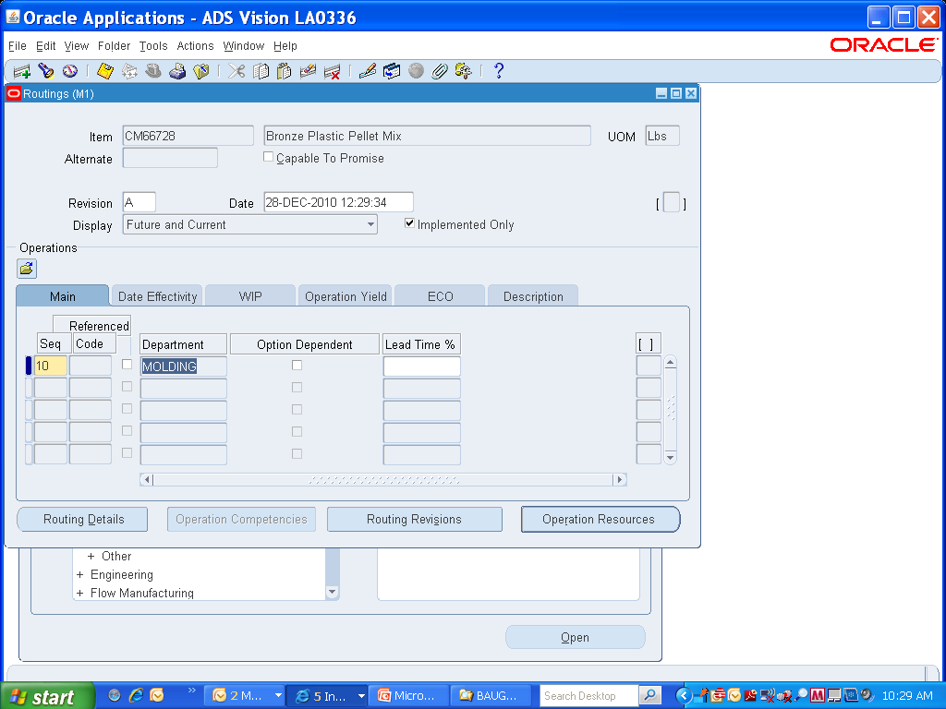

Slide 11
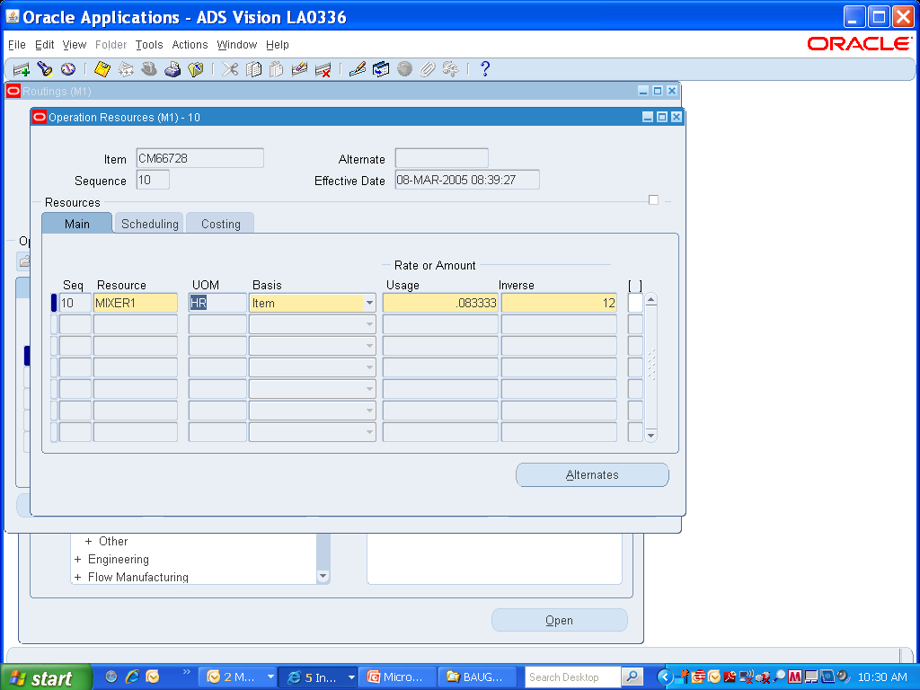

Slide 12
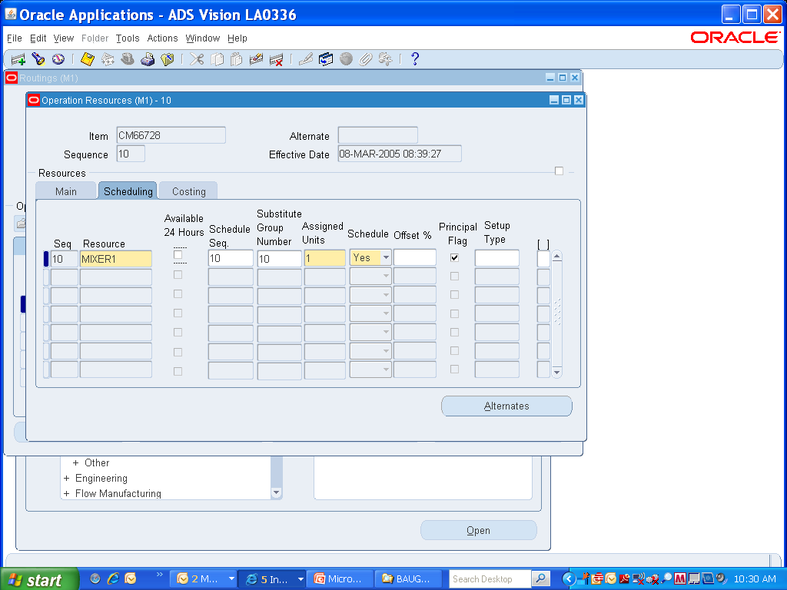

Slide 13
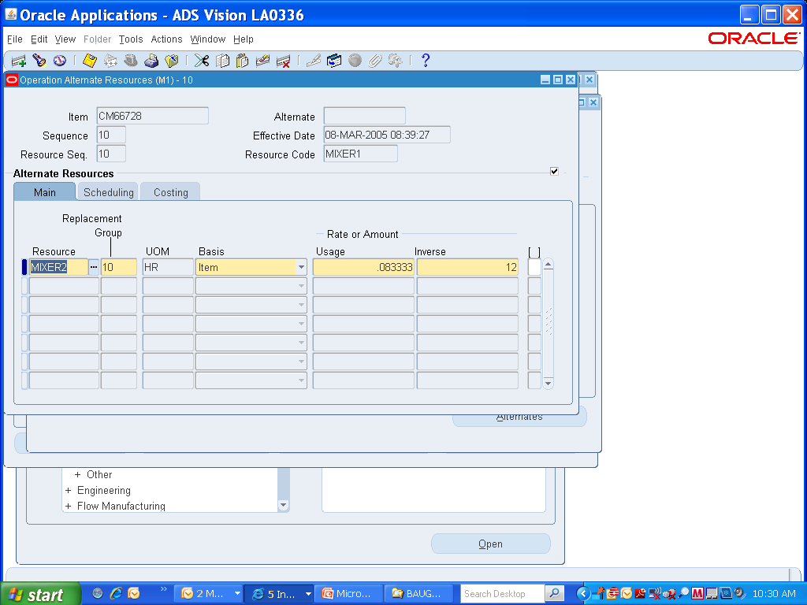

Slide 14
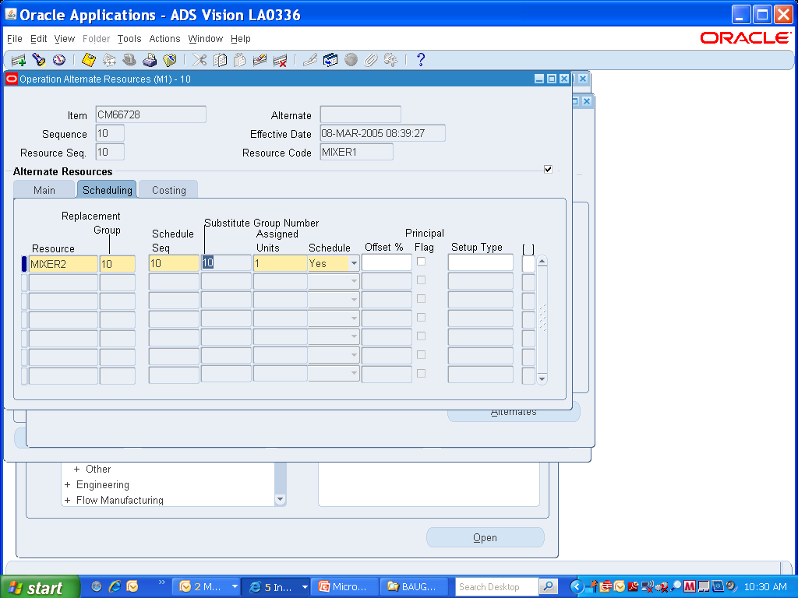

Slide 15
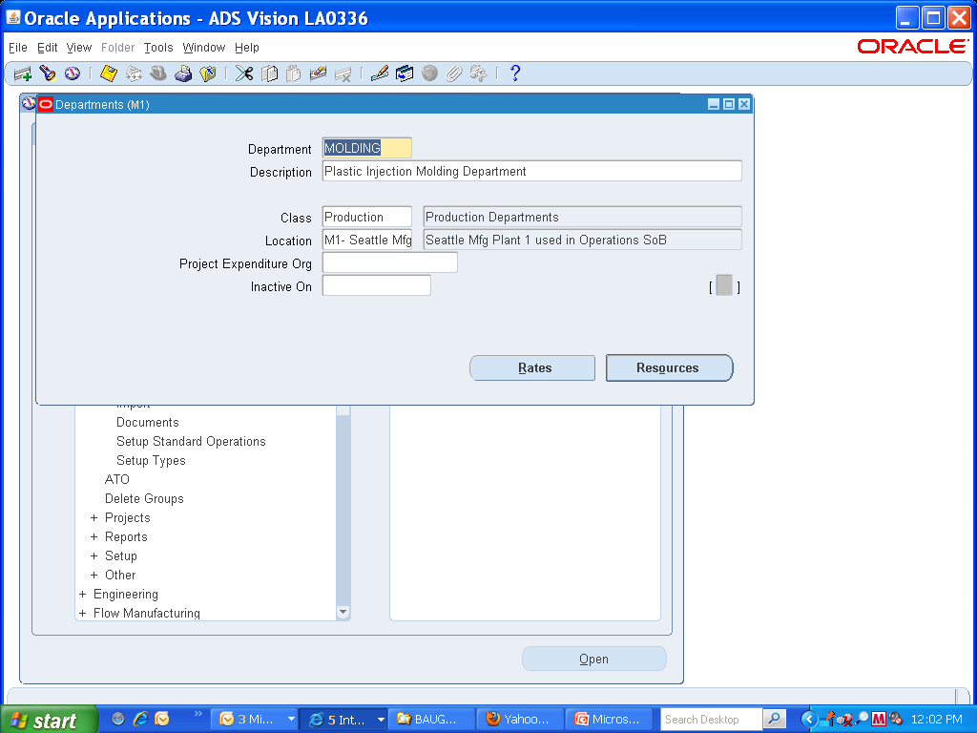

Slide 16
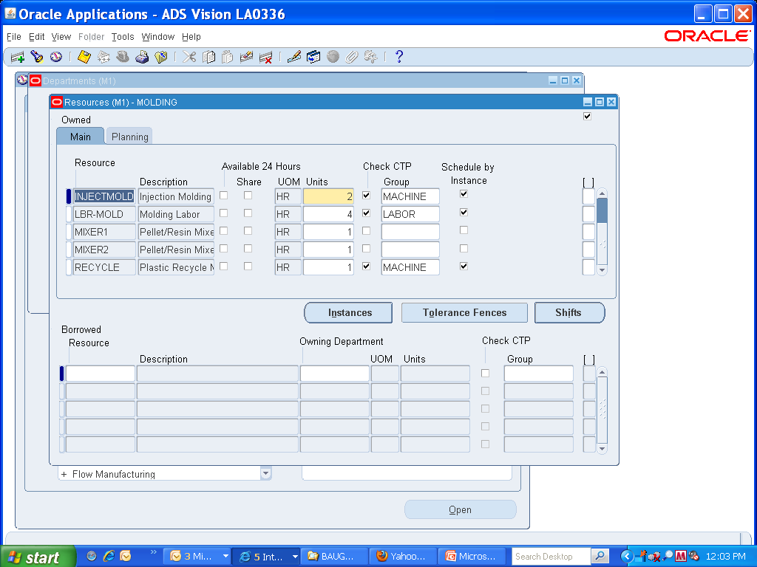

Slide 17
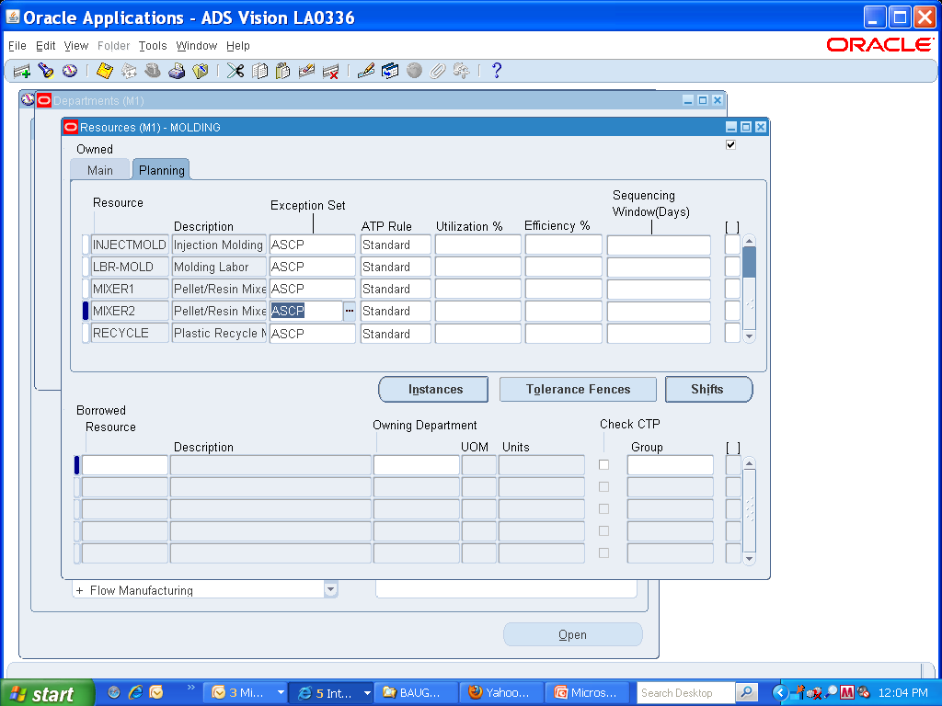

Slide 18
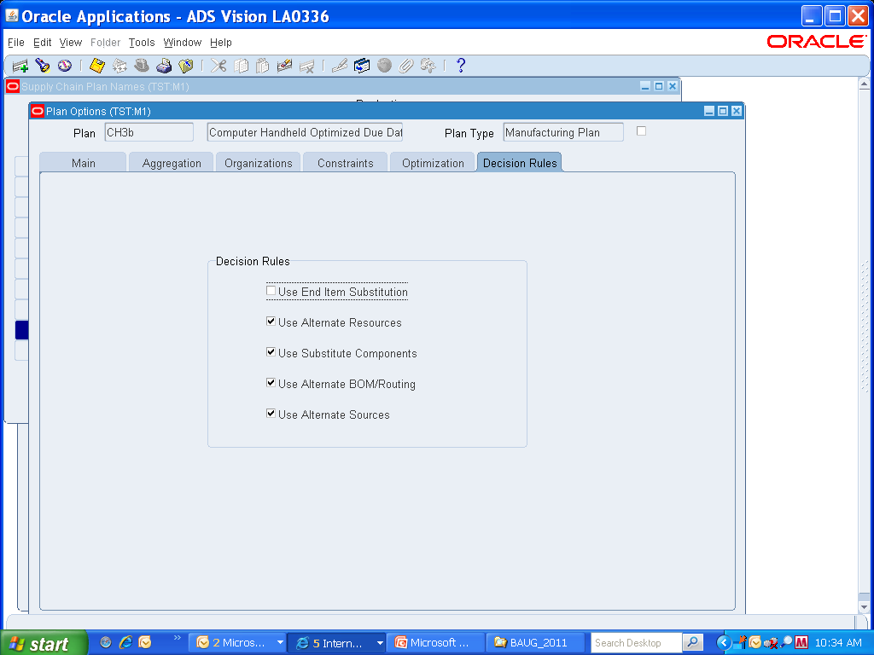

Slide 19
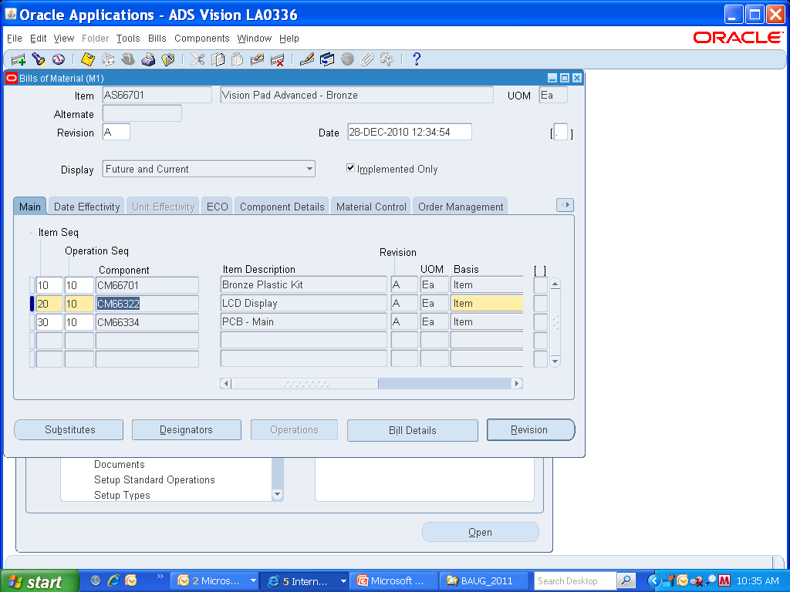

Slide 20
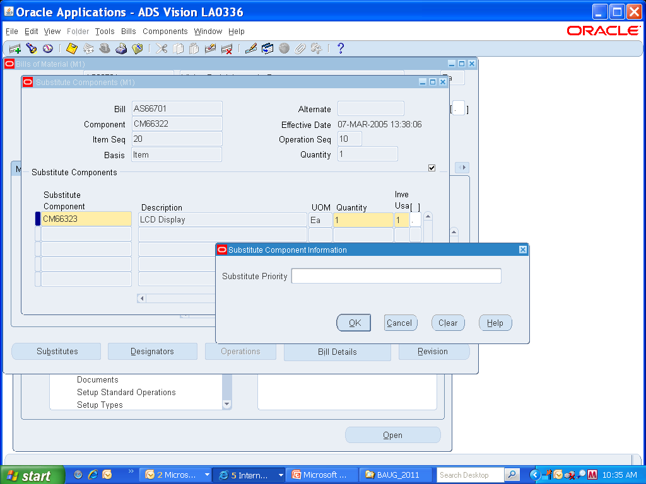

Slide 21


Slide 22
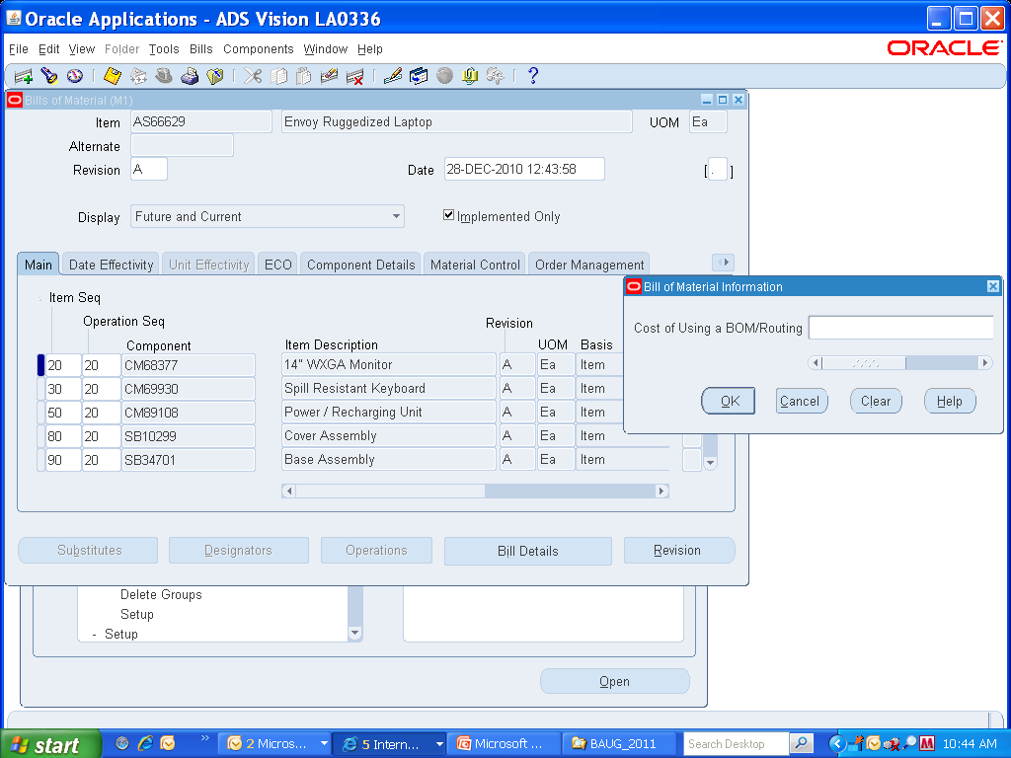

Slide 23
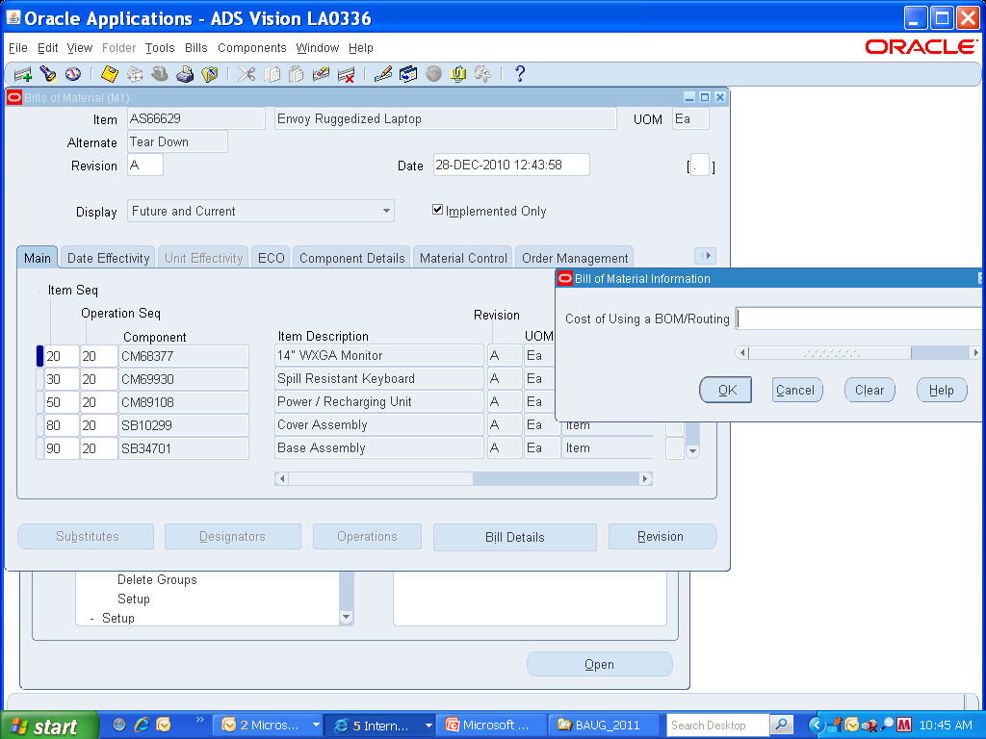

Slide 24
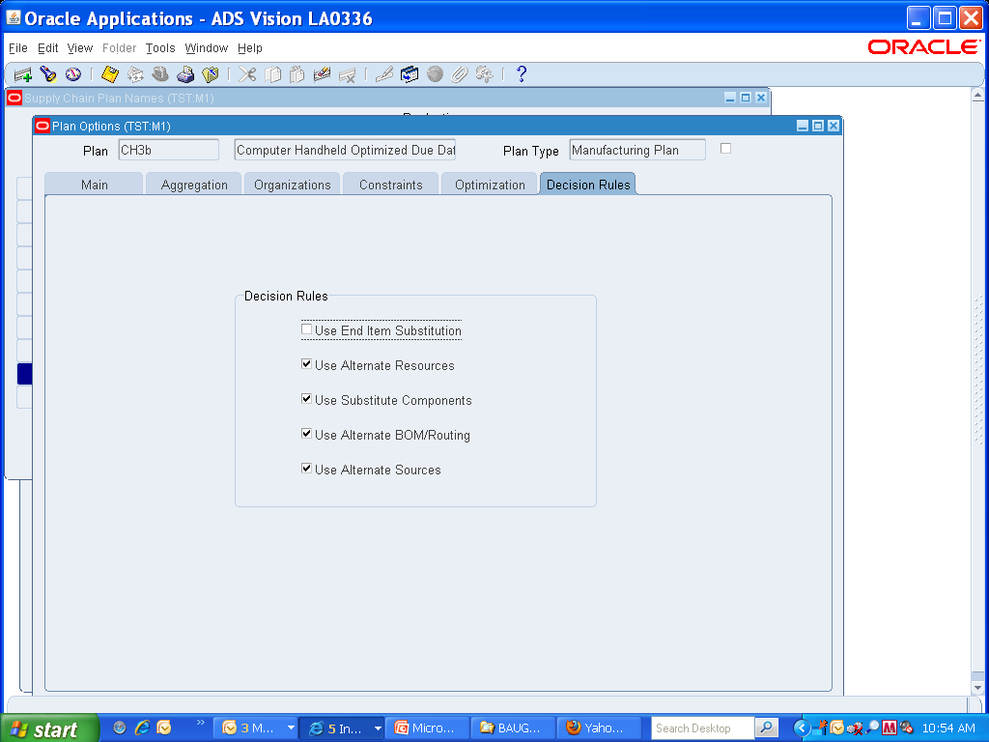

Slide 25
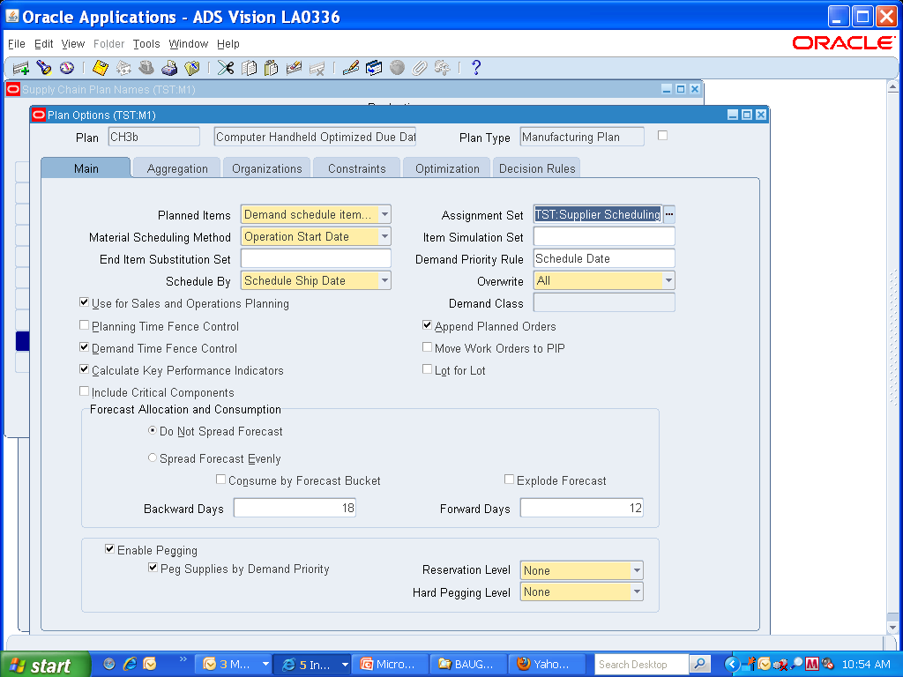

Slide 26
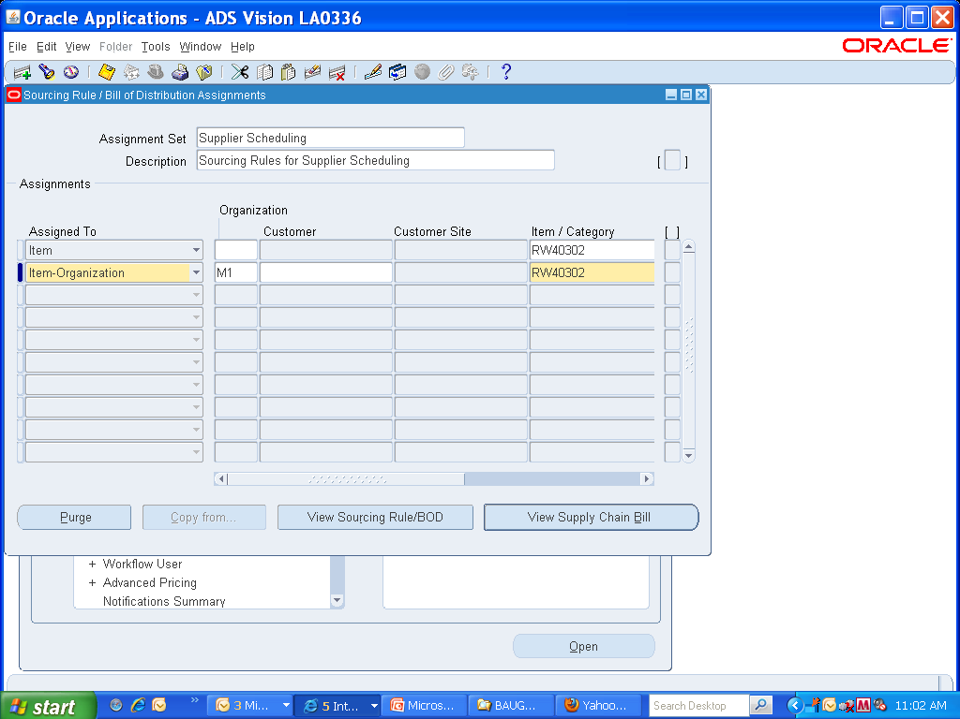

Slide 27


Slide 28
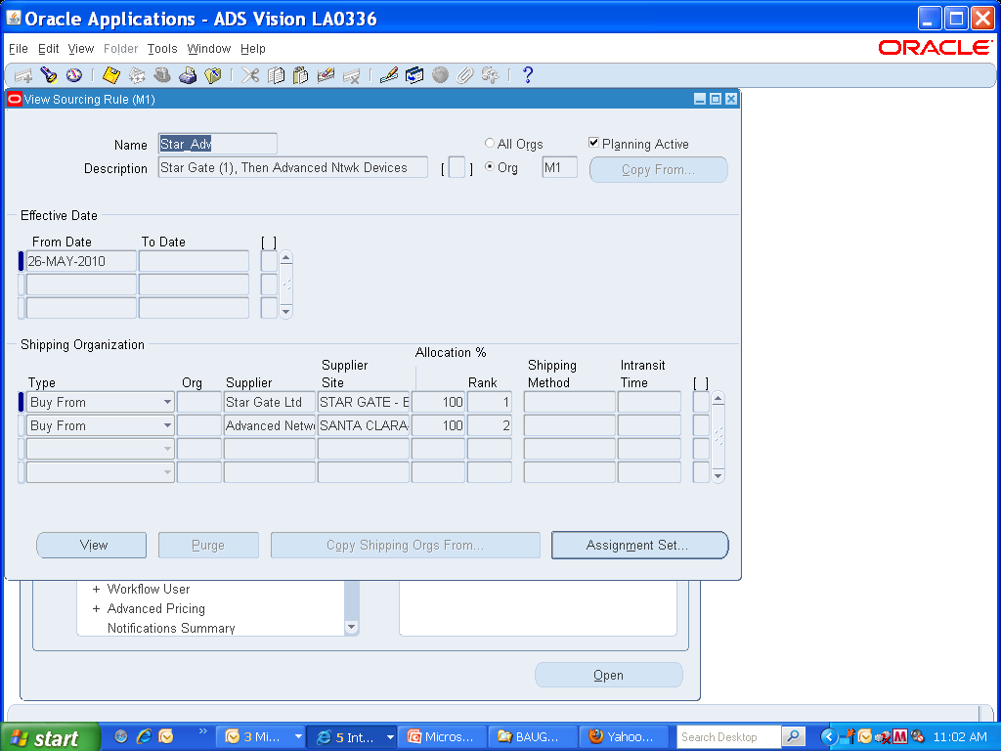

Slide 29
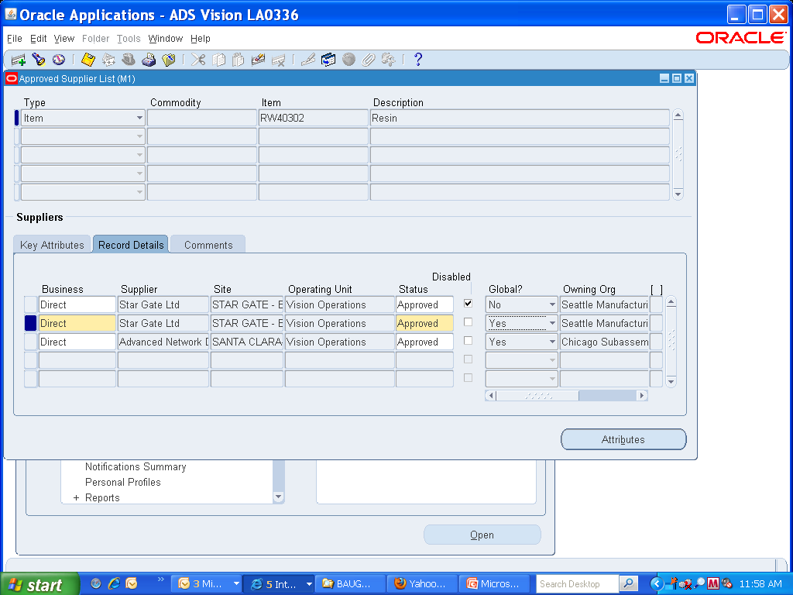

Slide 30
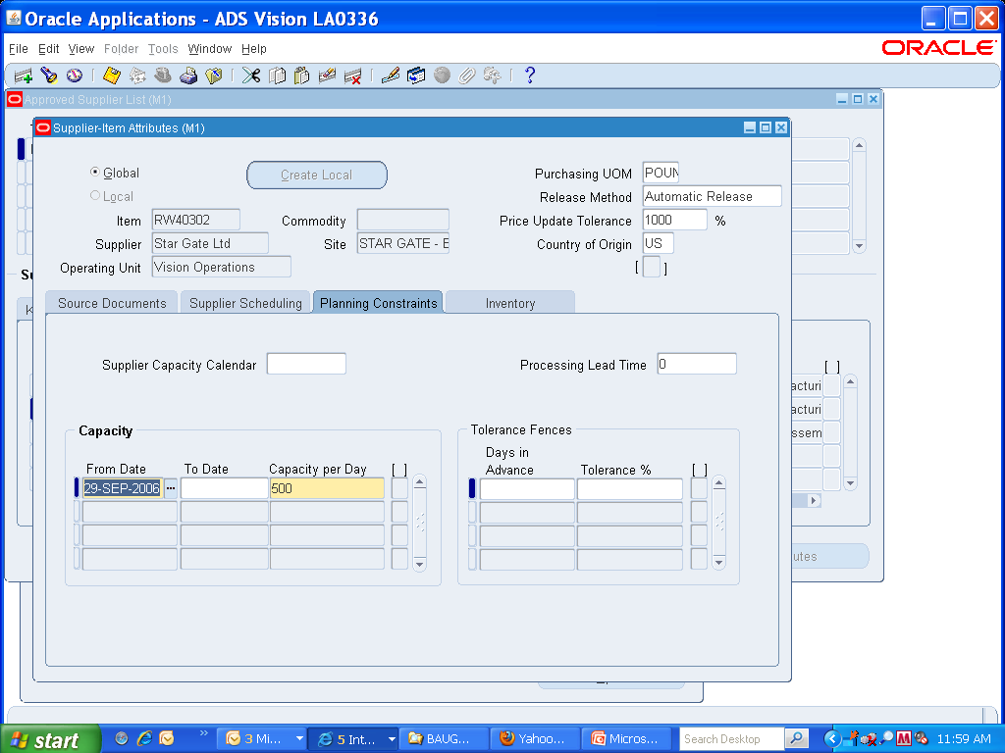

Slide 31
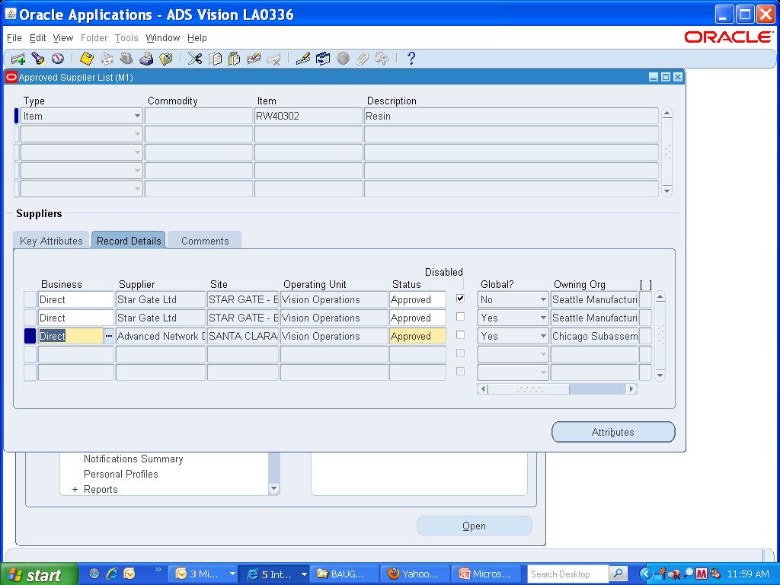

Slide 32
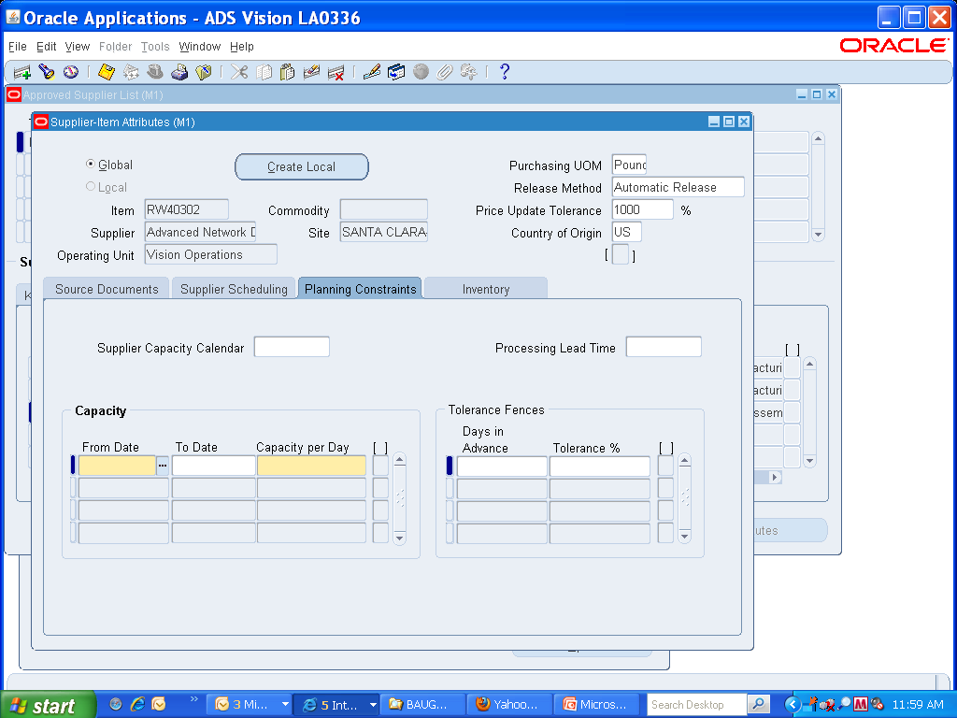

Slide 33
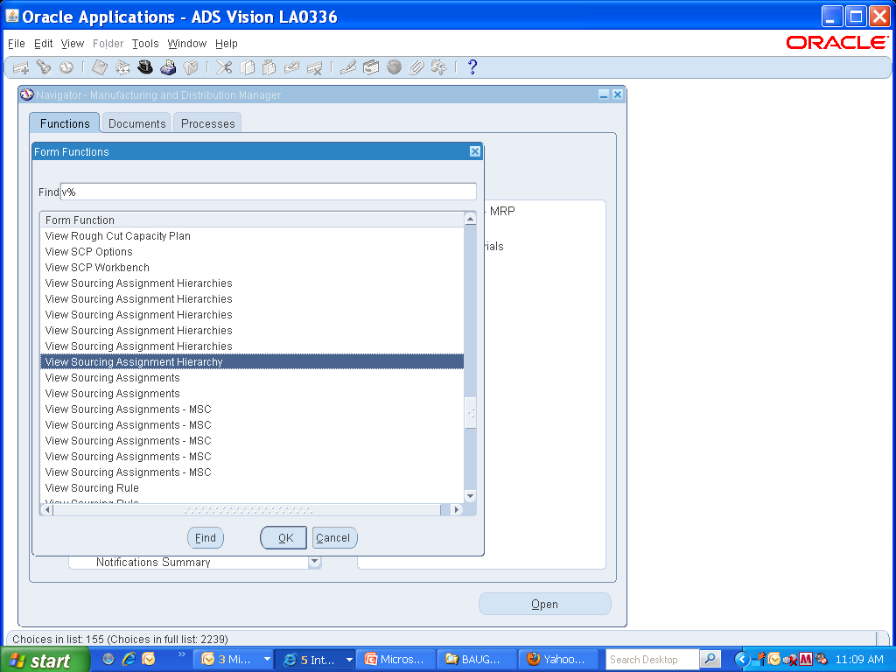

Slide 34
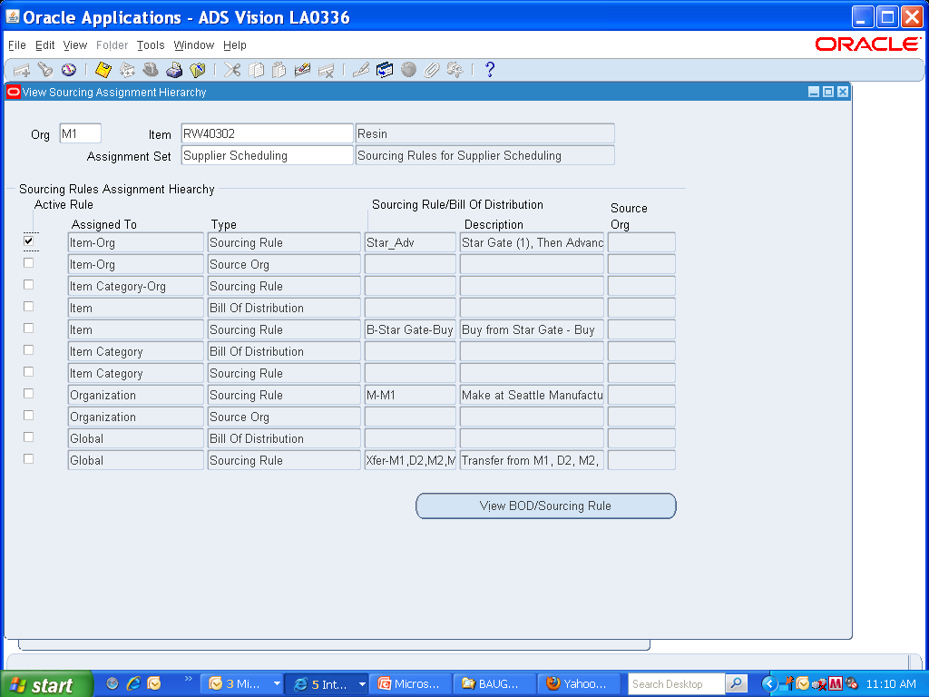

Slide 35
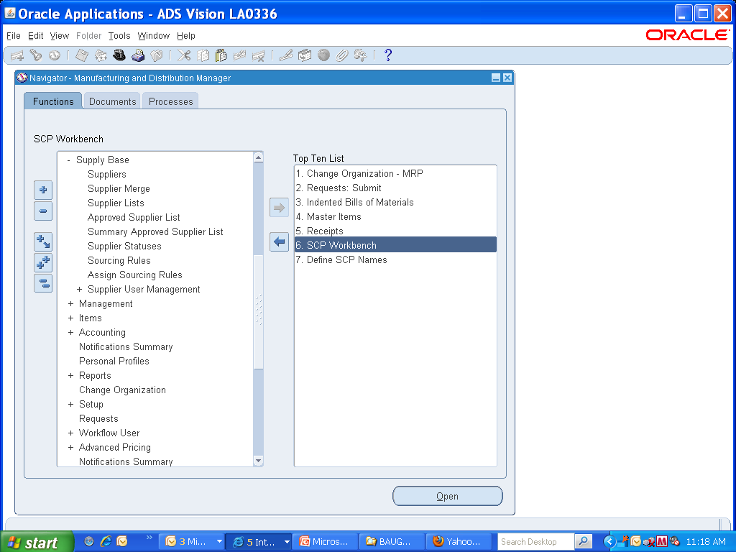

Slide 36
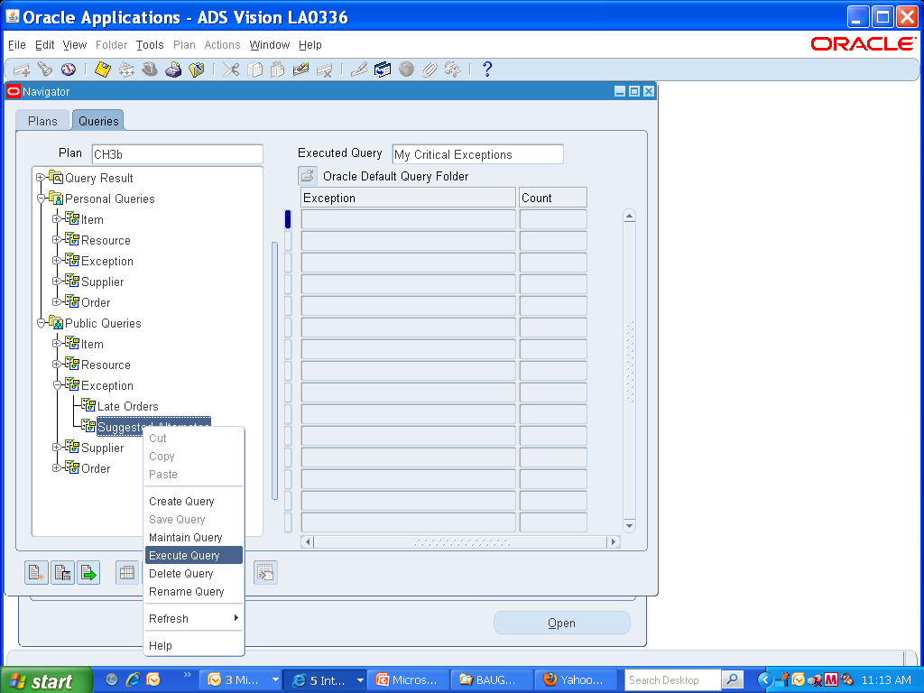

Slide 37
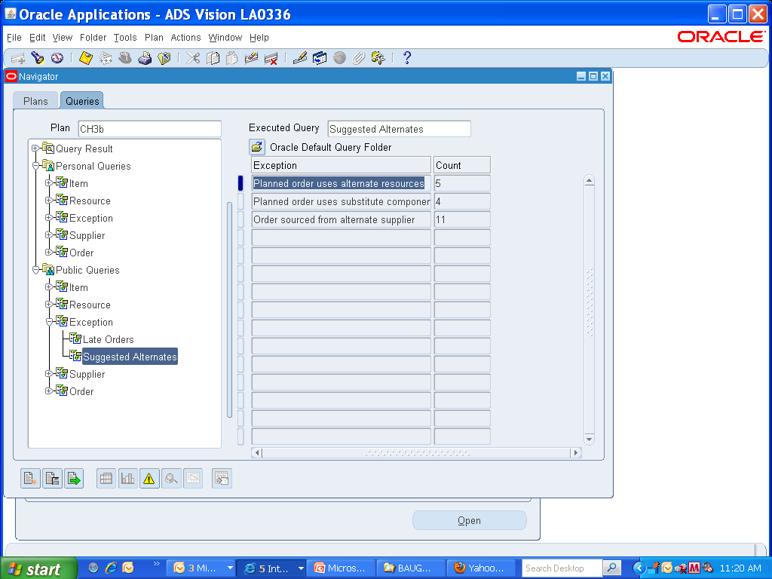

Slide 38
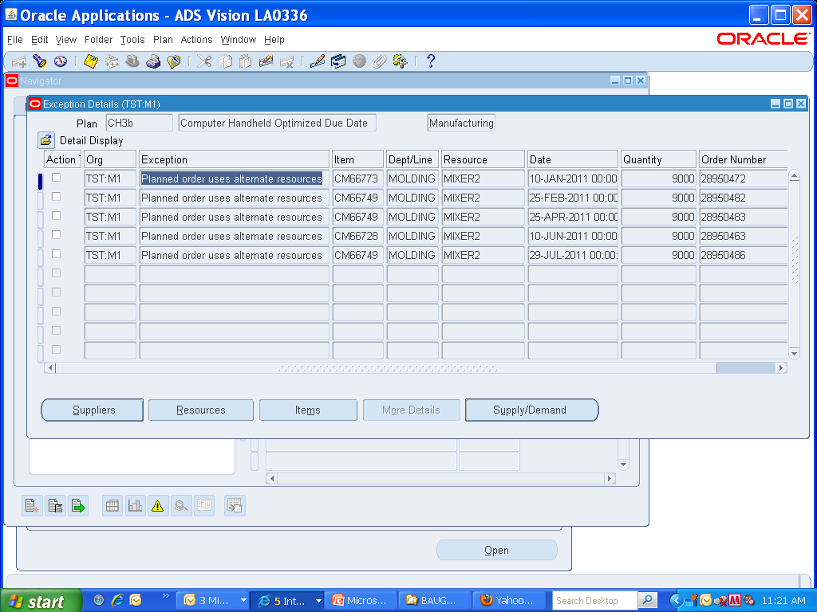

Slide 39
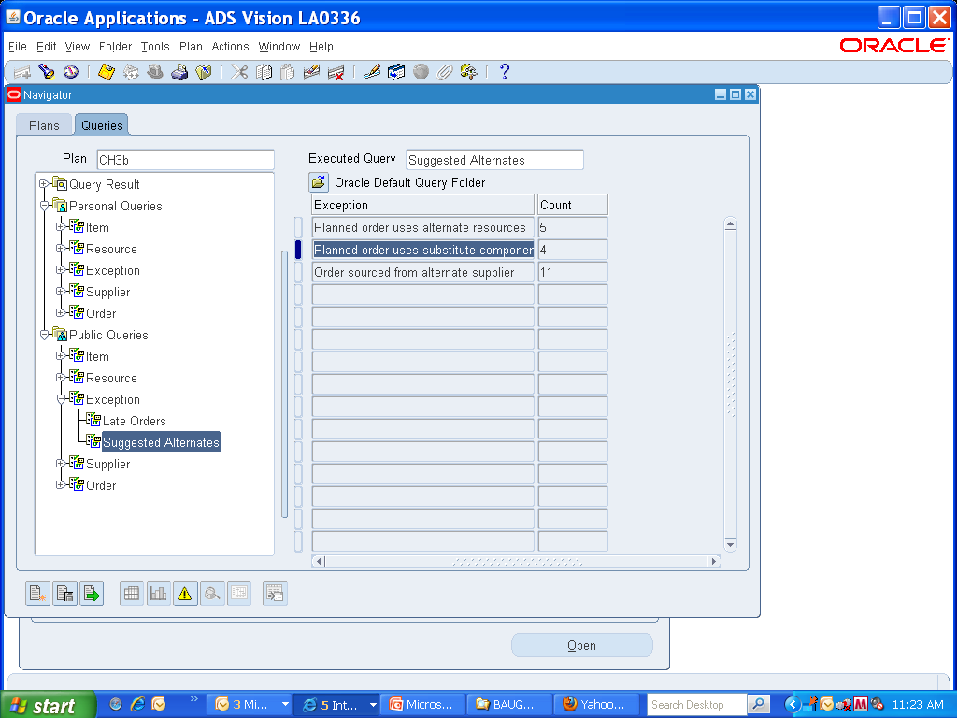

Slide 40
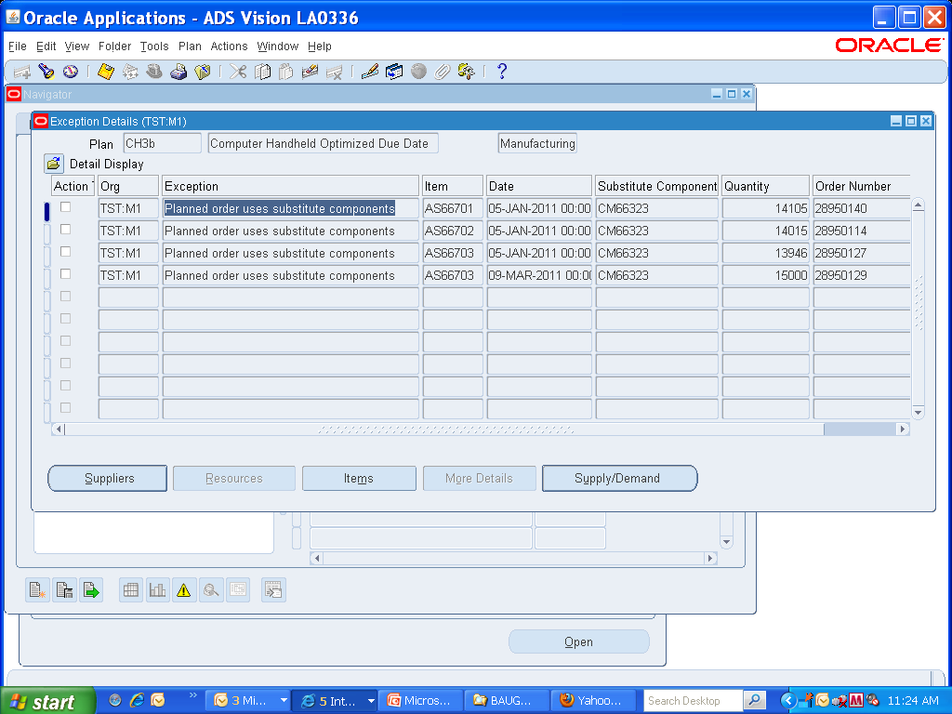

Slide 41
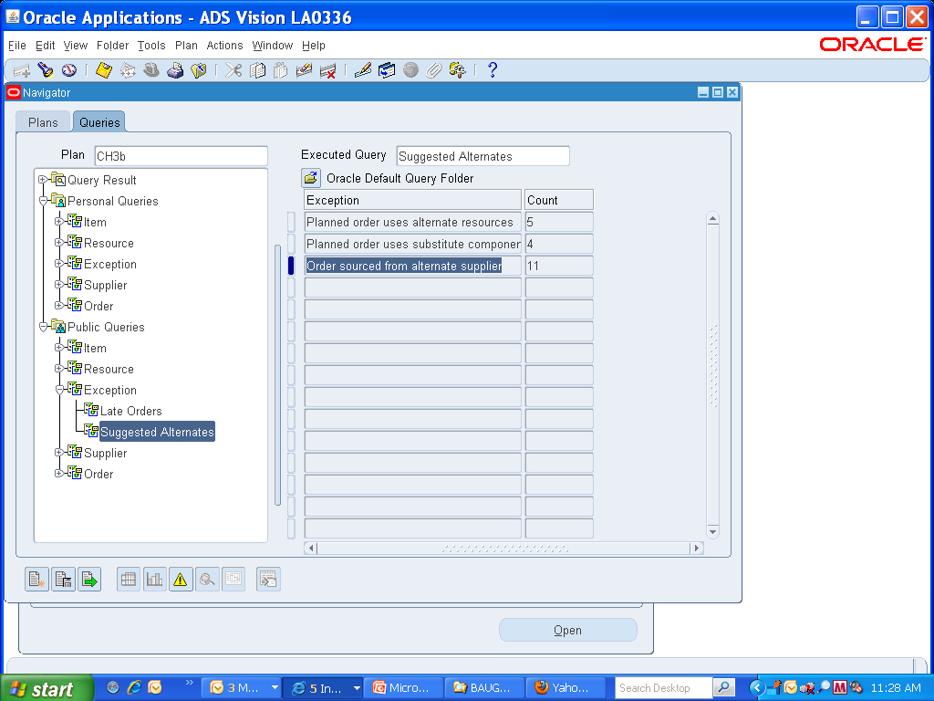

Slide 42
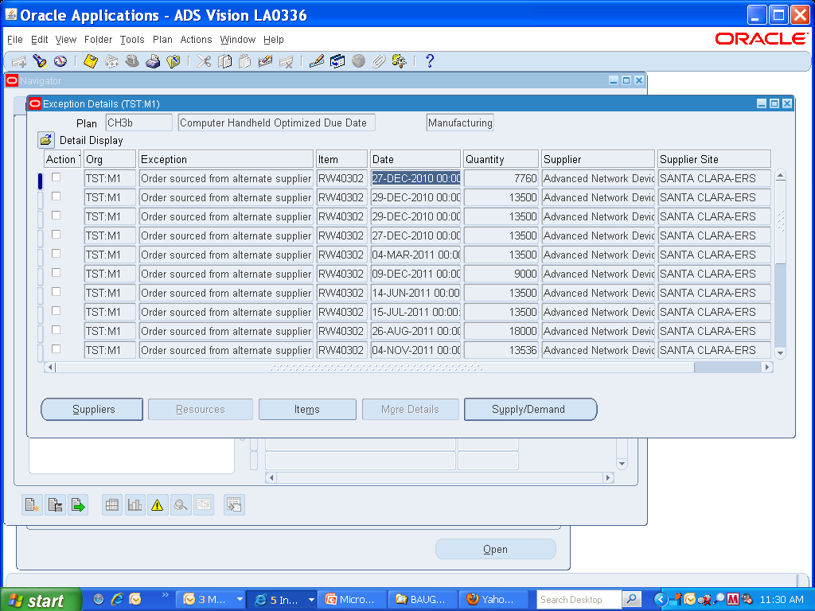

Slide 43
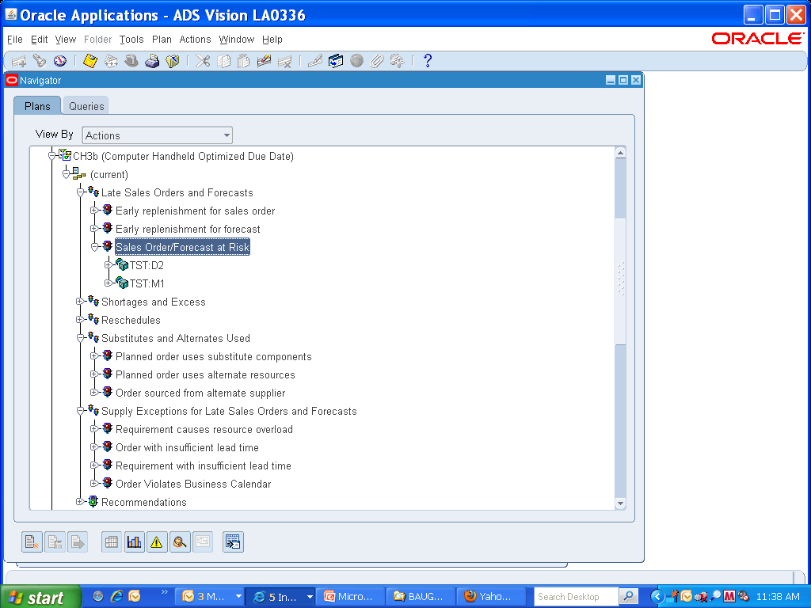

Slide 44
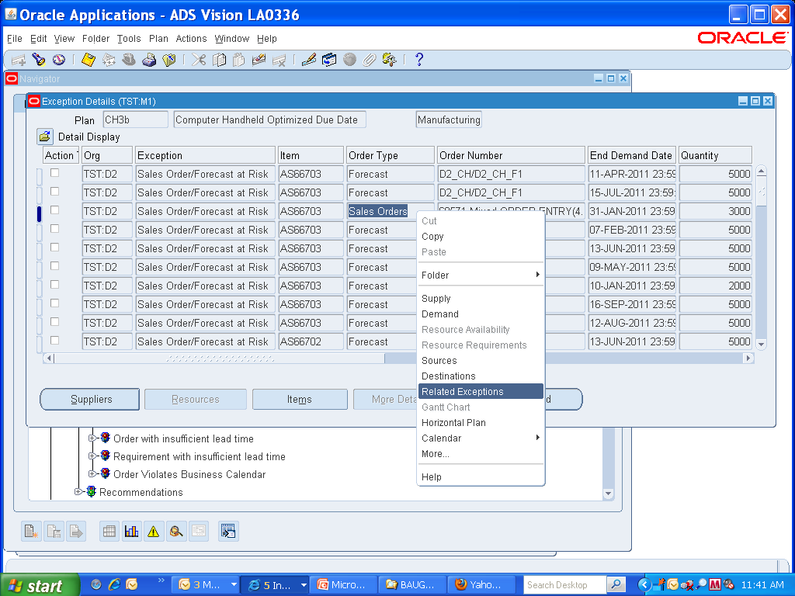

Slide 45
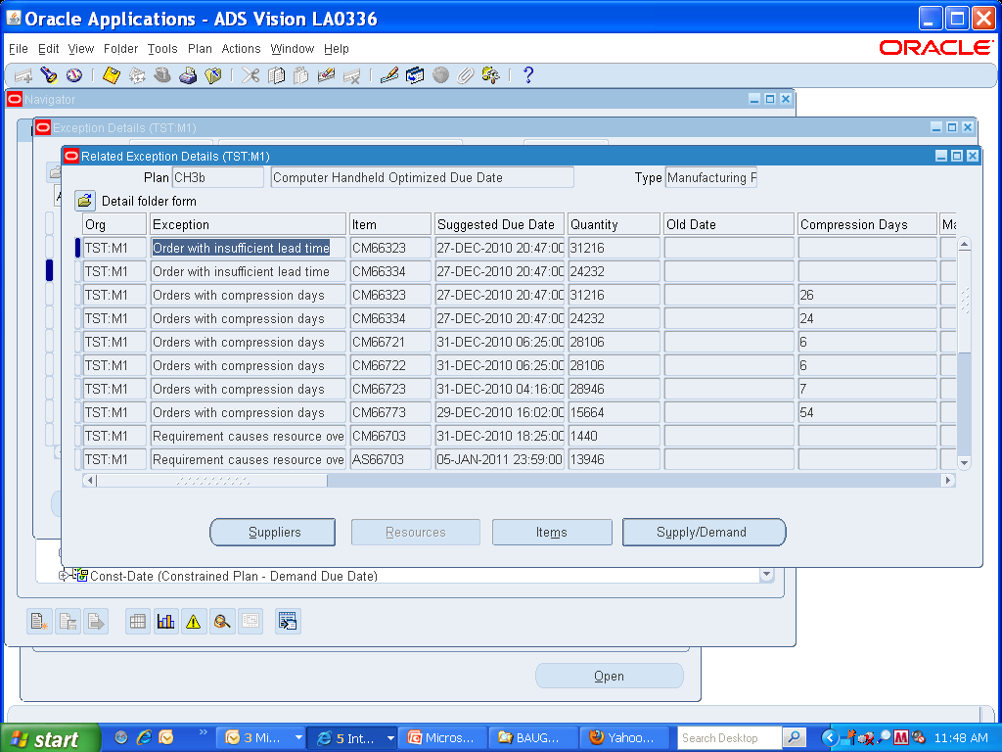

Slide 46
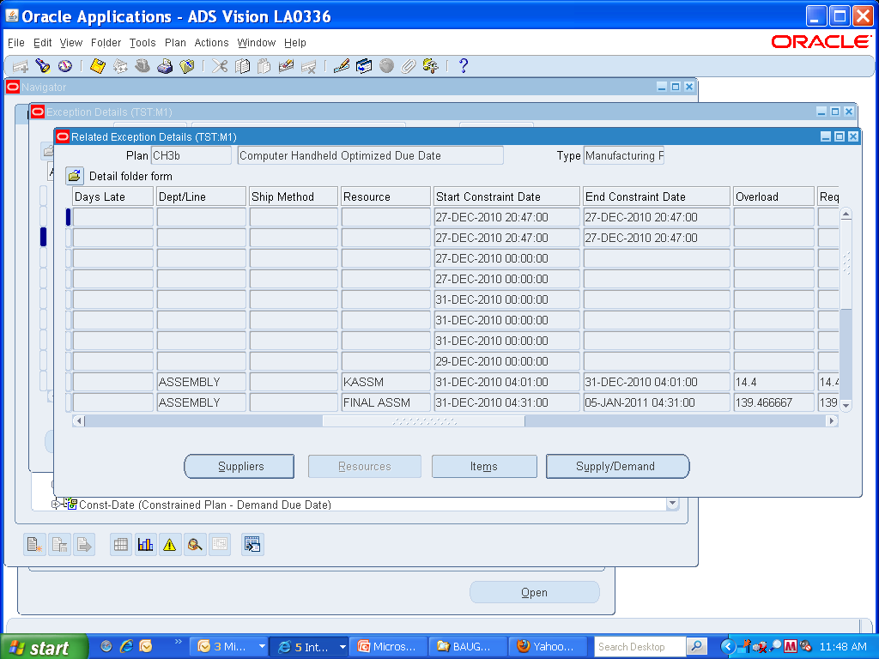

Slide 47
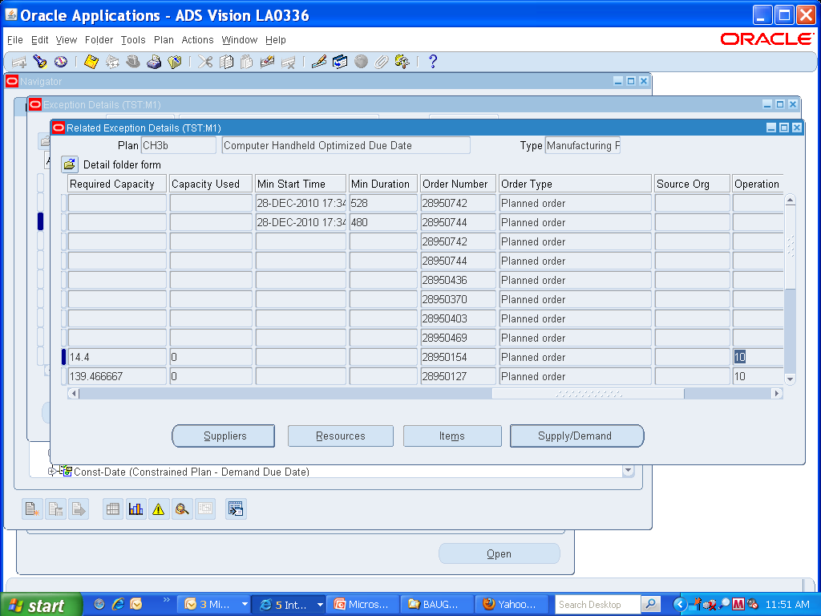

Slide 48
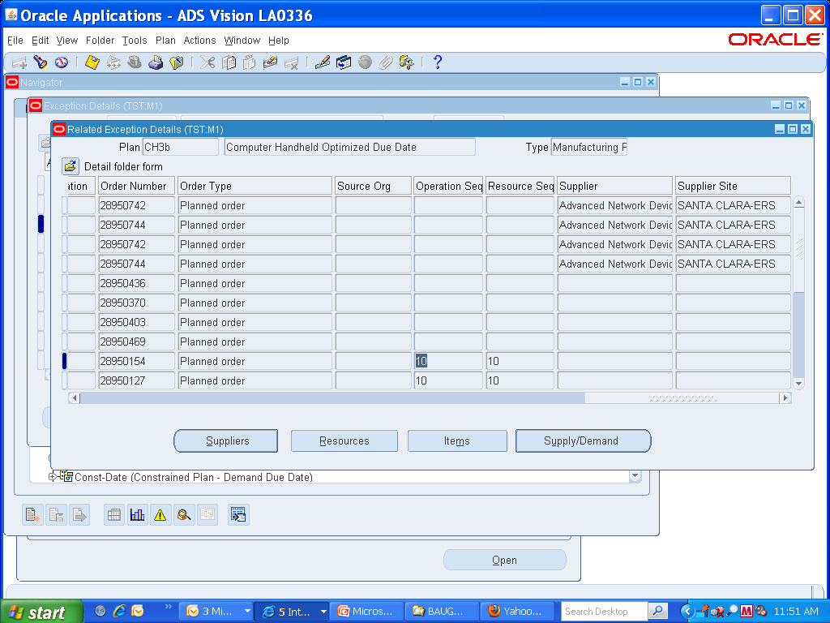

Slide 49
Agenda
Working Backwards - A theme that guides our thinking
    We know what we want to do, now how we do it ?
Oracle Solution
    ASCP Capabilities and Features
    EBS foundation set up and review
Why are we doing this ?
What tells us whether we are on track ?
Wrap Up/ Q&A

Slide 50
Why are we doing this ?
To Get Better - So what ?
    Supply Planning is a balancing act of three major objectives
      Customer Service – On time performance
      Inventory Turns
      Operating Efficiencies
    Comprehending the Realities of YOUR value/supply chain.
What is better – How do we know what is better for us ?
    A very relative set of measurements for every company
    Even including some uniquely defined metrics

Slide 51

How
Delivers

Slide 52


Today’s Supply Chain Executives’ Agenda
Uncertainty
New world: continuously adapting to changing supply chain business model
Volatility
Risk
Virtualization
Consolidation
Globalization
Changing Supply Chain Business Model
Compliance
Chaos
CEO’s Agenda
Drivers
For Success
Operational Flexibility
Risk Management and
Compliance
Increased
Shareholder
Value
and
Sustainable
Growth
Continuous Innovation
“What is required is a new type of decision support platform, one that integrates analytics and optimization. 15 years after the birth of Supply Chain Planning (SCP), we are now just starting to see analytics and optimization converge on a common platform”
AMR Research Report “How to measure your supply chain today “
Notes:
52
Supply chain executives today face a tough battle of trying to adhere to the CEO’s agenda of sustainable growth and shareholder value while dealing with an ever changing supply chain business model. The drivers for success are operational flexibility, risk management, and continuous innovation and they can really only achieve this by bringing analytics and optimization together into a common platform, as also described by AMR in one of their recent studies.

Slide 53




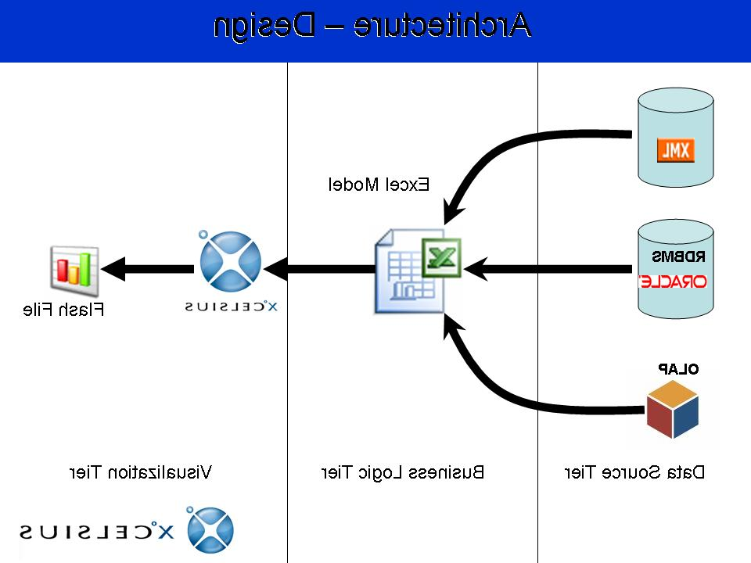






Traditional approach doesn’t work
Executives are not able to get actionable information on corporate metrics
CUSTOMERS
SUPPLIERS
Tier 1
Tier 2
Product
planning
Demand
planning
Supply
planning
Financial
planning
Manual measurement
and reporting from
multiple data sources
Paper
HIGH LATENCY, NO VISIBILITY
No connection between plans, plans not tied to execution
Misalignment between metrics and objectives
Unreliable forecasts and production plans
Reactive Management
Notes:
Most companies today have a very unstructured and fragmented process to measure performance. Each department tends to have a spreadsheet driven process with critical company data stored on spreadsheets. Departmental plans are not aligned, and there is misalignment between how departments are measured and overall company objectives.

Slide 54

The challenge of data integration
Pre-work activities
Time required for exec S&OP prep
No process
integration
Takes a long
time to gather
What data is most challenging?
#1 impediment to data collection
No access to
the right data
Lack of
systems
Notes:
Bridging the divide is all about data integration. Studies by AMR have pointed out that this is not a trivial task: it takes a long time to gather the information, there’s no structured integrated process to the analysis, and a lack of systems compounds the problem as there’s no access to the right supply and demand data to make their decisions.

Slide 55
How
Delivers
Notes:
So let’s now talk on how Oracle delivers …

Slide 56

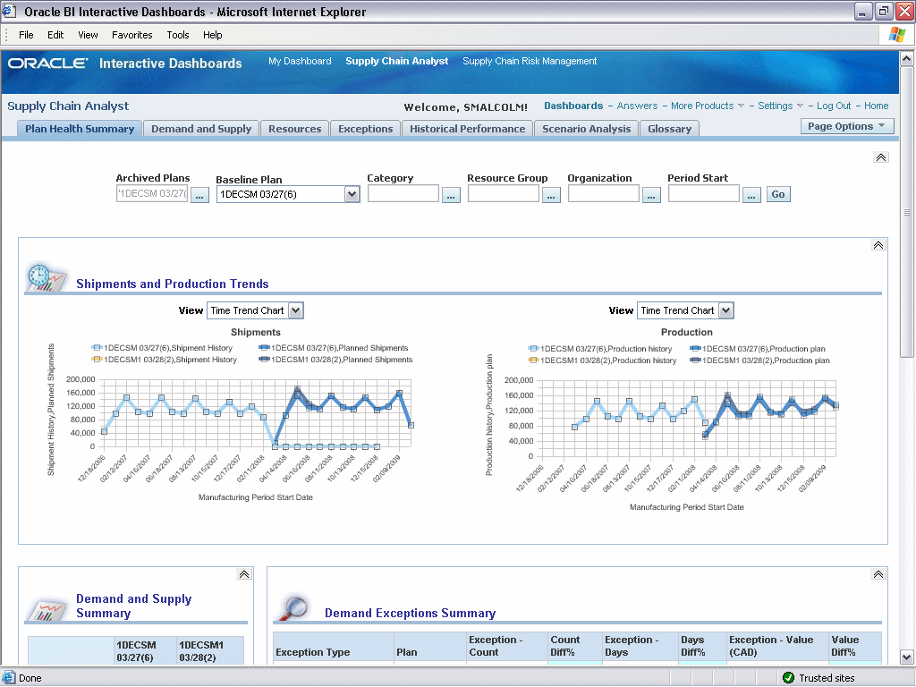










Oracle Advanced Planning Command Center
Enable holistic view of supply chain performance
Planning Dashboards and Reports
Provide insight to key decision makers
  Close the loop with embedded analytics
  Bridge the gap between analytics and planning through seamless integration with operational planning applications
  Leverage pre-built dashboards with rich content and KPIs
Proactively respond to deviations in performance
  Identify root cause
  Define and evaluate alternative business scenarios
  Manage execution of scenarios; assign tasks to planners and other stakeholders
Reduce decision making cycle time through process automation
  Use BPEL process flows to execute planning processes
  Configure and adapt
Analyze
Analytical
Data
Business scenario planning
Scenario and
Activity Management
Execute
scenarios
Plan
Planning process automation
Forecasting
Supply Planning
Orchestrate
Web Service enabled planning processes
Notes:
Oracle Advanced Planning Command Center enables your company to get a holistic view of supply chain performance:
It provides insight to key decisions makers
It enables you to proactively respond to deviations in performance, and
It enables you to reduce decision making cycle time through process automation

Slide 57
Oracle Advanced Planning Command Center
No need to build expensive “rear-view mirror only” disconnected data warehouse
Today
Summary information
Forward looking planning information
Translates planning data to corporate metrics
Forward looking perspective combined with past trends
Not a data warehouse for “rearview mirror” analysis
  Minimal data replication (archiving/publish of select summary data)
Available with Oracle Advanced Planning 12.1 and runs on top of:
  Demantra Demand Management, Demantra Real-Time Sales and Operations Planning, Strategic Network Optimization, Inventory Optimization, Advanced Supply Chain Planning
  Context sensitive drill-downs
Notes:
Key to understand is that Oracle Advanced Planning Command Center is much different from the traditional data warehouse approach:
Unlike the rear-view mirror orientation of a data warehouse, it provides a rear-view as well as forward looking perspective, real time
Unlike a data warehouse that forces you to replicate all data that you need for analysis, APCC requires minimal data replication and runs on top of existing planning data
Unlike a data warehouse’s static approach, with APCC you can drill down to the source application interactively, making it a tool not just for key decision makers at executive level but also at planner level

Slide 58
Agenda
Working Backwards - A theme that guides our thinking
    We know what we want to do, now how we do it ?
Oracle Solution
    ASCP Capabilities and Features
    EBS foundation set up and review
Why are we doing this ?
What tells us whether we are on track ?
Wrap Up/ Q&A

Slide 59


Advanced Planning Command Center
Business insight for supply chain executives
Provide insight to key decision makers
Proactively respond to deviations in performance
Reduce decision making time through automation
Notes:
After we talked about how APCC provides insight, let’s talk next about the type of analysis that supply chain decision makers can perform with Advanced Planning Command Center

Slide 60
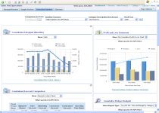
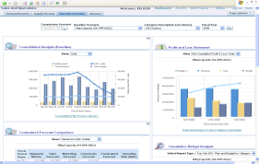
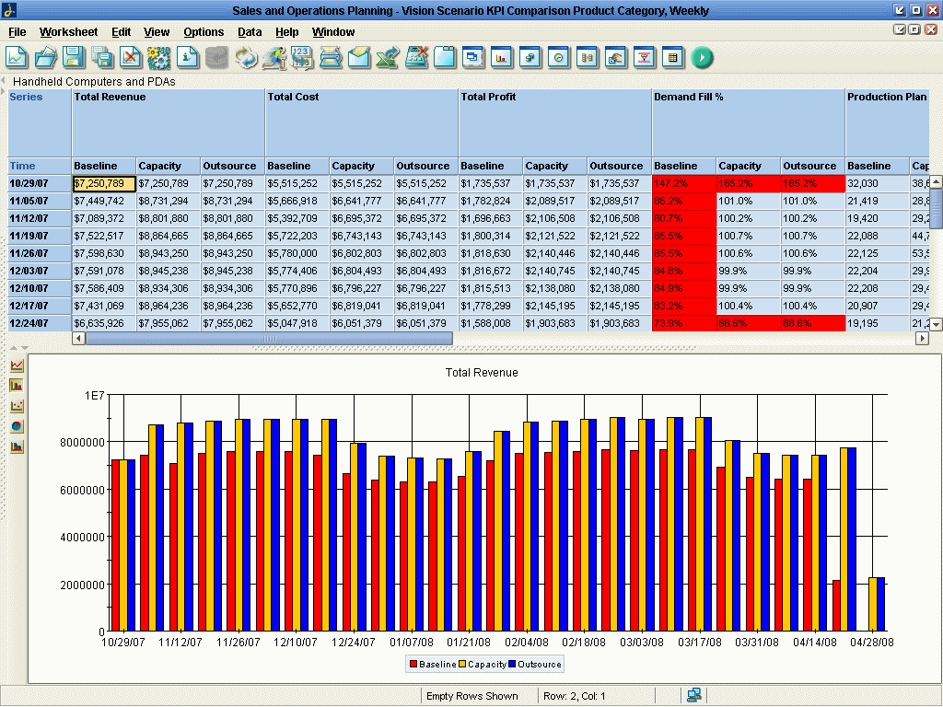
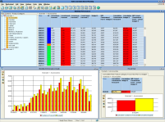
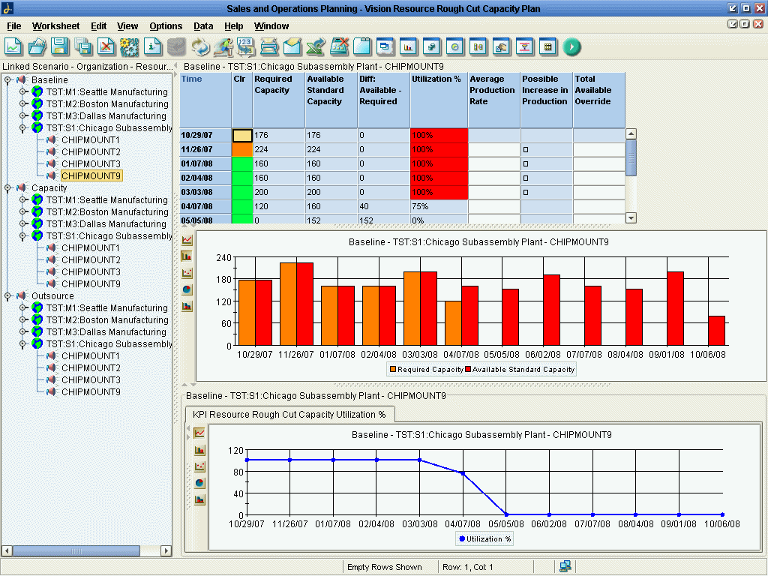
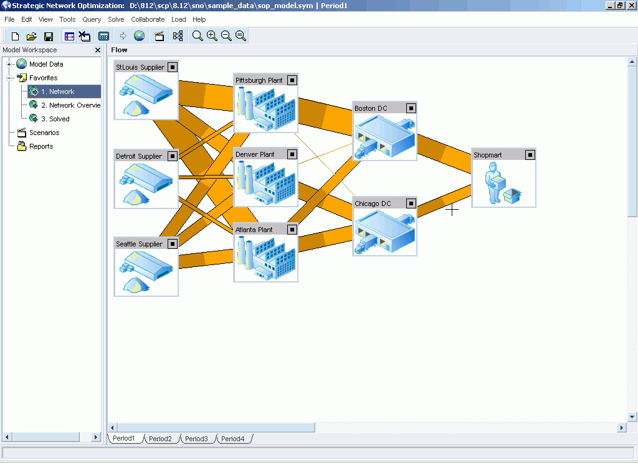


Provide insight to key decision makers
Answers = Correlating information from different existing information sources
Continuous performance management
Execution
Service levels vs inventory cost
Inventory policy
Carrier contracts
Profitable product mix
Weigh single vs. dual sourcing
Strategic Decisions
Balance capacity
Rebalance inventory
Allocate products
Shape demand
Reschedule promotions
Operational Decisions
Tactical Decisions
Delay orders
Expedite shipments
Deal with quality issues
What has changed since last month? How are we performing compared to last year?
Are we on plan financially? Is there any need to revise long term plans?
How are we performing to performance metrics? Are we achieving our six-sigma goals?
What new risks do we need to consider? Is our single sourcing strategy exposing us?
What decisions need to be made now and in the near future?
How are product families performing? Do I have the most profitable product mix?
Are we on track with product development? Do we need to delay new products?
Do we have any critical supply constraints or issues with key suppliers?
How is the resource utilization on our most critical resources?
Notes:
A typical agenda for the management review meeting, would consist of questions like these listed on the slide. Ultimately what APCC enables is accurate and efficient answers to these key questions and decisions necessary to drive your business complete with interactive simulation to answer the questions that come up during the executive meetings, for example S&OP meeting, in real time.

Slide 61





Provide insight to key decision makers
Answers = Correlating information from different existing information sources
Advanced Planning Command Center
Compare alternative business scenarios
  Planners execute scenarios
  Automatically translate detailed planning information to corporate metrics
  Track assumptions and attach supporting documents
Approve and drive into execution
  Choose your baseline plan
  Drive tactical and execution decisions
Monitor
  Continuously monitor performance and get real-time visibility to deviations
Suggested
alternatives
for evaluation
Demantra DM
ASCP / SNO
Planners execute assigned activities
IO
Business scenarios
Assigned
activities
Notes:
61
When getting to the right answers it is all about correlating information from different existing planning information sources – key to mention is that the typical planning information is often to detailed to make business decisions, hence it is essential to translate that information to corporate metrics, which is exactly what APCC enables.

Slide 62

Monitor S&OP performance in real time
Self service S&OP dashboard for interactive management review
Analyze profit
and loss
Compare alternate
scenarios
Analyze key
Planning metrics
Analyze constrained forecast
Notes:
The first dashboard APCC offers supports the executive level analysis of the S&OP process. You can review supply, demand, and executive level information concerning profit and loss.

Slide 63

Monitor operational plans
Self service Supply Chain Plan Analysis dashboard
Analyze specific product categories, organizations and resource groups
Check your shipment and production trends
Compare previous run to current run exceptions
Compare previous run to current run demand and supply metrics
Notes:
63
The second dashboard is targeted at the Supply Chain Analyst role in a company. The analyst can evaluate performance of various product categories and organizations, compare exceptions from one plan run to another, review production and shipment trends, and compare supply plan metrics from one plan run to another.

Slide 64





Pre-seeded rich content – KPIs
100+ dimensions and performance metrics
Notes:
As we mentioned earlier, it is key to have rich content when you want to start quickly. Oracle Advanced Planning Command Center ships with rich content out of the box – 100+ pre-seeded dimensions and performance metrics.

Slide 65
Pre-seeded rich content – Hierarchies
Pre-built aggregation levels based on familiar planning hierarchies
Trading Partners
Internal Orgs
Item
Misc
Time
Project
Source
Ship
Method
Order
Type
Year
Operating
Unit
Product
Category
Exception
Type
Planning
Group
Supplier
Customer
Mfg
Period
Demand
Class
Quarter
Zone
Resource
Group
ABC
Class
Product
Family
Department
Plan
Version
Fiscal
Period
Org
Week
Month
Project
Supplier
Site
Customer
Site
Scenario
Version
Subinventory
Resource
Item
Day
Task
Planning Facts: Supply, Demand, Inventory, Capacity, KPIs, Exceptions, Cost, …
Notes:
You can analyze the facts at various levels of aggregation, whether trading partner, internal org, item, time, project or by other angle.

Slide 66



Pre-seeded rich content – Reports
200+ pre-built reports for aggregate and detailed analysis
Notes:
Adv Planning Command Center also ships more than 200 reports that span Sales and Operations Planning and Supply Chain Planning Analysis across a wide set of important reports and metrics

Slide 67
Start quickly with pre-seeded content
Get a good answer on day one!
Pre-built dashboards
  Sales and Operations Planning process
  Supply Chain Plan(s) analysis
200+ Reports
  Analyze from many different business angles at aggregate and detail level
100+ Key performance indicators
  Analyze what is critical to the supply chain
  Optionally define alerts to get notified about problems
Extend and configure
  Quickly tailor to specific needs of individual users
Notes:
Analytics only work if you can get there quickly. It is for that reason that APCC enables you to get a good answer on day one by providing key dashboard and many pre-built reports and performance indicators that you can extend and configure as required.

Slide 68


Extensible and configurable
Adapt to the needs of individual users
Quickly define and modify reports and dashboards via drag and drop
Easily configure drill downs from dashboards to reports
Add textual instructions as needed
Notes:
Pre-built dashboards, reports, and metrics provide a quick start but often the need for extensions and configuration for additional roles remains. Adv Planning Command Center solves this issue by drawing from the key strength of Oracle’s Fusion Middleware Business Intelligence platform tools (OBIEE).

Slide 69




Extensible and configurable
Secure access
Show or hide
pages instantly
Attach
filters
Add
formulas
Set
permissions
Notes:
You can leverage this robust platform to attach filters, show or hide pages for particular (groups of) users, set access rights, and add presentation layer formulas that are based on facts that are being shown in the reports.

Slide 70
Advanced Planning Command Center
Business insight for supply chain executives
Provide insight to key decision makers
Proactively respond to deviations in performance
Reduce decision making time through automation
Notes:
After we talked about how APCC provides insight, let’s talk next about the type of analysis that supply chain decision makers can perform with Advanced Planning Command Center

Slide 71





Proactively respond to performance deviations
Determine problem ► Find cause ► Evaluate alternative solutions
What actions should I evaluate?
What problem do I have?
Why do I have this problem?
Plan overtime
Critical part shortage
Change sources
Revenue below target
Supply shortages
Lost production
capacity
Expedite orders
Lost sales due to lack
of supply
Split supply orders
VP of Supply Chain
Supply Chain Analyst
Planner
Embedded Analytics
Planning
Notes:
APCC enables you to proactively respond to performance deviations: you can easily go from recognition of a problem, to the root cause, to tangible action. And what is key is that the VP of Supply Chain, the Supply Chain Analyst and the individual planners can all look at the exact same performance number

Slide 72


Proactively respond to performance deviations
Quickly identify problem and root cause
Increase in
late shipments
Sudden
demand spike
Resource
overloaded
Supply
shortage
Notes:
72
For example: a Supply Chain Executive sees a large increase in late shipments in the latest supply plan
They drill down to see the cause and it is due to spike in demand from an important customer
There isn’t enough supply to fulfill the demand
This is caused by a critical resource being overloaded

Slide 73


Seamlessly move from problem to resolution
No separation between planning and analytics
Detect a resource problem
Directly drill down
within context
Compare the results of the simulation
Simulate a
possible
solution
Notes:
Analytics and optimization needs to work seamlessly together – APCC enables you to directly drill down in context from problem-cause to actions (in the planning tools) and back to analytics to compare the results of a simulation for example.

Slide 74





Determine which alternatives to analyze
Key decision makers assign tasks to planners for execution
Supply chain decision makers define business planning scenarios
  Unlimited number of baseline scenarios
  Unlimited number of alternative scenarios
Assign scenarios and tasks to planners for execution
  Shared accountability for supply chain planning metrics
  Planners execute plans using Planner Workbenches
Attach key documents
  Financial analysis
  External market data and industry reports
Assign and monitor
scenario activities
Personal
Activity List
Personal
Activity List
Personal
Activity List
Execute and
assign demand plans
to scenarios
Execute and
assign inventory plans
to scenarios
Execute and
assign supply plans
to scenarios
Demand Planner
Inventory Analyst
Supply Planner
Notes:
It is also important to determine which alternative business scenarios need to be analyzed. For that,
Advanced Planning Command Center provides robust Scenario Management which enables you to define business planning scenarios for which you can assign tasks (activities) to planners for execution. You can also attach key documents as backup to the scenarios that need to be implemented, such as results of a financial analysis or external market data and industry reports.

Slide 75



Scenario Management
Create baseline and alternative business planning scenarios
Group scenarios into scenario sets, for example
  Plan Health Analysis for March
  Monthly S&OP process
  Risk Analysis for single sourcing
Assign and monitor activities for planners to execute in the scenario set
  Reassign as required
Group
scenarios
Define
activities
Notes:
You can create baseline and alternative scenarios and group them into sets and define and monitor activities for a particular set. For example, execute your monthly S&OP process and group them into the “May S&OP” set with the alternatives that are being run during that cycle.

Slide 76

Executive Level Business Scenario Planning
Assign
activities
Launch
Dashboard
Attach
documents
Decide which
Plans to use
Add
comments
Notes:
Here’s an example of the screen that enables assignment of activities to planners.

Slide 77

Scenario management – Assign activities
Notes:
Here’s a screen that shows how you can assign activities to the constituents of the planning community that work on the various planning scenarios

Slide 78
Advanced Planning Command Center
Business insight for supply chain executives
Provide insight to key decision makers
Proactively respond to deviations in performance
Reduce decision making time through automation
Notes:
The last important part of the Adv Planning Command Center solution is the process management and orchestration layer and how it enables you to reduce overall decision making cycle time, which we’ll talk about next.

Slide 79

Reduce decision making time through process automation
All key planning processes are web service enabled
  Collections
  Forecasting
  Plan runs
  Plan name creation
Approval and review steps can be modeled and inserted into the process
Notes:
We web service enabled all key planning processes and linked these processes into comprehensive business flows that include approval and review steps.

Slide 80
Automatically archive summary information
Archive plans and scenarios for historical and trend analysis
Archive scenarios directly from scenario management, via concurrent program or web service
  Automatically archives KPIs and facts for plans that are linked to the scenario
    Archives Demantra Demand facts published to EBS
  Creates a new scenario version that can be used for comparison in the dashboards.
  Purge scenarios as they become obsolete (will not purge plans shares across multiple scenarios)
Archive plans directly from plan runs (optional) or Publish profile (SNO, Demantra)
  All facts, KPIs, and summaries for the plan are archived in a new plan version
  Compare plan versions in the dashboards
  Purge plan versions as they become obsolete
  ASCP/IO Purge plan: purges all plan versions
Plans and Archived Plans
Archive plans
Archive
scenarios
Notes:
Another important feature that is essential for trend analysis is the ability to archive plan performance information and scenarios in a single place. The archive of the plan can be performed automatically when running plans.

Slide 81
Agenda
Working Backwards - A theme that guides our thinking
    We know what we want to do, now how we do it ?
Oracle Solution
    ASCP Capabilities and Features
    EBS foundation set up and review
Why are we doing this ?
What tells us whether we are on track ?
Wrap Up/ Q&A

Slide 82

<Insert Picture Here>
Wrap Up / Q&A

Slide 83
<Insert Picture Here>
Thank You

Slide 84


Slide 85


