Slide 2
E-Business Suite
&
CRM On Demand
Lead to Order Advantage
Nicole Smayling – Solution Consultant
Notes:
What is the power of having both EBS & CRM OD? And how you can Outsmart and Out Execute your competition by combining the power of these two applications.

Slide 3
ORACLE
CRM On Demand
Sales – Marketing –Service
Notes:
Offer comprehensive CRM that deliver results
Have you heard of it?
What are you using now? (depending on size of the group)

Slide 4
Value Proposition:
Only ORACLE CRM On Demand enables you to outsmart and out execute your competition with solutions that are easy to use, provide fast ROI, and are available from a single vendor.
Notes:
What’s the bottom line for sales leaders? We know that what’s keeping you up at night is the following: How can I beat my competition? How can I maximize my team’s productivity? How can I get my team to adopt tools that are easy to use and that they’ll love? How can I ensure that I’m making the best short term decision that will provide fast ROI? And how can I make the best long-term decision as well?
The answer” Only Oracle CRM On Demand enables your organization to get smarter and beat the competition. And we do it with solutions that are easy to use, provide fast ROI, and are available from a single vendor with a long-term track record and a broad software portfolio.
So that you can grow your business and beat the competition
Oracle understands that in today’s market it’s more important than ever to have the right tools that help you outsmart and out execute your competition in order to grow your business. Oracle CRM On Demand gives you just that. With CRM on demand your sales force has the tools they need to outsmart out execute your competition.
4

Slide 5
Hosted
Application
Notes:
• Hosted model provides lower, predictable costs and rapid time to value
Enterprise grade SaaS
delivered over the Web as a subscription service
No upfront IT investment
can be deployed quickly, easily - Get started in weeks and scale to meet the most demanding requirements
Don’t worry about changing from one version to the next
Whether your needs are for Marketing, Sales, Service or all of the above.

Slide 6
Sales – Marketing – Service

Slide 7
Sales

Slide 8
CRM On Demand: Sales
Get Smarter
Increase sales execution & account penetration
Rapid access to the business information you need
Notes:
These tools empower you to target the most lucrative opportunities, focusing on those leads and opportunities you’re most likely to win.
You’re able to establish and measure corporate & divisional objectives, comparing trends over time
At the end of the day, these capabilities ensure your users get rapid access to the critical information that they need
Act on insight immediately
Grow revenue (and commissions)
Align everyone with trusted information

Slide 9
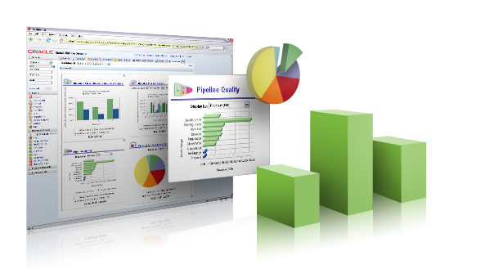
ORACLE
Business
Intelligence
Engine
Notes:
Strong analytics capabilities provide actionable insight to business trends and pipeline visibility
Robust pre-built analytics data warehouse for true historical data analysis
Leverage world-class Oracle technology
Drive objectives by comparing trends over time
Prompt informed actions with interactive dashboards
Leverage the industry’s only on demand solution with this capability
Quickly access and share more than 40 prebuilt reports and dashboards
Showcase dashboards across CRM On Demand tab homepages
Easily drilldown into report and dashboard data for key insights
Act on Insight Immediately with Real Time & Historical Analytics
Align Everyone with Trusted Information with Reports

Slide 10
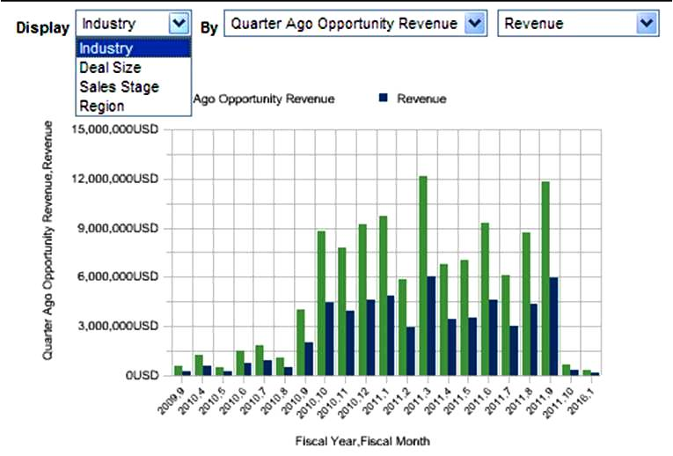
Historical Trending & Whitespace
Notes:
Reports are clickable … click into them to see what is generating t he data

Slide 11
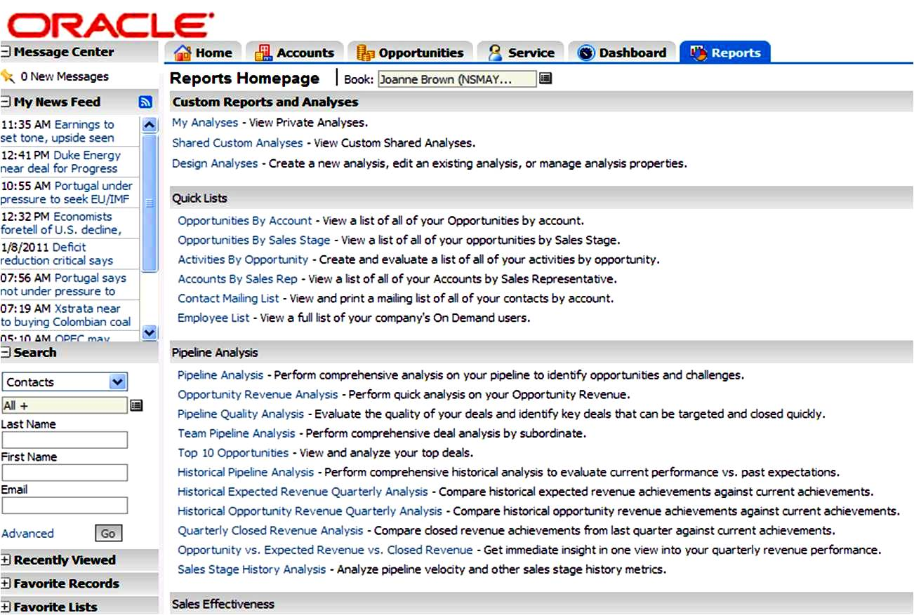
Over 40 Pre-Built Reports
Notes:
The best part is reporting is simple. CRM OD has 50 pre built reports so you can easily look at what you need.
Look at each and didvide further by breaking info down by industry, size, sales rep, etc.

Slide 12
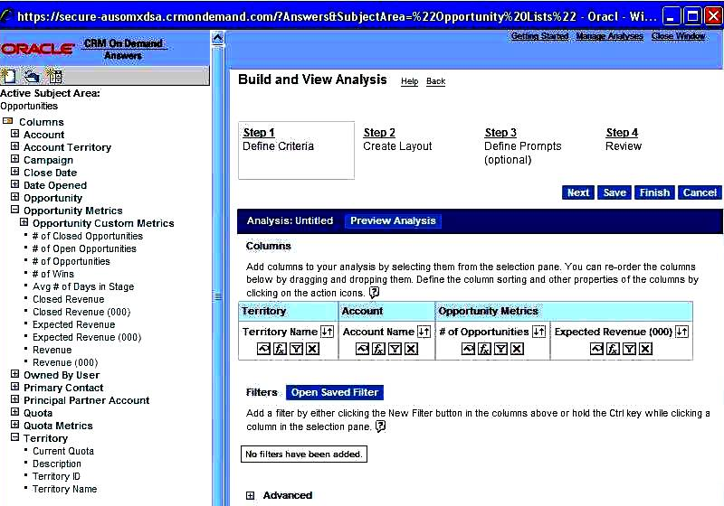
Drag & Drop Report Building

Slide 13
CRM On Demand: Sales
Get More Productive
Quickly identify & prioritize sales opportunities
Enable team selling via enriched collaboration
Leverage best practices across
the organization
Get the right information to the
right team members
Notes:
You want to ensure that you maximize your time and are focusing on the right areas.
CRMOD helps you priorize your time and energy accordingly. You’re able to leverage the collective knowledge of the sales team through our various collaboration tools, using messages and documents that are proven to be successful.
You can standarize and enforce best practices
At the end of the day, CRMOD ensures that critical information gets to the right people.
Uncover hidden demand
Focus on more of the right leads
Drive every qualified opportunity

Slide 14
Sales Prospector
Notes:
Increase User productivity
Sales Prospector:
Provides insight on what to sell to and to whom based on buying pattern analysis of similar customers

Slide 15
Social CRM
Sales Library
Notes:
Increase User productivity
Sales Library:
Shared library to facilitate finding, assembling and sharing targeted sales presentations

Slide 16
Embedded
Sales Coaching
Notes:
Embedded sales Marketing, and Service coaching enables best practices and provides real-time guidance
At each sales stage of an opportunity, your company might need to collect specific information, according to their business practices. To guide you in completing the information, your company administrator can set up follow-up tasks, require that you fill in specific information, and add information for you to review at each phase of the sales process.

Slide 17
Get The Best Value, Period
CRM On Demand: Sales
Superior User Adoption
Single vendor platform with superior economics and accountability
The most capabilities offered at universal low price
Provable ROI with Lowest TCO
Simplify & Gain Leverage with a Single Vendor
Notes:
Let’s talk about value…
Nucleus Research, an independent research firm, conducted a study and found that CRMOD was #1 in User Adoption and #1 in Business Impact. That’s significant because it doesn’t matter if you have the greatest system in the world. If your users don’t use it, it’s of no value.
Additionally, Oracle provides you all this capabilities and is a single point of control for all your business application and technology needs.
Superior economics by bundling solutions together from one vendor
Our customer are able to demonstrate rapid ROI and we provide the lowest TCO in the marketplace.
Leverage Oracle’s Experience to Gain Immediate Advantage
Achieve Lowest TCO
Simplify & Gain Leverage with a Single Vendor

Slide 18
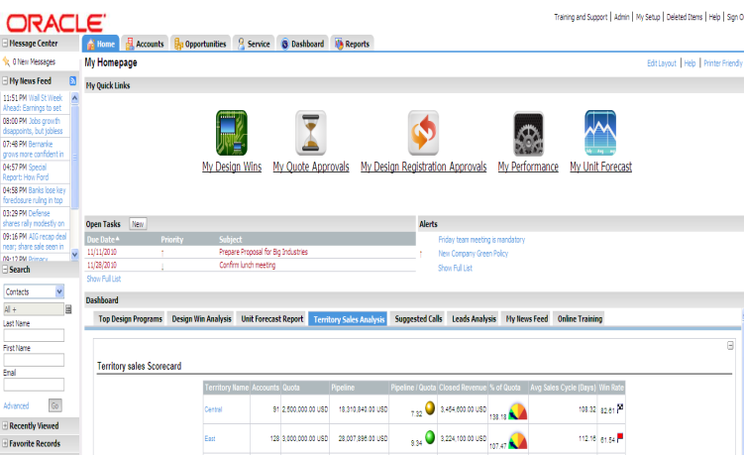
Configurable
User Interface
Notes:
An intuitive and customizable user interface facilitates user adoption and user productivity
-increases user adoption
Message Center
Widget and RSS feed support for mash ups
Seamlessly integrate to your corporate culture
Easy to configure and use by business users
Rapid time to value
Ability to quickly adapt to changing business conditions
Extend out-of-the-box functionality to meet unique business requirements
Custom objects augment CRM On Demand with company-specific data
Custom webtabs streamline access to 3rd party data

Slide 19
Social CRM
Portal Integration
Notes:
Increase User productivity
Integration with Portals:
iGoogle & MyYahoo
Crm visibility in your portal

Slide 20
Outlook Integration
Notes:
What is it?
For those of you who don’t know what CRM Desktop is, it’s a combination of two great products we already know and love – Oracle CRM On Demand and Microsoft Outlook.
Raise your hand if you use Microsoft Outlook. (Most of the room will raise their hands). As you can see, most of this room uses Microsoft Outlook. You may not know that over 500 million people in the entire world also use Microsoft Outlook, which makes this a red hot product.
Information tells us that people don’t like constantly shifting between applications and that’s why Oracle created CRM Desktop. Better data, Less training, higher user adoption
CRM Desktop
1. syncs data back and forth
2. associates Oppty’s, Conacts and Accounts so that information is always up to date and CRM data is also updated an stored
3. validation rules which allow users to do day-to-day data maintenance including; update the status on an oppty, record notes after a meeting, or target updates on an oppty and account.

Slide 21
Marketing

Slide 22
CRM On Demand: Marketing
“I have an offer”
“I have a person”
Campaign Centric
Customer Centric
offer
“Let me find a group of people to tell about it.”
“Let me find the best offer for this person.”
offer
offer
offer
Notes:
Drive effective, measurable campaigns

Slide 23
CRM On Demand: Marketing
Where the only option is to
buy expensive, add-on products
Contact Management
Saas Analytics Vendors
Analytics
Lead Management
Lead Nurturing
Lead Scoring
Opportunity Management
Saas Marketing
Vendors
Response Management
Forecasting
Website Monitoring
PRM
Web Marketing
Mobile
Campaign Automation
Sales Reporting
Saas CRM
Vendors
Email Campaigns
Sales
Marketing
Notes:
23

Slide 24
CRM On Demand: Marketing
Analytics
Contact Management
Analytics
Lead Nurturing
Lead Management
Lead Nurturing
Lead Scoring
Lead Scoring
Opportunity Management
Enterprise Visibility
Response Management
Response Management
Forecasting
Website Monitoring
Website Monitoring
PRM
Web Marketing
Web Marketing
Mobile
Campaign Automation
Campaign Automation
Sales Reporting
Email Campaigns
Sales
Marketing
Notes:
24

Slide 25
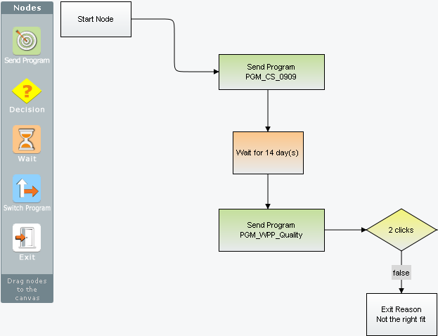
CRM On Demand: Marketing
Easy to design and manage multi-step nurture campaigns
true

Slide 26
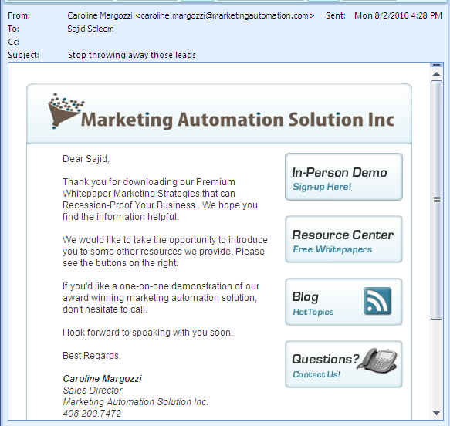
CRM On Demand: Marketing
Personalized Campaigns
Sales Rep From Email Personalization
Personalized Greeting
Sales Rep Signature from CRMOD
Personalized Microsite Link

Slide 27
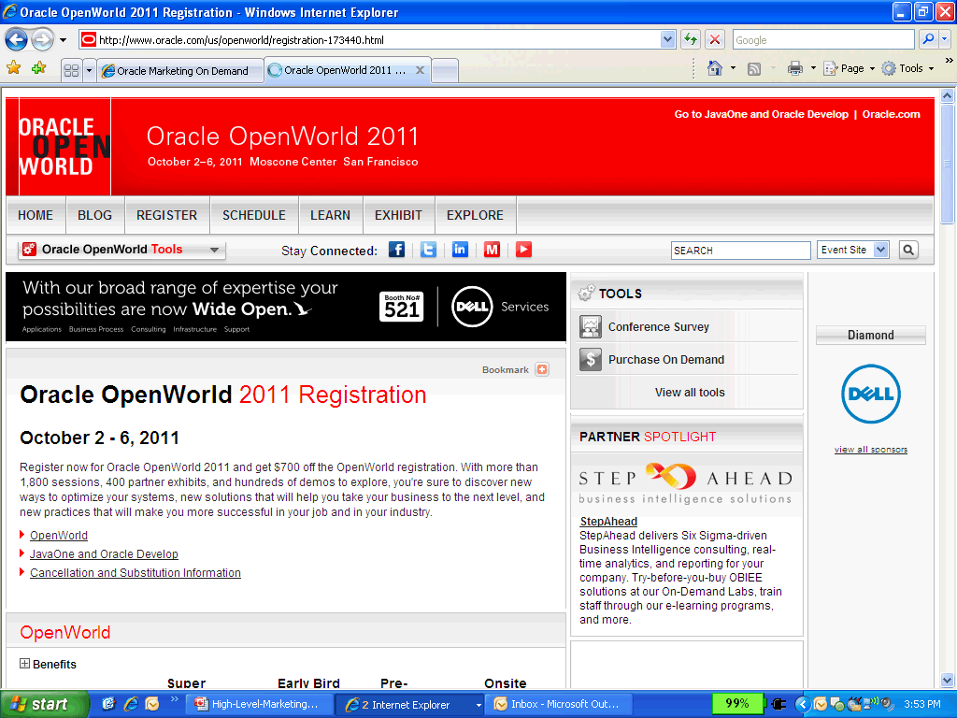
CRM On Demand: Marketing
Web Forms
Microsites

Slide 28
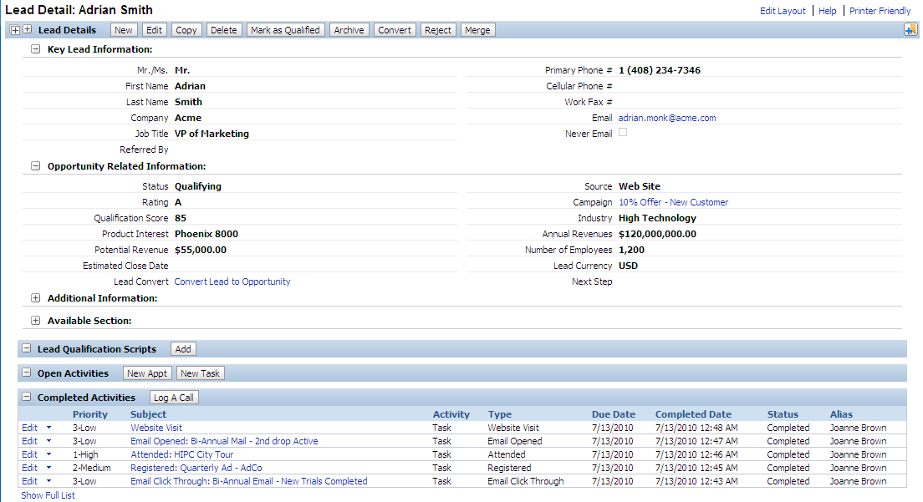
CRM On Demand: Marketing
Full Synchronization to Sales

Slide 29
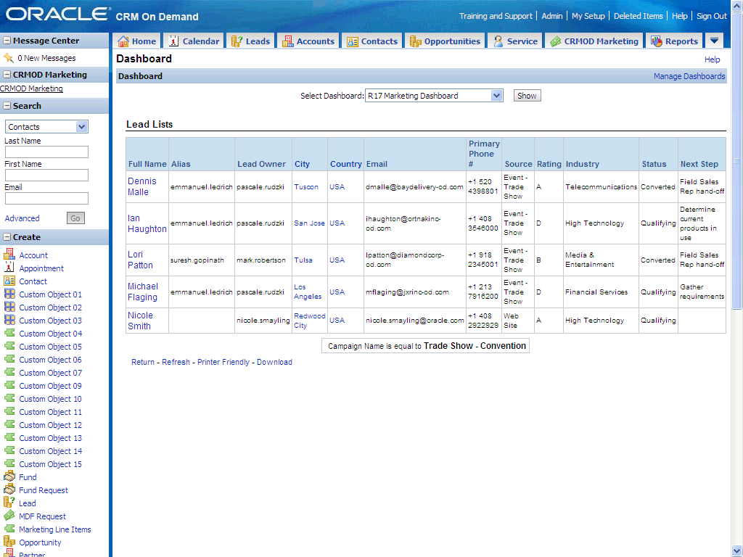
CRM On Demand: Marketing
1.
Closed Loop Analytics
3.
2.

Slide 30
Service

Slide 31
CRM On Demand: Service
360° Degree Customer View
Centralized Knowledge Base
Call Scripting
Customer Satisfaction Surveys
Solution Scoring
Notes:
COD fills that critical gap, and provides our customers with an end-to-end, unified contact center solution.
360° customer view
Centralized knowledge base
Call scripting - challenge of high agent turnover and training costs with call scripting, Call scripting accelerates the learning curve for new service representatives by guiding them through a series of questions that can calculate, for example, the priority of a service request or determine whether to escalate service request to another level.
Customer satisfaction surveys - administer customer satisfaction surveys, which automatically calculates survey scores and outcomes, giving managers the ability to take corrective action immediately
Customer Satisfaction:
More personalized, consistent service
First call resolution
Reduced training costs

Slide 32
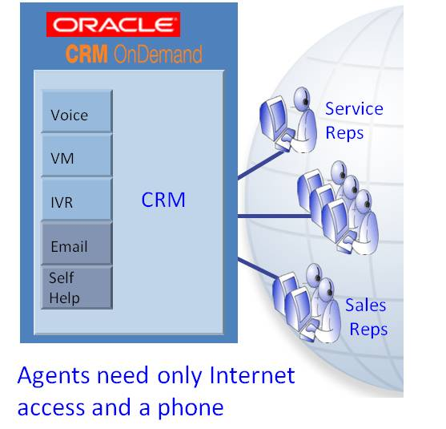
CRM On Demand: Service
Hosted Computer Telephony Integration
Hosted Interactive Voice Response
Hosted Automatic Call Distribution
Notes:
COD is an “Enabling Technology,” or Communications Layer within CRMOD for:
Automatic Call Distribution “ACD”
Multi-Channel Skills-based Routing - Voice and Email
Blended and Remote Agents, Universal/Virtual Queue
Interactive Voice Response “IVR”
Quality Monitoring, Reporting
Silent Monitoring, Call Recording
Real-Time/Historical Reporting
Overlays Existing Voice Infrastructure
Existing ACD, CTI, IVR systems will be replaced
Existing phone system (“PBX”) will stay in place
IVR - Efficient collection of pertinent customer information before the Agent picks up an incoming call, eliminates repeat requests for information. The caller can now enter information on the phone keypad before speaking to an agent. Interactive Voice Response, or IVR, is what is commonly known as a phone menu. IVR allows customers to use touch-tone keypad selections to help themselves and direct their phone calls to the right group. In CCOD Admin, you can also customize both the initial Welcome message as well as the menu of options that a caller hears.
Voice & Voicemail –
Voice Traffic
Supports PSTN, VoIP and SIP calls
800 number hosting, provisioning, redirect
Computer Telephony (CTI)
“Screen pop” with CRM data
View caller record prior to call delivery
Communications captured as Activities
Automatic Call Distribution
Intelligent call routing based on skill groups, available agents or custom rules
Interactive Voice Response
“Press 1 for Sales, 2 for Service…”
Customized call flows
Gather customer entered digits
Deliver pre-recorded announcements
Voicemail
Playback, transfer re-assign or save
- Remote access
Email –
Inbound E-mail Management
- Skills-based routing
- Automatic re-queuing of aging e-mails
- Customized workflow rules
E-mail Analysis
- Auto-responses
- Semi-automated using content analysis
- Auto-suggest
- Custom response templates
- Automatic routing ID
Flexible E-mail Client
- Integrates to any POP3 or SMTP server
- Eliminates third-party e-mail response system

Slide 33
CRM On Demand: Service
Notes:
Managers –
how many calls are getting taken,
how long are the calls?
Which products –
SR Aging analysis
Service Rep Productivity – by region, user, etc
Service Reps –
SR volume by product type
SR volume by customer
SR response rate

Slide 34
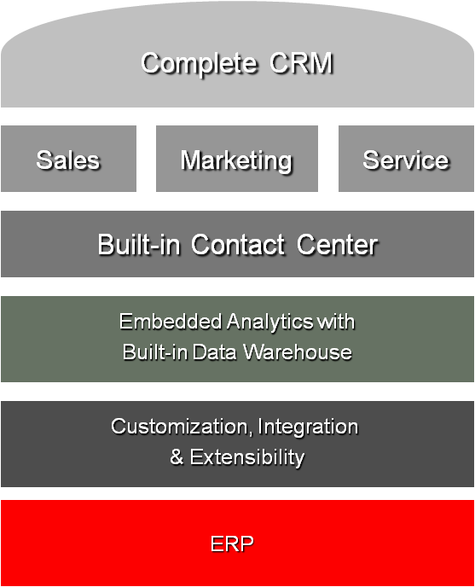
CRM On Demand
Proven CRM expertise
20 Languages
Multiple Currencies
Multiple Deployment Options
Single Vendor
Fully Integrated
Notes:
14+ years of CRM experience
Proven best practices and services to ensure CRM success
Industry leader in on-demand solutions with over 1.7 million on-demand users
Single Vendor Commitment
World Class Hosting, Single and Multi-Tenant options
Over 6 million CRM users use Oracle
34

Slide 35
Why?
E-Business Suite & CRM On Demand

Slide 36
Siloed Data
Notes:
the Old Paradigm represents a point of integration—often between different vendors--and of Cost & Complexity.or Call Center is that you had all these solutions but each needed high configuration for integration.
Risks - Multiple points of integration, Silo Data Sources, Inflexible applications

Slide 37
Excessive
Administrative Work
Notes:
Consequently, salespeople are forced to spend time out of their busy day reconciling information and manually entering data to make up for the functional disparity. Without accurate information about a customer, sales representatives have a difficult time identifying the best strategy to pursue a sale and develop a customer relationship. Rather than freeing your sales force to focus on customer relationships, sales people are instead spending more time on administrative activities. Ultimately, the productivity and effectiveness of the sales force is impacted.

Slide 38
Lost
Sales
Notes:
For example, account shipping information stored in an ERP system may not be updated with changes made in the front office application, resulting in a lost order. Sales activities for a single business process that span application borders need to be broken up to accommodate limitations in application integration. Because information is not readily available through a single application, salespeople are forced to toggle between applications to access and interact with relevant data, such as leads, quotes, and product information.
Consequently, salespeople are forced to spend time out of their busy day reconciling information and manually entering data to make up for the functional disparity. Without accurate information about a customer, sales representatives have a difficult time identifying the best strategy to pursue a sale and develop a customer relationship. Rather than freeing your sales force to focus on customer relationships, sales people are instead spending more time on administrative activities. Ultimately, the productivity and effectiveness of the sales force is impacted.

Slide 39
Better Together
Notes:
Oracle CRM On Demand and Oracle E-Busines Suite – Better Together With Oracle CRM On Demand, organizations can augment Oracle E-Business Suite implementations to quickly realize business value and tap into the capabilities and benefits of Oracle’s market leading on demand solution:
Addressing these inefficiencies requires an integration solution that allows information to flow across front and back office applications – at the data, user interface, and business process levels. Sales people need the most up-to-date information, regardless of where that data is stored or how it is dispersed across the enterprise. They require that all pertinent information regarding a customer, whether related to an order, quote, or opportunity, be viewable from one application. And they need to be able to initiate and complete an entire sales process from within a single application, regardless of what is happening across application boundaries. To accomplish all of this requires a solution based on open standards to ensure a seamless, sustainable, and extensible integration.

Slide 40
The Business Value of Integration
Oracle AIA
Data
Business data is consistent and up to date across applications
Notes:
Sales people need the most up-to-date information, regardless of where that data is stored or how it is dispersed across the enterprise. They require that all pertinent information regarding a customer, whether related to an order, quote, or opportunity, be viewable from one application. And they need to be able to initiate and complete an entire sales process from within a single application, regardless of what is happening across application boundaries. To accomplish all of this requires a solution based on open standards to ensure a seamless, sustainable, and extensible integration.
Such seamless integration between the front and back office offers the following productivity benefits to salespeople:
Minimal data entry. Salespeople spend less time keying in data and reconciling data duplication errors, for example when information from an opportunity in a CRM application is automatically converted to a quote in the ERP system.

Slide 41
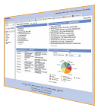
The Business Value of Integration
Can complete a flow
in CRMOD w/o going elsewhere
Oracle AIA
Data
Business data is consistent and up to date across applications
Notes:
All relevant information accessible in one application. All information that a sales person needs is available in a single application that is familiar to the user. Because users can now access back office information – such as products and quotes –from the front office application, less time needs to be spent training salespeople on multiple applications. And sales users have more information available at the point of interaction with their customers, enabling a better service experience.

Slide 42
The Business Value of Integration
Streamlined and Seamless
Lead to Order Process
Can complete a flow
in CRMOD w/o going elsewhere
Oracle AIA
Data
Business data is consistent and up to date across applications
Notes:
Automated business processes. By automating key business processes like opportunity-to-quote, a salesperson can complete an entire transaction within a single application quickly, easily, and accurately
Which means most customers who buy SFDC then go buy these other products from niche vendors with different licensing, different SLA’s, different security, no warranty or support from SFDC, and glue it all together just to match functionality that Oracle already offers in a fully integrated and supported solution at a much lower price: To pick up on John’s point - these are spot on!. Whilst, SFDC can supplement offerings with other 3rd party applications from AppExchange it does bring a lot of complexity to customer solutions from additional cost, security, data duplication to implementation, service & support. Remember, some of these solutions provide their own cloud environments- therefore security, data, data resilience, data centre, data privacy, governance, compliance could be compromised & not meet customer IT requirements. Finally, it is also worth noting that many of these 3rd party vendors provide a potential high risk to a customer since many are small & do not have the capacity or longevity to serve large enterprise customers.

Slide 43
One Unified Set of Data
360 Degree View
Notes:
Complete Customer View
Arms salespeople with critical information
Enables personalized knowledgeable service
Ensures customer data consistency & quality across front and back office applications
Provides a 360-Degree Customer View
your sales team gains a 360-degree view of critical customer information such as opportunities, quotes, orders, invoices, and service requests. This provides sales representatives with better customer insight, resulting in more effective customer interactions. Your sales agents work from the same customer records and product data that you have previously established in Oracle E-Business Suite. When sales people need to create a new customer record or add an additional contact during their day-to-day activities, the Oracle CRM On Demand Integration Pack allows these new records to be synchronized between the Oracle E-Business Suite and Oracle CRM On Demand. The prebuilt integration ensures accurate and consistent customer data across your back- and front-office applications.

Slide 44
Increases Productivity
Notes:
Improves Sales Agent Productivity
The Oracle CRM On Demand Integration Pack provides out-of-the box support for critical business flows, which increases the productivity of sales professionals by enabling them to spend more time with customers and less time on administration. The Lead-to-Cash business flow enables organizations to accurately track lead conversion data to incrementally improve sales and marketing effectiveness. With the Opportunity to Quote business flow, Oracle CRM On Demand sales opportunity information is automatically synchronized to create a new Oracle E-Business Suite quote. Once the quote is generated, sales representatives can further negotiate the quote with their prospect or customer and convert the quote into an order. With the Oracle CRM On Demand Integration Pack, sales agents benefit from a seamless user interface experience with no need to manually toggle between front- and back-office applications in order to access important customer information

Slide 45
Drives Revenue
Notes:
More efficient, smarter, work faster, more productive work force
Users experience difficulty completing a single business transaction, often because such activities require needless toggling between various applications,
and thus additional user training. Most importantly, users do not have access to the complete set of information they need to do their jobs. For example, without the
ability to easily view past orders stored in a back office system while working on an opportunity in a CRM application, a sales representative may miss invaluable up-sell
or cross-sell opportunities. Users cannot tap into the true potential of CRM without the ability to share and communicate information seamlessly with other
applications.

Slide 46
Integration
Notes:
Offer comprehensive CRM that deliver results

Slide 47
Integration Complexity
Notes:
Why Is Integration So Hard?
instances run the risk of becoming isolated application silos without the means to easily and effectively link to the wider application network. Integration attempts are complicated by the following factors:
Increase in environment complexity - different systems, and these systems can be a mix of custom, packaged, on premise, and on demand. Consequently, customer information is often fragmented across various repositories and difficult to incorporate into a single view.
Different vendors, different architectures - Proprietary data models, standards, and interfaces may be used, making integration across these unrelated applications even more difficult. Integration of multiple proprietary platforms is further complicated by divergent roadmaps and uncoordinated release cycles
Expensive do-it-yourself integrations - As a result of the lack of standards based architectures and prebuilt integrations, organizations are forced to undertake the costly process of building custom integrations that are not easily adaptable, extendable, or upgradeable.
Insufficient integration depth - A user experience cannot be seamless if a user needs to toggle between applications and re-enter information that was already captured in another system. For example, re-entering account information on an order stored in the back office when that information is already captured in the front office is a time-consuming and error-prone exercise for the user

Slide 48
ORACLE
Application Integration Architecture
Notes:
Oracle takes such an approach to integration by leveraging its Application Integration Architecture (AIA), an open, standards-based platform for managing business processes across Oracle and other packaged and custom applications. AIA leverages open standards and a Service Oriented Architecture (SOA) to deliver industry best practices and operational governance capabilities to help organizations build integrated industry processes, regardless of the applications involved. Using AIA as a framework, organizations can link Oracle CRM On Demand with market leading applications, leveraging a best-in-class technology foundation and industry leading best practices. Built using Oracle Fusion Middeware and BPEL, and based on a common data model, these processes are extensible, repeatable, and sustainable.
Open, Standards-Based Platform
Service Oriented Architecture (SOA)
Built Using Oracle Fusion Middeware and BPEL
Based On A Common Data Model
Extensible, Repeatable, and Sustainable

Slide 49
Industry Standards
AIA is an open standards - based platform
Automate the complete end-to-end business processes, leveraging the applications you have and use.
Notes:
Standards-Based Foundation for Integration
Companies have made wide ranging investments in their existing application infrastructure and want to preserve these assets while maximizing return on investment. Leveraging industry standards such as Business Process Execution Language (BPEL) and Web services meets this goal by providing a common framework for applications to communicate and coordinate activities across a business process. BPEL enables organizations to not only quickly assemble a set of Discrete services into an end-to-end process flow but also to rapidly modify processes as business conditions change.
What Oracle has done for you, our customers, is leverage our Fusion Middleware technology and world class applications experience to create an open standards based solution that allows you to create loosely coupled end to end businesses processes across your applications, that can be continually modified and optimized over time.
This solution is called Oracle Application Integration Architecture. And the key thing here is that it works between Oracle applications as well as non-Oracle apps. Oracle is uniting its applications into a composite business process, that spans multiple applications and modules. Enabling mission critical business processes.
You’re not just limited to integrating across our apps, which is often the case for other vendor solutions.

Slide 50
Application Integration Architecture
Traditional Approach:
Point to Point Integration
Oracle’s AIA Approach
Integration Solution
Affordable – Leverage Your Investment now and in the future
Agile – Common Framework Extends To Fit Your Needs
Sustainable – Build Once Then Reuse and Configure As Your Needs Change
Costly – Consumes Large % of IT Budget
Difficult to Upgrade Different Points
Not Sustainable - Upgrades and Implementations of Any New Functionality “Breaks” Integrations

Slide 51
CRM On Demand & E-Business Suite
Combines the ease of use and rapid deployment of Siebel CRM On Demand with the power of Oracle E-Business Suite
BPEL library of business processes to extend integration solutions across Oracle applications
Siebel CRM On Demand
Oracle E-Business Suite
Oracle Application Integration Architecture
Synchronize customer information between
Front and Back Office systems
Notes:
For example, with this pre-built integration, front-line sales people gain a 360 degree view of the customer, with access to more comprehensive invoice and order management information. This enables them to provide better and more informed service at the point of their interactions with customers. And with integrated business process flows such as Opportunity-to-Quote Conversion and Lead Conversion – including comprehensive Data Quality Management, they can spend less time on administration and more time with customers….all from within the CRM On Demand interface. Furthermore, organizations can extend the integration features of this prebuilt integration to meet specific organizational requirements.

Slide 52
Data Quality
Notes:
Data. The most basic form of integration involves the data layer via Web services, batch integration, and data import and export. More critical
information, such as customer and product data, needs to be appropriately synchronized in real-time or accessed regardless of where the data originally resides to ensure that users can access the latest information from any source without fear of duplication. It is critical to have real-time flow for data such as accounts, contacts and products, where information frequently changes. For instance, customer orders can be delayed or even lost if account shipping information in CRM and ERP systems are not kept up-to-date, severely
impacting customer satisfaction.
AIA prebuilt integrations for grater impact and value
- industry business process to support business requirements
- Allows all of your applications to work together

Slide 53
Single User Interface
Notes:
User Interface. A more highly developed integration involves the user
interface layer where advanced integration extensions enable usability features like mashups and web links to embed custom HTML and third party content within the Oracle CRM On Demand user interface. As a result, users can view information from other applications within a single user interface, vastly improving usability and user productivity. Users can interact with content through one application rather than needing to navigate across multiple applications. Because users can access back office information – such as products and quotes – from the front office application, less time needs to be spent training salespeople on multiple applications. And sales users have more information available at the point of interaction with their customers, enabling a better service experience.

Slide 54
Business Processes That Span Across Organizations
Notes:
Business Processes. The highest level of integration involves business processes that span across applications. In addition to business process
orchestration, business logic, such as data validation rules, need coordination as well to ensure consistency throughout the entire process. Business processes
based on BPEL are the key enabler for adopting a Service Oriented Architecture (SOA), enabling steps in a business process to be stitched together
across applications to form a complete, end-to-end flow. By leveraging business process integration, organizations can build processes around the customer that
span application boundaries rather than conforming to integration constraints. With business process integration, a complete business flow such as lead
conversion can reconcile account information from a lead in a CRM application with similar information in an ERP system, eliminate redundant and duplicate
data, and automatically convert the lead to an opportunity. Rather than change the application when business needs change – which can be a lengthy process –
organizations can simply alter the business process in real time to adjust to changing dynamics.
Achieve Business process Adaptability and Agility
- industry Leading Application Foundation
- Designed for rapid change with minimal disruption

Slide 55
The ORACLE Advantage
Notes:
THE ORACLE ADVANTAGE
As the world’s leading enterprise software provider, Oracle understands the requirements and challenges facing organizations looking to maximize value with
existing software investments, as well as the challenges they face in integrating their applications.
Organizations expect their applications to interoperate as a virtual suite, regardless of whether the applications are provided by Oracle, another packaged vendor, or
are custom-built. Oracle delivers on this expectation by providing an integration strategy that is standards-based, leveraging the Application Integration Architecture
Framework. True interoperability requires complete integration of these applications at the data, user interface, and business process tiers.

Slide 56
The ORACLE Advantage
Commitment to standards.
Long-term vision and unified roadmap.
Full responsibility for product quality, service, and support.
Products built to work together.
Notes:
THE ORACLE ADVANTAGE
As the world’s leading enterprise software provider, Oracle understands the requirements and challenges facing organizations looking to maximize value with
existing software investments, as well as the challenges they face in integrating their applications.
Organizations expect their applications to interoperate as a virtual suite, regardless of whether the applications are provided by Oracle, another packaged vendor, or
are custom-built. Oracle delivers on this expectation by providing an integration strategy that is standards-based, leveraging the Application Integration Architecture
Framework. True interoperability requires complete integration of these applications at the data, user interface, and business process tiers.
• Commitment to standards. Built on the open, standards-based Application
Integration Architecture foundation for managing business processes across
applications, Oracle’s integration solutions ensure extensibility, upgradeability
and sustainability.
• Full responsibility for product quality, service, and support. Oracle’s
dedication as a sole vendor ensures single point of contact for the Process
Integration Packs and integrations across its portfolio of applications.
• Products built to work together. As the leading provider of software
applications, Oracle ensures compatibility among its existing solutions and next
generation Fusion applications, with a common development platform and
synchronized releases.
• Long-term vision and unified roadmap. With more than 5,000 CRM
customers and 5.6 million ‘live’ users, Oracle is dedicated to the long-term
sustainability of its products to ensure customers can continue to leverage,
extend, and evolve their applications. Oracle’s unified roadmap ensures
applications deployed today will evolve with the broader product suite and
provides the option of choosing different deployment options as an
organization’s requirements change.

Slide 57
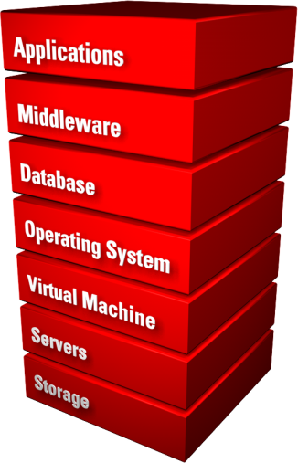
Products Built to Work Together
Complete Solutions.
Complete Choice.
Notes:
The sole CRM solution provider that owns the entire technology stack, – from database and middleware to application user interface to hosting
services – only Oracle offers a single vendor advantage in providing a seamless integration experience across Oracle CRM On Demand and the world’s leading
applications:
seamless front- and back-office user experience by connecting Oracle CRM On Demand with the Oracle E-Business Suite at the data, business
process, and user interface levels. Leveraging the power of Oracle Fusion Middleware, this prebuilt solution combines the ease of use and rapid
deployment capabilities of Oracle CRM On Demand with the power of the Oracle E-Business Suite, and can be further extended to meet the unique requirements
of your organization
Standards Based, not Proprietary. With Oracle the customer can utilize standards based development languages such as Java, HTML, JavaScript, & .NET.
Oracle’s CRM OD offering has been developed for Enterprise class customers with requirements around: scalability, security, open standards based development, and completeness of solution.
Oracle’s applications strategy reflects our customers’ desire for both integrated and best-in-class solutions, and is built on two main pillars: Complete Solutions and Complete Choice.
Complete Solutions -- based on a complete and integrated product strategy. Oracle is redefining the IT market by completely engineering IT solutions at the factor so customers don’t have to.
Complete Choice -- based on an open, standards-based product strategy. While customers want integrated solutions, they also want the option of plugging into other Oracle and non-Oracle solutions.

Slide 58
Only ORACLE:
Database
Data Warehousing
Database on Linux
Embedded Database
Middleware
Enterprise Portal
Application Server
Enterprise Performance Mgmt.
CRM
Human Capital Mgmt
Retail
Communications
Financial Services
Banking
Public Sector
Professional
Services
Notes:
Complete Choice:
Our strategy of delivering best in class enterprise applications integrated to best of breed industry solutions and making that available on a common platform has been validated in the marketplace, which have voted with their budgets. Oracle is now #1 in all of these areas
We let you upgrade on your timeframe, by offering lifetime support, you can choose when and what to upgrade. Our continued innovation in all our products, ensures that when you are ready, there will be new capabilities to continually improve your business.
Our Applications are licensed in a way that offers you maximum choice. You can decide to implement one module, a product family – such as HCM or Financials or an entire suite – it’s up to you. And we tools and pre-built integrations, to ensure that you have connected business processes across your enterprise.
Finally, we offer you choice of deployment options – traditional on premise, public cloud, or private cloud – or a combination of the above for different aspects of your busines

Slide 59
CRM On Demand Customers
Notes:
THE ORACLE ADVANTAGE
As the world’s leading enterprise software provider, Oracle understands the requirements and challenges facing organizations looking to maximize value with
existing software investments, as well as the challenges they face in integrating their applications.
Organizations expect their applications to interoperate as a virtual suite, regardless of whether the applications are provided by Oracle, another packaged vendor, or
are custom-built. Oracle delivers on this expectation by providing an integration strategy that is standards-based, leveraging the Application Integration Architecture
Framework. True interoperability requires complete integration of these applications at the data, user interface, and business process tiers.

Slide 60
Organizations of All Types & Sizes Choose ORACLE CRM On Demand
Notes:
60

Slide 61
Sample CRM Semiconductor Customers
CRM On Demand
Notes:
Vertical industry editions:
Semiconductor
Life Sciences
Finance
Hi-tech
Automotive

Slide 62
Rackable Systems Achieves 330% ROI from Oracle CRM On Demand, E-Business Suite & AIA
/
Challenges: Comprehensive visibility into leads, opportunities and sales forecast
Results: Increased sales efficiency; better data quality
New business process required for Lead-to-Quote and Build/Design to Order model
Low user adoption of previous CRM system
Sales lacked visibility to back-end data
Small IT staff, limited budget, short timeline
Fully integrated front-to-back office →10 Mos.
Better data quality, single customer/order view
Improved forecast accuracy & sales closure
Achieved 330% ROI with payback in only 5.3 Mos.
Notes:
PIP customer - live
Company Overview
Leading provider of high-density compute servers
•Industry: High Technology
•Employees: 286
•Revenue: US$360 million

Slide 63
What Rackable / SGI Is Saying
 With AIA, we have a single vendor solution to connect Oracle CRM and Oracle EBS. This allows for improved user adoption, better pipeline visibility, one view into customers and orders, and reduced IT costs.
Dominic Martinelli, CIO

Slide 64
Contact Information:
TK Kesler
CRM On Demand Specialist
(415) 305-9274
Tk.Kesler@Oracle.com
Ryan Cavanagh
CRM On Demand Specialist
(408) 616-9010
Ryan.Cavanagh@Oracle.com

Slide 65
Questions?
Notes:
65

Slide 67
ORACLE Application Integration Architecture
A comprehensive, open, standards-based integration platform that process-enables the entire value chain
Front Office Applications
Faster, cheaper, easier integration of core processes
CRM
Custom
Hosted
eStore
Portals
Self Service
Other
Reduced integration risk
People
Business Processes
Information
Legacy
Supply
Chain
B2B
Custom
ERP
Analytics
Service
Providers
Improved adaptability of business processes
Back Office Applications
Connecting People, Processes & Information across the Enterprise
Notes:
AIA delivers adaptable business processes that can change as your business changes
Based On A Common Data Model
Extensible, Repeatable, and Sustainable
BPEL enables organizations to not only quickly assemble a set of Discrete services into an end-to-end process flow but also to rapidly modify processes as business conditions change.
AIA is a cost effective and risk mitigating solution to integration requirements
Reduce your integration cost and risk
- stop rebuilding integrations with every new application and release
- focus on core competencies not integration

