Slide 1
Next-Generation Mobile Applications for
Oracle E-Business Suite
Parag Jain
ERP Lead
BioMarin Pharmaceutical Inc
01-13-2011

Slide 2
Safe Harbor Statement
This non-confidential presentation might contain ‘forward-looking statements’ about the business prospects of BioMarin Pharmaceutical Inc., including potential future products in different areas of therapeutic research and development. Results may differ materially depending on the progress of BioMarin’s product programs, actions of regulatory authorities, availability of capital, future actions in the pharmaceutical market and developments by competitors, and those factors detailed in BioMarin’s filings with the Securities and Exchange Commission such as 10-Q, 10-K and 8-K reports.

Slide 3
Agenda
BioMarin at a Glance
Focus & Strategy
Business Problem
Solution
Challenges
Architecture
Lessons Learned
Recommendations
Q&A
Process Flow
The App
Benefits

Slide 4
BioMarin at a Glance
Proven Business Strategy Targeting Genetic and Serious Medical Disorders
BioMarin Pharmaceutical Inc. (Nasdaq: BMRN) is a multinational biopharmaceutical company that specializes in providing first-to-market therapeutics to patients with rare genetic diseases. BioMarin has developed and commercialized 4 products in over ten years, a remarkable accomplishment in the biopharmaceutical industry, and a testament to the company’s passion and dedication to patients with serious, unmet medical needs. The company has successfully advanced 4 breakthrough products from bench, to market, to patients.
Four commercial products
  Total 2010 revenue projected: $370M–$393M*
  Aldurazyme® for MPS I
  Naglazyme® for MPS VI
  Kuvan® for PKU
  Firdapse™ for LEMS (EU)
Multiple new product opportunities
  GALNS for MPS IVA
  PEG-PAL for PKU
  New IND candidates in development
  Ongoing business development efforts
* Financial information per BioMarin press release issued August 2, 2010 (excludes $5M to $7M in expenses
related to the planned development of BMN-701 for Pompe disease announced on August 17, 2010)

Slide 5
BioMarin at a Glance
Focus & Strategy
Business Problem
Solution
Challenges
Architecture
Lessons Learned
Recommendations
Q&A
Process Flow
The App
Benefits

Slide 6
Focus & Strategy – Expanding Product Pipeline
Focus
Rare (Orphan) genetic diseases.
Providing rapid access to treatment for patients with serious unmet medical needs
Optimizing powerful biology with demonstrated potential and development clarity
Accelerating approval process and strategic pipeline development.
Strategy

Slide 7
BioMarin at a Glance
Focus & Strategy
Business Problem
Solution
Challenges
Architecture
Lessons Learned
Recommendations
Q&A
Process Flow
The App
Benefits

Slide 8
Business Problem
120 Requisitions with Multiple lines per week.
Constant increase in volume of Requisitions.
Cumbersome email searches for travelling executives.
Significant delays & lead time for approvals.
Issues with stuck Requisitions.
Delays in releasing PO’s.
Impact to Supply chain.
Drive to reduce costs and improve productivity

Slide 9
BioMarin at a Glance
Focus & Strategy
Business Problem
Solution
Challenges
Architecture
Lessons Learned
Recommendations
Q&A
Process Flow
The App
Benefits

Slide 10
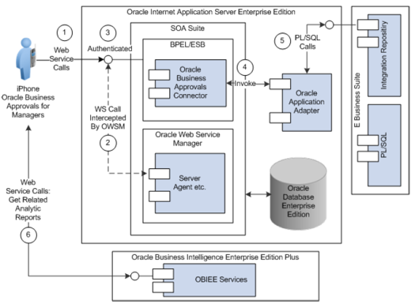
Solution & Environment
Environment
  Oracle E-business Suite 12.0.4
  Platform - Linux x86
  iPhone - 3G/3GS/4.0
  iOS 3.0.x / 4.0.x
Solution
  Oracle E-business Suite Adapter 1.0
  SOA 10g – BPEL, ESB, Web Services & Application server control.
  Oracle iPhone app – Oracle Business Approvals for Managers 2.0.

Slide 11
Solution Flow
ESB
Application Server Control
iPhone
E-business Suite
BPEL
Web Services Control

Slide 12
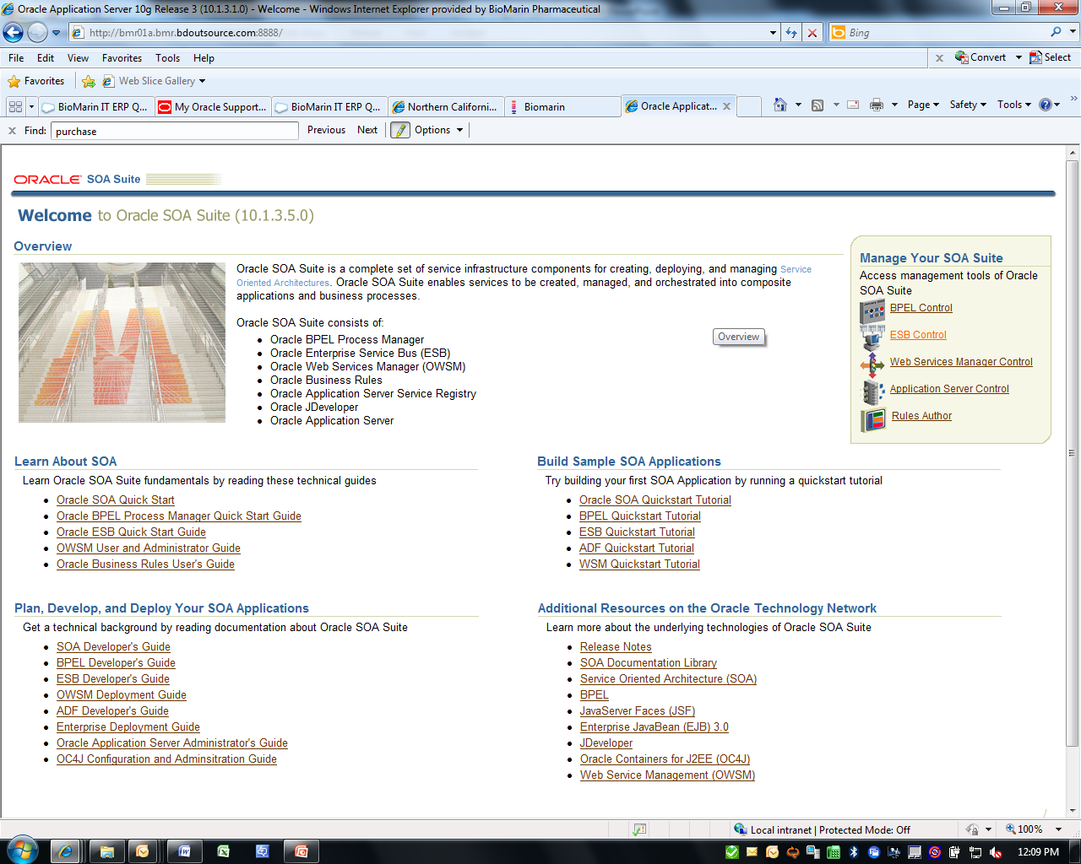
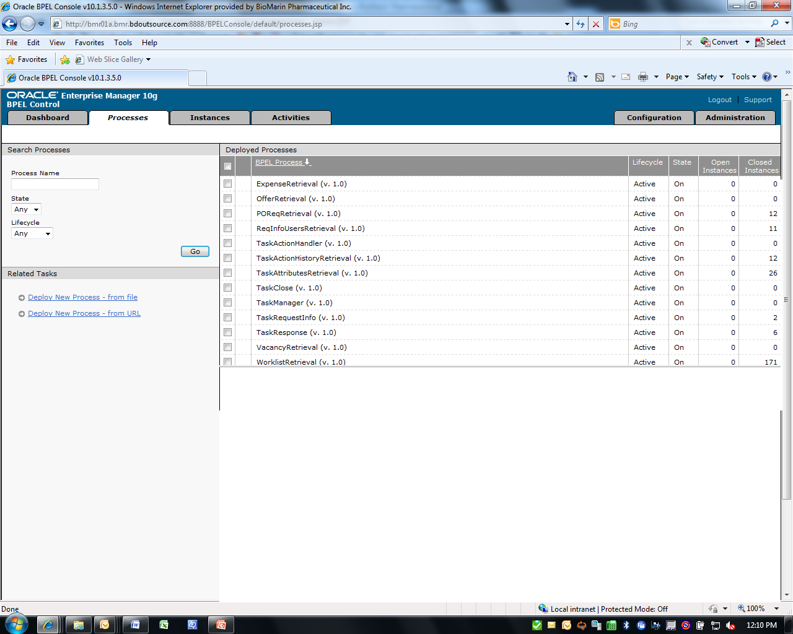
BPEL Configuration
SOA Components
BPEL Processes after deploying connector

Slide 13
BPEL Configuration – Ant Script
Deploy Ant 1.6 Script in OC4J instance
Modify AUBI.properties file; Set bpel.home with a path to the bpel directory, example:\\Oracle\product\10.1.3.1\OracleAS_1\bpel
Execute ant commands:
/Foundation
/Approvals

Slide 14
Enterprise Service Bus (ESB) – DVM’s
Importing DVM’s for the Connector

Slide 15
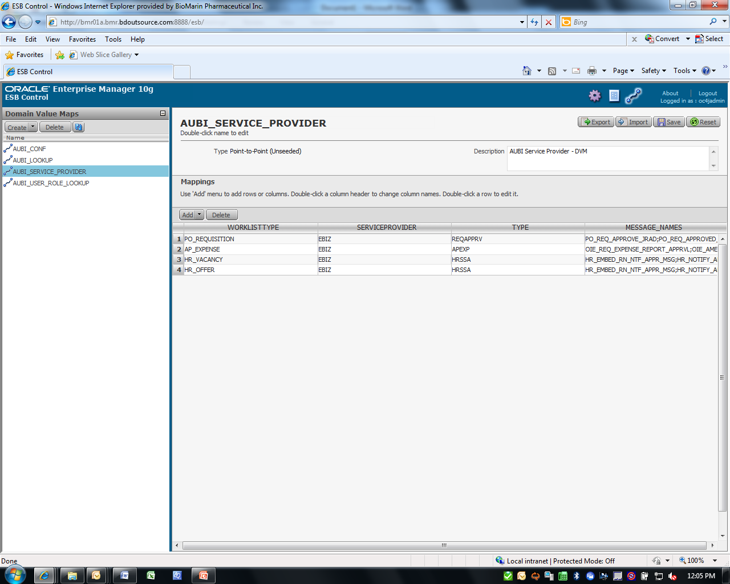
Enterprise Service Bus (ESB) – 4 DVM’s
AUBI_LOOOKUP
AUBI_SERVICE_PROVIDER
AUBI_USER_ROLE_LOOKUP
AUBI_CONF
Domain Value Mappings

Slide 16
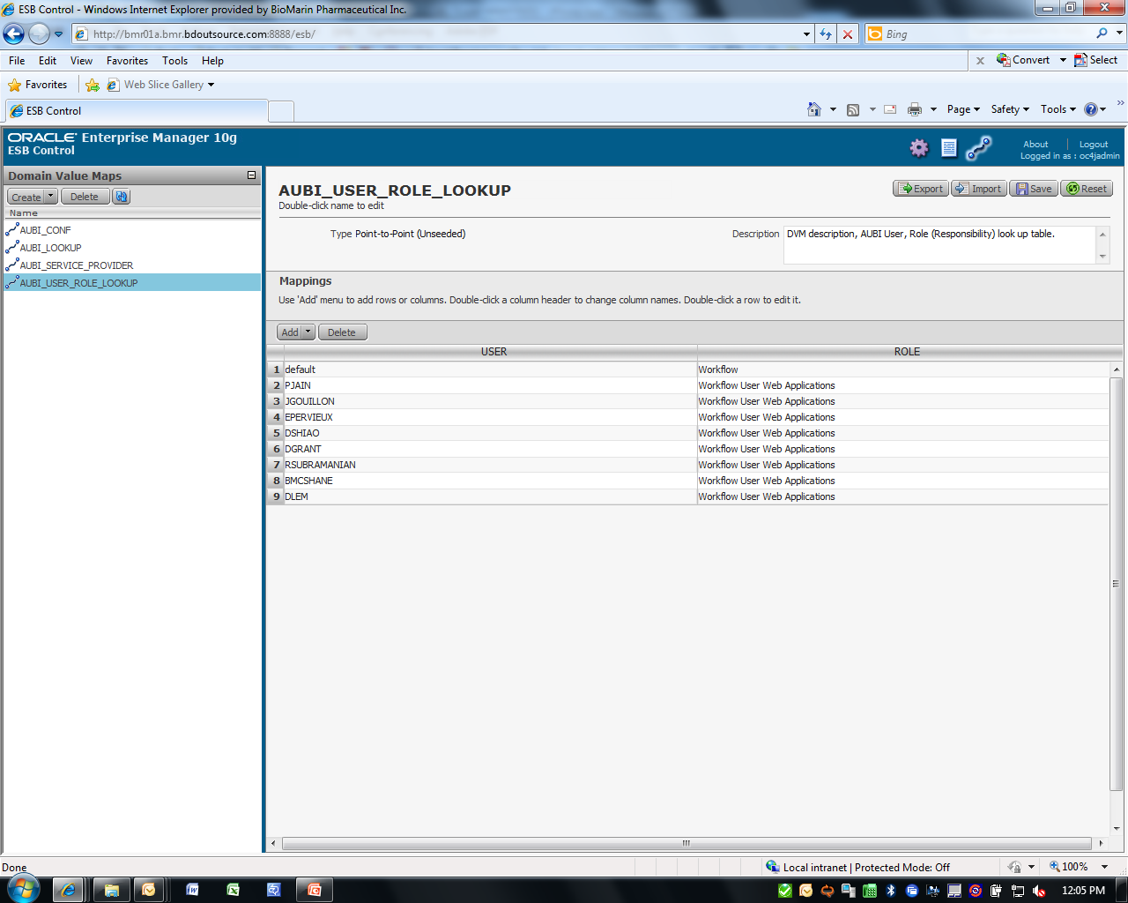
Enterprise Service Bus
User Role DVM
User Access & Role definition
Define EBS Username
Define EBS Responsibility

Slide 17
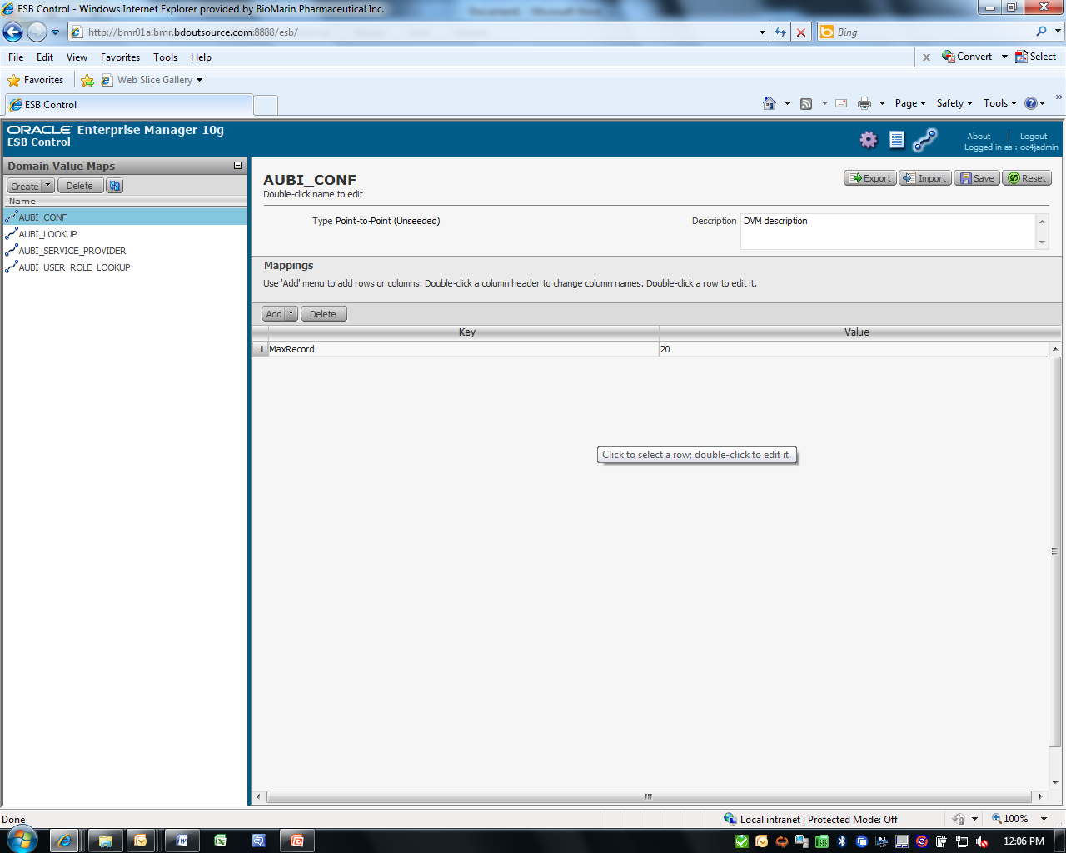
Data Control
No of Records to view
Max records to be viewed on iPhone

Slide 18
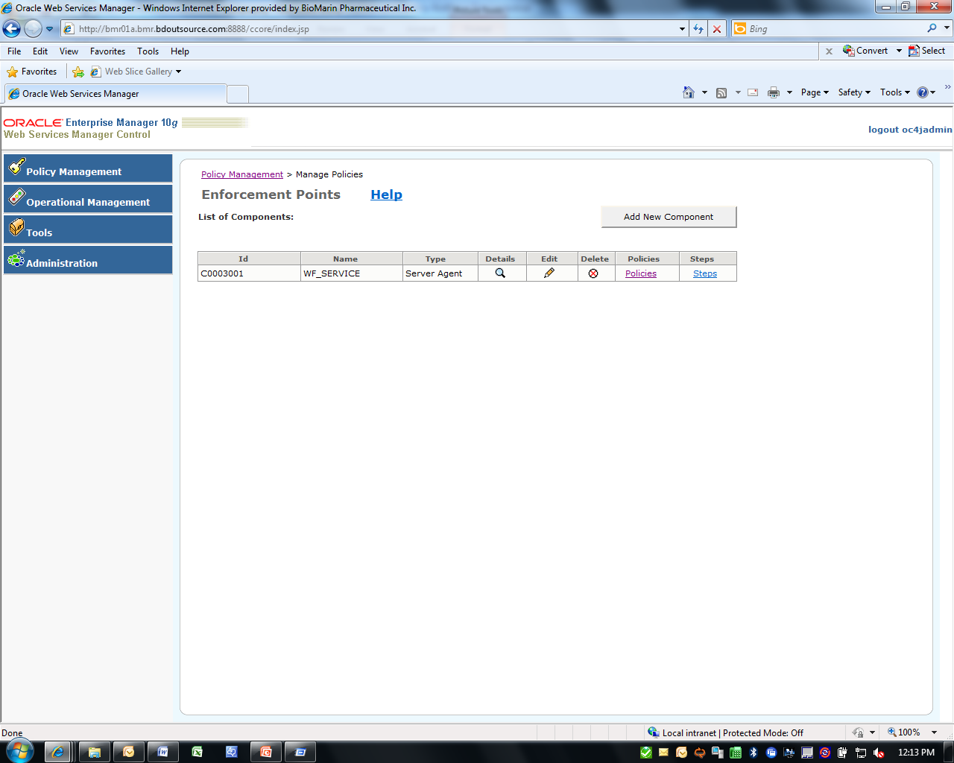
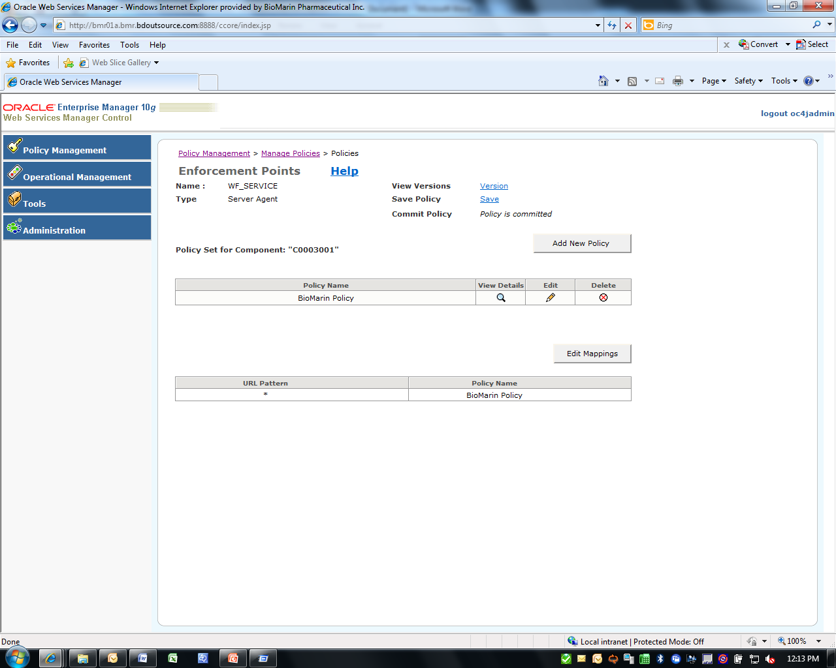
Web Services Control – Security Policy
Configuring Connector Security
  Adding a New Server Agent Component
  Adding a Policy

Slide 19
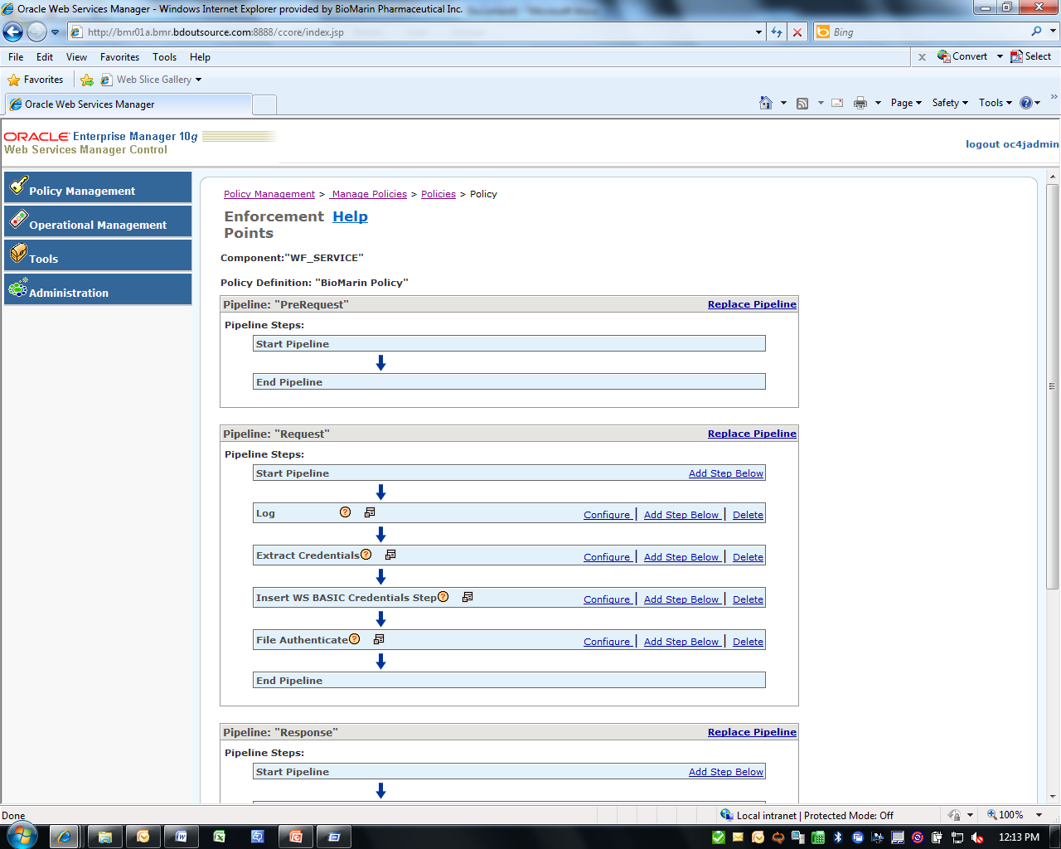
Security Policy
  Enabling Server Agent Components

Slide 20
Security Policy
Set the agent.component.id property in the agent.properties file to the policy ID.
Run <SOA Install>\owsm\bin\wsmadmin installAgent for the policy created
The agent.properties file is located in this directory:
\\SOA Install\owsm\bin\

Slide 21
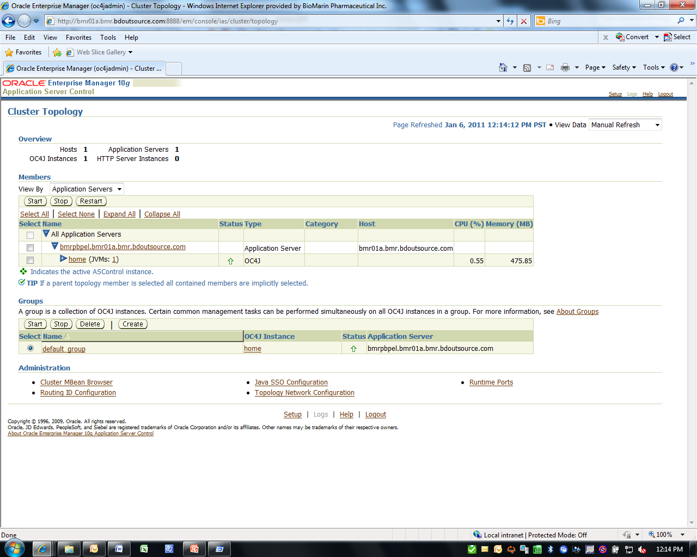
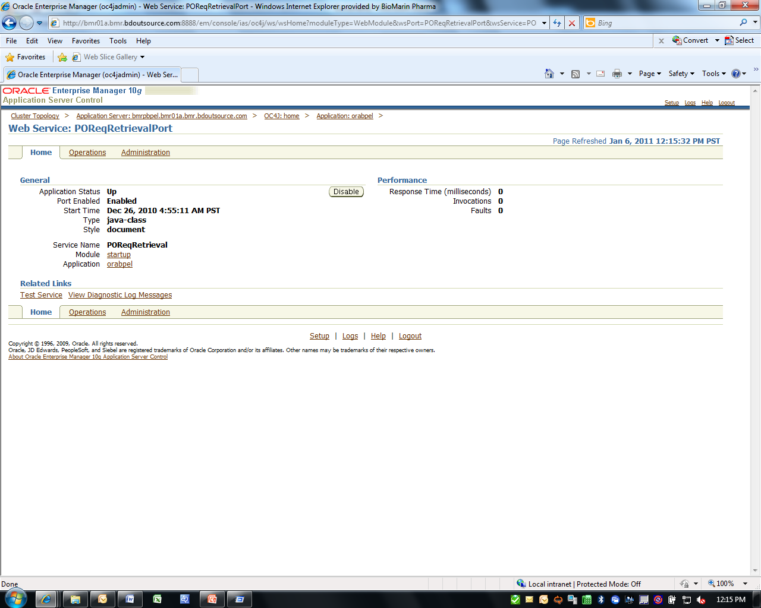
Application Server Control
  Associating a Web Service with Server Agent

Slide 22
Application Server Control
Secure all BPEL web services
Enable/Disable Features button to enable the port.
Enter the server agent ID

Slide 23
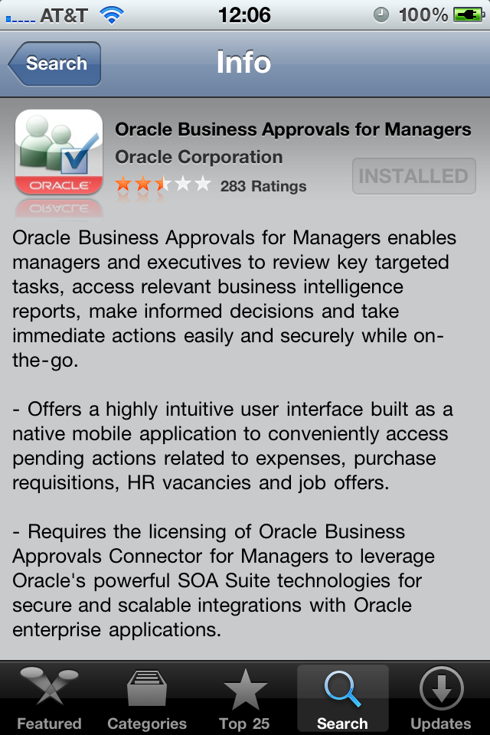
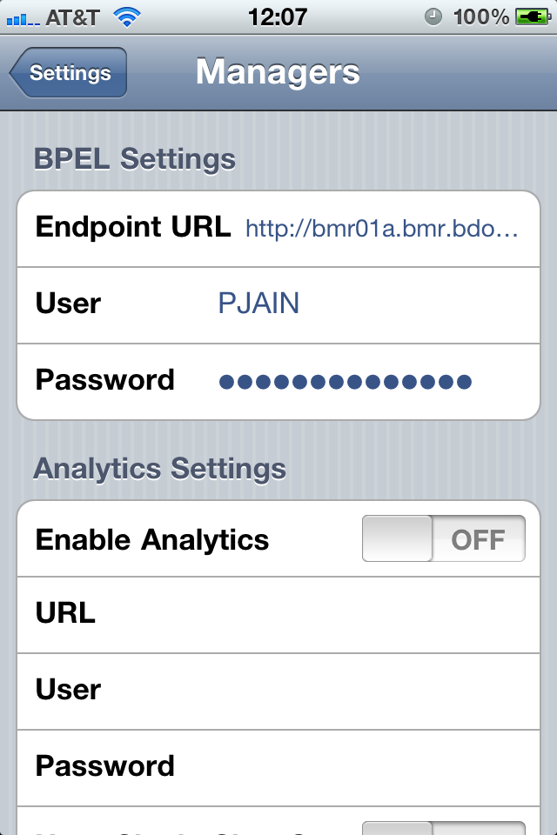
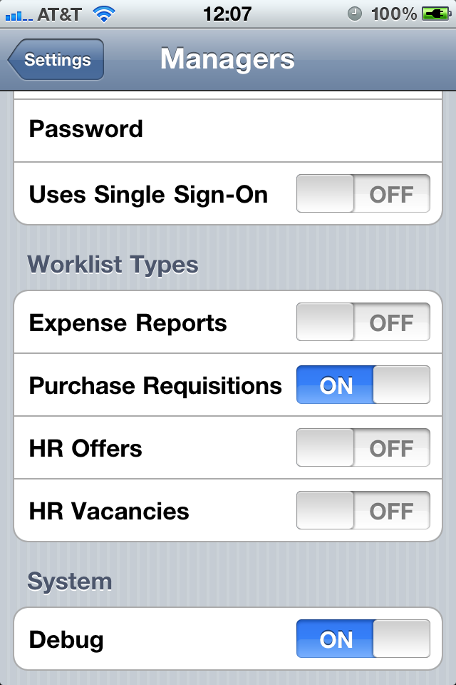
iPhone Setup
BPEL Details
EBS Username
The App
EBS Password
Worklist Setup

Slide 24
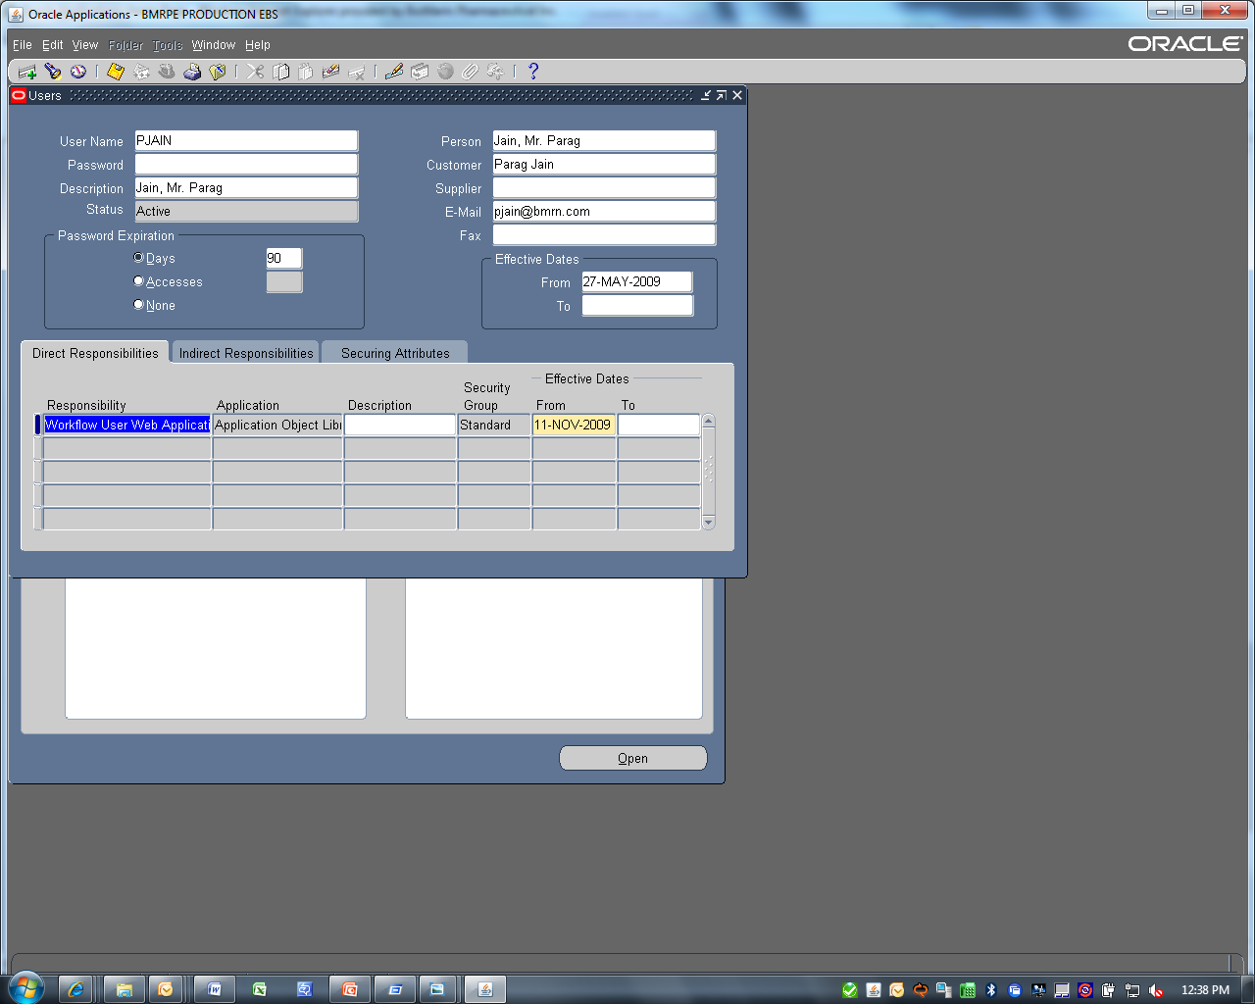
E-business Suite – Setup
EBS Username
EBS Responsibility

Slide 25
BioMarin at a Glance
Focus & Strategy
Business Problem
Solution
Challenges
Architecture
Lessons Learned
Recommendations
Q&A
Process Flow
The App
Benefits

Slide 26

Process Flow
iPhone
SOA
Web Services Calls
Approver
Configuration
System
BPEL
ESB
Oracle Purchase Requisition
Application
System
Oracle
Database
Oracle
Database
Requester

Slide 27
BioMarin at a Glance
Focus & Strategy
Business Problem
Solution
Challenges
Architecture
Lessons Learned
Recommendations
Q&A
Process Flow
The App
Benefits

Slide 28
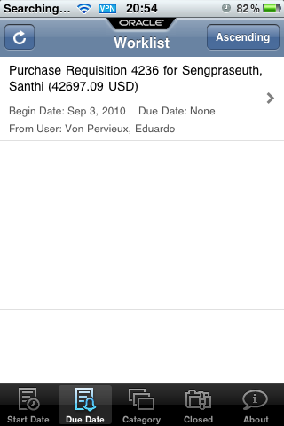
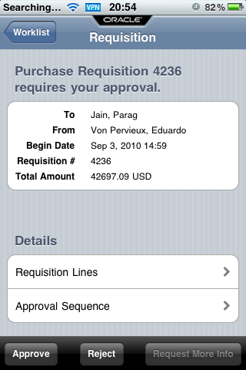
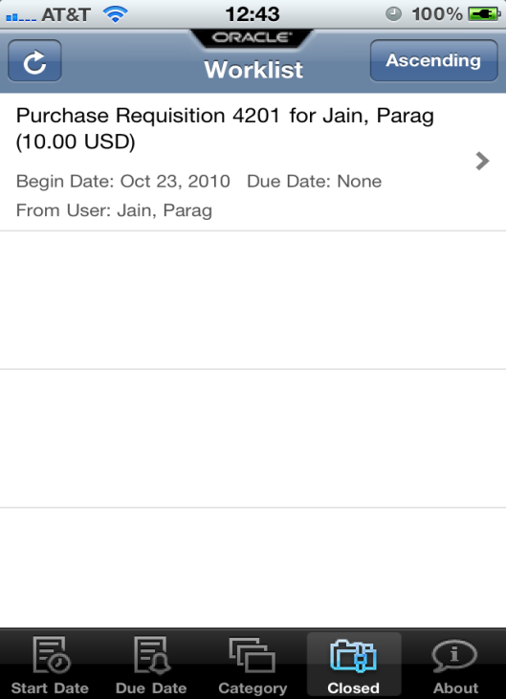
Oracle iPhone App

Slide 29
BioMarin at a Glance
Focus & Strategy
Business Problem
Solution
Challenges
Architecture
Lessons Learned
Recommendations
Q&A
Process Flow
The App
Benefits

Slide 30
Challenges & Value Proposition
CHALLENGES
CAPABILITIES
VALUE
Improve approval efficiency
Improve visibility to approval chain & commit PO dates.
Improve ease of use.
Increase turnaround time.
Integrate EBS with SOA
Integrate DVM’s (Domain Value Mappings) & Enterprise Service Bus (ESB)
Create Security policies with Web services control.
Associate a web services agent
VPN Compatibility
Improve speed in Requisition approvals.
Reduction in stuck requisitions
Remote access
Approvals by due date
Efficient status tracking
Faster turn around time
Enhanced User Experience

Slide 31
BioMarin at a Glance
Focus & Strategy
Business Problem
Solution
Challenges
Architecture
Lessons Learned
Recommendations
Q&A
Process Flow
The App
Benefits

Slide 32
Network Architecture – FDA Regulated

Slide 33
BioMarin at a Glance
Focus & Strategy
Business Problem
Solution
Challenges
Architecture
Lessons Learned
Recommendations
Q&A
Process Flow
The App
Benefits

Slide 34
Lessons Learned
Ant 1.6 script was easier to use instead of JDeveloper tool.
Compatibility of app with iOS 4.0.x.
Error Handling

Slide 35
BioMarin at a Glance
Focus & Strategy
Business Problem
Solution
Challenges
Architecture
Lessons Learned
Recommendations
Q&A
Process Flow
The App
Benefits

Slide 36
Benefits - Business Value
Cost Savings
Potential cost Savings up to $20K per year
Business Process improvements
Efficiency
Faster Turn around time
Better lead times
Avoids email searches for approvals
Accessibility
Remote access – VPN Support
Slick App interface - Touch of a button
Electronic Approvals

Slide 37
BioMarin at a Glance
Focus & Strategy
Business Problem
Solution
Challenges
Architecture
Lessons Learned
Recommendations
Q&A
Process Flow
The App
Benefits

Slide 38
Recommendations
Ticker notification to identify total no. of pending approvals on app.
Ability to approve Invoices in future release.
Deployment of app settings remotely.
Compatibility of the app with Blackberry.
Attachment capabilities.

Slide 39
Q
&
A

