Slide 1
Oracle Receivables Fundamentals (and How it Fits into the “Big Picture”)
Cathy Cakebread
Consultant
NorCal OAUG January 13, 2011

Slide 2
Agenda
Quote to Cash Flows
Customers/Parties
Shared Setups
Orders to Invoices
Oracle Receivables Processes
Transactions
Payments
Adjustments
Accounting
Questions??

Slide 3
Target Audience
Folks Who Use Oracle Receivables
To Learn More About Where Their Data Comes From
And, to Learn About Shared Setups
Folks Who Use Applications That Pass Data to Oracle Receivables
To Learn More About Where Their Data Goes
To Learn The Impact of Their Activities
And, to Learn About Shared Setups
CRM, Order Management, Contracts and Projects folks

Slide 4
Basic Premise
The Oracle E-Business Suite is comprised of many different applications performing various business functions. A key aspect of this is that most of these applications share setups with other applications and data is often passed from one application to others. What this means is that what you do in your application may have an impact on many other applications, in ways that you may not be aware of.
The purpose of session is to provide attendees with the details of how the data flows in and out of Oracle Receivables, how certain setups are shared across multiple applications and to see how Oracle Receivables fits in the “Big Picture”.

Slide 5
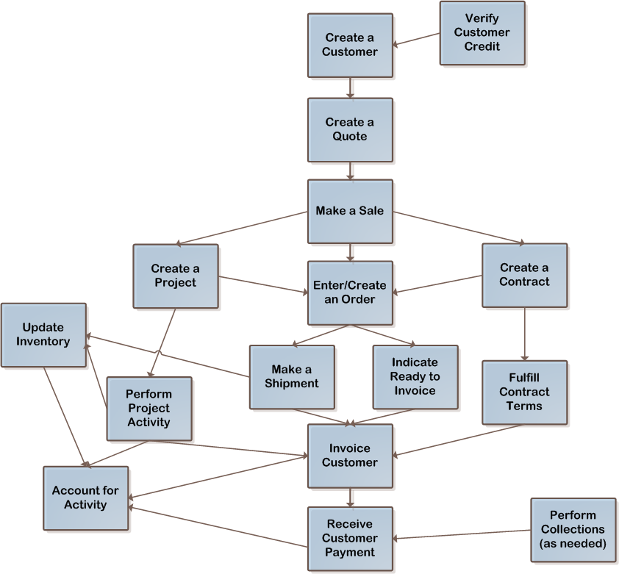
Quote to Cash Flows

Slide 6
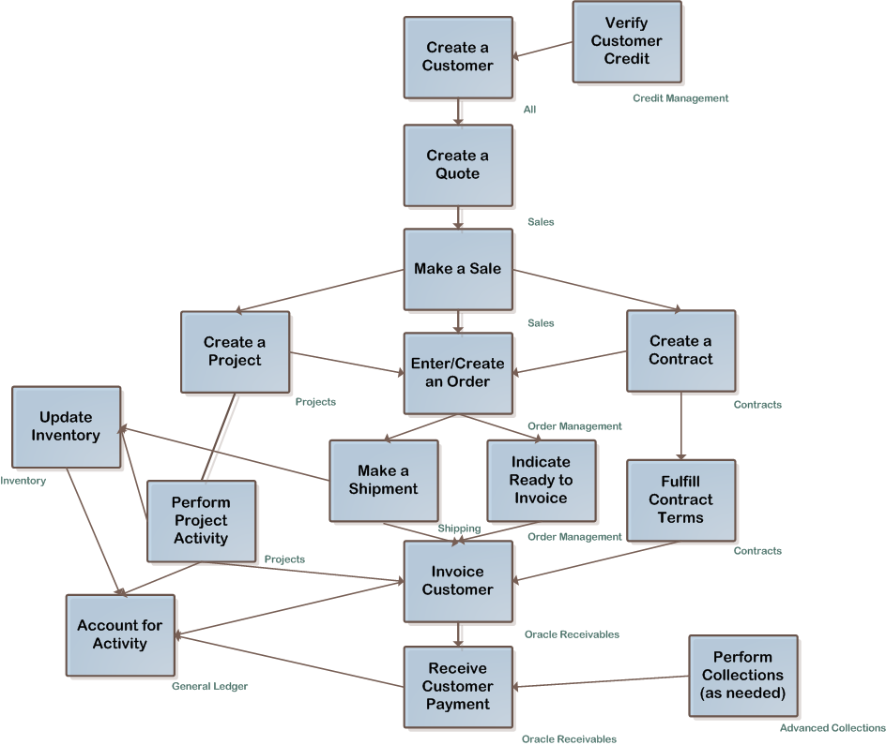
Quote to Cash Applications

Slide 7
One Way Only!!!
Tip: Make Corrections in the Source System, Whenever Possible

Slide 8
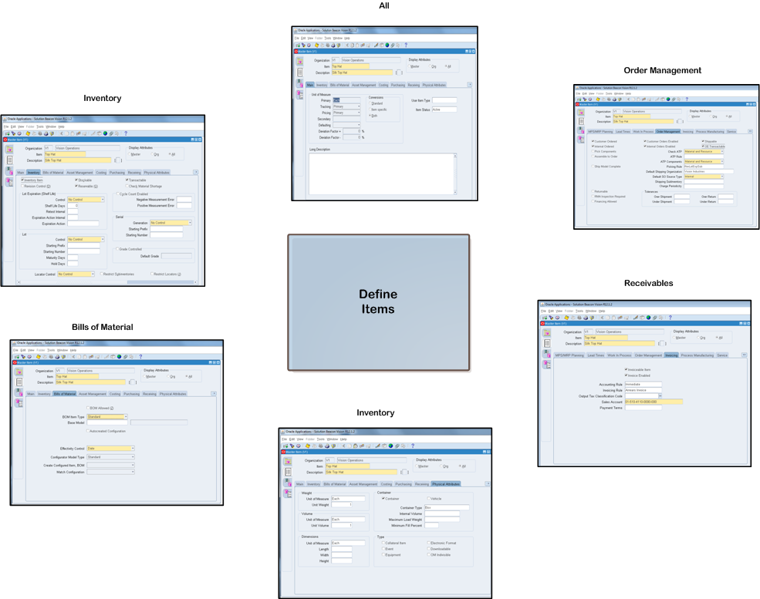
Items

Slide 9
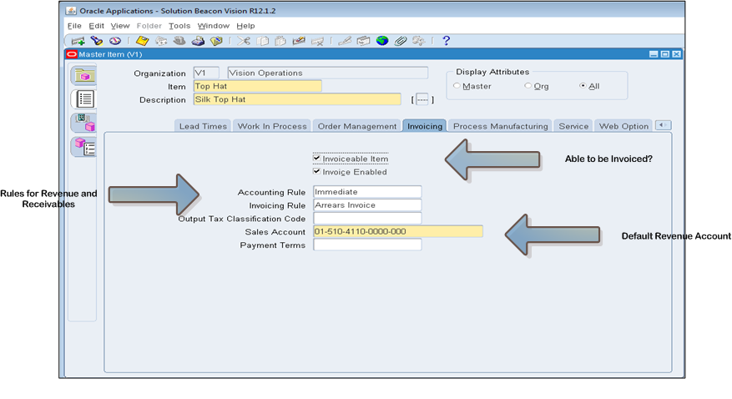
Items and Receivables

Slide 10
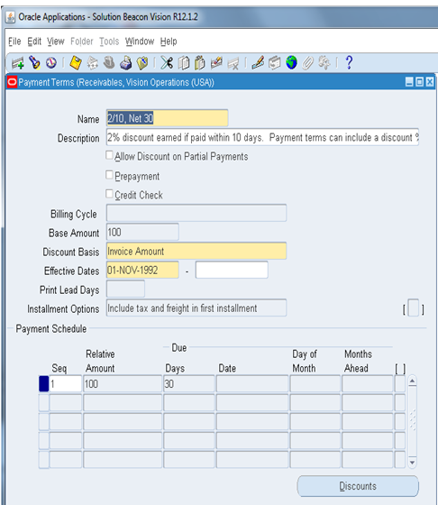
Payment Terms (Orders, Invoices, Contracts, Projects)

Slide 11
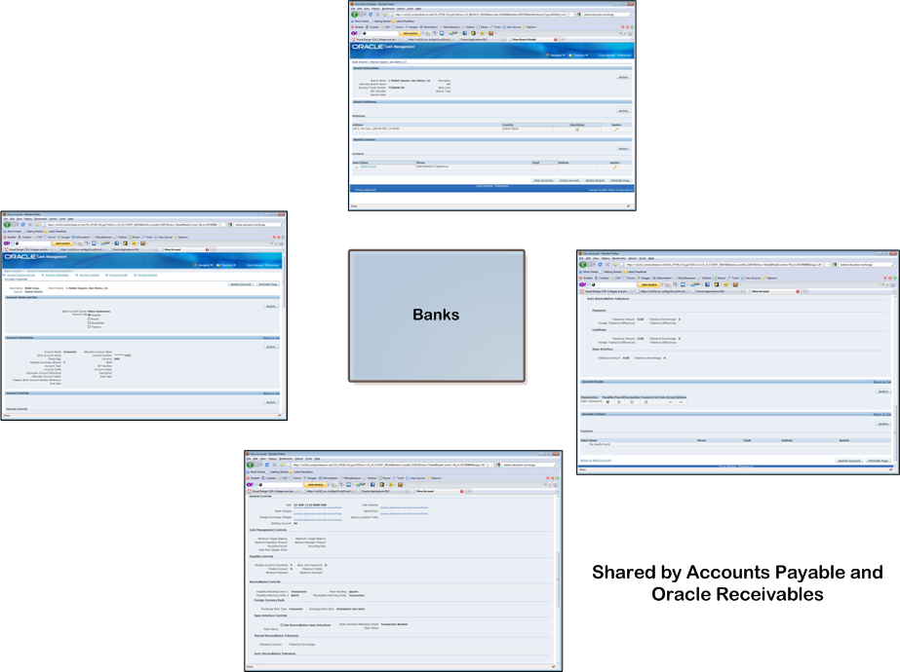
Banks

Slide 12
What Is A Customer? A Party? A Customer Account?
One “Customer” May be All Three
Party
Highest Level – “Global Entity”
Used More By CRM Applications Than “Back Office”
Can Be:
Customer, Suppliers, Employees, Anyone/Business That Interacts With Your Company
Customer
Made Up of One or More Legal Entities
Made Up of One or More Addresses /Sites
Entity for Orders and Invoices
Customer Account
A Customer May Have One or More Accounts

Slide 13
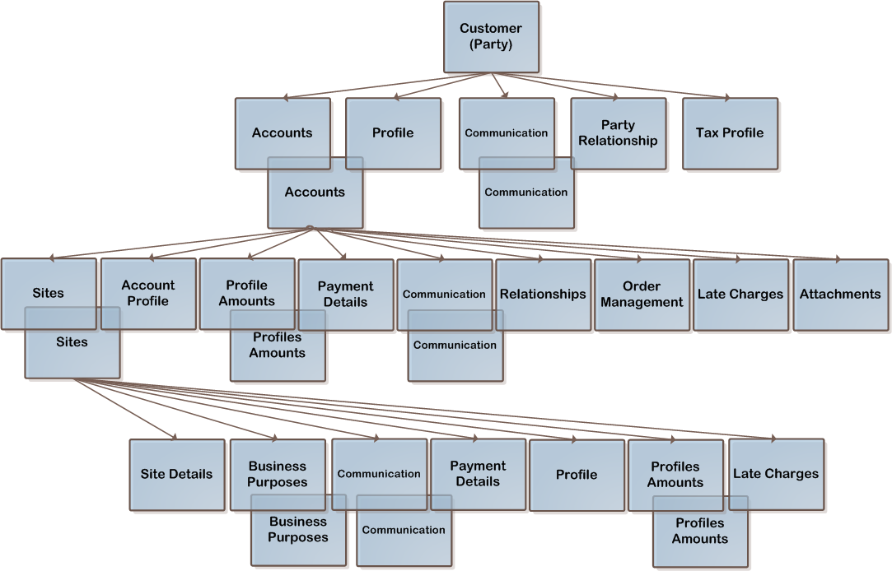
Customer Components

Slide 14
Customer Examples
Customer Relationship
Customer Account 1
Customer Account 2
Customer Account 3
Site
Address 1
Site
Address2
Site
Address3
Bill To
Ship To
Bill To
Ship To
Site
Address201
Site
Address303
Ship To
Bill To
Ship To
Site
Address304
Bill To
Marketing
Customer (Party)
Customer
(Party)
Customer
Account
Site
Address 1
Bill To
Ship To

Slide 15
Typical Customer Creation (Who)
Complete Credit Application (Salesrep/Customer)
Approve Credit Application
(Credit and Collections)
Add New Customer
(Credit and Collections / Salesrep / Order Entry / Accounts Receivable)
Update Credit Details
(Credit and Collections)
Add New Relationships (as Needed)
(Credit and Collections / Accounts Receivable)

Slide 16
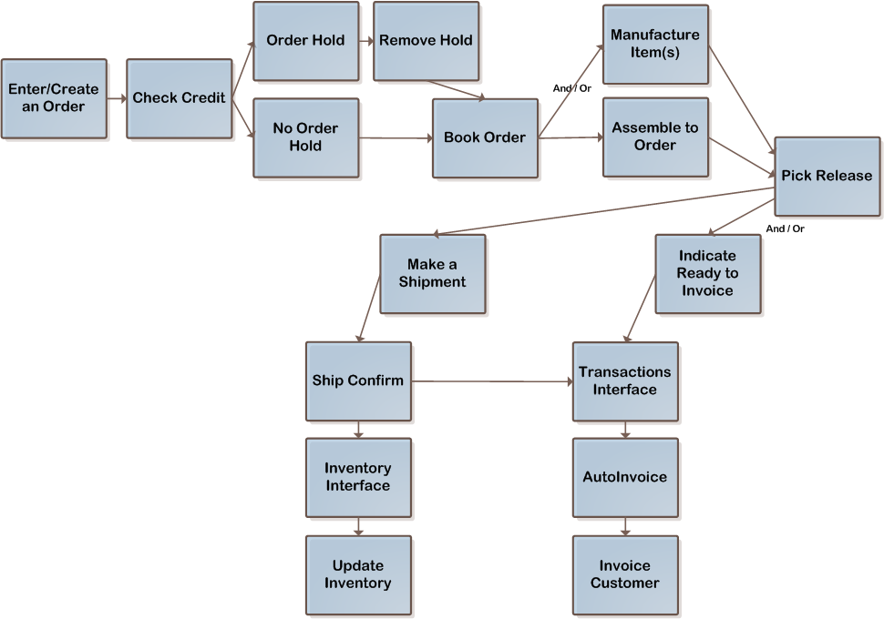
Orders – Workflow Example

Slide 17
Assemble to Order Workflow

Slide 18
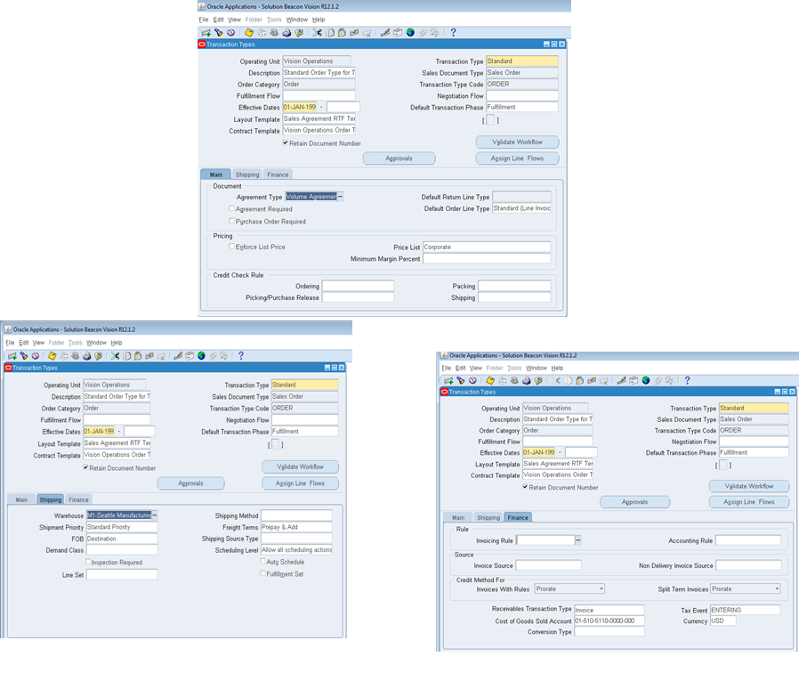
Order Transaction Types

Slide 19
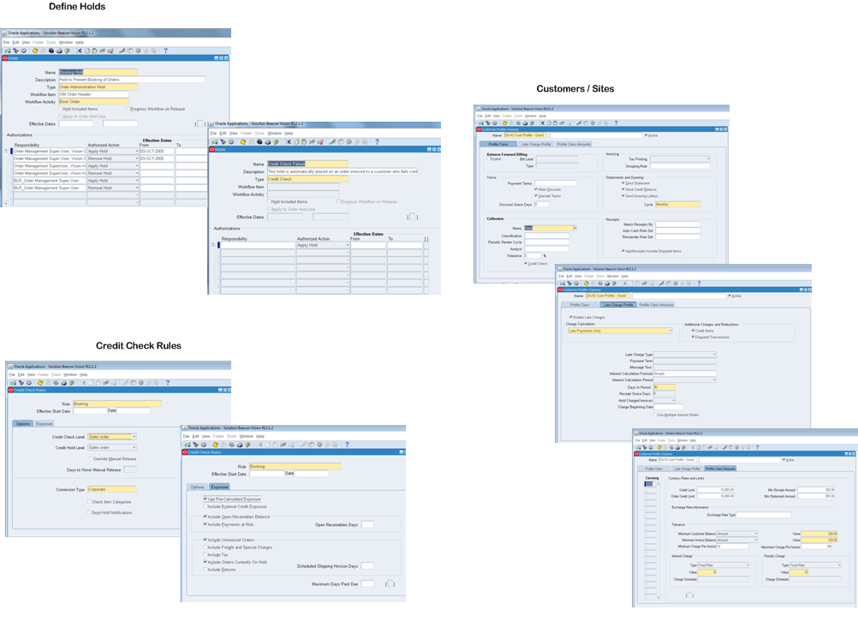
Credit Holds / Credit Checking Rules

Slide 20
Transactions
Invoices
Credit Memos
Debit Memos
Deposits
Guarantees

Slide 21
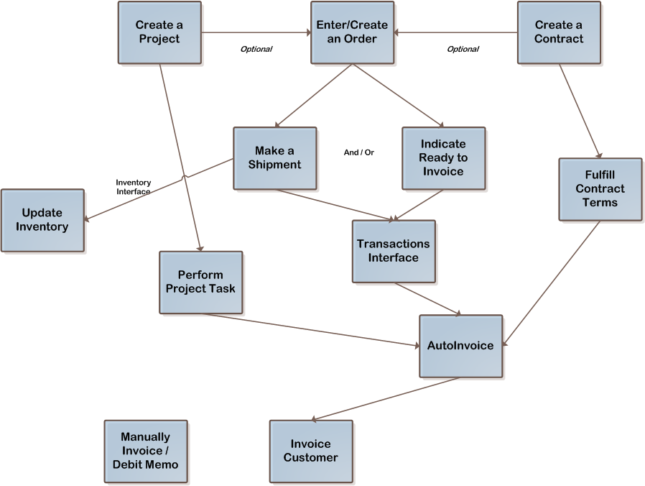
Transactions Flow / Sources

Slide 22
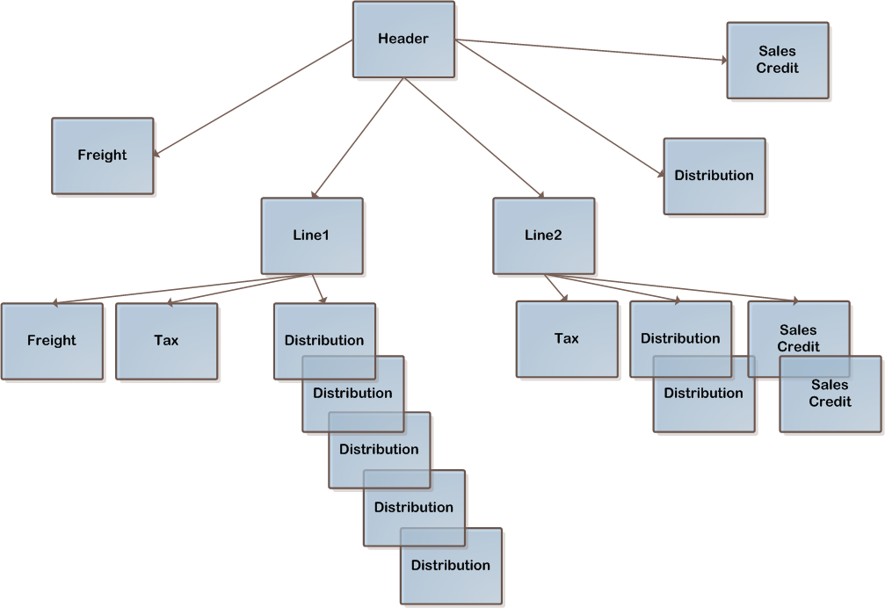
Transactions Example - Invoice

Slide 23
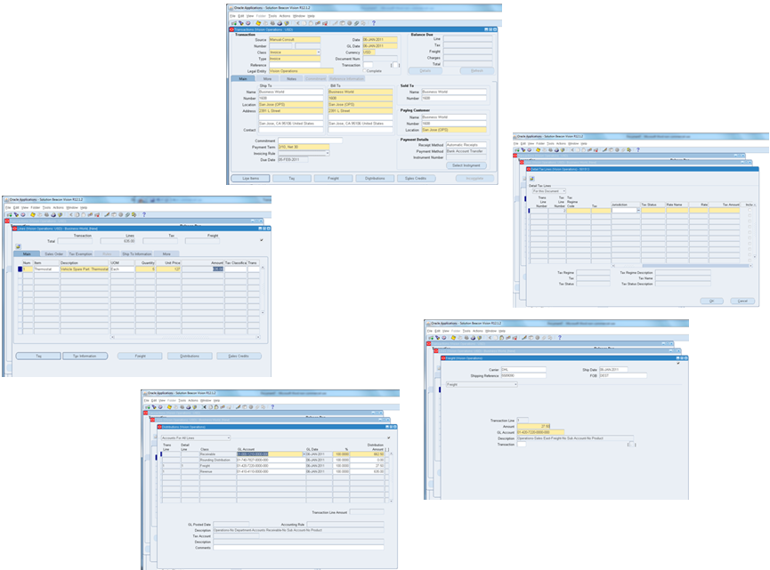
Transaction Details
Source: Orders
Contracts
Projects
Source: Order Lines
Contract Lines
Project Tasks

Slide 24
Transactions Setup
Payment Terms (Shared – Defines When Payment is Due)
**Transaction Types (Business and Accounting Grouping and Default GL Accounts)
Sources (Where Transactions Come From & Numbering Rules)
Items (Shared – “Parts”)
Memo Lines (Used for Debit Memos)
Accounting Rules (Derive How Revenue and Receivables Are Accounted For)
**AutoAccounting (Derive Accounting Values)
AutoInvoice
Line Ordering Rules (Rules for Sequencing Transaction Lines)
Grouping Rules (Rules for What Goes on the Same Transaction)

Slide 25
Receipts
Payments for Non-Accounts Receivable Activity called “Miscellaneous Receipts”
Payments for Company Events, T-Shirts, COBRA Payments, Utility Refunds...
Payments from Customers For Accounts Receivable Activity (Paying for Open Transactions)
Forms of Payment:
Checks
Cash
Credit Card Payments
Letters of Credit

Slide 26
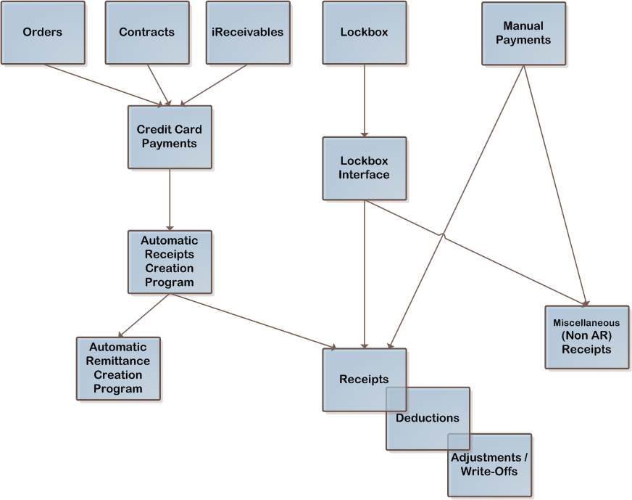
Receipt Sources

Slide 27
Receipts Setup
**Receivable Activities (Base Activity and Miscellaneous Cash Definitions)
AutoCash Rule Sets (Rules for How to Apply Cash Through Lockbox)
Application Rule Sets (Rules for Partial Payments)
Distribution Sets (for Miscellaneous Cash with Multiple Accounts)
Receipt Sources (Where Receipts Came From and Rules)
**Receipt Classes (Key Accounting Setup)
Bank Charges (Rules for Bank Charges)
Lockboxes
Lockboxes (Bank and Processing Rules)
Transmission Formats (Layouts of Data From Bank)
Banks (The Banks and Associated GL Accounts)

Slide 28
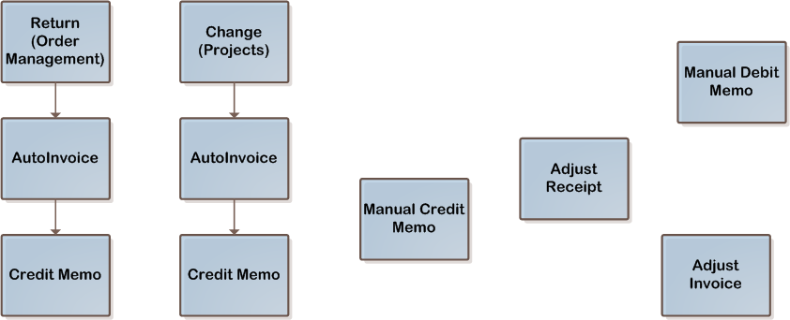
Adjustments
Credit Memos:
Tied to an Invoice When Created
“On-Account Credit” Not Tied to an Invoice When Created

Slide 29
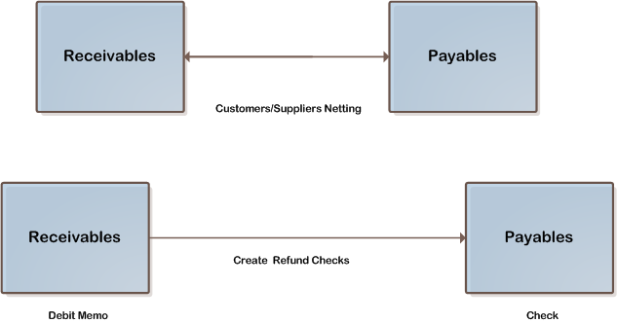
Payables and Receivables

Slide 30
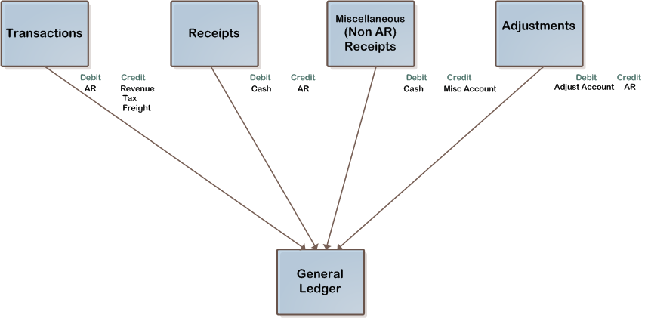
Accounting (Basics)

Slide 31
Questions and Answers
Questions?
Cathy Cakebread
cathyc@cathycakebread.com
(650) 610-9130
www.cathycakebread.com

