Slide 1

Oracle Payables: Implementing Internal Controls for Electronic Payments (EFT)
Daisy H. Dabandan and
Vinayak Jindam
January 13, 2010

Slide 2
Safe Harbor Statement
  The following is intended for information purposes only, and may not be incorporated into any contract. It is not a commitment to deliver any services, material, code, or functionality, and should not be relied upon in making purchasing decisions.
  The development, release, and timing of any features or functionality described for Oracle’s products remains at the sole discretion of Oracle.
Notes:
The leading provider of comprehensive IT services to the SMB market for Enterprise Business & Technology solutions.
Here is our Safe Harbor Statement.

Slide 3
Agenda
Objectives
Business Need
Features and Benefits
What Are Your Options
Solutions Walkthrough
Benefits using Oracle Workflow over Form Personalization
Bank Approval Process Setup and Components
Q & A

Slide 4
Objectives
Present options in implementing bank account creation and bank account assignment approval process for internal controls and SOX compliance
Implement a systematic approach that can :
  Eliminate fraud and deliberate assignment of bank accounts for one's advantage
  Send and Receive email notifications when a bank account is created and/or assigned to a Supplier
  Send and Receive email notifications when a request is approved or rejected
  Disable specific Oracle fields for Submitter and Approver for tighter controls

Slide 5
Business Needs
Segregation of Duties
  Payment User – Submitter
  Payables Manager - Approver
Supplier Bank Account setup should be kept on HOLD till Payables Manager reviews and approve
Any changes to Supplier Bank Account should be instantaneously notified to Manager (Supplier Bank Account Changes and Supplier Site Level Bank Account Assignment Changes)
Payables Manager should be able to Approve or Reject the Bank Account details with comments

Slide 6
Features and Benefits
Features and Functionality
Supplier Bank Account Approval
Process
Supplier Bank Account Assignment
Approval Process at Supplier Site
level
Simple and easy approval solution
process
Only Submitter needs access to
Bank Account Screen
Comments for Rejecting the Bank
Account details are available
Notifications are managed using
Oracle Workflow
Benefits and Potential:
11i and R12 EBS Customers using
EFT needs Bank Account Approval
Process
Simple and Easy Method to Use
Approver doesn’t need access to
the Bank Screen
Solution can be enabled for single
or multiple organizations

Slide 7
What are the Possible Options?
One Step Approval Process
  Bank Account Creation and Assignment to Supplier
Two- Step Approval Process
  Bank Account Creation
  Assignment to Supplier
Form Personalization
Bank Approval Workflow

Slide 8
Solutions Walk Through

Slide 9
Approval Solution using Form Personalization
Payment User
Payable Manager

Slide 10
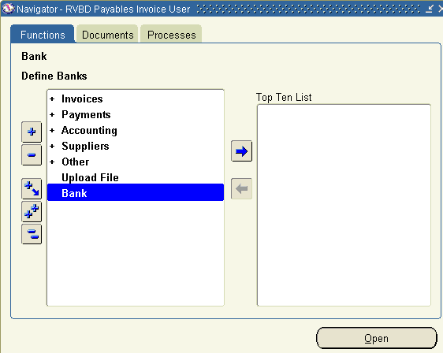
Bank Account Creation and Supplier Site Assignment
Click on Bank (Menu)

Slide 11
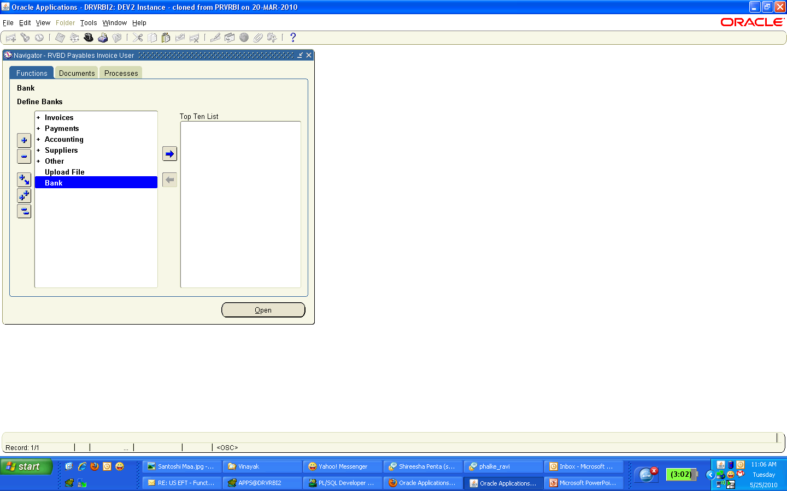
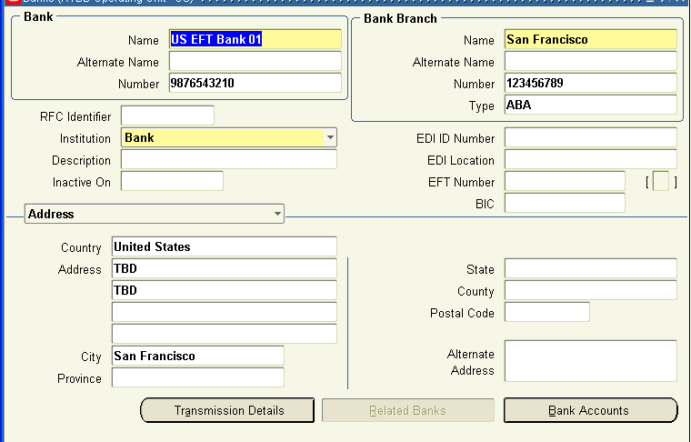
Bank Account Creation and Supplier Site Assignment
→ Mandatory
→ Required
Enter Bank Name
Enter Branch Name
Select Type as ‘ABA’ for US Banks
9 Digit Bank Routing Number for US Banks
Select Supplier Country and Address with City
Save and Click on Bank Accounts

Slide 12
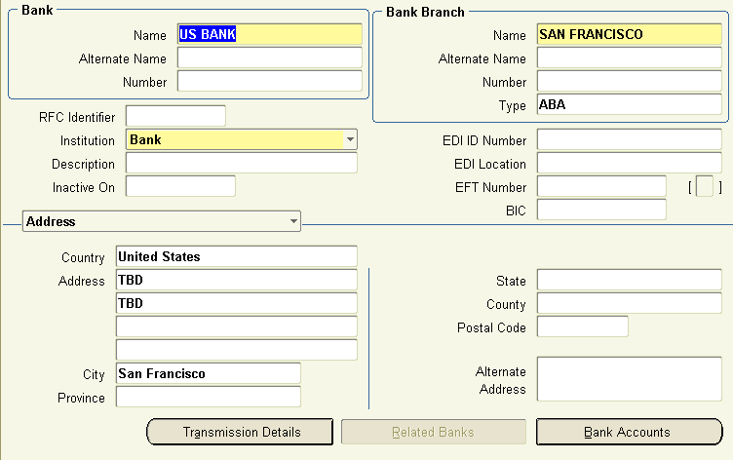
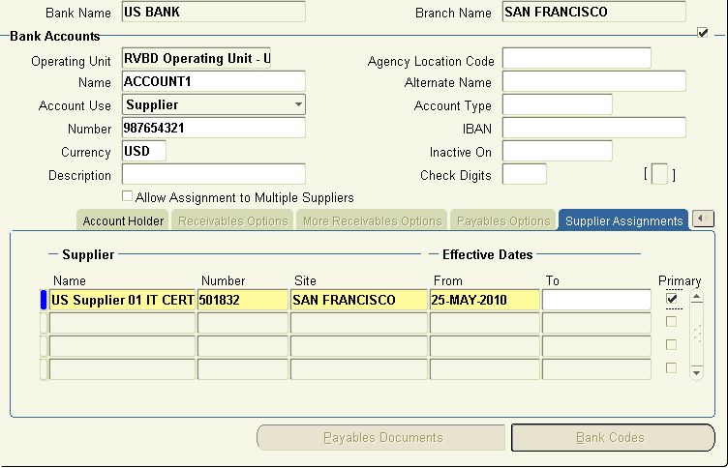
Bank Account Creation and Supplier Site Assignment
→ Mandatory
→ Required
Enter Bank Account Name
Select Account Use as ‘Supplier’
Enter Account Number
Supplier Site Required When Supplier is Selected
Before Saving

Slide 13
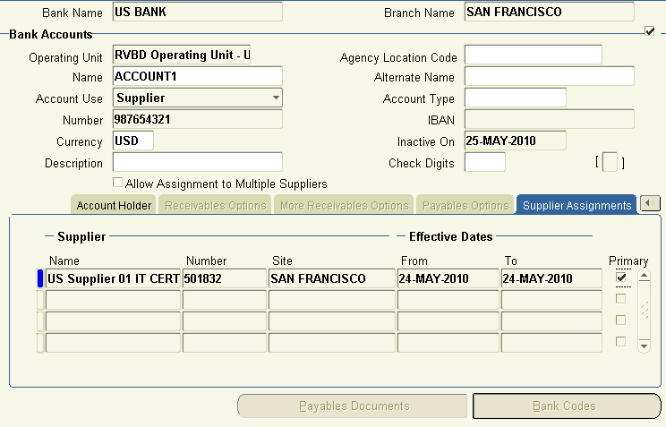
Bank Account Creation and Supplier Site Assignment
After saving, system will disable Bank Account Number, Inactive On fields and the Supplier Site Assignment Record.
Alert notification will be sent to Manager for Approval.
After Saving

Slide 14
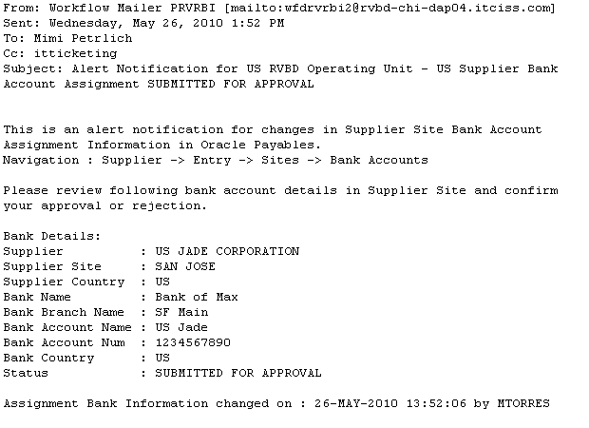
Bank Account Creation and Supplier Site Assignment
Approval notification to Payables Manager

Slide 15
Approving Supplier Bank Account Assignment

Slide 16
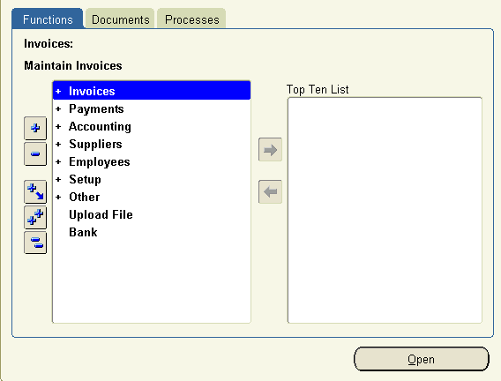
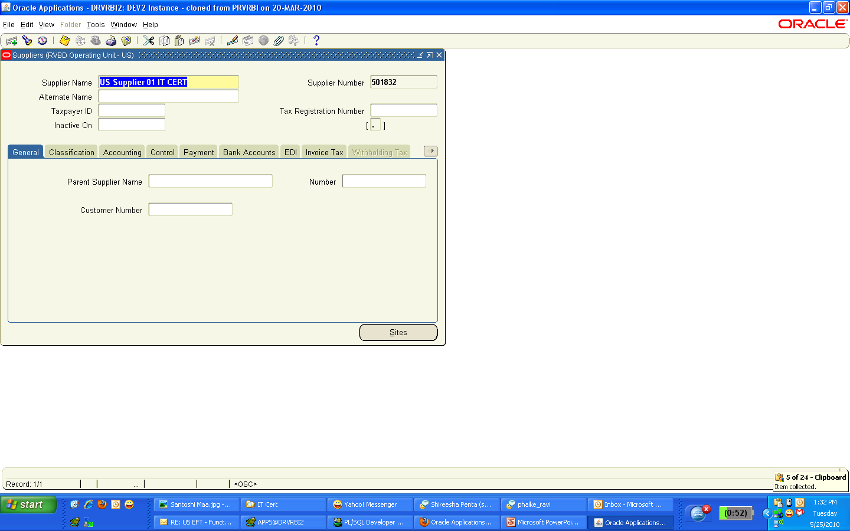
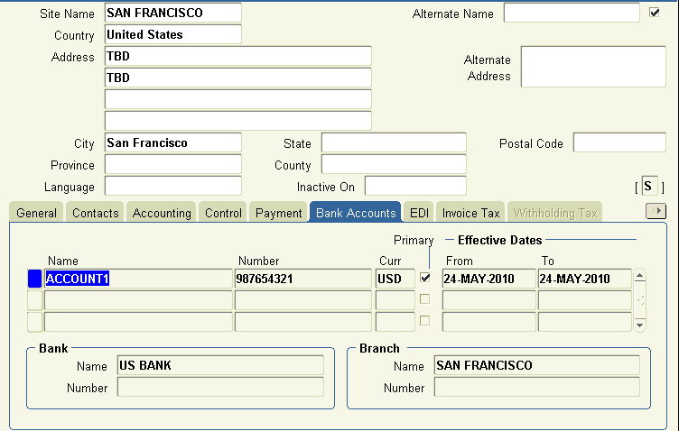
Approving Supplier Bank Account Assignment
Responsibility: Payables Manager
Bank Account Record at Supplier Site is Disabled. Bank Account Status shows “S” (Submitted).
Before Approving

Slide 17
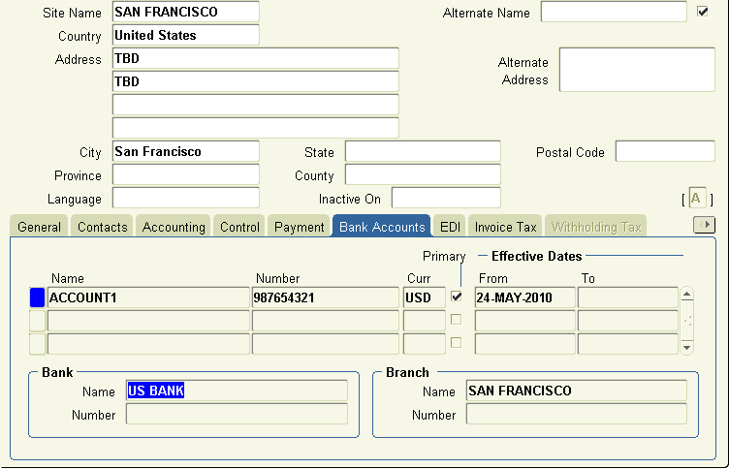
Approving Supplier Bank Account Assignment
Manager selects “A” (Approve) to approve the Supplier Bank Assignment. After saving, Bank Account Record remains disabled. Alert notification will be sent back to Payment User who created the Bank Account and Supplier Assignment.
After Approving

Slide 18
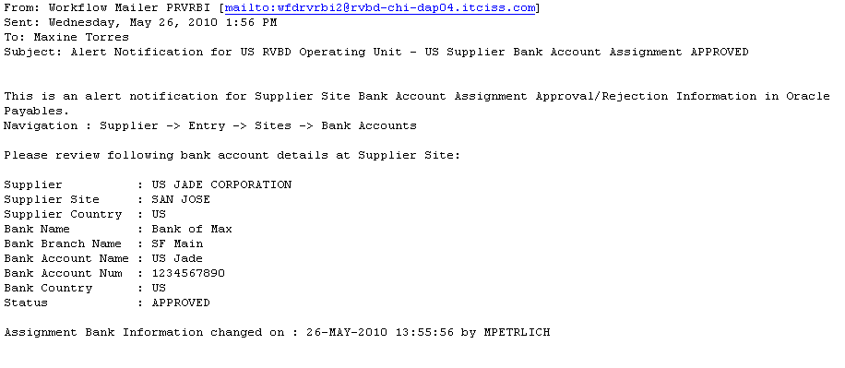
Approving Supplier Bank Account Assignment
FYI Notification to Payables Payment User

Slide 19
Rejecting Supplier Bank Account Assignment

Slide 20
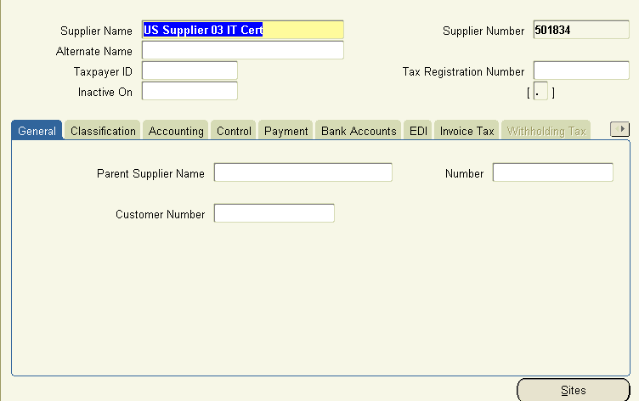
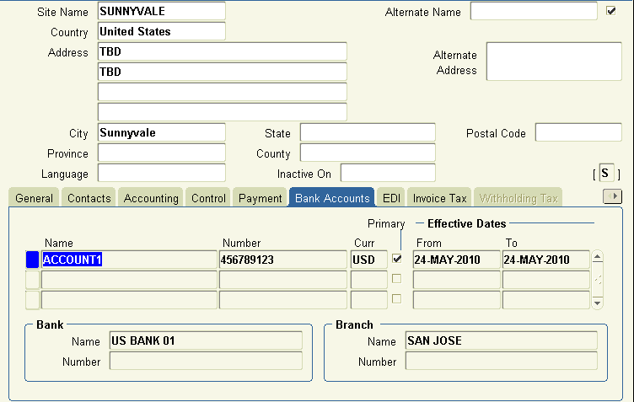
Rejecting Supplier Bank Account Assignment
Bank Account Record at Supplier Site is Disabled. Bank Account Status shows “S” (Submitted).
Before Rejecting

Slide 21

Rejecting Supplier Bank Account Assignment
Manager selects “R” (Reject) to reject the Supplier Bank Assignment. After saving, Bank Account Record remains disabled. Alert notification will be sent back to Payment User who created the Bank Account and Supplier Assignment.
After Rejecting

Slide 22
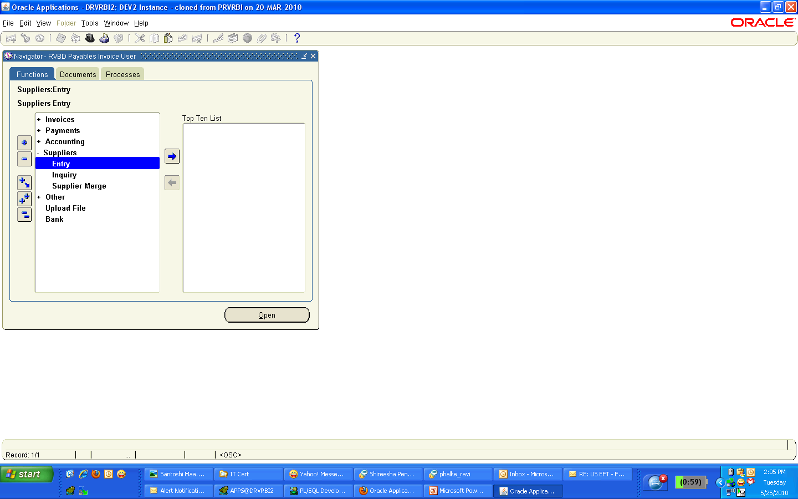
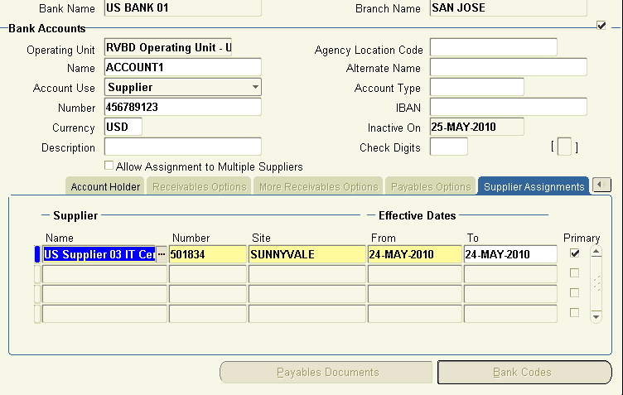
Rejecting Supplier Bank Account Assignment
Supplier Bank Account Form viewed by Payment User after Manager Rejects the Supplier Bank Assignment. Inactive On field is Disabled. Supplier Assignment Record becomes Available for edits.

Slide 23
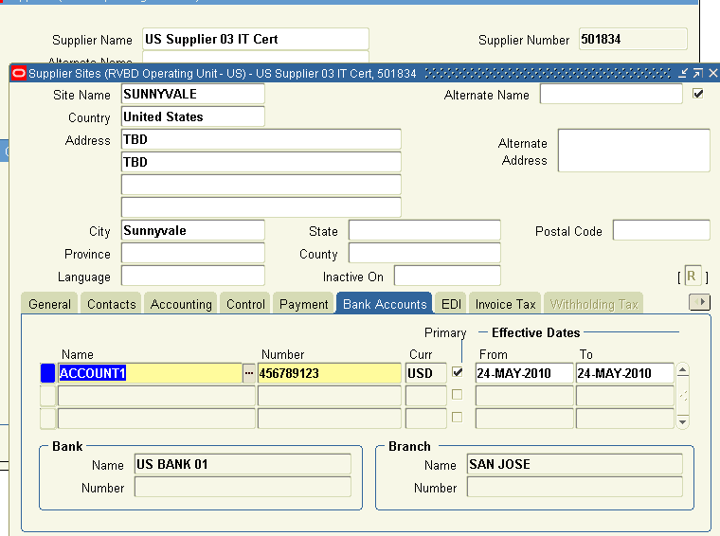
Rejecting Supplier Bank Account Assignment
Supplier Site Bank Account Assignment Form viewed by Payment User after Manager Rejects the Supplier Bank Account Assignment. Status shows “R” (Rejected). Bank Account Record becomes available for edits.

Slide 24
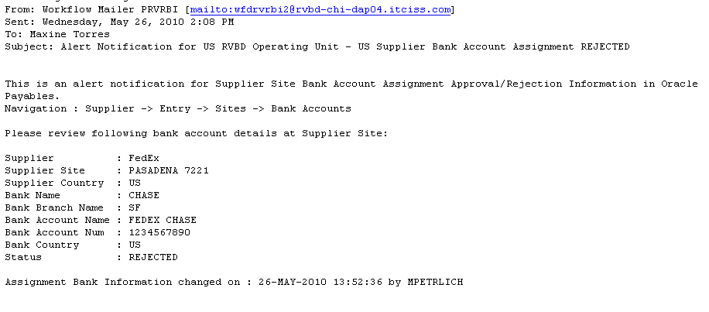
Rejecting Supplier Bank Account Assignment

Slide 25
Solution Approval using Oracle Workflow
Enter Bank Branch Details
Enter Bank Account Details
Save Bank Account Details
Change Bank Status to ‘Submit’ and Disable Key Fields
Payment User
Start Workflow Process
Send Notification to Payables Manager
Review response from Payable Manager
Open Notification
Review Bank Account Details
Approve or Reject Bank Account Details
Payables Manager
Enter Comments for Payment User
Send Notification to Payment User
Update Bank Status and Enable Key Fields

Slide 26
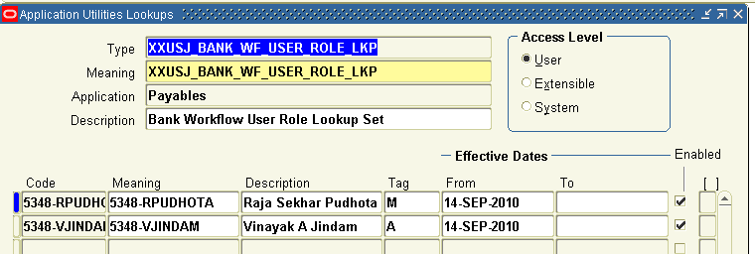
Bank Account Approval Process Components
Lookup Set for User Roles

Slide 27
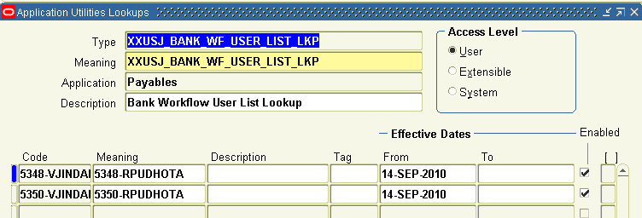
Bank Account Approval Process Components
Lookup Set for User List

Slide 28
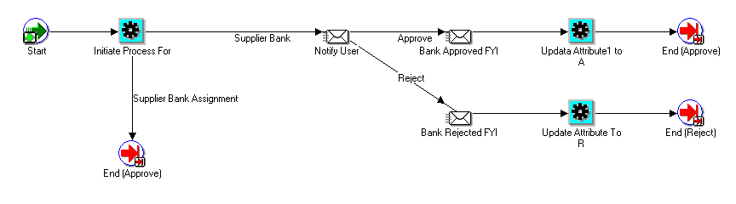
Bank Account Approval Process Components
Workflow Process

Slide 29
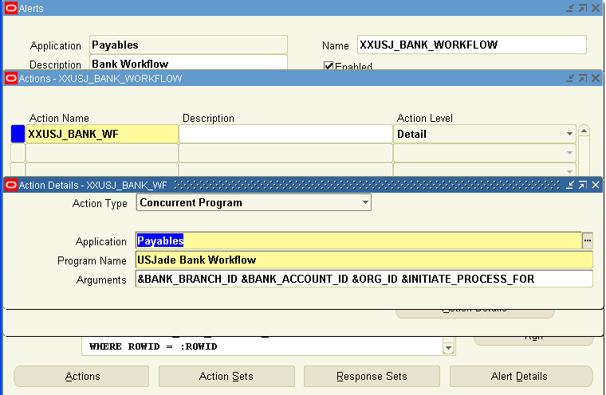
Alert Manager and Concurrent Program

Slide 30
Disadvantages using Form Personalization
Complex Approval Process Solution over Oracle Workflow Solution
Personalization limitation causing issues in approval process
Both Submitter and Approver need access to Bank Account Screen
Comments for rejecting the bank account details is not available
Complexity in debugging for IT
Issues with Alert Manager Notification for not sending the notifications to

Slide 31
Advantages using Oracle Workflow
Simple Workflow Approval Process Solution
Only Submitter need access to Bank Account Screen
Comments for Rejecting the Bank Accounts details is available
Sending notifications using Alert Manager is removed. Oracle Workflow itself is managing to send the notifications to users
Simple in debugging for IT (if any issues identified)
Reduce IT Ticketing

Slide 32
About Us
  Your Long Term IT Services Partner for Growth
  Enterprise System Integrator
Served more than 50 customers for over 10 years
  Oracle Platinum Partner
  Oracle Certified Accelerate Solution Provider
  Strategic Partnerships
  Experience with Global Implementations
  Global Delivery Capability – US, India, China, Israel
  Right Shore Delivery Model
  Right Size
  SAS 70 Certified

Slide 33
&
Q
A

Slide 34







For More Information
Global Headquarters
1731 Technology Drive, Suite 350
San Jose, CA 95110
877-JADE-4IT (523-3448)
http://www.jadeglobal.com
Boston Area Office
1900 West Park Drive, Suite# 280
Westborough, MA 01581
(508) 983-1457
Daisy Dabandan
Senior Consulting Manager
daisy.dabandan@jadeglobal.com
Jade Global - India
E-Space IT Park, A-3, 2nd Floor,
102 D/E, Wadgaon Sheri,
Pune-Nagar Road, Pune 411-014
Phone: 91-2066081500
VOIP: (408) 907-2730
(408) 834-8606
Notes:
Thank you for joining us, if you’re not able to stay for the Q&A, or would like to arrange a customized demonstration or have any unanswered questions, please contact me and I will make sure you’re taken care of.
Jade Global brings years of Oracle HRMS functional and technical experience and our reusable solutions to our engagements
For more information such as;
White papers
Case Studies
Customer references
Other Jade Global Solutions and services
Please Contact me and I will be happy to help.
Thank you for attending this session and I am hopeful that you would reach out to us for any clarifications or questions. We would also like to offer to you a free assessment on your systems and propose a recommended path, and please refer to this presentation when you contact us.

Slide 35

Our IT Expertise. Your Success.

