Slide 1

Transform Your Planning Process with Oracle Advanced Supply Chain Planning (ASCP)
Manoj Rathi
NorCal OAUG Training Day
January 13, 2010

Slide 2

Introductions
Manoj Rathi CSCP
Consulting Manager
17+ years in Manufacturing, supply chain and costing
Oracle certified Advanced Planning Implementation Champ
Featured speaker on OAUG forums

Slide 3
Today We Will Discuss
Why do you need to change your traditional planning process?
How can Oracle ASCP help?
How do I plan my supply chain rapidly and frequently?
How do I plan my supply chain globally?
How can I plan supply from multiple sources?
How can I plan for capacity constraints?
How can multiple planners access the same plan?
How can I model multiple-scenarios and perform what-if analysis?
How can I implement ASCP in only 8 weeks?
1
2
3
4
5
6
7
8
9

Slide 4
What is ASCP?
Advanced Supply Chain Planning
Part of Oracle Advanced Planning Suite
What it can do
  Plan supply for local and global demands from multiple sources
  Understand risks associated with your demands
  Plan material and capacity constraints and suggest alternates
  Plan manufacturing, purchasing and logistics lead times
  Run and compare multiple plans for different scenarios
What it is NOT designed to do
  Manage your demand
  Execute complex material allocations
  Execute material transactions
  Run time decision making for material transactions

Slide 5

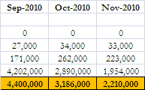
Traditional Supply Chain Planning
What Many Organizations Are Doing?
1
How much do we need?
When? Where?
Collect Data through conventional means
How much do we procure?
When? Where?
Communicate through traditional means
Supply Chain Plan
When and where do we plan? How much time would it take us to plan?

Slide 6
How can Oracle ASCP help?
2
Integrated with Oracle EBS
Sophisticated, flexible and scalable planning engine
Automated and faster run of plan
Single plan for the whole supply chain
  Plan product structure across multiple organizations
State of the art planner work-bench
  Multiple views – vertical/horizontal plans
Ability to perform what-if analysis; run and compare multiple plans

Slide 7
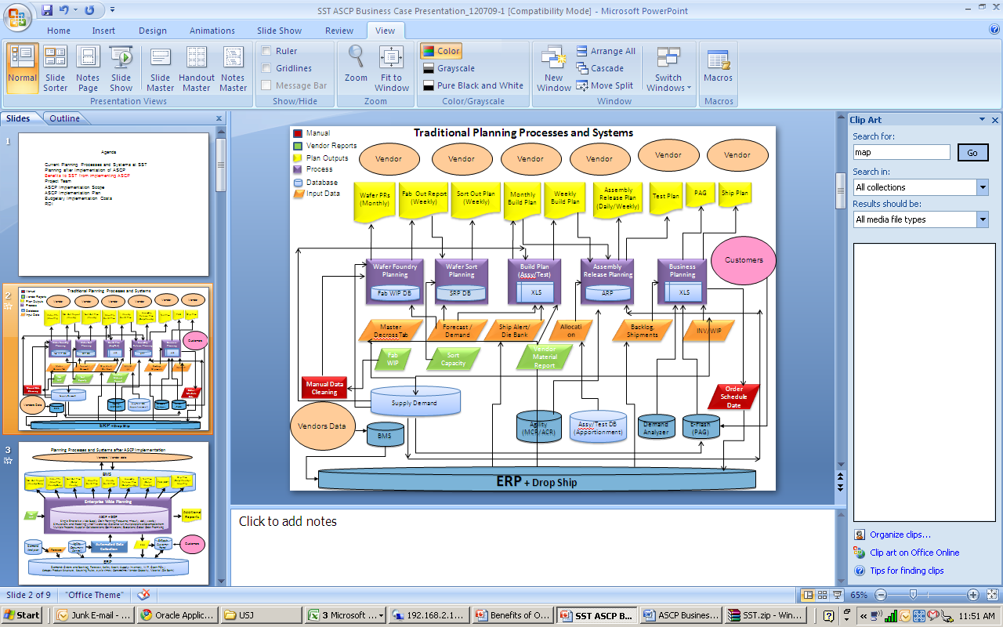

Slide 8
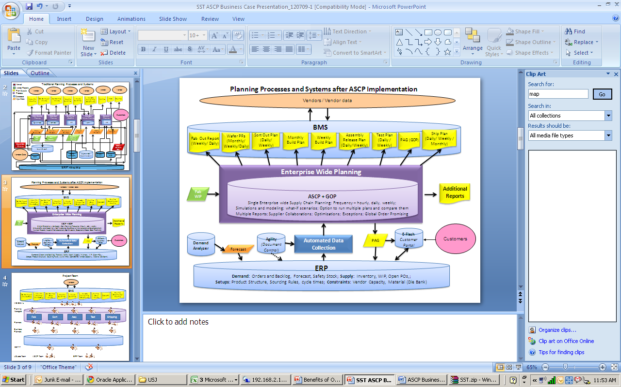

Slide 9
How do I plan my supply chain rapidly and frequently?
3
Plan run desired frequency.
  Time to review and act on plan recommendations and exceptions
  Degree of supply and demand volatility
Data Collection options and frequency
  Use of hybrid approach for data collection.
  Full refresh every weekend and incremental changes daily/few times a day.
  Continuous collection for volatile supply-demand
Geographical regions involved in the supply chain

Slide 10
How do I plan my supply chain globally?
4a
ASCP is global supply chain planning
Multiple inventory organizations
    ASCP plans for the whole supply chain comprised of multiple inventory organizations and supply sources in a single plan.
Single plan accessed by planners globally.
Single plan for all processes -
  Raw material purchases
  Semifinished goods manufacturing and stocking
  Finished goods manufacturing and stocking
Multiple demands from different sources can be used in the single plan

Slide 11
How do I plan my supply chain globally?
4b
ASCP
Forecast1
INV ORG1
INV ORG2
Forecast 2
INV ORG3
Supplier 3
Supplier 4
Supplier 1
Supplier 2
Other ERP Modules

Slide 12
How can I plan supply from multiple sources?
5
INV ORG1
Supplier1
Priority1
60%
Supplier 2
Priority1
40%
Supplier 3
Priority2
100%
INV ORG 2
Priority3
100%
Need to define manufacturing sites as inventory orgs.
Sourcing Rules make ASCP plan global.
  How does shipping network work?
  Include transfers from other inventory orgs
Requisitions for supplier sourcing and inter-org transfers
Work orders for manufacturing
Multiple assignment sets for simulations

Slide 13
How can I plan for capacity constraints?
6
What do you want to accomplish?
Where is push and pull in the supply chain?
Demand or supply driven?
What’s the Stocking strategy?
  FGI or semi-finished?
Is manufacturing in-house or outsourced? Do you have control over supplier capacities or scheduling?
Use of time based (scheduling) resources.
Start with few critical resources; expand as required.
Benefits vs. maintenance requirement
Are reports good enough to satisfy your objectives?

Slide 14
How can multiple planners access the same plan?
7
ASCP is web based plan and multiple planners can access it simultaneously.
  Same plan can be accessed on a different computer from a different location by the same or a different person.
Each planner can save their own default queries to filter out data that they plan to work on.
Multiple simulations allow planning groups to run their individual plans.

Slide 15
How can I model multiple-scenarios and perform what-if analysis?
8
Use of multiple plans; plans comparison reports
Use of simulation sets
  Increase or decrease forecast by a set percent;
  Plan for preventive maintenance or simulate breakdown
Minor changes can be simulated using online re-plan.
Different plan can use different forecasts/demands.
Long term plan for budgeting and upstream forecasts ; short term plan for scheduling, manufacturing and releasing purchasing requisitions.

Slide 16
How can I implement ASCP in 8 weeks?
9a
Requirements
CRP
UAT
GO-LIVE
Requirements and Design
Build and Test
User Acceptance
Implement and Support
Training
Launch
Project
Design
Documents
Plan UAT
UAT Sign-offs
Go-Live
Preparations
Support
Training
Deliverables
Requirements
Functional Design
Technical Design
ASCP demo
CRP test cases
CRP test results
B2B PiPs
User Training
Training Guide
Configuration Documents
UAT test cases
UAT test results
Open issues and resolution plan
GO-NOGO approvals
Configured PROD instance
B2B PiPs
Support

Slide 17
How can I implement ASCP in 8 weeks?
9b
Vanilla implementation – no customizations
Minimum capacity constraints
Design a workable solution for running your business – not for a wish list.
Need push from top management; some resistance is inevitable as comfort zones are breached.
2 test cycles - CRP and UAT.
Trust! ASCP works!

Slide 18
Summary
Critical Considerations
Planning objectives – Long term vs. short term; planning for material, resources, vendor capacity, etc.
Understand difference between planning and logistics/ plan-execution.
Existing system configuration – what changes are required?
What is the impact on other user groups – Finance, OM, Logistics, etc.
Production Volumes – current and projected
Single instance vs. distributed architecture
Constrains – are they critical enough to plan for
Team size – number of planners and number of implementation team members.

Slide 19
Summary (Cont.)
ASCP Benefits
Global planning
Fast planning cycle (speed up your planning)
Frequent and smaller planning deltas
Modeling tools for multi-scenarios
Integrated with ERP system.
Scalable in terms of volumes and functionality

Slide 20
About Jade Global
  Your Long Term IT Services Partner for Growth
  Enterprise System Integrator
Served more than 50 customers for over 10 years
  Oracle Platinum Partner
  Oracle Certified Accelerate Solution Provider
  Strategic Partnerships
  Experience with Global Implementations
  Global Delivery Capability – US, India, China, Israel
  Right Shore Delivery Model
  Right Size
  SAS 70 Certified

Slide 21
&
Q
A

Slide 22














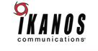









Some of our Customers

Slide 23







For More Information
Global Headquarters
1731 Technology Drive, Suite 350
San Jose, CA 95110
877-JADE-4IT (523-3448)
http://www.jadeglobal.com
Boston Area Office
1900 West Park Drive, Suite# 280
Westborough, MA 01581
(508) 983-1457
Manoj Rathi
Consulting Manager
Manoj.rathi@jadeglobal.com
Jade Global - India
E-Space IT Park, A-3, 2nd Floor,
102 D/E, Wadgaon Sheri,
Pune-Nagar Road, Pune 411-014
Phone: 91-2066081500
VOIP: (408) 907-2730
(408) 834-8606

Slide 24

Our IT Expertise. Your Success.

