Slide 1
SLA-making changes to FA and PO Accrual Accounting
Mohan Iyer
FSCP Solution Inc.

Slide 2
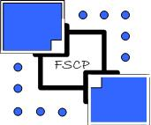
Sub-Ledger Accounting
Release 12 has introduced a new layer called SubLedger Accounting (SLA)
This module sits in between the sub-ledgers (AP,AR,PO and Costing) and General Ledger
The standard GL Interface still exists – but it is only for backward compatibility
The sub-ledgers (AP,AR etc,) now use a process called Create Accounting to transfer to GL

Slide 3
Sub-Ledger Accounting
The SubLedger Accounting “module” is a rules based engine
This allows the transaction and the accounting to be separated
This facilitates the ability to create multiple accounting representations for a single transaction
This is best explained by a need for accounting in GAAP and IFRS for a single transaction

Slide 4
Pre-R12 Accounting
Prior to R12 accounting was managed as below – with AP Invoice as an example
The defaults gave one side of the accounting (Liability - Credit)
Distributions captured the accounts you enter for the other side (Expense - Debit)
You ran Payables Accounting Process (11i)
You chose to transfer to GL when you ran above
The accounting transactions were pushed to GL Interface
You ran Journal Import process to create a Journal

Slide 5
Sub-Ledger Accounting
In R12 accounting was managed as below – with AP Invoice as an example
The defaults gave one side of the accounting (Liability - Credit)
Distributions captured the accounts you enter for the other side (Expense - Debit)
You run Create Accounting and
Chose to transfer to GL when you ran above
The accounting transactions were pushed to GL Interface
You also choose to run Journal Import to create a Journal

Slide 6
Accounting Modifications
In versions prior to R12 accounting modifications were as below – with AP Invoice as an example
The defaults gave one side of the accounting (Liability - Credit)
Distributions captured the accounts you enter for the other side (Expense - Debit)
You either
created a trigger change the accounting
if the accounting was created using Workflow then you modified the workflow
changed the accounts in GL after the fact with reclass entry

Slide 7
Accounting Modifications
With SLA modifications are simple – with AP Invoice as an example
The defaults gave one side of the accounting (Liability - Credit)
Distributions captured the accounts you enter for the other side (Expense - Debit)
To change the accounting from the default
You modify SLA rules to change the accounting (in most cases)
You may in specific scenarios use Workflow

Slide 8
SLA Modification Examples
Here are two examples I want to present
Change FA Accounting
Change PO Accrual Accounting

Slide 9
Chart of Accounts structure
The client had an 8 segment Accounting Flexfield
Company (Balancing Segment)
Region
Cost Center (Cost Center)
Account (Natural Account)
SubAccount
Channel
Commodity
Intercompany (Intercompany)

Slide 10
Business Rules for transactions
The client had an 8 segment Accounting Flexfield
All Expense accounts needed a non zero region and cost center
Some Expense accounts needed a non zero channel and a commodity value
All Asset Cost and Accumulated Depreciation Accounts needed a non zero region value
Assets managed in a book could have multiple regions for a given balancing segment
AP transactions would contain multiple company and regions values when interfaced from Mass Additions

Slide 11
AP and FA transactional scenario
A single Ledger would use multiple Company Codes
A single company could have multiple regions values when transacted
Depreciation is by company, region and function
Asset Cost and Accumulated Depreciation is maintained by Company and Region
There is a need to limit Asset Categories
There is a need to limit customizations

Slide 12
Default FA Account Generation
Asset defaults
Depreciation is built from Asset Assignment
Asset Cost and Accumulated Depreciation is built from Asset Category
Cost of Sale and Removal and related accounts are built from Book Controls form
Except for the Depreciation Account all other account derivations had to be modified to meet business rules

Slide 13
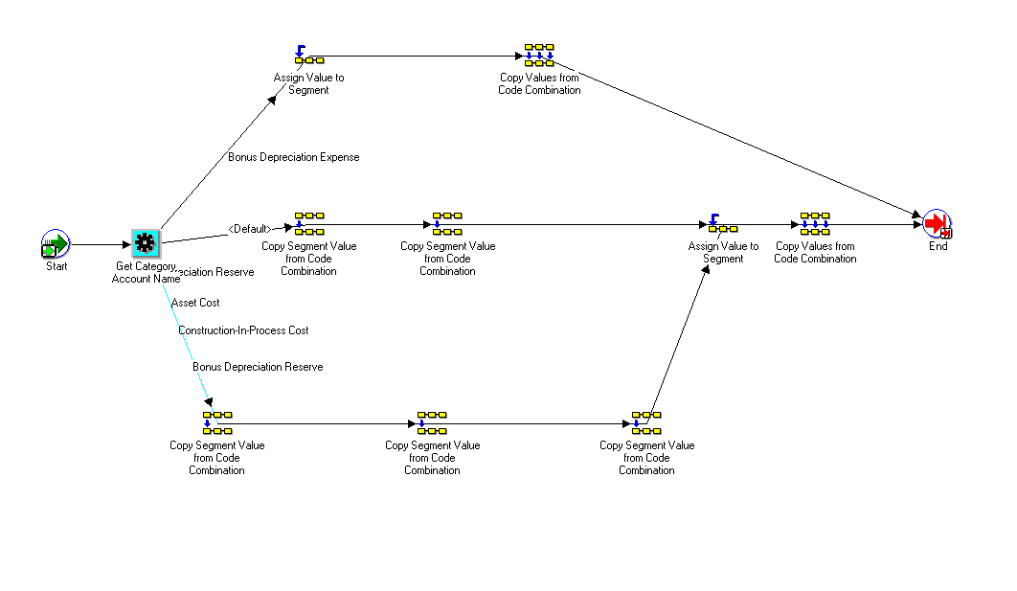
Workflow modification

Slide 14
SLA modification
The connection to make these changes are attached to the Ledger at the Accounting Setups
Assign the new / Custom Subledger Accounting Method (SLAM) you define
The SLAM will have a new/custom Application Accounting Definition (AAD)
The AAD will have new Journal Line Definitions (JLD)
The JLD will have a new Account Derivation Rule

Slide 15
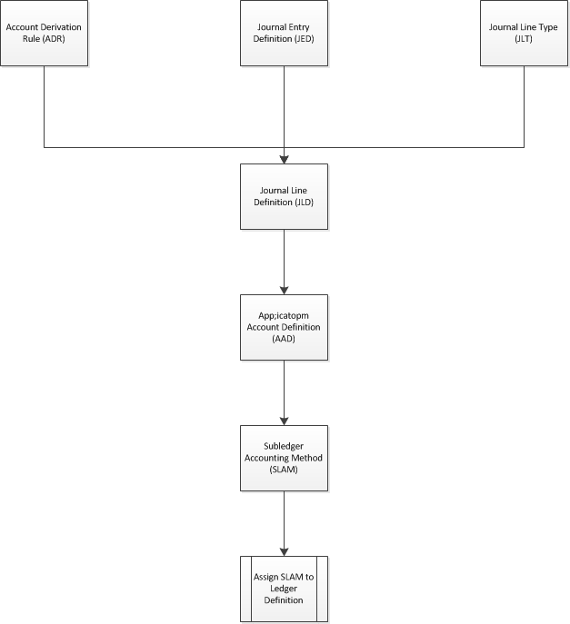
SLA modification pictorial

Slide 16
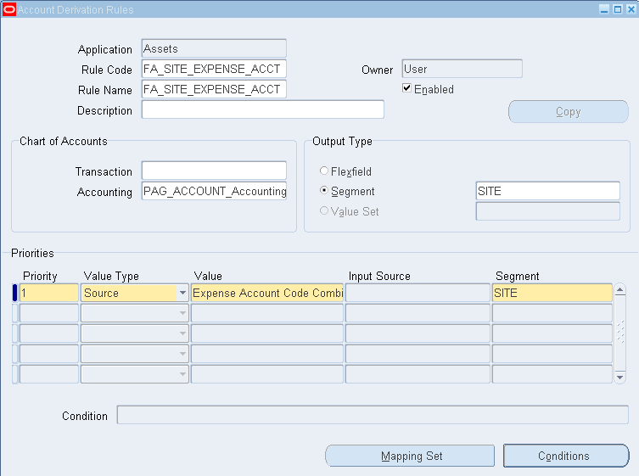
SLA – Accounting Rule Derivation

Slide 17
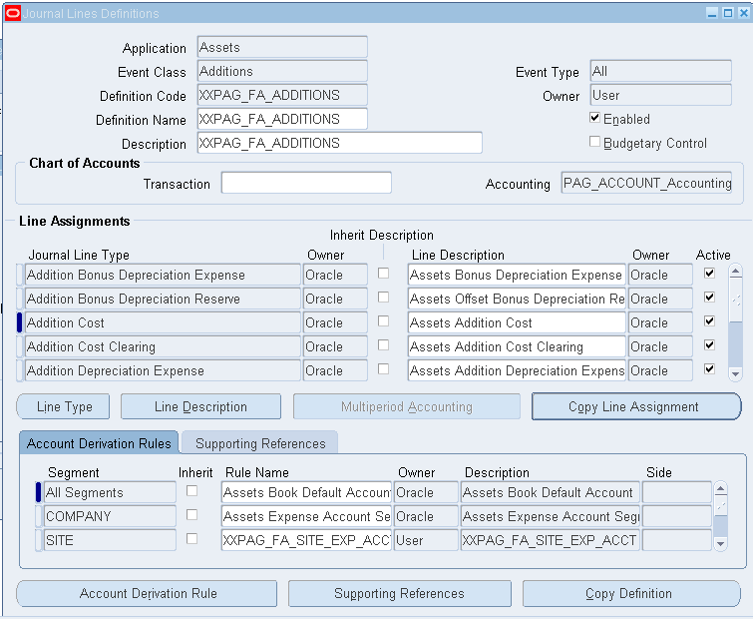
SLA – Journal Line Definition

Slide 18
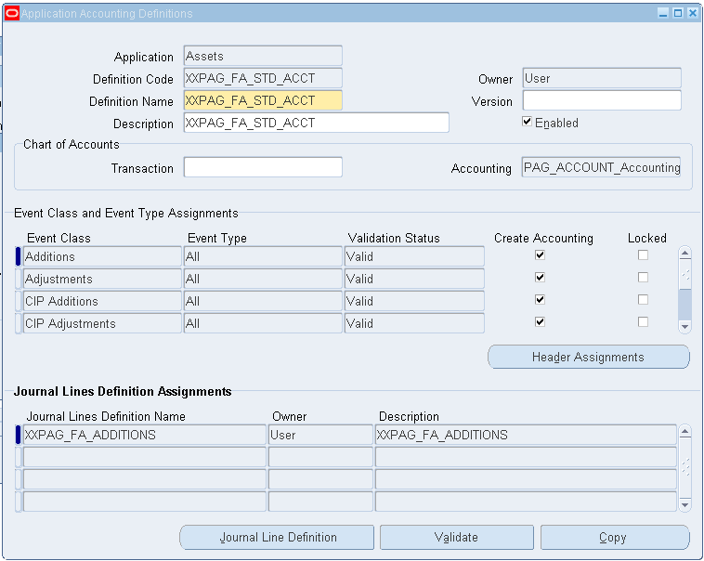
SLA – Application Account Definition

Slide 19
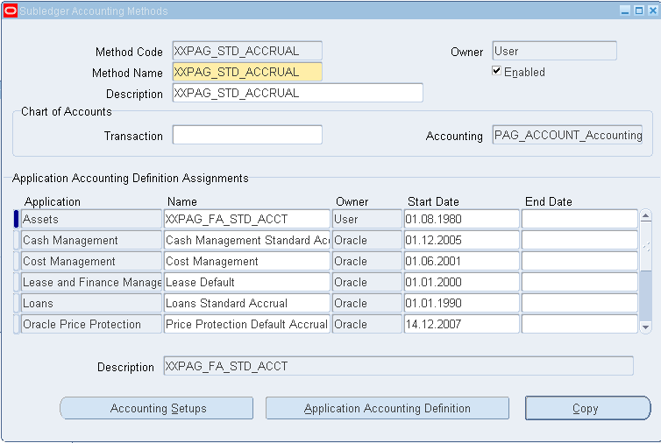
Subledger Accounting Method (SLAM)

Slide 20
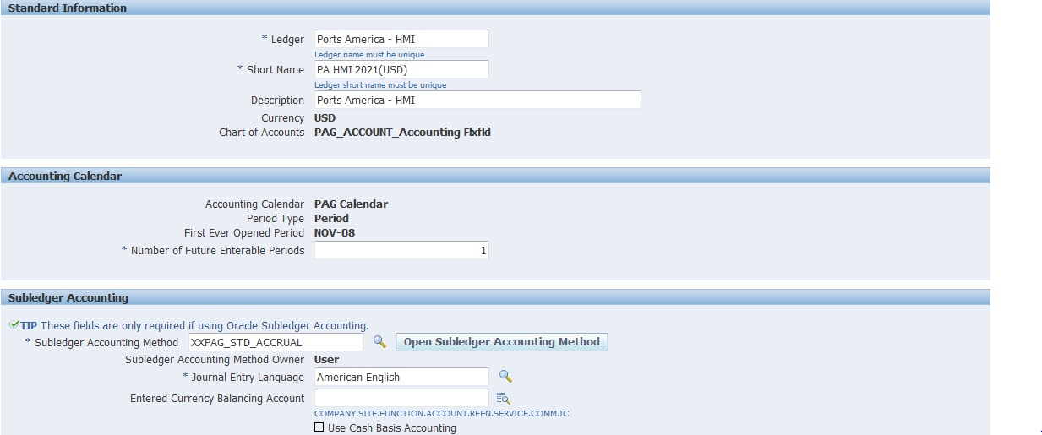
Assign Subledger Accounting Method to Ledger

Slide 21
Default PO Accrual Account Generation
PO Accrual Account defaults
PO Accrual Account defaults from the Inventory Org for Perpetual Accruals
PO Accrual Account defaults from the OU setup (Receiving Options) for Expense Accruals
Period End Accruals are generated for Expense PO lines
The Accrual account needed to be changed to be for the accurate Company based on the PO Charge Account

Slide 22
Modification to Default PO Accrual Account Generation
Going by the same pictorial view of the changes in SLA
We followed the same route
ADR
JLD
ADD
SLAM
Assign to Ledger
Or thought we could

Slide 23
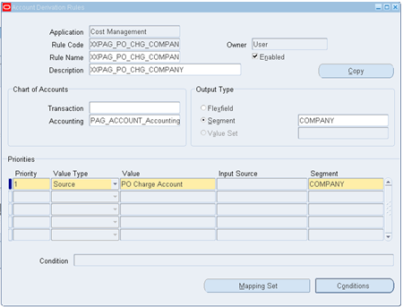
SLA – Accounting Rule Derivation

Slide 24
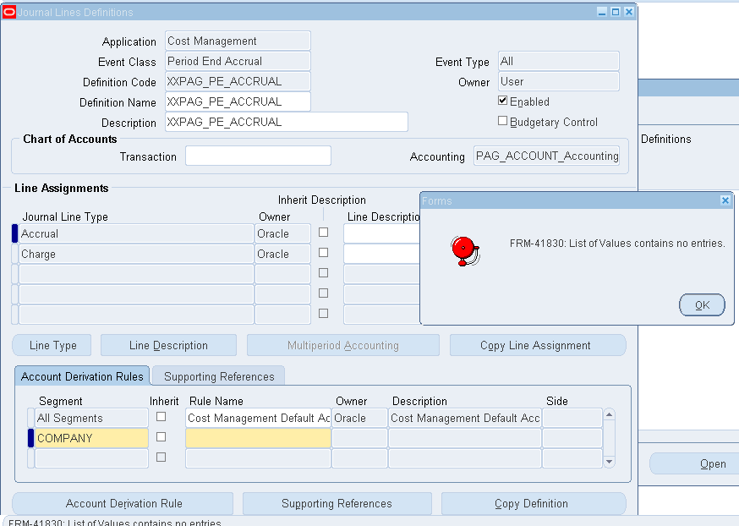
SLA – Journal Line Definition

Slide 25
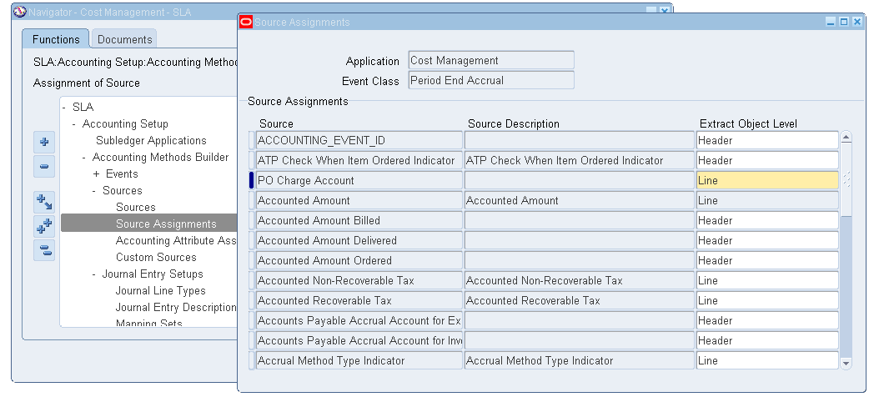
SLA – Journal Line Definition – Fix

Slide 26
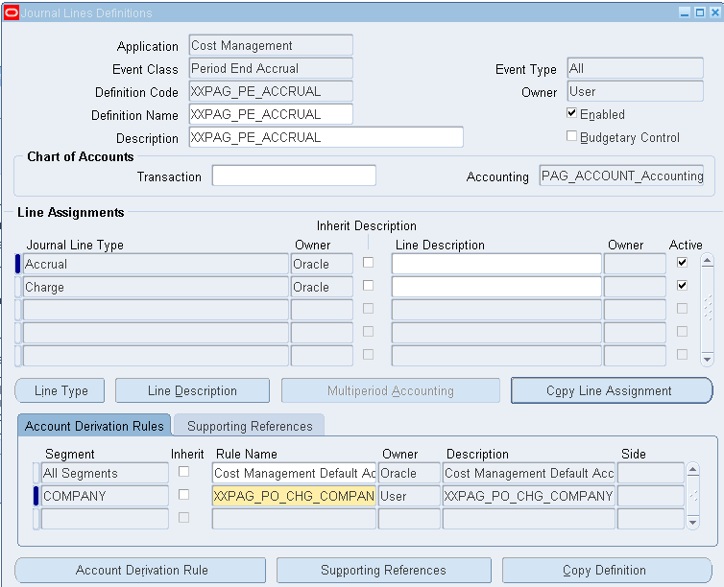
SLA – Journal Line Definition

Slide 27
PO Accrual Account – Workflow
Even after specific changes needed were incorporated the Application Account Definition would not validate
To enable the Application Account Definition to be used in a SLA Method, it has to be validated
After multiple discussions with Support it was deemed that a Workflow Mod would suffice as a workaround.

Slide 28
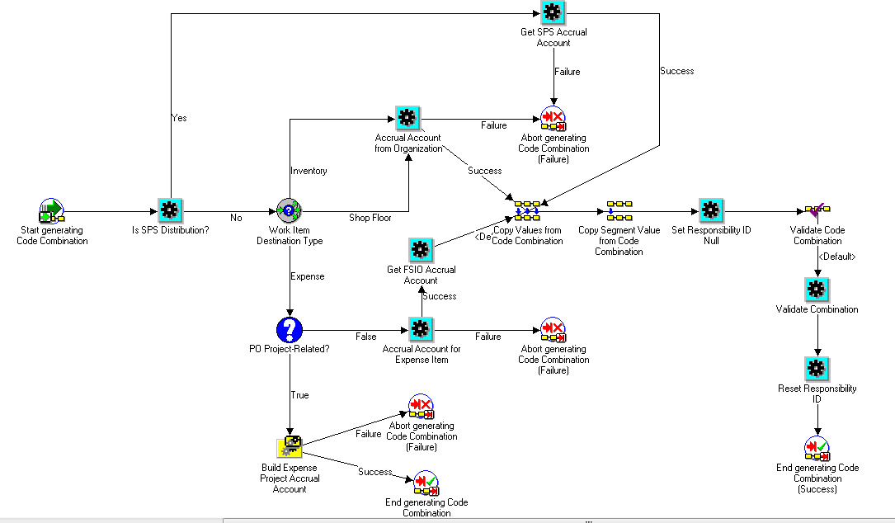
PO Accrual Account – Workflow

Slide 29
Reference
White Paper – Subledger Accounting Setup for Oracle Assets
This is written by Harriet Reissenberger
Is available on Metalink
You can also review and read the following as reference docs
Oracle Assets User Guide Release 12
Oracle Subledger Accounting Implementation Guide

Slide 30
Reference
Using Oracle Workflow is not recommended by Support :
Due to possible performance issues with the Create Accounting process
Debugging in case Create Accounting fails is difficult
Set the profile option FA: Use Workflow Account Generation must be set to Yes.
In order to use the FA Account Generator workflow instead of SLA

Slide 31
End Slide
Mohan Iyer
Principal Consultant
mohan@fscpsolutions.com
408 859 4484
www,fscpsolutions.com

Slide 32
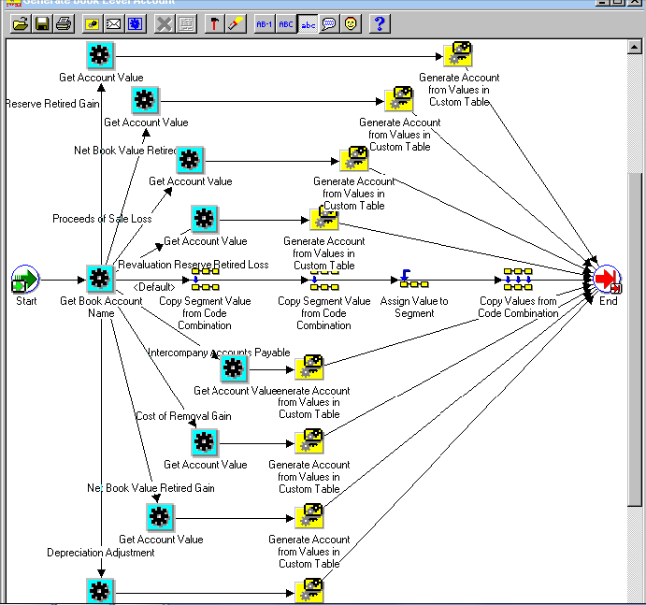
Workflow modification

