Slide 1
Hosted Catalogs using iProcurement in R12
Parag Jain
ERP Lead
BioMarin Pharmaceutical Inc
01-13-2011

Slide 2
Safe Harbor Statement
This non-confidential presentation might contain ‘forward-looking statements’ about the business prospects of BioMarin Pharmaceutical Inc., including potential future products in different areas of therapeutic research and development. Results may differ materially depending on the progress of BioMarin’s product programs, actions of regulatory authorities, availability of capital, future actions in the pharmaceutical market and developments by competitors, and those factors detailed in BioMarin’s filings with the Securities and Exchange Commission such as 10-Q, 10-K and 8-K reports.

Slide 3
Agenda
BioMarin at a Glance
Focus & Strategy
Catalogs ??
Requisition Template
External Marketplace
Q&A
Catalog Sources
Local Store
Solutions
Catalog Authoring

Slide 4
BioMarin at a Glance Proven Business Strategy Targeting Genetic and Serious Medical Disorders
BioMarin Pharmaceutical Inc. (Nasdaq: BMRN) is a multinational biopharmaceutical company that specializes in providing first-to-market therapeutics to patients with rare genetic diseases. BioMarin has developed and commercialized 4 products in over ten years, a remarkable accomplishment in the biopharmaceutical industry, and a testament to the company’s passion and dedication to patients with serious, unmet medical needs. The company has successfully advanced 4 breakthrough products from bench, to market, to patients.
Four commercial products
Total 2010 revenue projected: $370M–$393M*
Aldurazyme® for MPS I
Naglazyme® for MPS VI
Kuvan® for PKU
Firdapse™ for LEMS (EU)
Multiple new product opportunities
GALNS for MPS IVA
PEG-PAL for PKU
New IND candidates in development
Ongoing business development efforts
* Financial information per BioMarin press release issued August 2, 2010 (excludes $5M to $7M in expenses related to the planned development of BMN-701 for Pompe disease announced on August 17, 2010)

Slide 5
BioMarin at a Glance
Focus & Strategy
Catalogs ??
Requisition Template
External Marketplace
Q&A
Catalog Sources
Local Store
Solutions
Catalog Authoring

Slide 6
Focus & Strategy – Expanding Product Pipeline
Focus
Rare (Orphan) genetic diseases.
Providing rapid access to treatment for patients with serious unmet medical needs
Optimizing powerful biology with demonstrated potential and development clarity
Accelerating approval process and strategic pipeline development.
Strategy

Slide 7
BioMarin at a Glance
Focus & Strategy
Catalogs ??
Requisition Template
External Marketplace
Q&A
Catalog Sources
Local Store
Solutions
Catalog Authoring

Slide 8
What is a Catalog?
Catalogs are organized resource of Supplier product Information.
Catalogs provide a robust medium for buyers to easily retrieve right information.
What are Hosted Catalogs?
Hosted catalogs is an online, electronic supplier catalog maintained & stored either by Supplier, buying organization or a Marketplace.
These catalogs contain supplier products with contractual pricing.
What are Punchout Catalogs?
Punchout catalogs are vendor catalogs specifically designed to connect to a buyer's e-procurement system using various ecommerce protocols.
Punchout catalogs can vary from buyer to buyer in pricing and products shown.

Slide 9
BioMarin at a Glance
Focus & Strategy
Catalogs ??
Requisition Template
External Marketplace
Q&A
Catalog Sources
Local Store
Solutions
Catalog Authoring

Slide 10
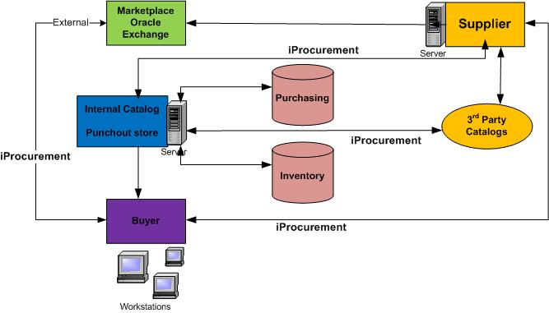
Catalog Sources

Slide 11
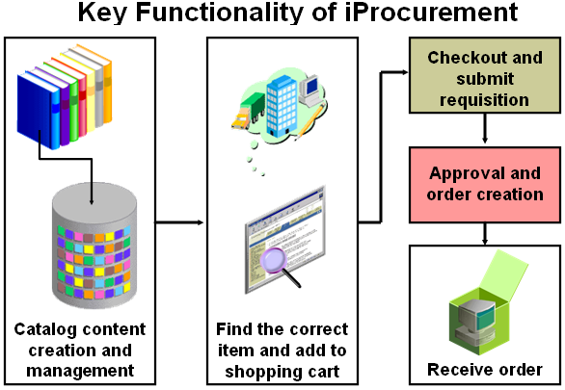
iProcurement
Provides flexible solution to catalog and content management, enabling you to select from several approaches based on your business model.

Slide 12
BioMarin at a Glance
Focus & Strategy
Catalogs ??
Requisition Template
External Marketplace
Q&A
Catalog Sources
Local Store
Solutions
Catalog Authoring

Slide 13
Solution – iProcurement
Requisition Template
Local Punchout Store
Catalog Authoring using iSupplier
Oracle Marketplace

Slide 14
Solution - Options
These solutions can be used based on types of catalogs, product categories, ease of use & maintenance.
Local Punchout Store:
Using Catalog and Content Management feature in iProcurement, catalogs can be loaded directly into the Oracle iProcurement using the catalog bulk loader, which supports catalogs formatted in XML, standard text, catalog interchange format (CIF), or cXML. Using the catalog bulk loader, you can load new catalogs, update existing catalogs, and delete catalog content.
Requisition Template:
Automate requisitioning of commonly ordered items like office supplies. To create a requisition for office supplies, requestors in your organization simply use your template and enter the quantity of each item they want to order.
Oracle Exchange:
Shopping in catalogs hosted by third-party sources or by the supplier. Punchout to a supplier or marketplace Web site to search for items and bring them back into iProcurement to be used on a requisition.
Catalog Authoring via iSupplier :
Supplier catalogs can be easily managed & authored using Professional Buyer Work Center, iSupplier portal, GBPA & iProcurement Catalog Administration.

Slide 15
BioMarin at a Glance
Focus & Strategy
Catalogs ??
Solutions
Requisition Template
External Marketplace
Q&A
Catalog Sources
Local Store
Catalog Authoring

Slide 16
Local Punchout Store
Create local content zones and group into one or more stores
iProcurementCategory Mapping
Purchasing
Shopping
Define Catalog Schema
Item Categories
Browsing Categories
There are two types of mapping:
Purchasing to shopping :
Only one-to-one mapping
This mapping is used during item search where a item in a particular purchasing category is shown under a corresponding shopping category.
The item with a purchasing category can be mapped to only one shopping category
Shopping to purchasing :
This is used only for bulkload purpose.
link multiple shopping to same purchasing.
This mapping is not used for item search.

Slide 17
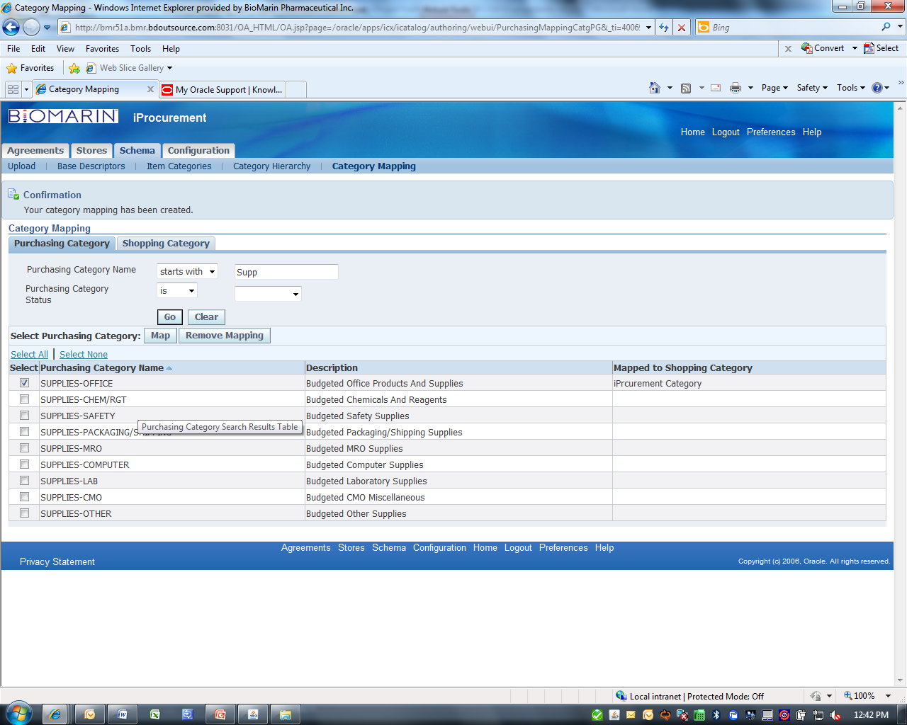
Local Punchout Store
Shopping Category
iProcurement Shopping Category
iProcurement Category
Purchasing Categories
Category Mappings

Slide 18
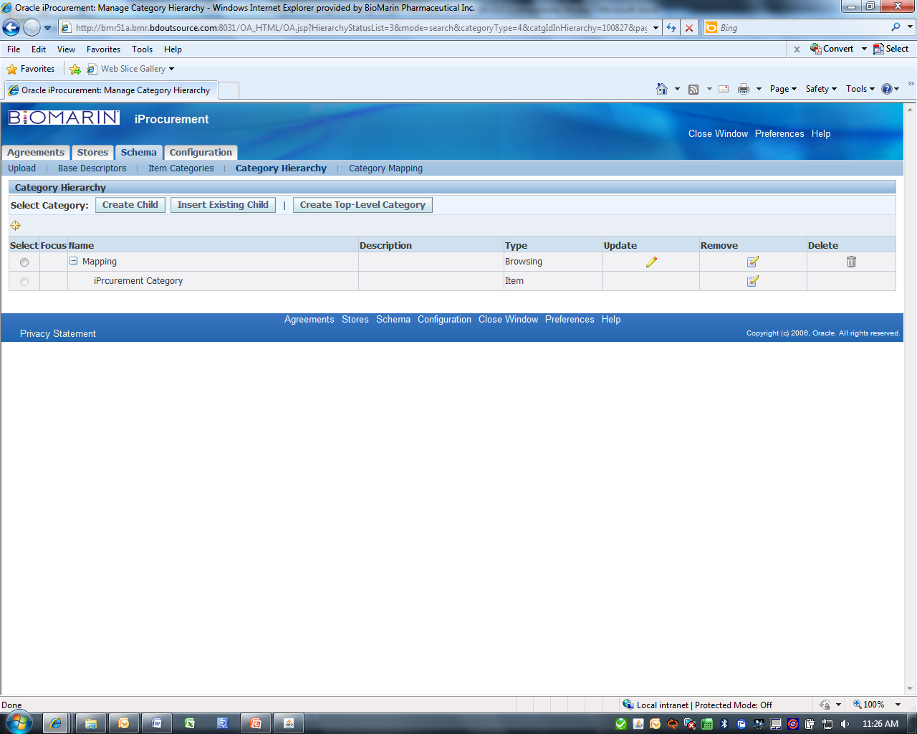
Category Hierarchy
Setup Category Hierarchy
Browsing & Shopping category structure
Child Category

Slide 19
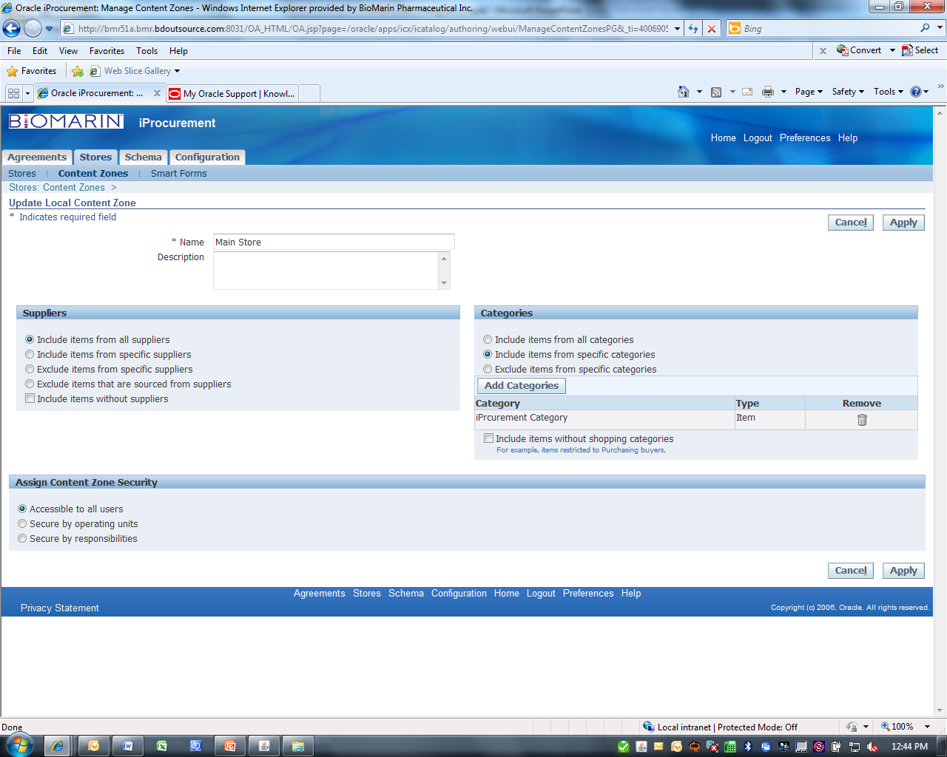
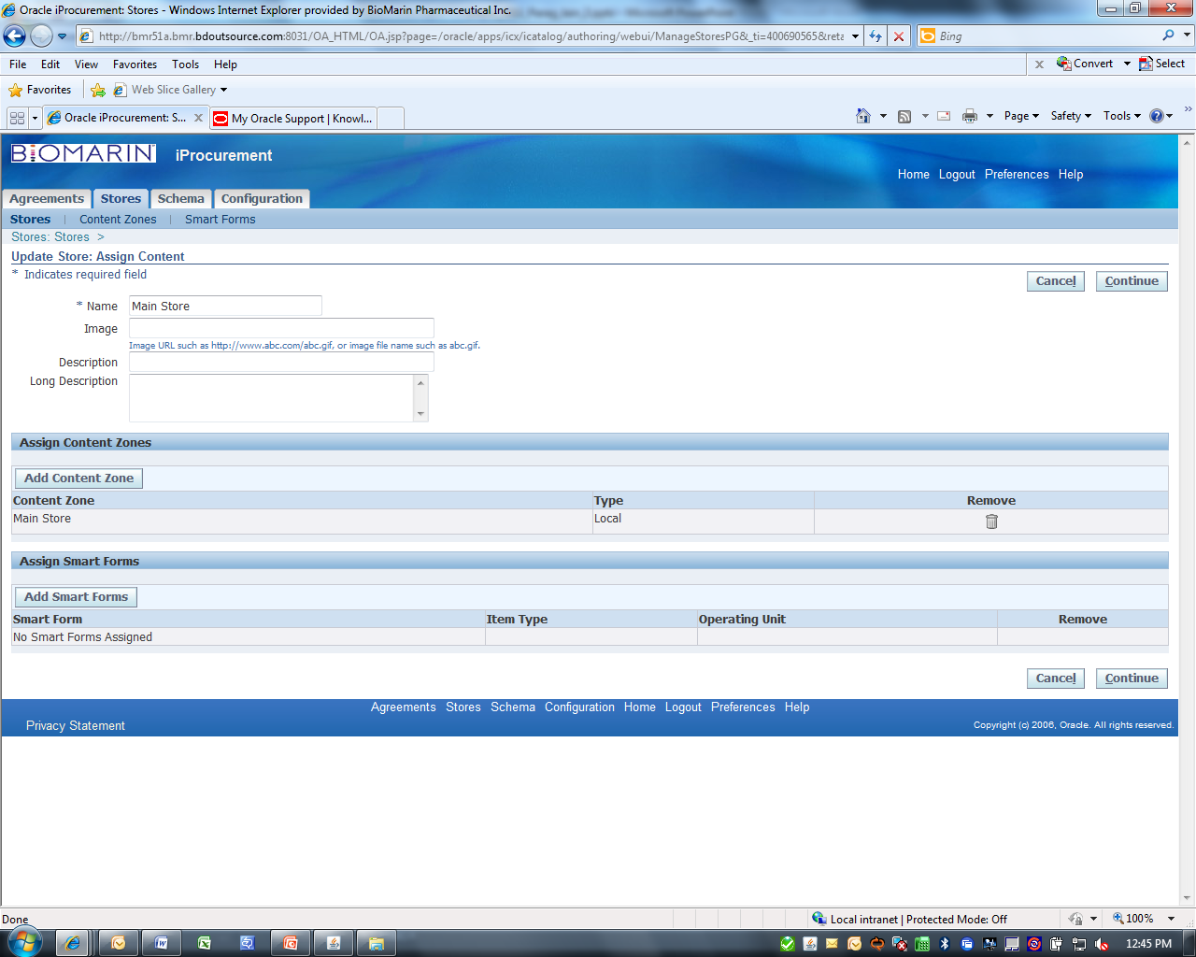
Create Local Store
Setup Local Content Zone
Create Store
Restrict by Shopping category
Assign local content zone
Content Security
Local Store

Slide 20
Punchout to Local store
Item Creation Sources:
Global Blanket Purchase Agreement (GBPA)
Traditional manual way - Item Master
Bulk loads using iProcurement catalog administration
Local Store

Slide 21
Local Punchout – Benefits
Local catalogs allow buying organization to manage the purchase of items from suppliers that they do not wish to have their entire catalog available for ordering.
Limit the visibility of a supplier’s items to only those that have a negotiated price.
Create a hierarchy for browsing and selecting items according to specific purchasing categories and shopping categories.

Slide 22
BioMarin at a Glance
Focus & Strategy
Catalogs ??
Solutions
Requisition Template
External Marketplace
Q&A
Catalog Sources
Local Store
Catalog Authoring

Slide 23
Requisition Templates
Requisition Templates create Shopping Lists in iProcurement
Requisition templates in Purchasing are a pre-filled listing of frequently ordered items.
These are accessible through Supplier Item Catalog
or as a shopping list in iProcurement
It lets you quickly create requisitions for commonly purchased items.
Buyers create templates that group commonly ordered items like office supplies into one place.
Requisition Templates can have both system items and expense items.
Requisition Templates can have different suppliers per line item or group of line items.

Slide 24
Requisition Template
Template Name
These templates automate requisitioning of commonly ordered items like office supplies.
To create a requisition for office supplies, requestors in your organization simply use your template and enter the quantity of each item they want to order.
Template contents

Slide 25
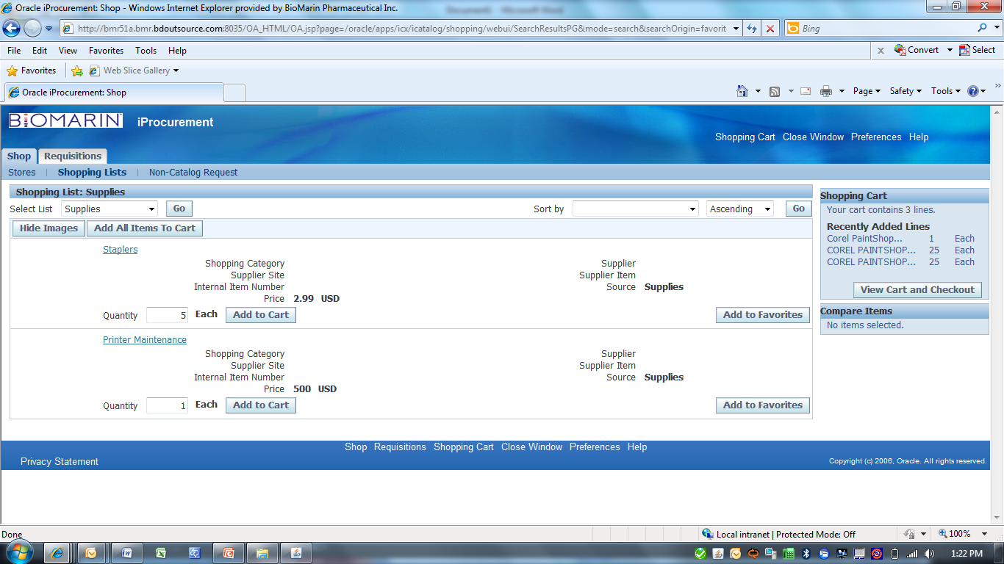
Requisition Template
Template accessed via Shopping list
Access Template content

Slide 26
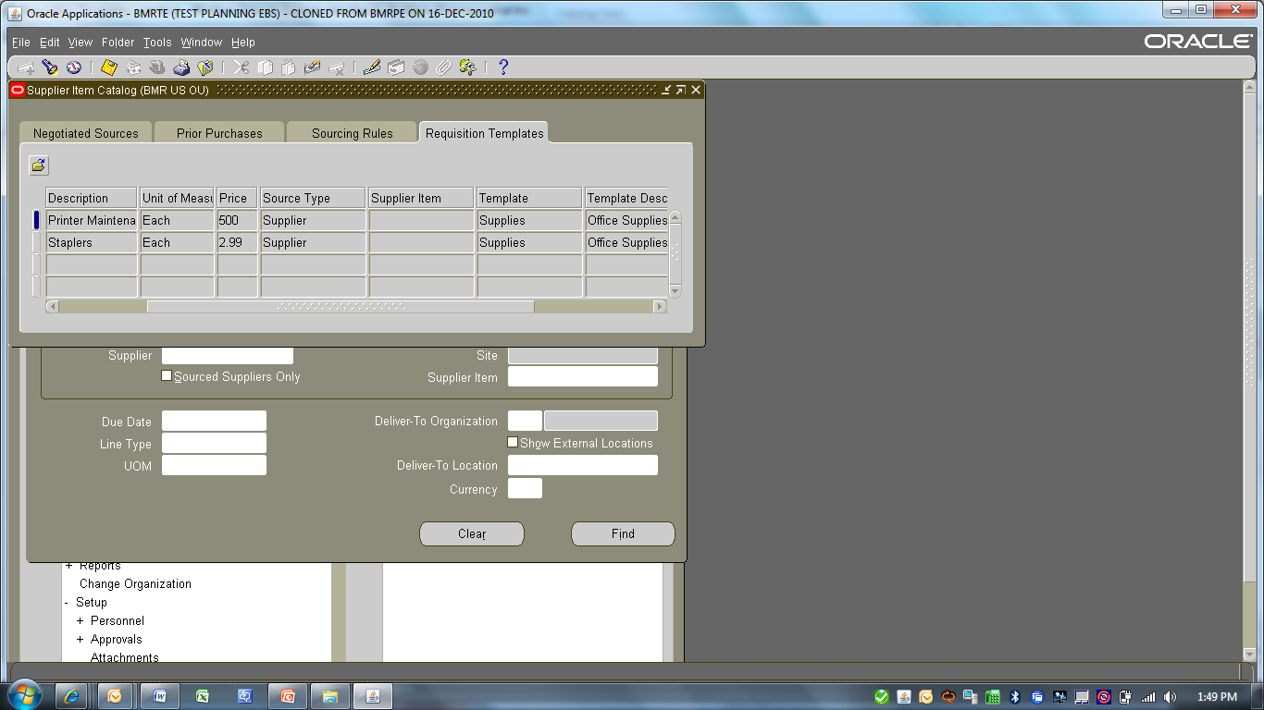
Requisition Template
We can reference the template in the Supplier Item Catalog.
Purchasing displays all template lines that are valid for the destination organization, and these can be used in any of these lines on requisition.
Supplier Item Catalog

Slide 27
Requisition Template – Benefits
Easiest installation and flexible for multiple suppliers with limited item selection.
Group items by shopping category or supplier.
Can handle various items types e.g. Expense

Slide 28
BioMarin at a Glance
Focus & Strategy
Catalogs ??
Solutions
Requisition Template
External Marketplace
Q&A
Catalog Sources
Local Store
Catalog Authoring

Slide 29
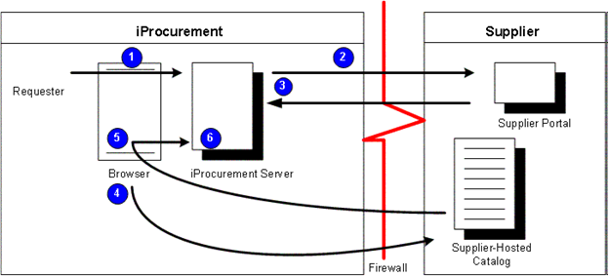
Punchout to External Marketplace OracleExchange
Punchout is a feature from iProcurement and Oracle Exchange which allows to access the external catalog and bring the items to iProcurement in order to create requisitions.
The external catalog can be hosted by Oracle Exchange, a third party organization or by the supplier.

Slide 30
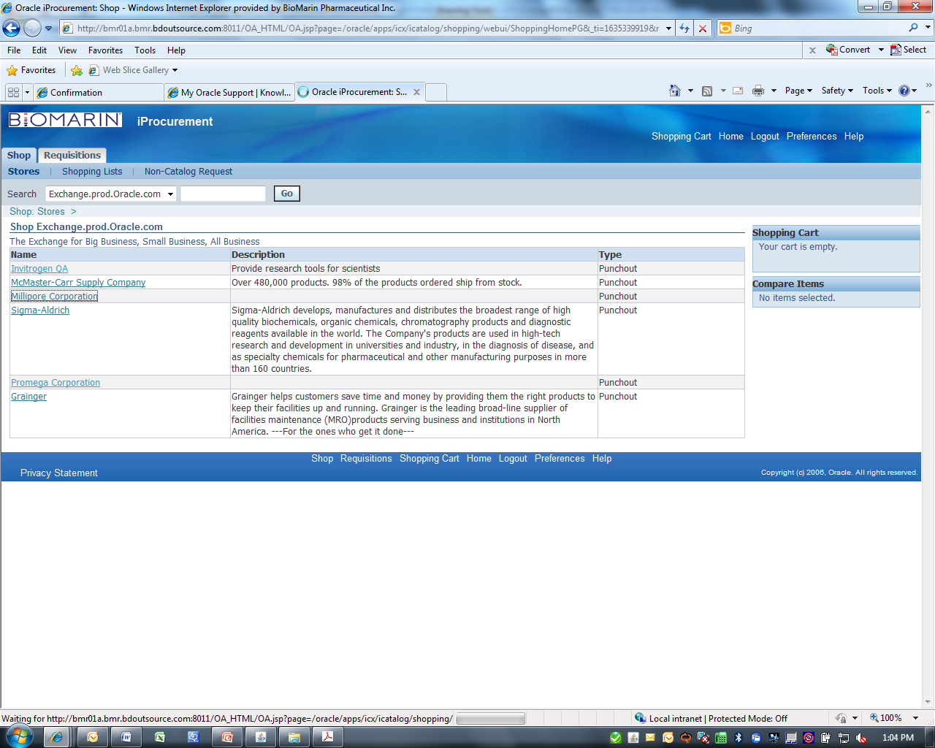
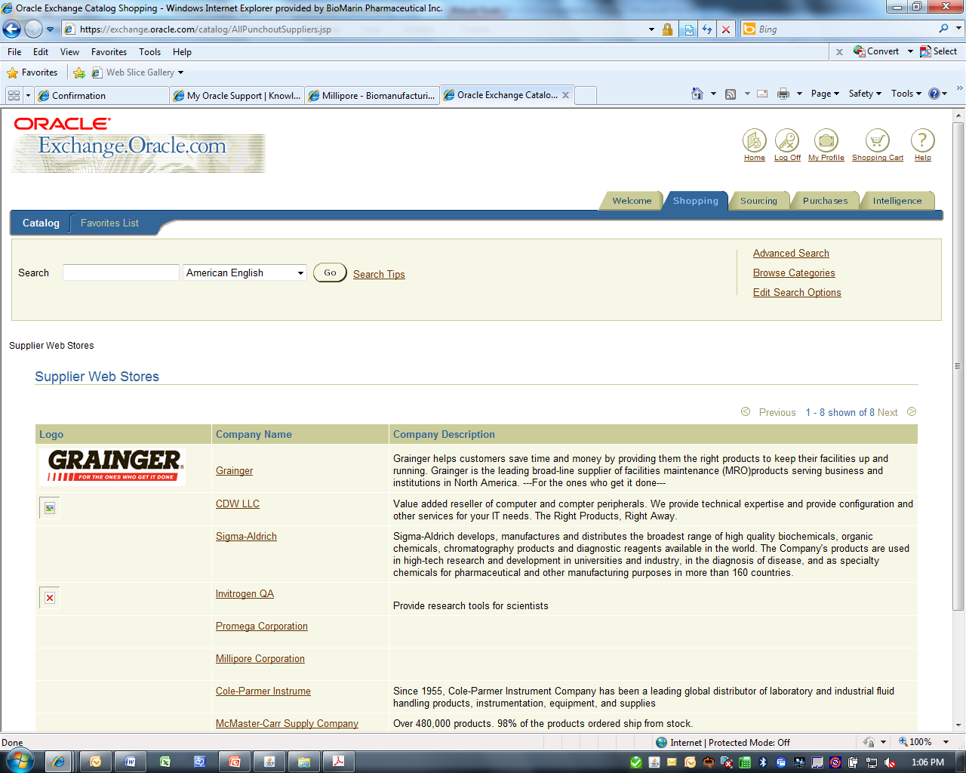
Oracle Exchange – External Marketplace
Vendors on Exchange
Lot of choice
Vendor catalogs on iProcurement from exchange

Slide 31
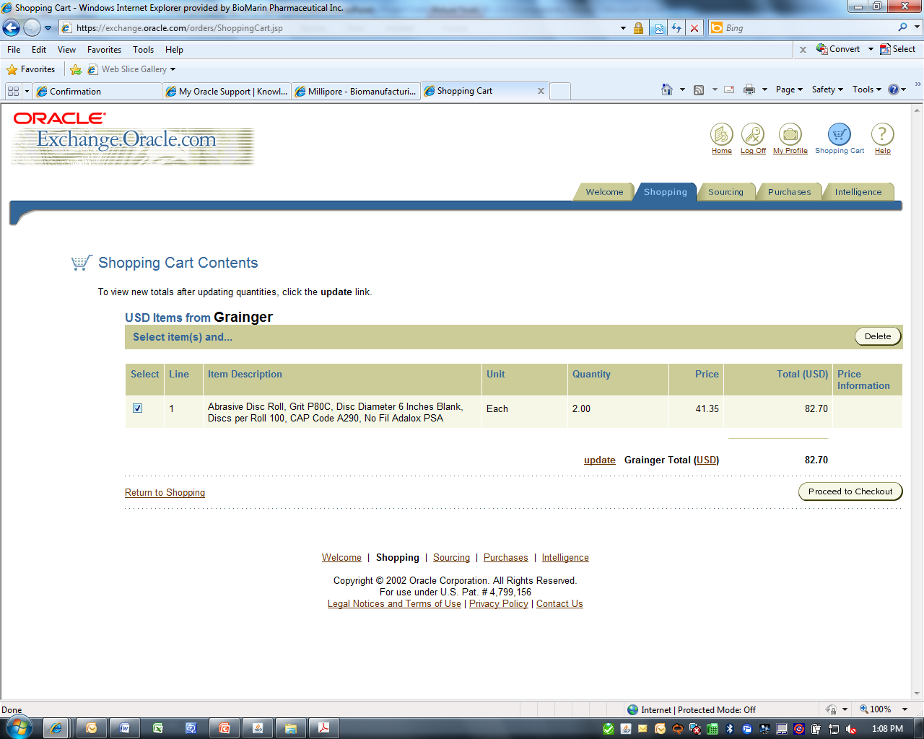
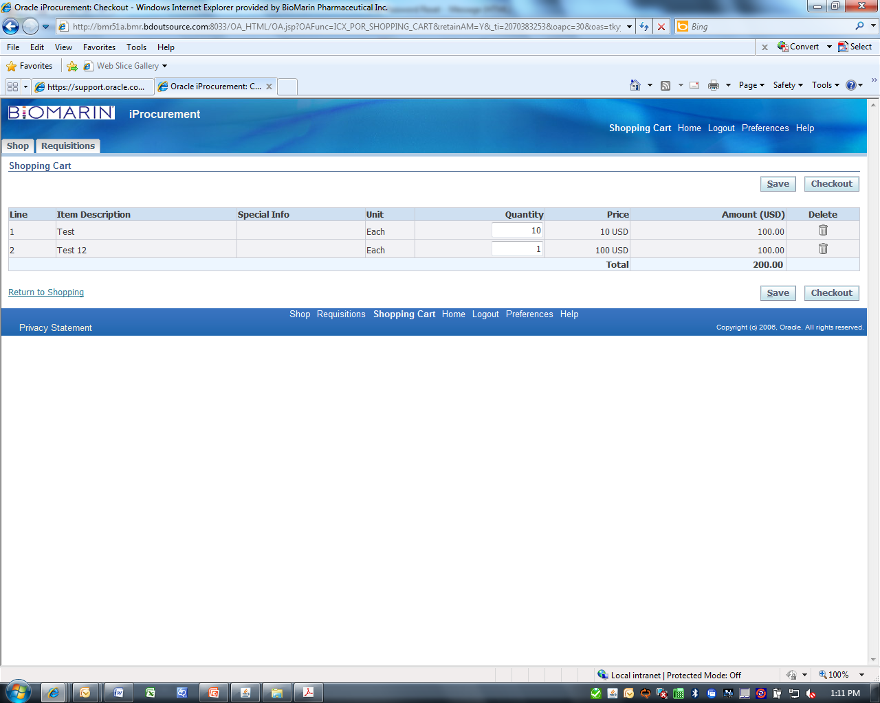
Exchange Cart -> iProcurement cart
Transition of shopping cart from Exchange to iProcurement
Shopping cart in Exchange

Slide 32
External market Place - Benefits
Supplier has responsibility for managing the catalog and pricing information.
Users would search by category on exchange and see a link to the supplier hosted catalog.
Requires Supplier to create new categories, add new base attributes, category attributes and create the hierarchies that support customer schema.

Slide 33
BioMarin at a Glance
Focus & Strategy
Catalogs ??
Solutions
Requisition Template
External Marketplace
Q&A
Catalog Sources
Local Store
Catalog Authoring

Slide 34
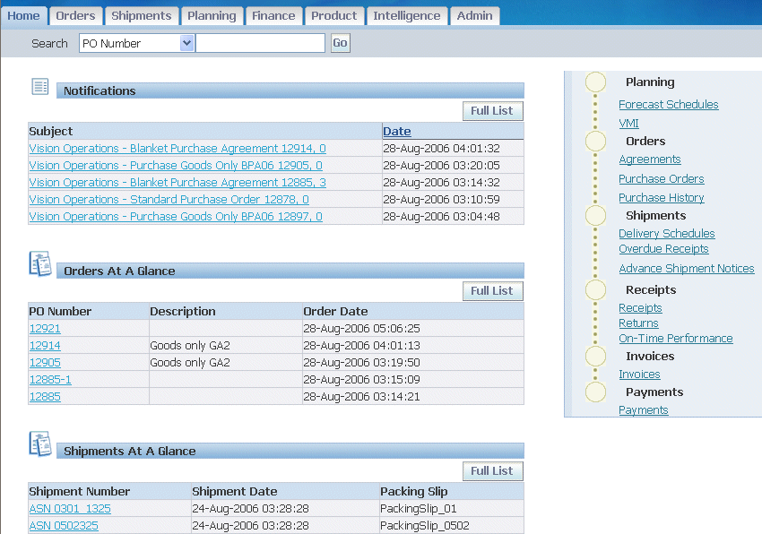
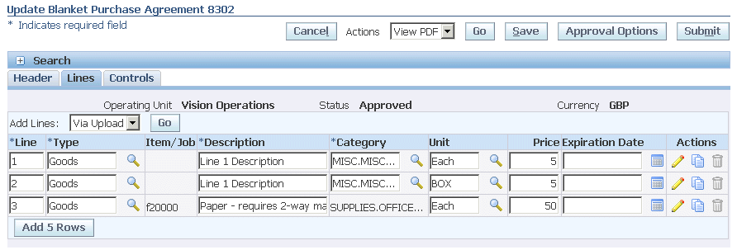
Catalog Authoring using iSupplier Portal
Access to PO details iSupplier
Supplier can make modifications to GBPA

Slide 35
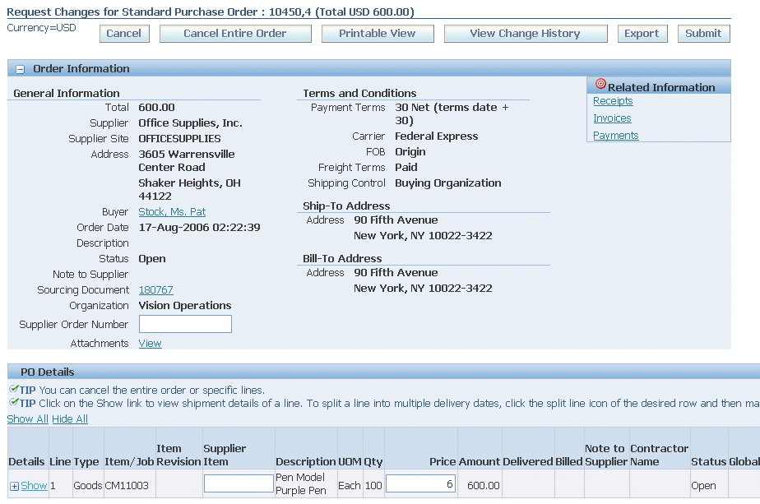
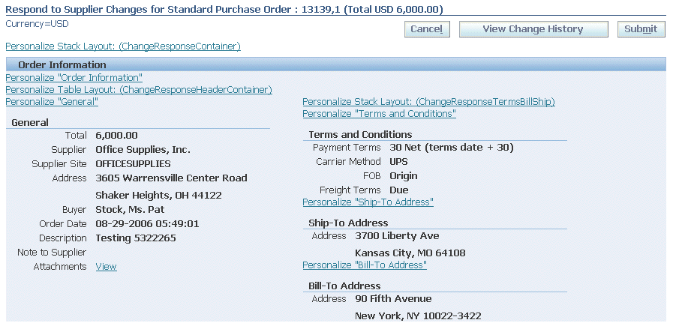
Approve PO Changes
View detail changes
Buyer can review changes
After submitting your changes, the purchase order status changes to Supplier Changes Pending until the buyer approves the changes.

Slide 36
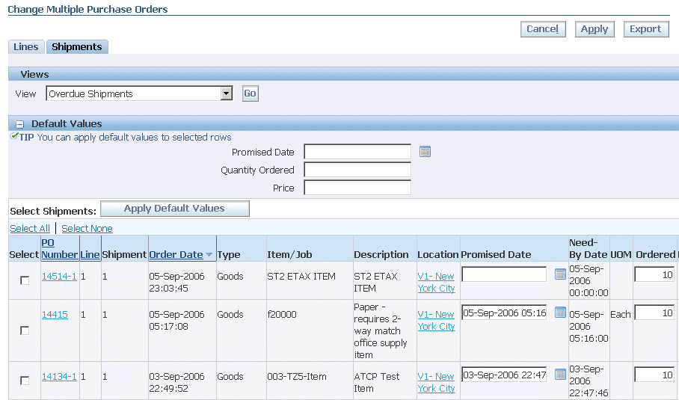
Respond to Changes
Multi PO option
Review detail changes
Approve / Reject individual changes or All changes.

Slide 37
Changes in iProcurement
Changes to local store are reflected real time.
Catalogs with unapproved changes are still available to transact with last approved changes.
Changes to catalog in iProcurement

Slide 38
Q
&
A

