Slide 1


Slide 2
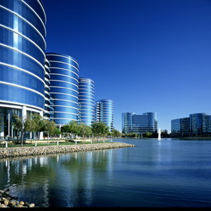
Factors Influencing R12 Upgrade and Re-implementation
Deep Ram,
Technical Director
Dennis Horton,
Senior Director

Slide 3
The following is intended to outline our general product direction. It is intended for information purposes only, and may not be incorporated into any contract. It is not a commitment to deliver any material, code, or functionality, and should not be relied upon in making purchasing decisions.
The development, release, and timing of any features or functionality described for Oracle’s products remains at the sole discretion of Oracle.
Notes:
3

Slide 4
Agenda
Why R12?
Dilemma
Install
Upgrade
Re-implement
Summary
Q/A
Notes:
4

Slide 5
Why R12?
IT Drivers | Business Drivers
Supportability | New modules
Stability | New features and functionality
Improved performance | New requirements
New Features | Operational efficiency
Reduce maintenance cost | Design improvements
Out of box use | Opportunity to re-engineer
Retire Customizations | More business-handling Capabilities

Slide 6
Key Metrics
Metrics | 11.5.10 - | 11.5.10 + | R12
Performance
Scalability
Availability
Security
Stability
Manageability
Extensibility
Supportability
Functionality
Quality | Marginal | Good | Excellent

Slide 7
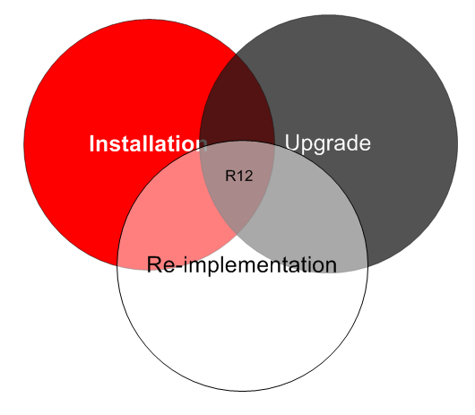
Dilemma
Notes:
7

Slide 8
Install
Install software and database
Implement applications
Use applications
Notes:
8

Slide 9
Why Install?
New to Oracle applications
Fresh implementation
Ease of implementation
Notes:
9

Slide 10
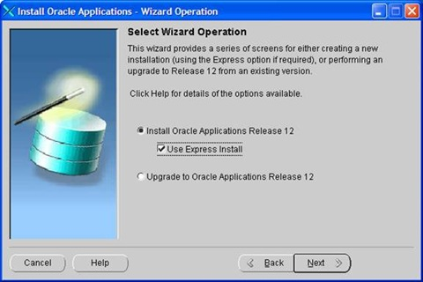
Installation Tools and Utilities
Rapidwiz
Notes:
10

Slide 11
Upgrade
Supported tools, utilities, and documentation used
Entire data and application available after upgrade
Clear, straightforward, proven method
Notes:
11

Slide 12
Why Upgrade?
Business transformation
Consolidation / Decentralization
Configuration changes Org, COA, Calendar, Flexfields
Merger, acquisition, restructuring
Organize COA, calendar, etc
Large delta from new to old Apps
Large RICE components
Cleanup old data/modules
Cleanup past mistakes
Simplify NLS, MLS, and currency
Complex upgrade path
Notes:
12

Slide 13
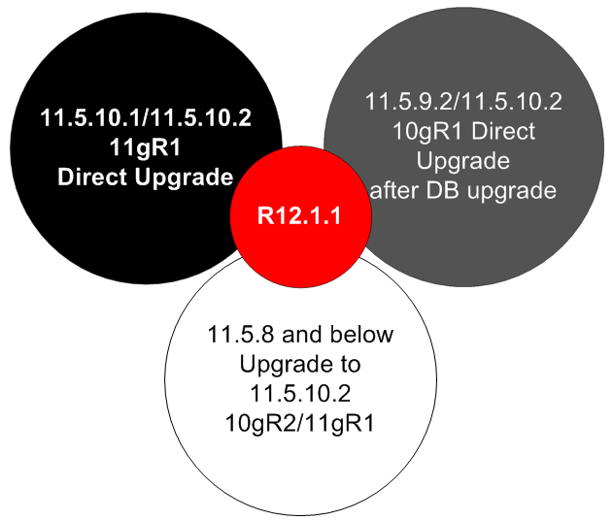
Upgrade Path
Notes:
13

Slide 14
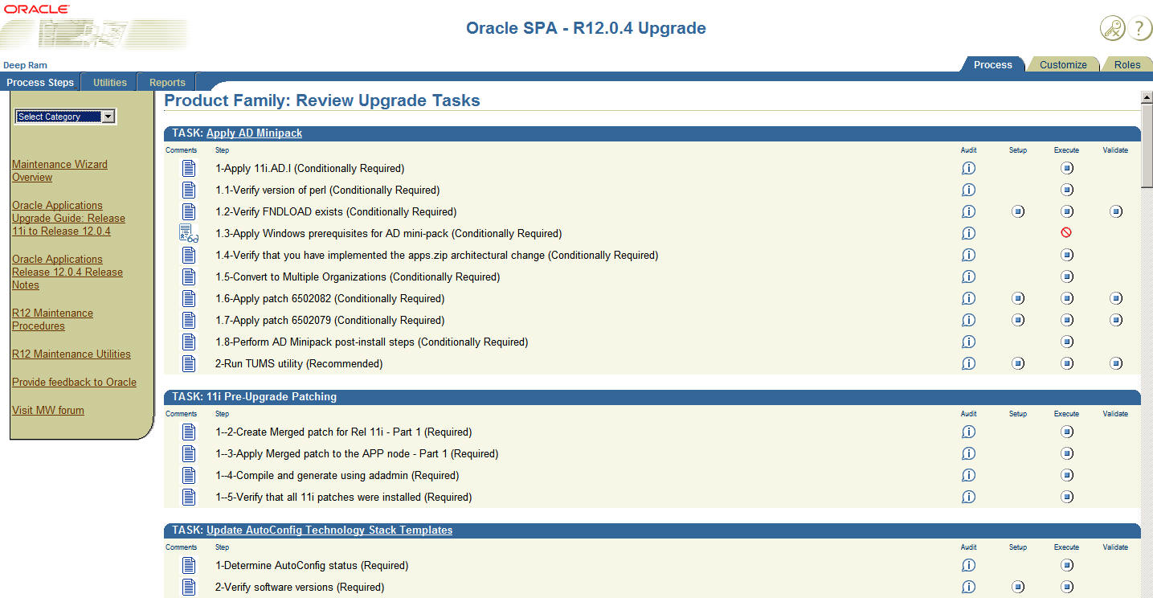
Upgrade Tools and utilities
Maintenance Wizard

Slide 15
Maintenance Wizard’s
Capabilities
Applications:
10.7 Smart Client to 11.5.10.2
10.7 Character to 11.5.10.2
10.7 NCA to 11.5.10.2
11.0.3 to 11.5.10.2
11.5.3 or higher to 11.5.10.2
11.5.8 or higher to 12.0.4
12.0.0 or higher to 12.0.6
Database
8i to 10.2.0.3
9i to 10.2.0.3
9.2.0.8 to 11.1
10.1 or 10.2 to 11.1

Slide 16
Re-implement
Setup applications
Migrate data
Migrate customizations
Go live with small data
Phased conversion of remaining data
Notes:
16

Slide 17
Why Reimplement?
Simplify complex configuration (Languages, Currencies)
Acquisitions
Consolidating multiple Instances
Decentralizing multiple Instances
Replacing RICE components
Replacing old modules
Minimize large data volume
Minimize downtime
Discard old data
Changes in business structure
Notes:
17

Slide 18
Re-implementation
Tools and Utilities
iSetup
fndload
exp/imp
SQL plus
Data loader
Open interfaces

Slide 19
Plan your implementation
Inception
Elaboration
Construction
Transition
Production
Requirement Analysis (RA)
Business Requirements (RD)
Analysis (AN)
Design (DS)
Technical Architecture (TA)
Implementation (IM)
Testing (TE)
Performance Management (PT)
Documentation (DO)
Data Acquisition & Conversion (CV)
Transition (TS)
Training (TR)
Operations & Support (PS)
Organization Change Management (OCM)

Slide 20
What Can You Do Now?
Plan Early
Inventory
Develop upgrade Strategy
Plan upgrade path
Ensure adequate hardware resources
Ensure skilled resources
Get trained
Study technical and functional impacts
Download software and stage
Do multiple test upgrades
Do cutover and transition tests
Minimize downtime
Test thoroughly
Use Maintenance Wizard
Workshop
POC

Slide 21
Minimizing Down Time
Independent of activities
  Ensure Adequate hardware
  Shared APPL_TOP
  Staged APPL_TOP
  Distributed AD
  Hot and merge patches
  Archive/purge
  Consider only required data for upgrade
  Tune upgrade performance
  Automate fixes
  Export/Import of gathered statistics
  Multithread activities as applicable

Slide 22

Work with All
Business, Apps tech, DBA, IT

Slide 23
Install, Upgrade, or Reimplement?
Summary
Install
Upgrade
Reimplement
New to Oracle applications
Fresh implementation
Ease of implementation
Entire data and application available after upgrade
Supported tools, utilities, and documentation used
Existing Oracle Applications
Low Cost
Short Time
Multi Org
Small Delta from new to old Apps
Meets business needs
Few RICE components
Simple configuration
Business transformation
Consolidation / Decentralization
Configuration changes Org, COA, Calendar, Flexfields
Merger, acquisition, restructuring
Organize COA, calendar, etc
Large delta from new to old Apps
Large RICE components
Cleanup old data/modules
Cleanup past mistakes
Simplify NLS, MLS, and currency
Complex upgrade path
Notes:
23

Slide 24
Acknowledgement
Metalink Notes
RCDs/TOIs
Various presentations and documentations
Customer interactions
Consultant interactions

Slide 25
Q
&
A

Slide 26
For More Information
search.oracle.com
or
oracle.com
Notes:
26

Slide 27


